Slide 1


HPD (SHPO) and YOU!
Meg Richardson, Environmental Review Historian

Slide 2







Georgia Department of Natural Resources

Slide 3
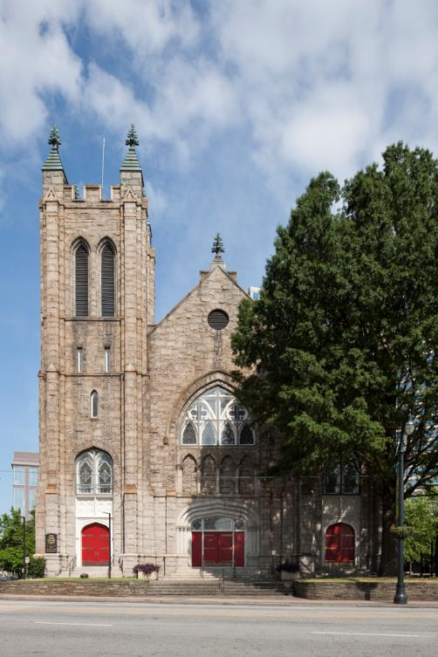
Mission Statement
To promote the preservation and use of historic places for a better Georgia.

Slide 4
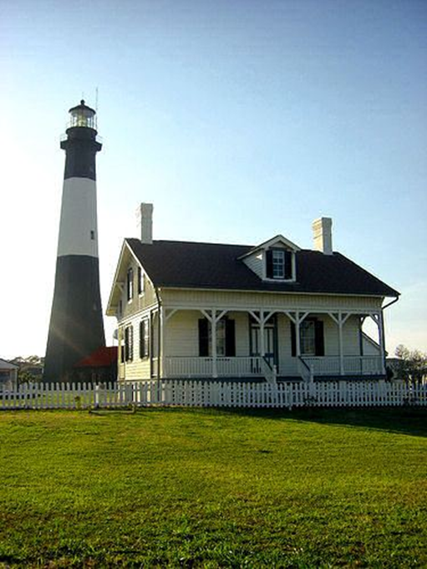
National Historic Preservation Act
State Historic Preservation Offices
Advisory Council on Historic Preservation
National Register of Historic Places
Section 106

Slide 5
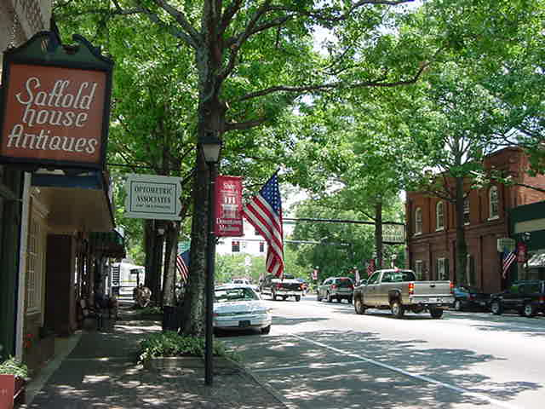
HPD Programs
Federal Programs
  National Register of Historic Places
  Environmental Review
  Tax Incentives and Grants
  Certified Local Governments
State Programs
  Georgia Register of Historic Places
  Tax Incentives and Grants
  Historic Resources Survey
  Archaeology
  Centennial Farm Program
  African American Preservation Network & Program

Slide 6
Environmental Review/Section 106
  Mandated by federal law
Undertaking:
    “project, activity, or program funded in whole or in part under the direct or indirect jurisdiction of a Federal agency, including those carried out by or on behalf of a Federal agency; those carried out with Federal financial assistance; and those requiring a Federal permit, license or approval.” 36 CFR Part 800.16
Historic Property:
  “any prehistoric or historic district, site, building, structure, or object included in, or eligible for inclusion in, the National Register of Historic Places…” 36 CFR Part 800.16
SHPO involvement required

Slide 7
Our Role
Advise and assist federal agencies in carrying out S106 responsibilities
Provide comments on eligibility and potential effects to historic structures and/or archaeological sites
Environmental Review program staff review over 2000 project submittals a year

Slide 8
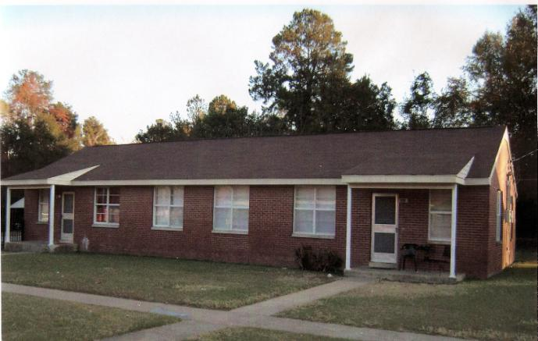
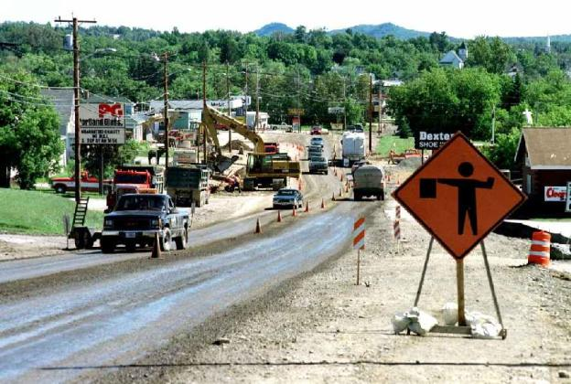
Section 106 Project Types
Water/sewer projects
Bank branches
Docks
Highway/road projects
Public housing
Transmission lines
Military installations
Pipelines
Notes:
8

Slide 9
Section 106 Process
Initiate Section 106 Process
Public Involvement
Establish undertaking
Identify appropriate SHPO/THPO
Plan to involve the public
Identify other consulting parties
No Undertaking / No Potential to Cause Effects
Undertaking is type that might affect historic properties
Public Involvement
Identify Historic Properties
Determine scope of effort
Identify historic properties
Evaluate historic significance
No Historic Properties Affected
Historic properties may be affected
Public Involvement
Assess Adverse Effects
No Historic Properties Adversely Affected
Apply criteria of adverse effect
Historic properties are adversely affected
Public Involvement
Resolve Adverse Effects
Memorandum of Agreement
Continue consultation
FAILURE TO AGREE
COUNCIL COMMENT

Slide 10

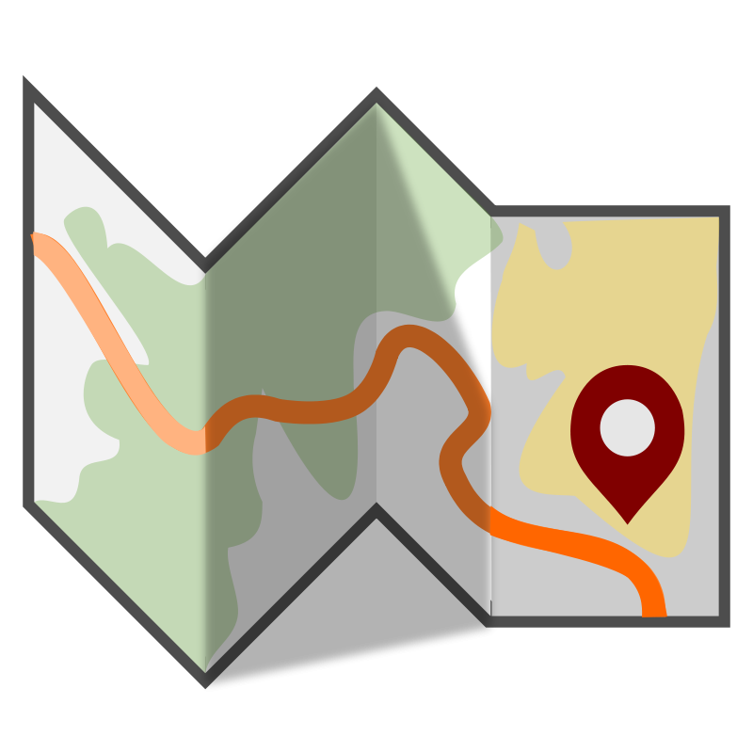
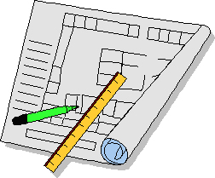

Consultation
Environmental Review Form
  http://www.georgiashpo.org/review
Project information
Map
Photographs

Slide 11
Environmental Review Form

Slide 12
Environmental Review Form

Slide 13
Environmental Review Form

Slide 14
Environmental Review Form

Slide 15
Environmental Review Form

Slide 16
Environmental Review Form

Slide 17
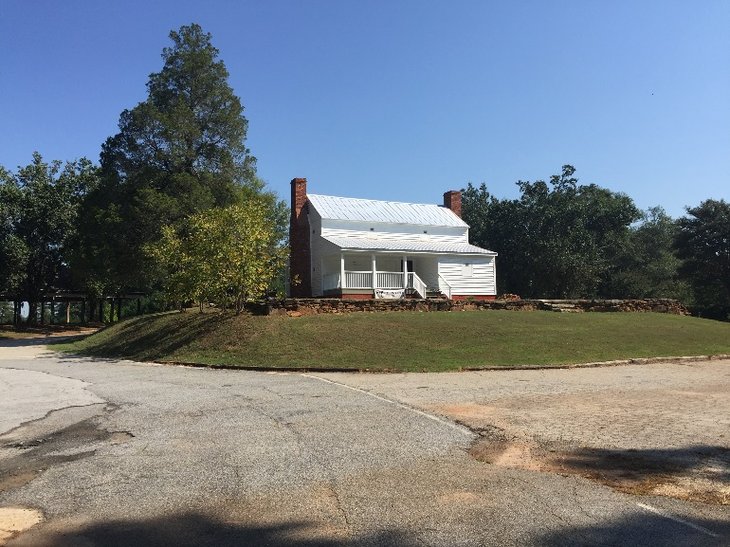
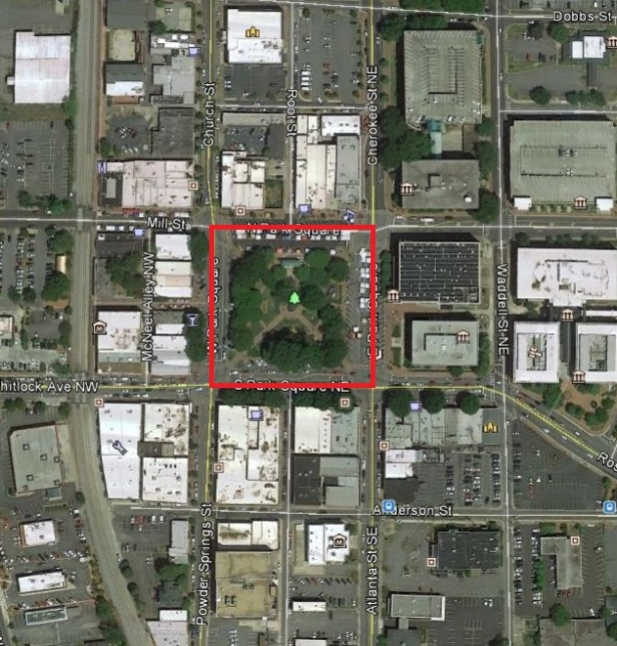
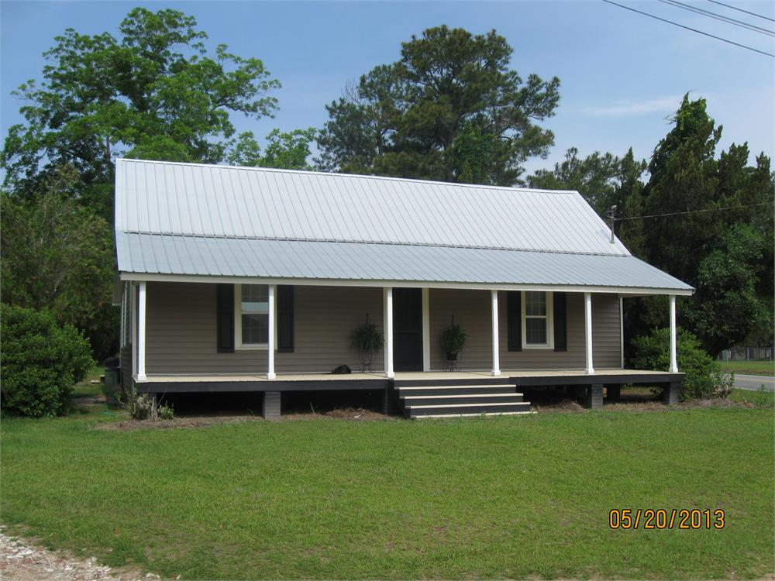
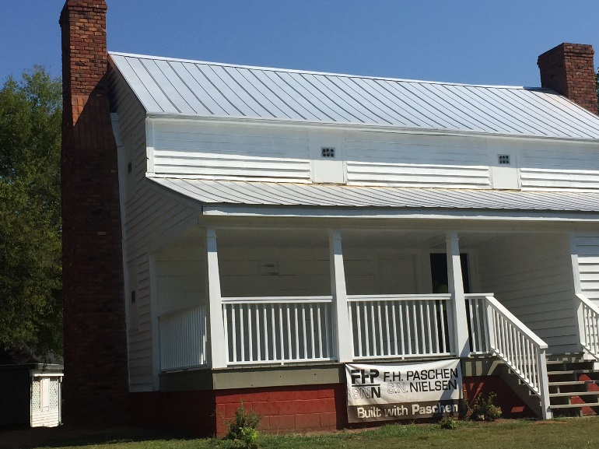
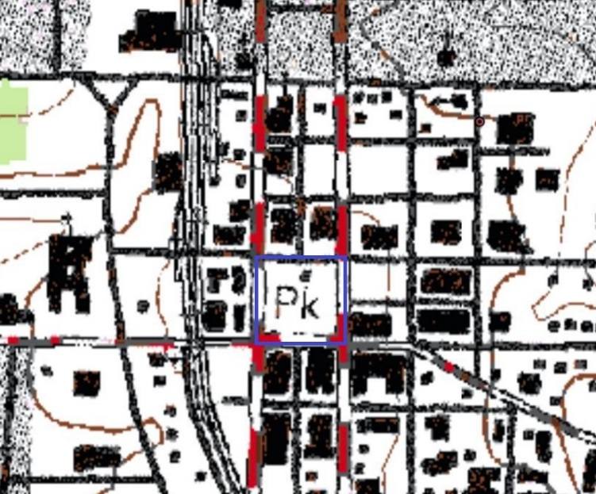
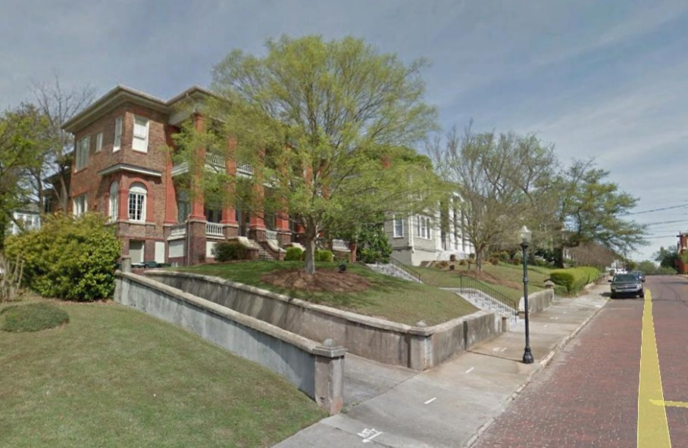
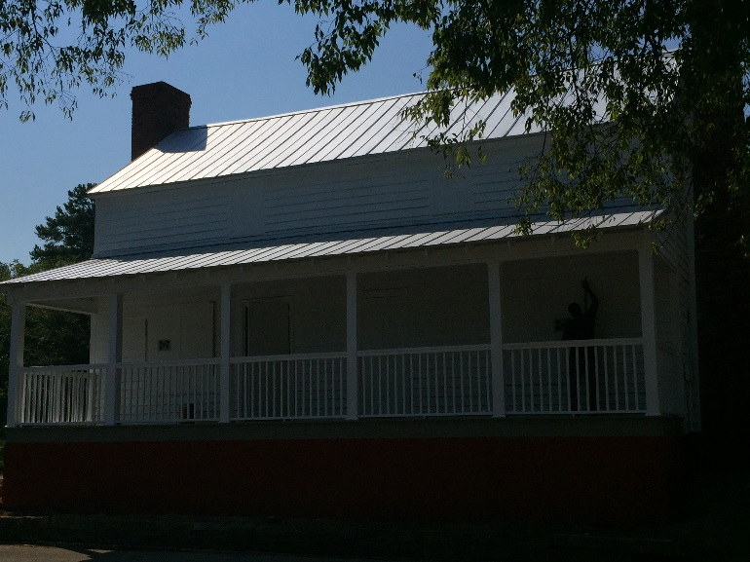
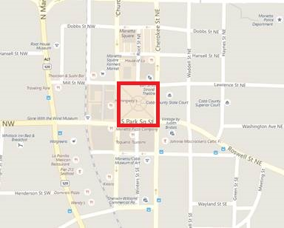
Environmental Review Form
Environmental Review Form
  http://www.georgiashpo.org/review
Project information
Map
Photographs

Slide 18
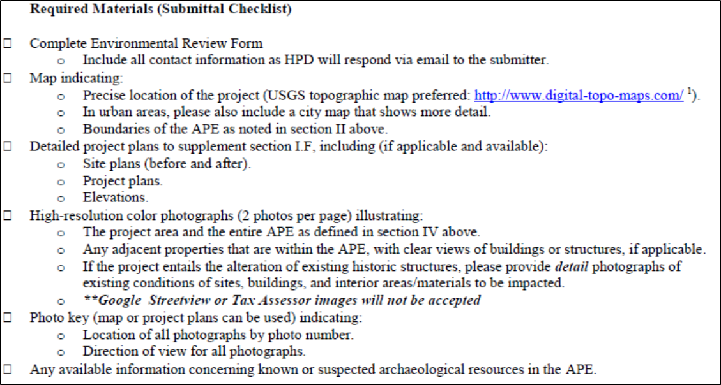
Checklist

Slide 19
Tips for the ER Form
Clear, detailed information
Color Photos keyed to a map
Map of project location and APE
Include all of the information you have for the project
Historic Structures in the APE does not automatically mean the project cannot be funded

Slide 20
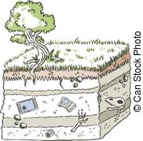

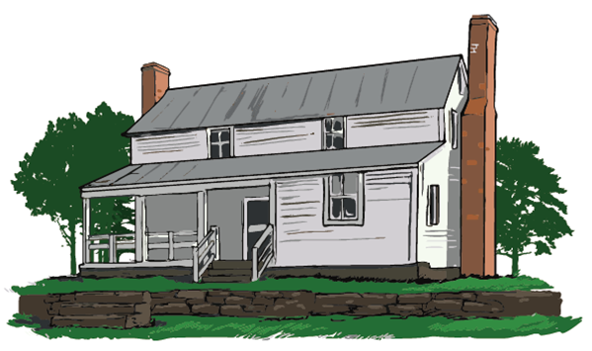
Process
Submittal Received
Review/Request for information
  Project Type
  Historic Properties
  Effects
Response (NHPA, NAE, CNAE, & AE)

Slide 21
Adverse Effects (AE)
Adverse Effect: found when an undertaking may alter, directly or indirectly, any characteristics of an eligible or listed property that qualify it for inclusion in the NRHP in a manner that would diminish the integrity (location, design, materials, workmanship, feeling, and association)

Slide 22
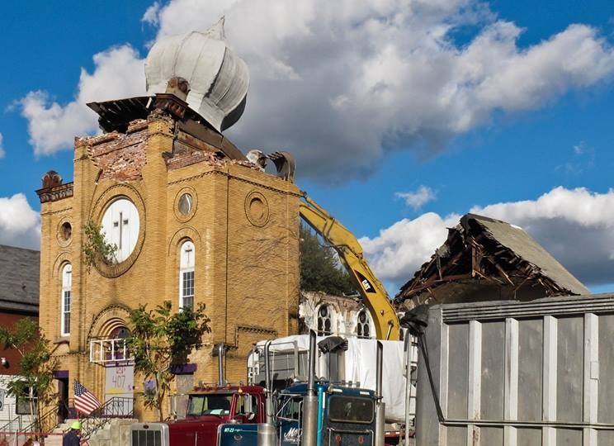
Section 106 Assess Effects
Adverse Effect =
  Introduction of incompatible visual or atmospheric elements
  Change in use, character or setting
  Destruction or damage
  Neglect
  And more…
Notes:
22

Slide 23
Section 106 Resolve Adverse Effects
AN ADVERSE EFFECT DETERMINATION DOES NOT STOP A PROJECT
Adverse Effects must be resolved.
Avoid
Minimize
Mitigate

Slide 24
The Next Steps
Can the adverse effect be avoided or minimized?
Decide on mitigation measures
Notify the ACHP
Write the MOA
Complete the Stipulations

Slide 25
Avoid or Minimize
Avoid Adverse Effect
  Move undertaking to alternate site
  Use alternative, compatible design
  Repair instead of replace
  Follow Secretary of the Interior’s Standards
    https://www.nps.gov/tps/standards.htm
Minimize Adverse Effect
  Alter plans to minimize effect
  Utilize Landscaping to reduce visual impacts

Slide 26
Mitigate Adverse Effects
If avoidance is not possible, the agency consults with HPD, the public and interested parties to identify measures to mitigate the adverse effect
Balances loss of historic properties with the public good
Creative approaches are encouraged
Notes:
26

Slide 27
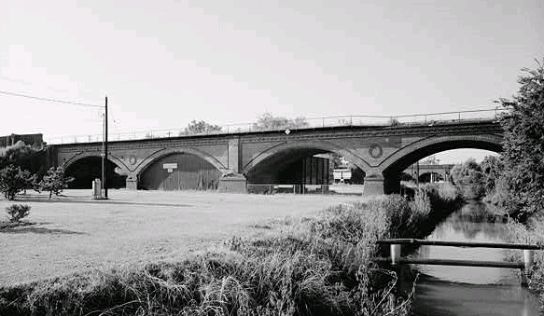
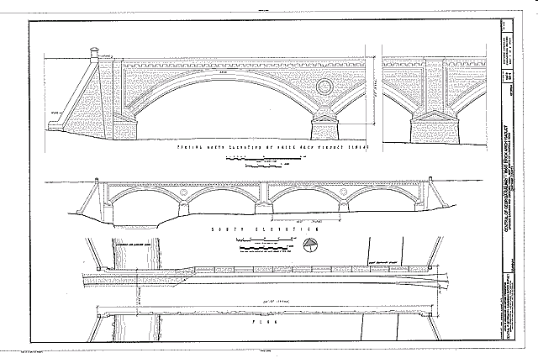
Mitigation Measures
Popular Report
Exhibit
NRHP Nomination
Photographic
Documentation
Archaeological Excavation
Historic Resources Survey
Notes:
27

Slide 28
Notify ACHP
To Include:
Description of the undertaking, specifying fed involvement
APE to include photos, maps, and drawings as needed
Description of steps taken to ID historic properties
Explanation of why the criteria of AE were found applicable, including any conditions or future actions to avoid, minimize or mitigate (i.e.. MOA stips)
Copies or summaries of any views from consulting parties (HPD) and public
Note working with HPD to develop MOA
Notification of Adverse Effect Letter
Provides details of project and asks if they want to participate in resolution of adverse effects
HUD contact at ACHP, Jaime Loichinger

Slide 29
MOA
Includes:
Whereas Clauses- Who? What? Where? Why?
Stipulations
  Action: what will be done, who is doing it, and when it will be done
  Administrative: Dispute Resolution, Performance Monitoring, Sunset, Amendment, Termination
  Conclusion
  Signature Blocks
Memorandum of Agreement
Formalizes mitigation measures
Assigns duties and responsibilities to the signatories
Legally binding

Slide 30
Final Points
Cold Reader
Clear, Color Photos
Site Plans and Elevations
Adverse Effect is NOT the end, does NOT stop a project
Applicant’s Priority vs. HPD’s Priority
Feel free to call or email with questions.

Slide 31
www.georgiashpo.org
Meg Richardson
Environmental Review Historian
meg.richardson@dnr.ga.gov
(770) 389-7852
Jewett Center for Historic Preservation
2610 GA Hwy 155, SW
Stockbridge, Georgia 30281

