Slide 1
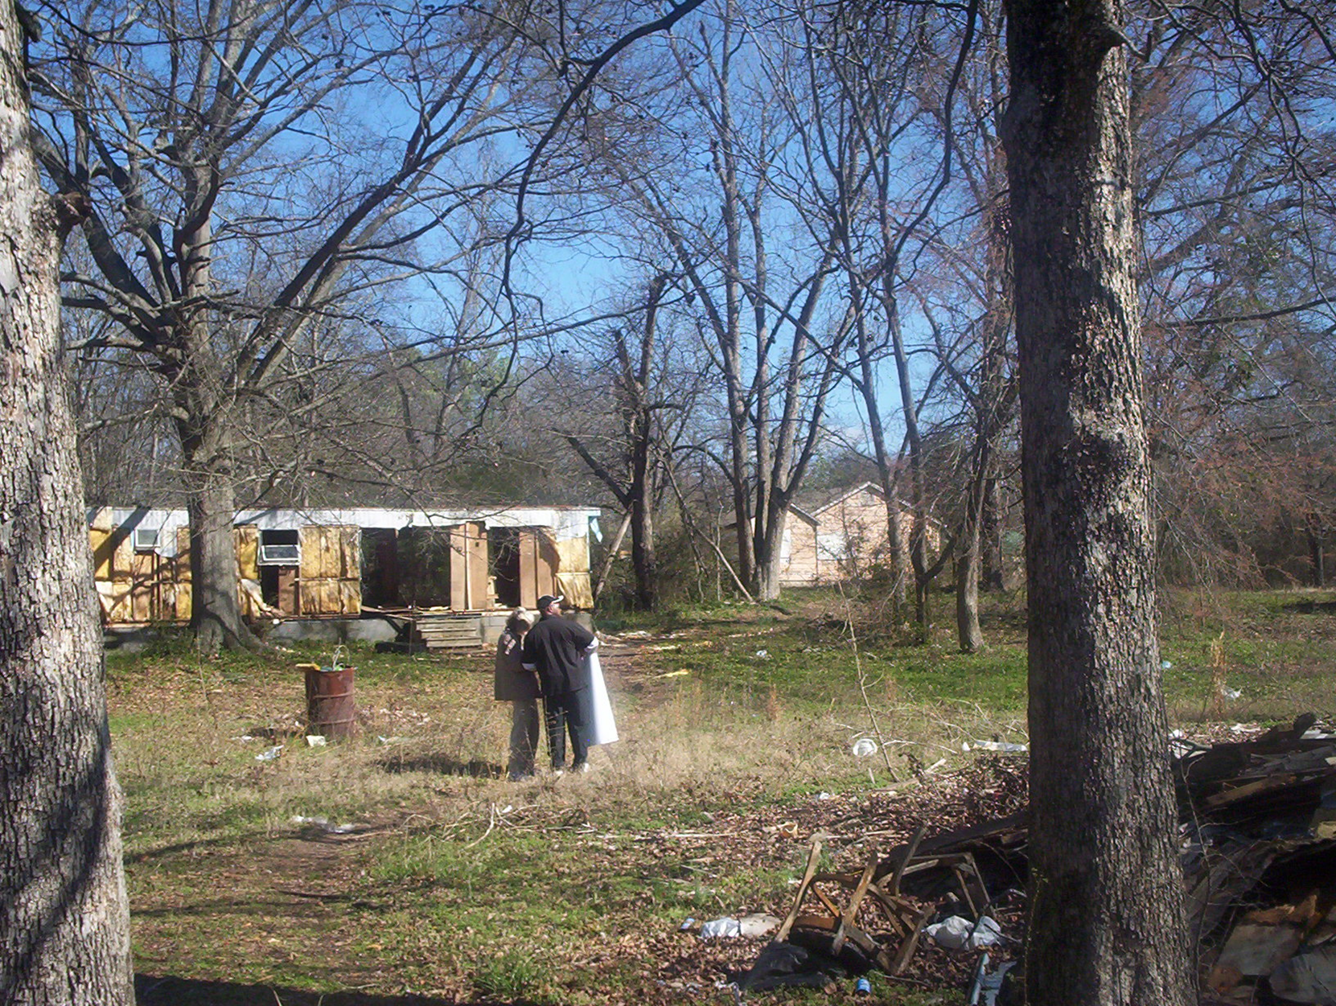
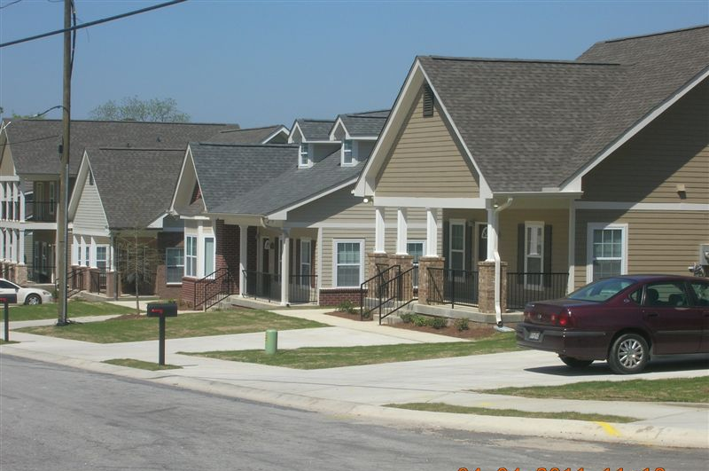
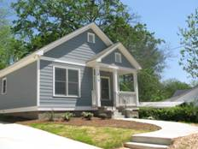

Urban Redevelopment and
Revitalization Area Strategy
12/5/2017
Glenn Misner

Slide 2
Revitalization Area Strategies
DCA designation that rewards efforts demonstrating:
Long-term vision for the area
Well-defined area that included comprehensive activities
Grassroots involvement from area residents
Commitment from other funding partners
Documented commitment from funders and stakeholders

Slide 3
“A masterplan with teeth” – M. Reimann
Urban Redevelopment Plan
Summary of Georgia’s Urban Redevelopment Act (O.C.G.A 36-61-1)
  Gives cities and counties broad powers to redevelop blighted or threatened areas of the community.
  Allows communities to use eminent domain to buy and assemble property for revitalization and resale.
  Does not require a referendum.
  The required Urban Redevelopment Plan (URP) is fairly easy and inexpensive to prepare and amend.
  Can be implemented by a Downtown Development Authority (DDA) or a Redevelopment Authority appointed by the local government.

Slide 4
“A masterplan with teeth”
Urban Redevelopment Plan
Summary of Georgia’s Urban Redevelopment Act (O.C.G.A 36-61-1) Cont.
  Encourages involvement of private enterprise/public private partnerships to redevelop neglected areas of the community.
  Permits use of tax exempt bonds for redevelopment purposes. These may be secured by loans and grants.
  Lets the public know what is being planned for the redevelopment area.
  Guides investments in infrastructure to support redevelopment.
  Allows the City or County to negotiate variances and waive many requirements of its existing zoning and development requirements in order to achieve the optimum economic and aesthetic results in the redevelopment area.

Slide 5
“A masterplan with teeth”
Urban Redevelopment Plan
Allows for limited condemnation (where necessary) of property for the implementation of the plan
  Check with the local government attorney for procedures—note changes to eminent domain law that took effect in 2006

Slide 6
“A masterplan with teeth”
Urban Redevelopment Plan
Allows the imposition of conditions more specific than existing land use regulations. Conditions run with the property and control development above other land use regulations. Design standards may be included
Can waive or modify ordinance provisions that stand in the way of revitalization
Shows public what will replace blight
UR entity may issue tax exempt bonds to be repaid with profits from redevelopment project. May be secured by mortgages on property within the district.

Slide 7
Urban Redevelopment Plans
O.C.G.A. 36-61
Urban Redevelopment Plan Checklist--
A Statement that the URP is consistent with the local government comprehensive plan
Clearly defined boundaries
Explanation of negative conditions in the area
Defines the city or county land use objectives for the area
Outlines possible exceptions to development regulations
Description of land parcels to be acquired

Slide 8
Urban Redevelopment Plans
O.C.G.A. 36-61
URP Checklist, cont’d.
Structures to be demolished or rehabilitated
Strategy for relocating any displaced residents
Any covenants / restrictions to be placed on properties in the redevelopment area
Public infrastructure to be provided (transportation, water, sewer, sidewalks, lighting, streetscapes, public recreational space, parking, etc.) to support redevelopment
Strategy for leveraging private resources
A workable strategy for implementing the plan

Slide 9
RAS Rewards:
  Can apply for CDBG every year, provided that current CDBG project meets timeliness criteria
  Provides up to 20 bonus points on CDBG Annual Competition applications that are proposed within the RAS area
  Designation is effective for 3 years, then can re-apply
Note: DCA will only allow geographic amendments to RAS boundaries every three years upon application for renewal status

Slide 10
CDBG Revitalization Strategies
RAS Application Scoring
Threshold – 5 points
Economic Development Tools
– 5 points
Collaboration
– up to 5 points
Investment Partnerships
– up to 5 points

Slide 11
CDBG Revitalization Strategies
  Threshold Criteria – 5 points
    RAS must be within eligible census block group(s) 20% or greater poverty rate
    RAS must be within Urban Redevelopment Area with an adopted Urban Redevelopment Plan (O.C.G.A. 36-61)
    CDBG Public Participation process
Note: The CDBG Target Area must be located within the RAS Area in order to receive RAS bonus points

Slide 12
CDBG Revitalization Strategies- NEW FOR 2018
20% or greater poverty rate – may now be determined by
  ACS Data OR
  Local Survey conducted in accordance with the “Guide to Acceptable Survey Methodology – November 2017” – Appendix C in the CDBG Applicants’ Manual
  NOTE – Poverty rate income is DIFFERENT than AMI income

Slide 13
CDBG Revitalization Strategies- NEW FOR 2018
Should the local survey method be chosen, the survey must be performed in accordance with DCA survey methodology.
A narrative describing the survey methodology, analysis of results, and copies of all survey instruments used for the survey must be included in the RAS application.
See CDBG Revitalization Area Strategies 2018 Applicants’ Manual

Slide 14
CDBG Revitalization Strategies
Threshold
Census Block Group(s) with 20% Poverty
URA Area
RAS Area
CDBG Target Area
Note: Please show source of poverty data on the map legend

Slide 15
CDBG Revitalization Strategies
Threshold
RAS Area
Property values for the RAS area are to be tracked each year.
*Taxable value of property--Sample spreadsheet.
Tax Parcel | Street Address | Tax Value
A
B
C
D
etc.
Total tax value |  | Total MUST be included

Slide 16
CDBG Revitalization Strategies- NEW FOR 2018
The Tax valuation Spreadsheet MUST also be submitted electronically to:
cdbg.biz@dca.ga.gov
*Taxable value of property--Sample spreadsheet.
Tax Parcel | Street Address | Tax Value
A
B
C
D
etc.
Total tax value |  | Total MUST be included

Slide 17
More reasons to develop the URA plan…
  Expanding access to job tax credits through Opportunity Zone designation
  Provide bonus points for Low Income Housing Tax Credit applications

Slide 18
CDBG Revitalization Strategies
Economic Development tools – 5 points
      Tax Allocation District (O.C.G.A. 36-44)
      Community Improvement District
      Business Improvement District
      Enterprise Zone (O.C.G.A. 36-88)
      Opportunity Zone
      Other locally designated, geographically
      targeted strategies

Slide 19
CDBG Revitalization Strategies
Investment partnerships
– up to 5 points
Application must demonstrate Investment into the area by revitalization, residential improvement, social service funding programs or job creation / retention programs Investment partnerships may be:
Private developers
Public programs chartered by the State of Georgia,
  Georgia Housing and Finance Authority, the
  U.S. Department of Treasury

Slide 20
CDBG Revitalization Strategies
Investment partnerships
– up to 5 points
  SBA
  USDA
  Federal Home Loan Bank
  TVA
  HUD
  DOL
Habitat for Humanity,
The Fuller Center for Housing
Other non-profit organizations

Slide 21
CDBG Revitalization Strategies
Collaboration
– up to 5 points
Application must demonstrate that initiatives will be created and/or undertaken within the eligible area by private for-profit and/or not-for-profit community stakeholders.
Local lending institutions
Community or Neighborhood housing organizations

Slide 22
CDBG Revitalization Strategies
Collaboration
– up to 5 points
Community development organizations or groups that will carry out some aspect of the Revitalization Area Strategy.
  GICH
  Housing or other task forces,
  City code enforcement efforts

Slide 23
Other Examples of Collaboration
Credit counseling, Homebuyers Classes
Housing Expo, Senior Expo
Cleanup campaigns, junk appliance roundup
Formation of Neighborhood Associations and Neighborhood Watch
Church outreach: Food Pantry, Boys and Girls Club, After-school programs
Summer youth mission group builds handicap ramps and trim shrubbery
“Hands-On” projects: paint elderly houses, help build park

Slide 24
Specific Documentation
Points for Collaboration / Investment Partnerships are based on the documentation submitted (in addition to narrative):
Before and after photos
Newspaper clippings, newsletters
Letters from partners, with specific details
Minutes from council meetings
Code enforcement logs
Agreements, deeds, etc.
Grant award letters, etc.

Slide 25
RAS Application submission:
Applications can be submitted anytime up until the CDBG application due date each year………
Deadline April 2, 2018

Slide 26
http://www.dca.ga.gov/communities/CDBG/programs/CDBGrevitApproval.asp
For more info:
  Please refer to RAS Manual and
  RAS Form 1 for Application
  See RAS Form 2 for Annual Progress Report

Slide 27
For more info:
Revitalization Area Strategies, contact:
  Glenn Misner(404) 679-3138
  glenn.misner@dca.ga.gov
Urban Redevelopment Plans, contact:
  Kelly Lane (404) 227-3619
  kelly.lane@dca.ga.gov

Slide 28

Questions?

