Slide 1

Review Process Discussion
December 5-6, 2017
2018 CDBG Applicants’ Workshop

Slide 2
Water & Sewer Applications

Slide 3
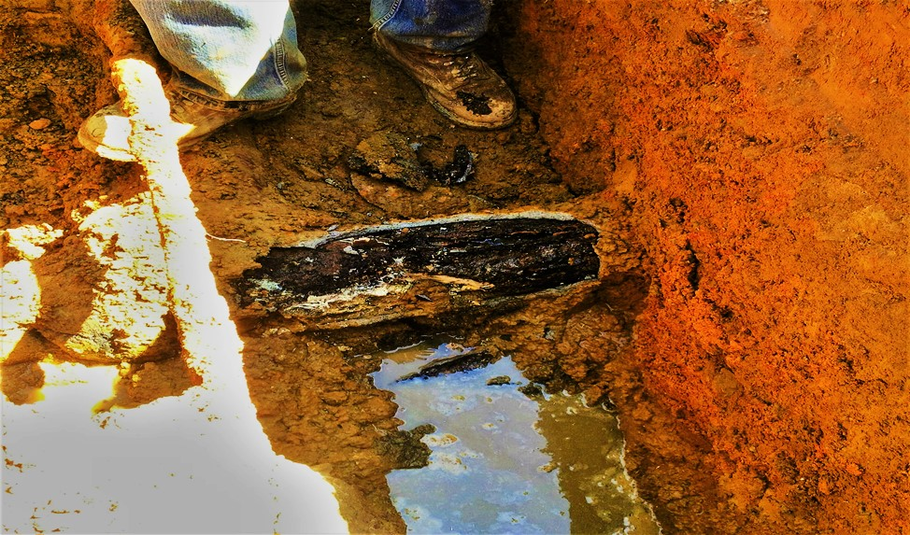
Water & Sewer

Slide 4
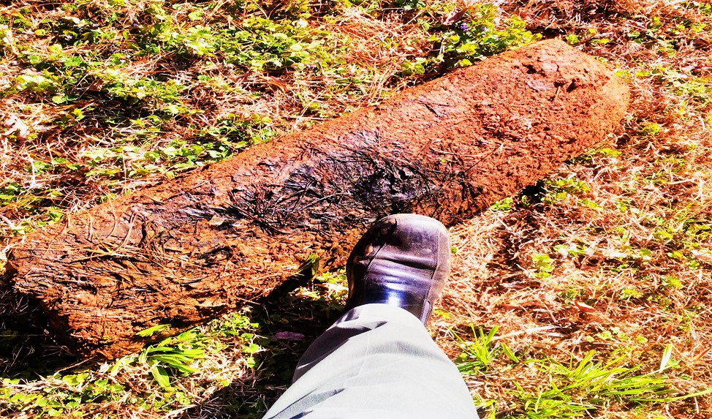
Water & Sewer

Slide 5
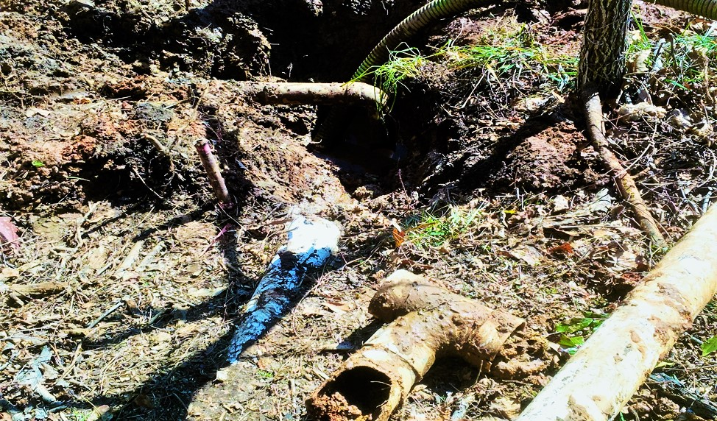
Water & Sewer

Slide 6
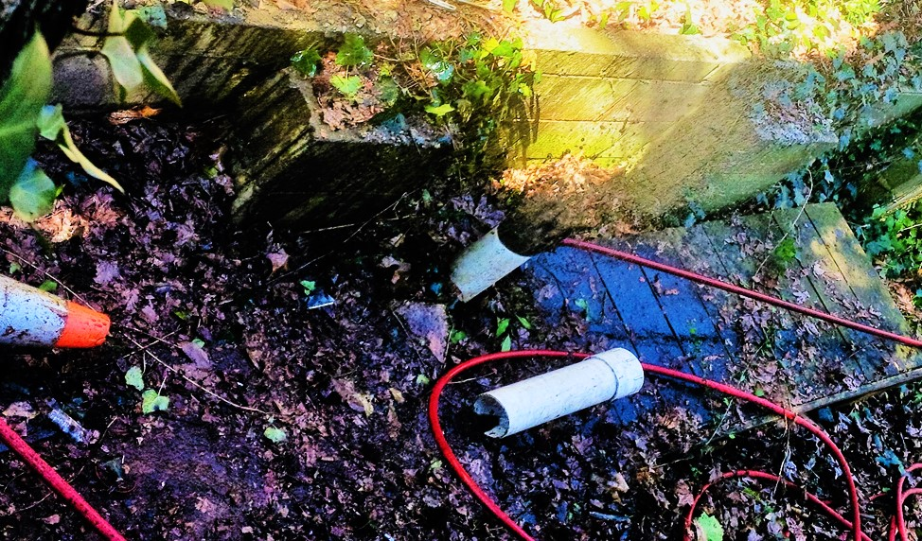
Water & Sewer

Slide 7
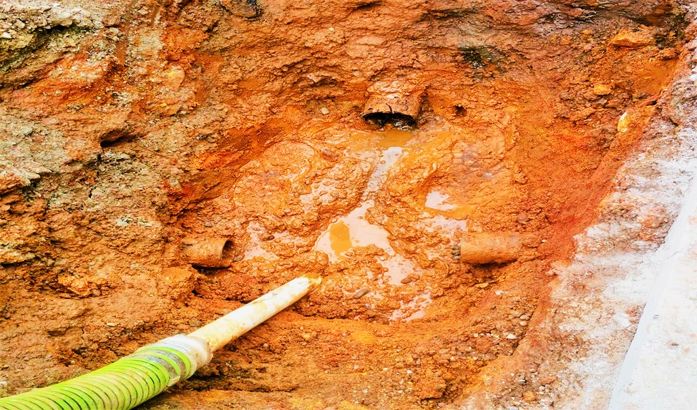
Water & Sewer

Slide 8
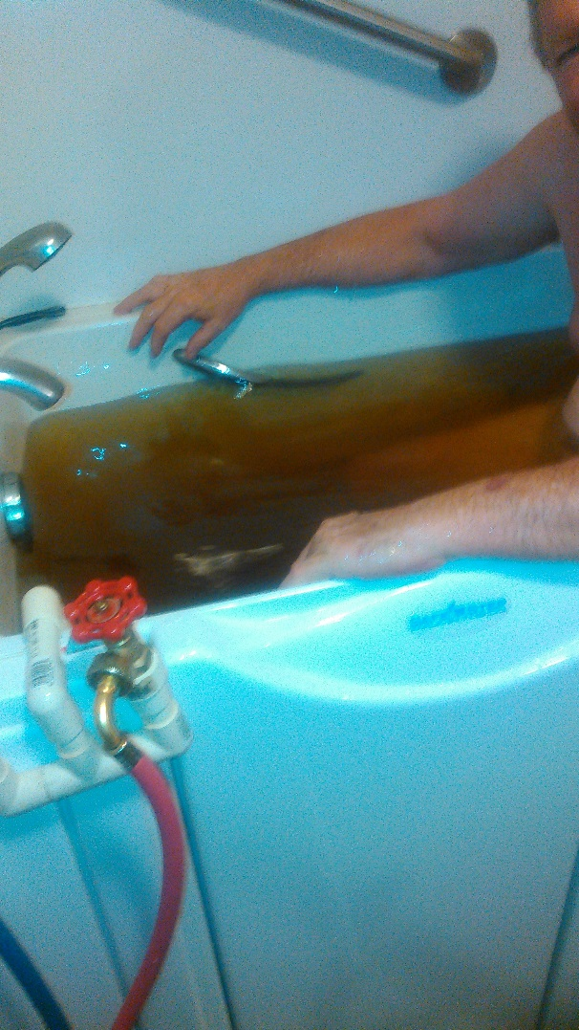
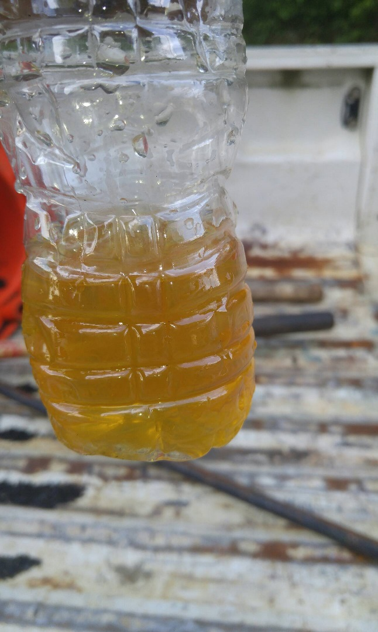
Water & Sewer

Slide 9
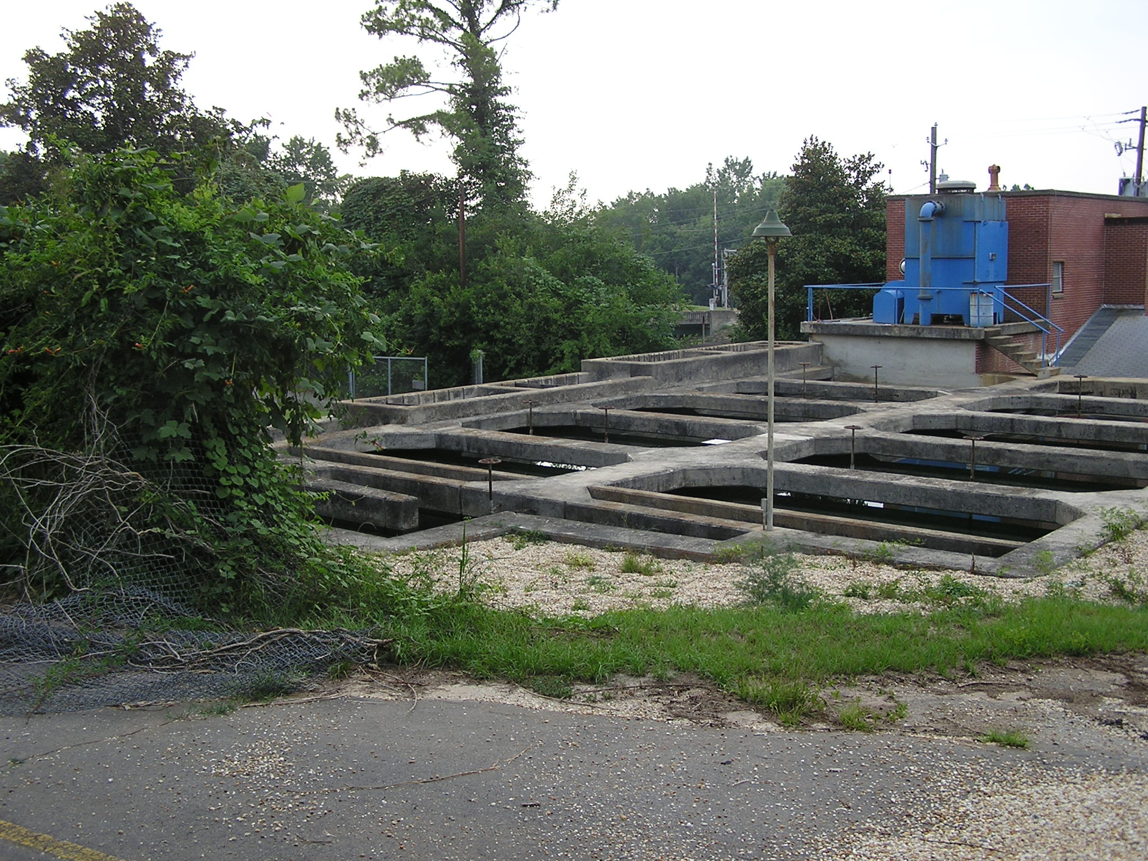
Water & Sewer

Slide 10
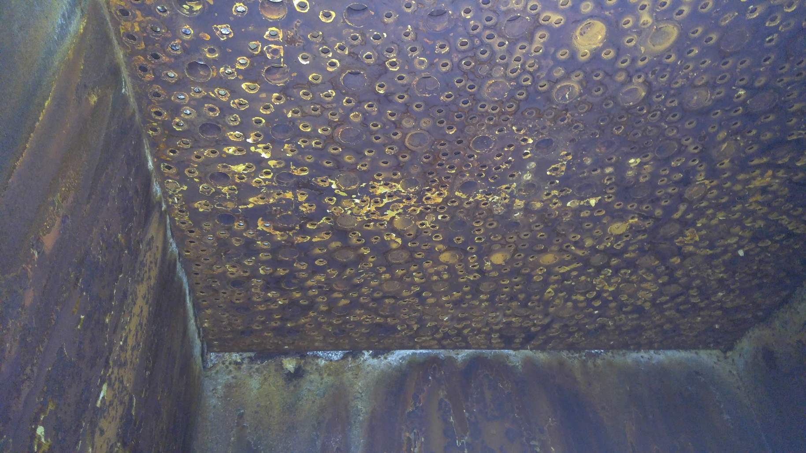
Water & Sewer

Slide 11
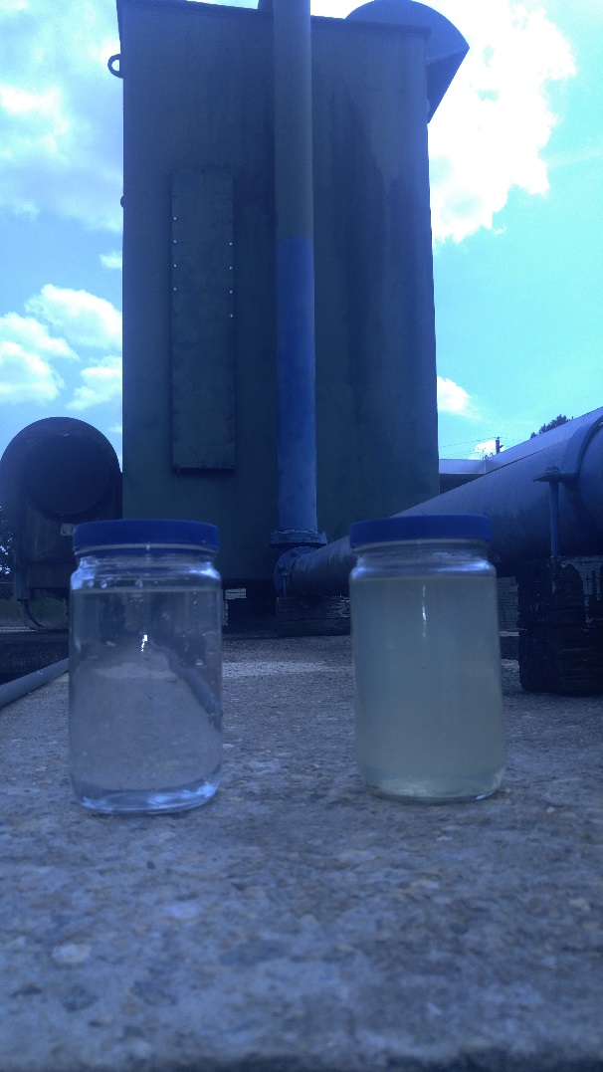
Water & Sewer

Slide 12
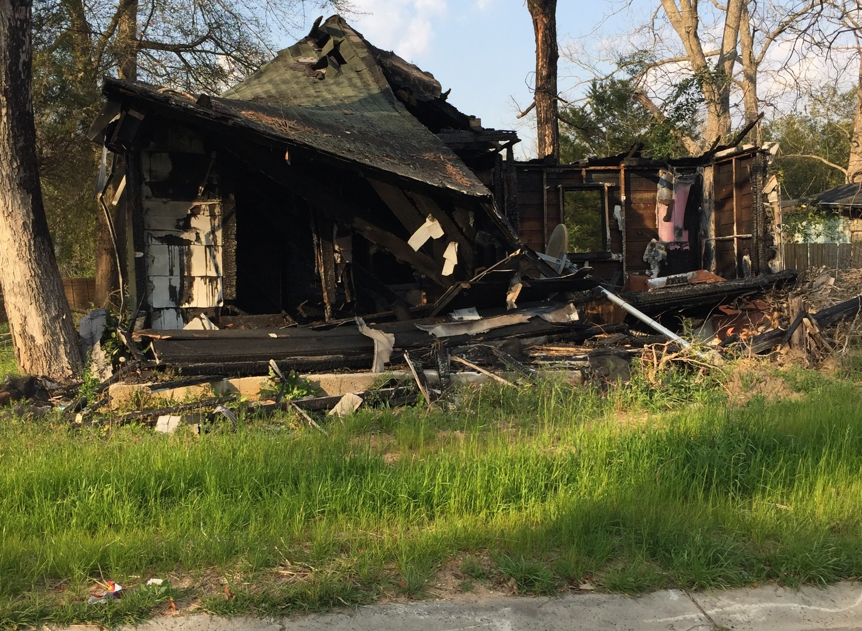
Water & Sewer

Slide 13
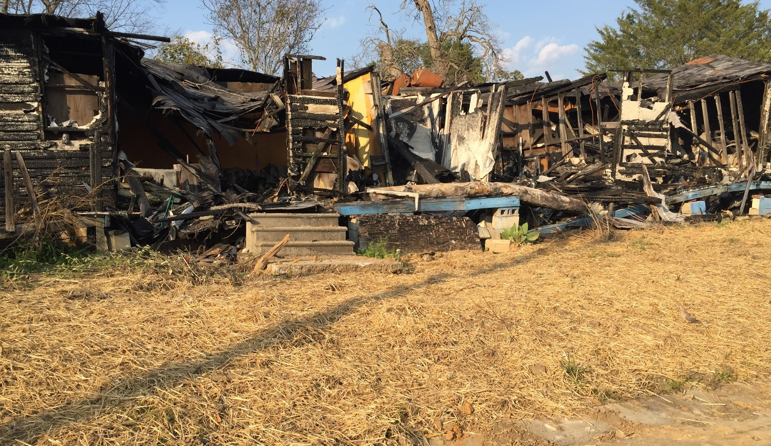
Water & Sewer

Slide 14
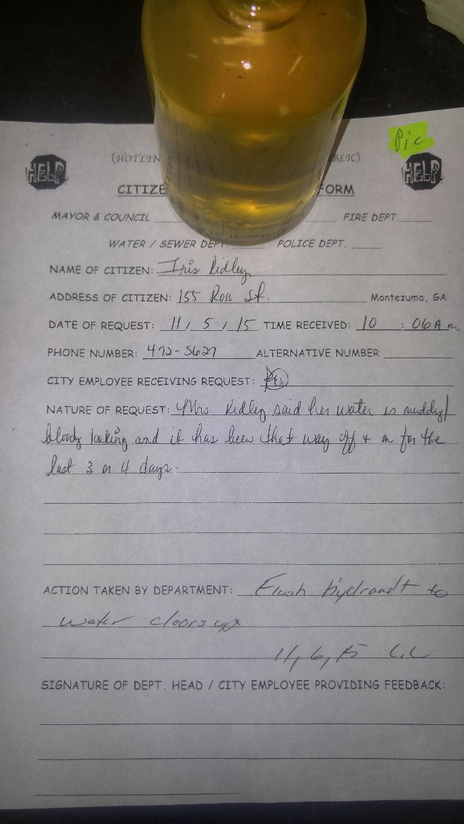
Water & Sewer

Slide 15
Street & Drainage Applications

Slide 16
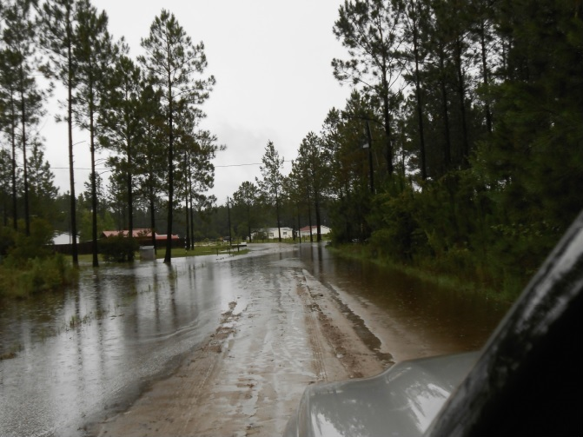
Street & Drainage

Slide 17
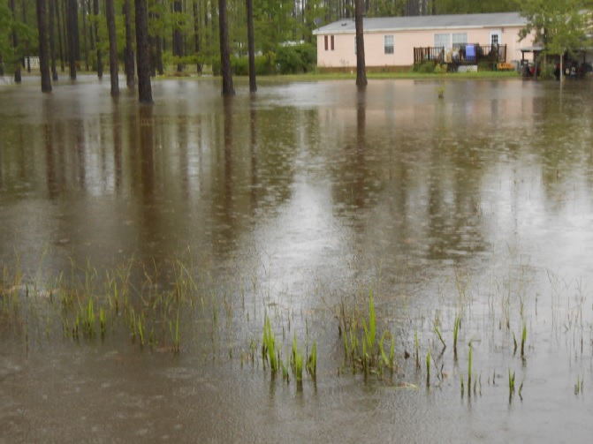
Street & Drainage

Slide 18
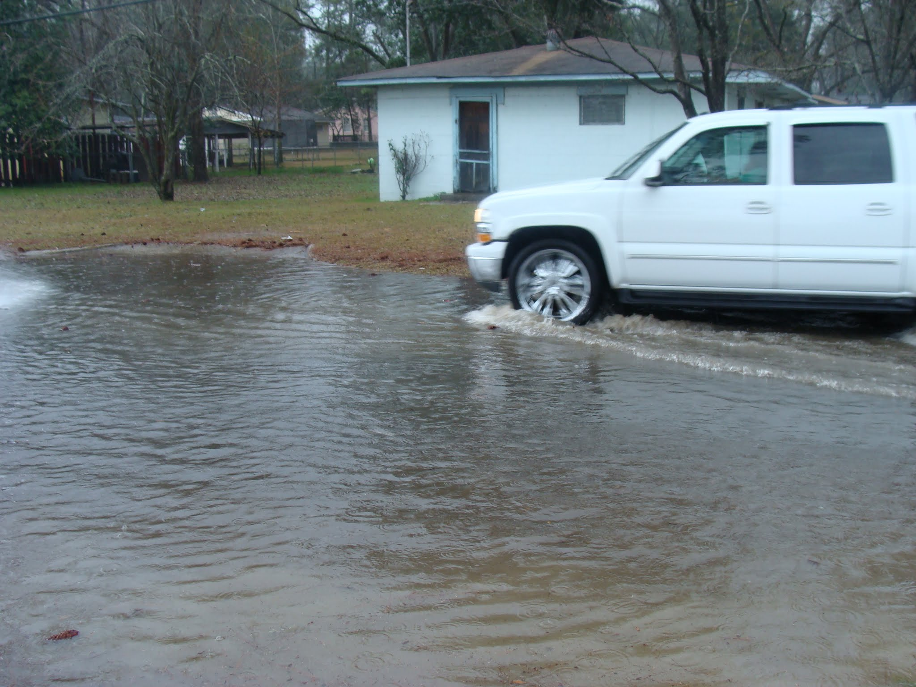
Street & Drainage

Slide 19
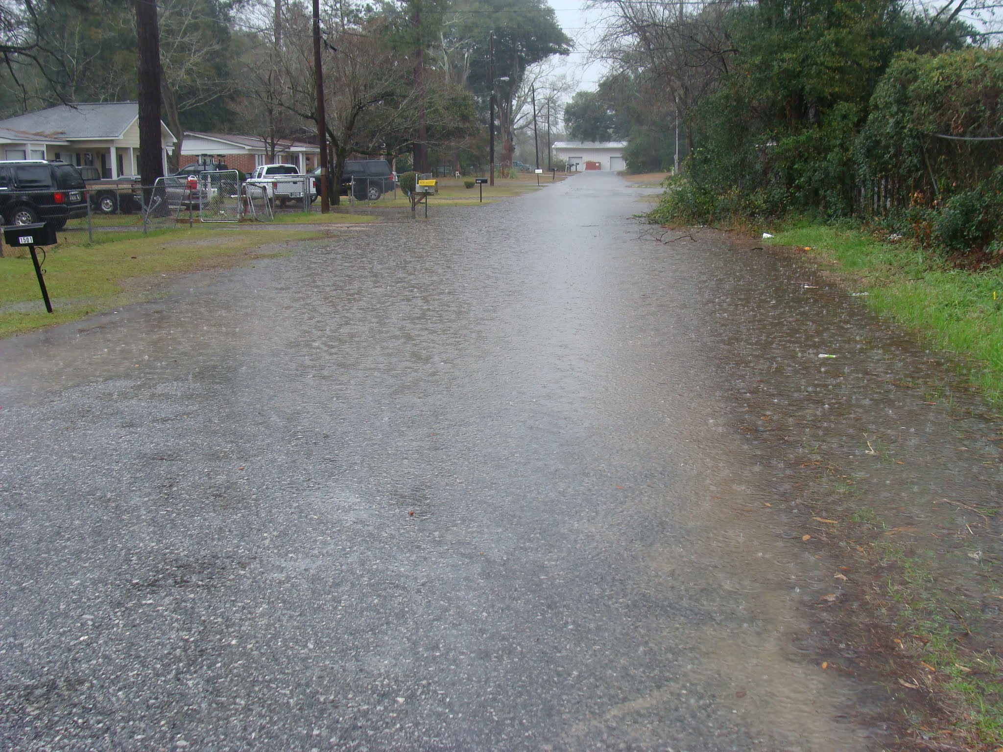

Slide 20
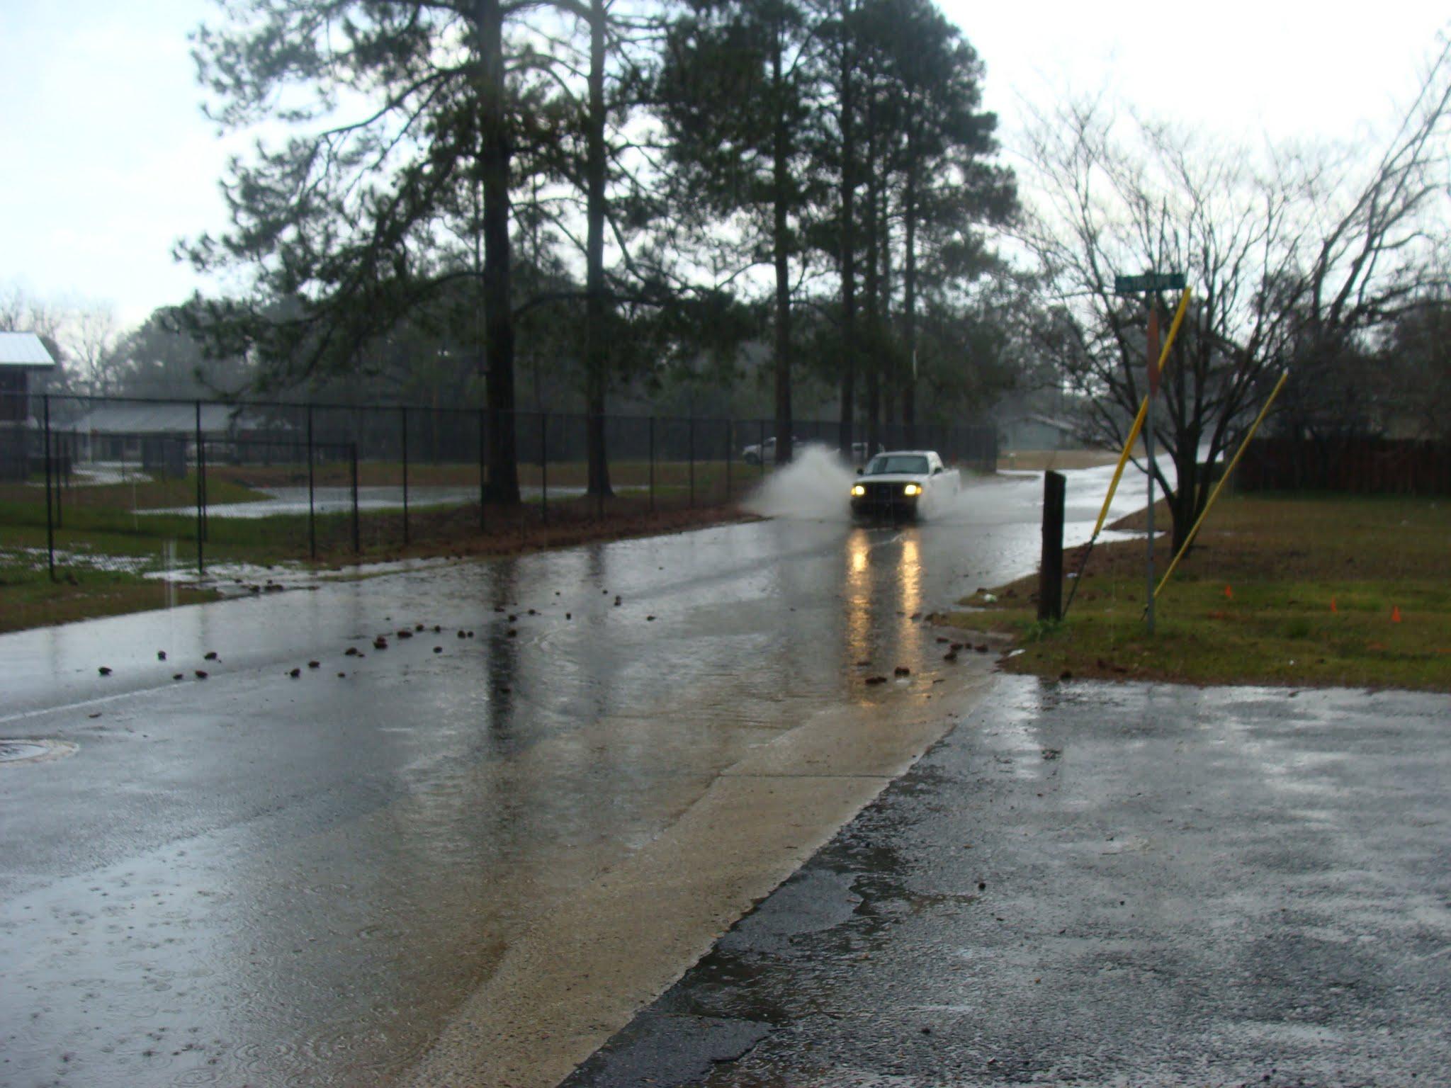

Slide 21
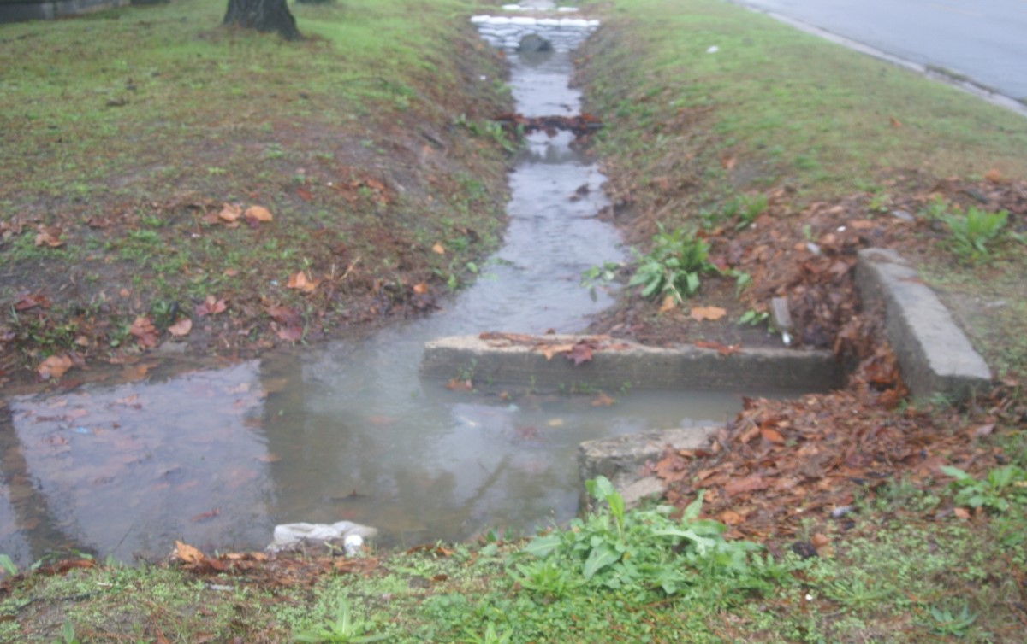
Street & Drainage

Slide 22
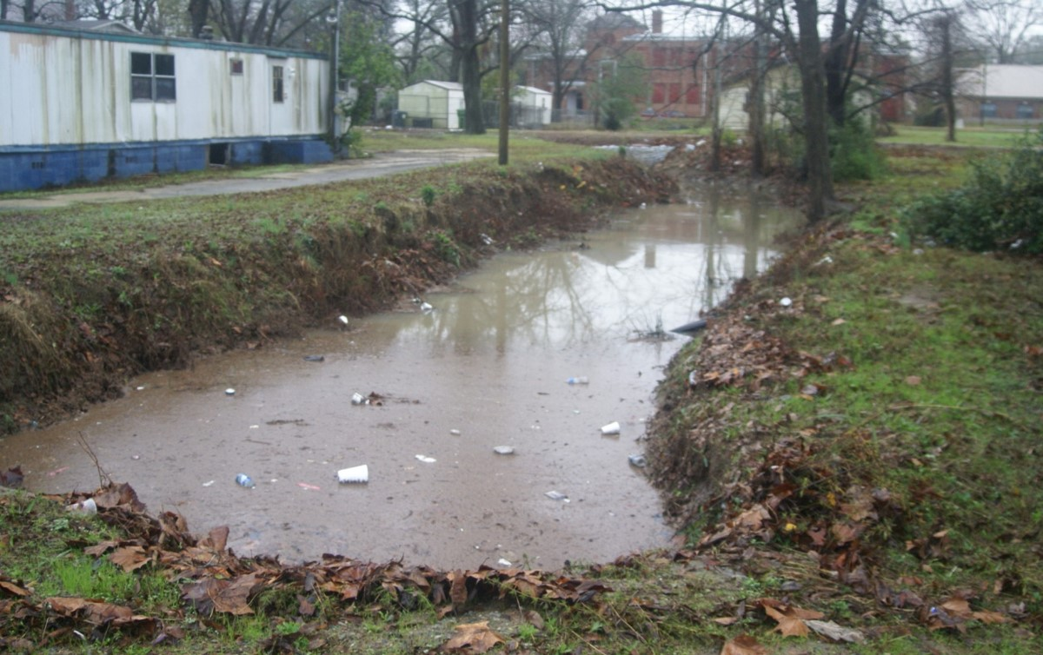
Street & Drainage

Slide 23
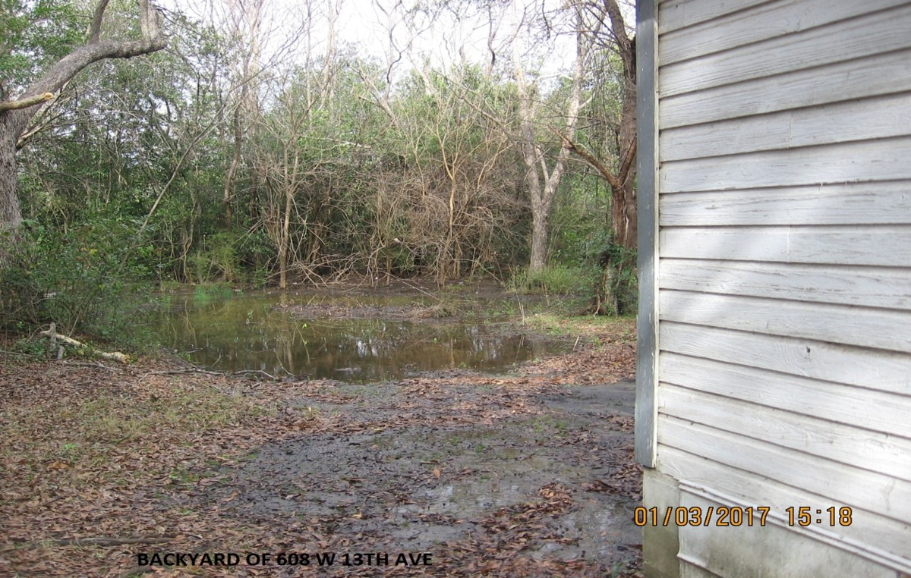
Street & Drainage

Slide 24
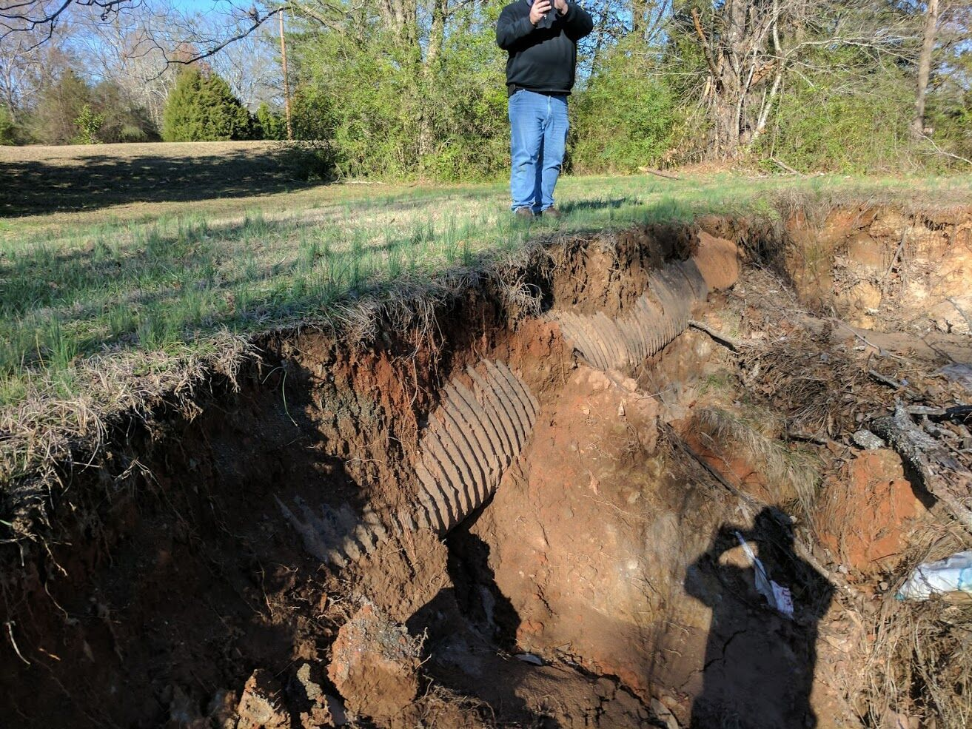
Street & Drainage

Slide 25
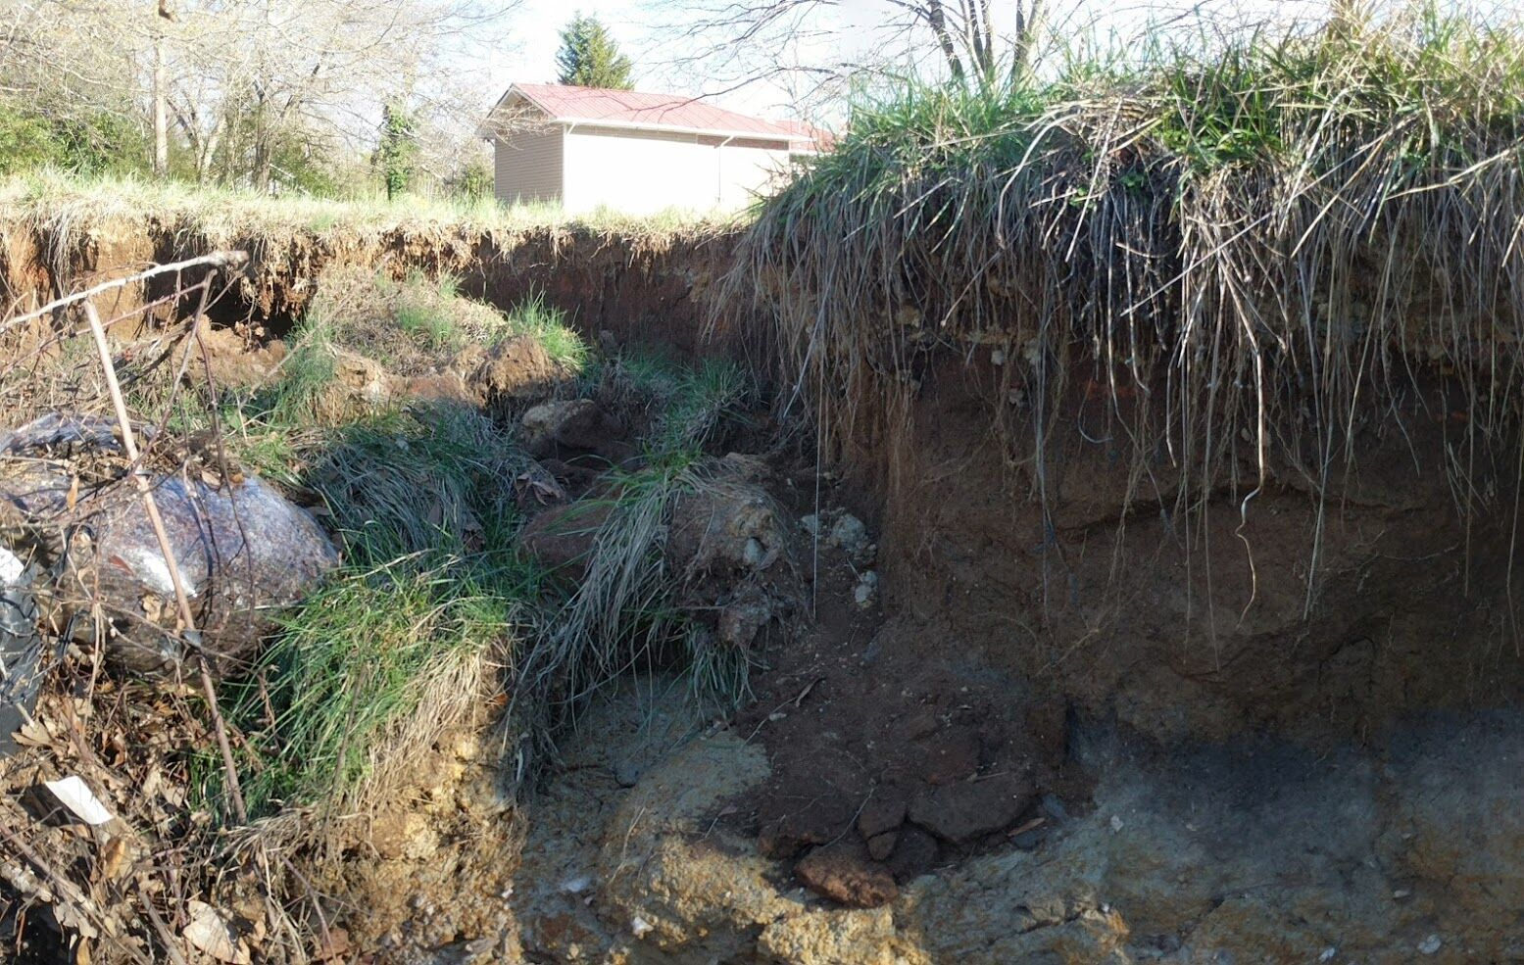
Street & Drainage

Slide 26
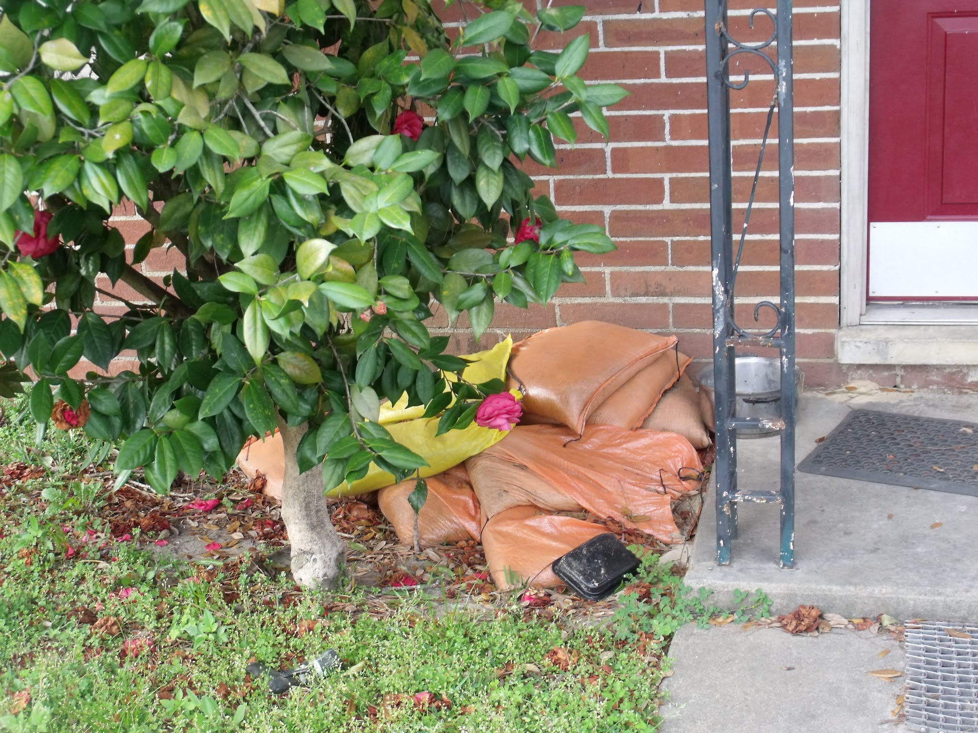
Street & Drainage

Slide 27
Building Applications

Slide 28
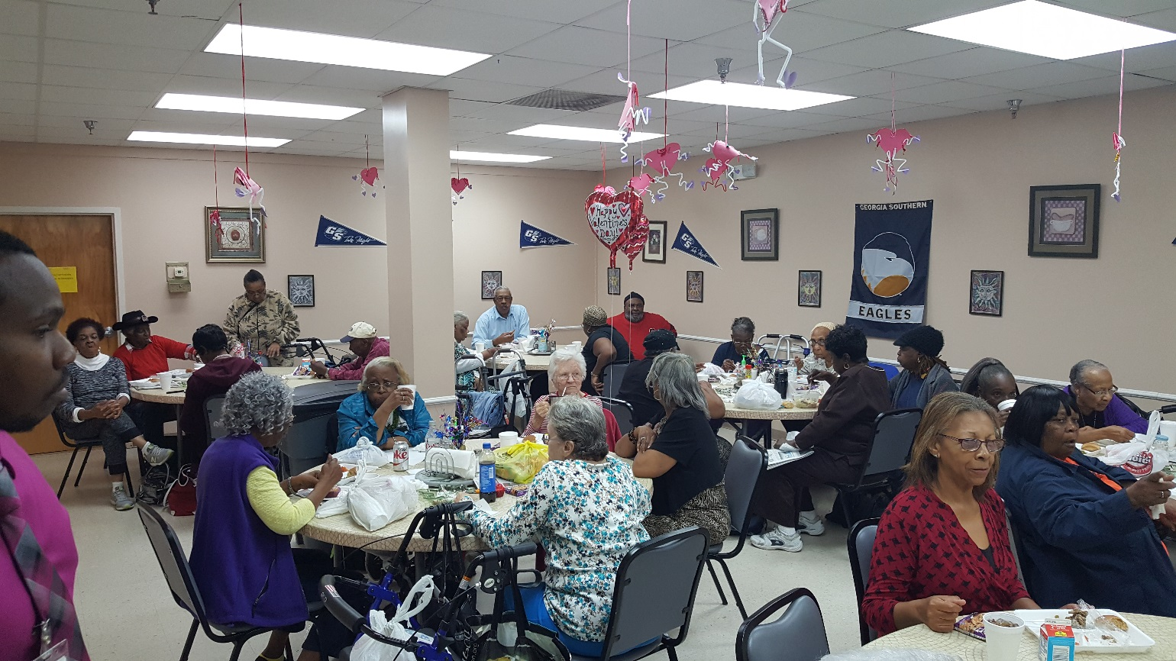
Buildings

Slide 29
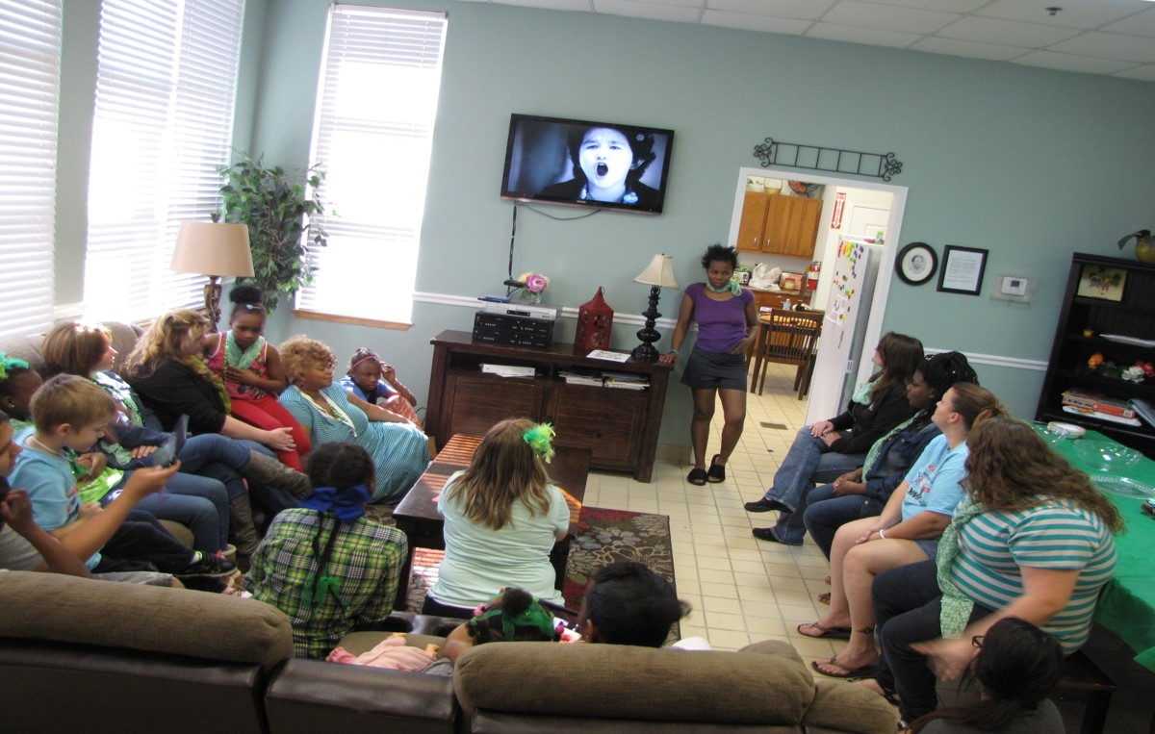
Buildings

Slide 30
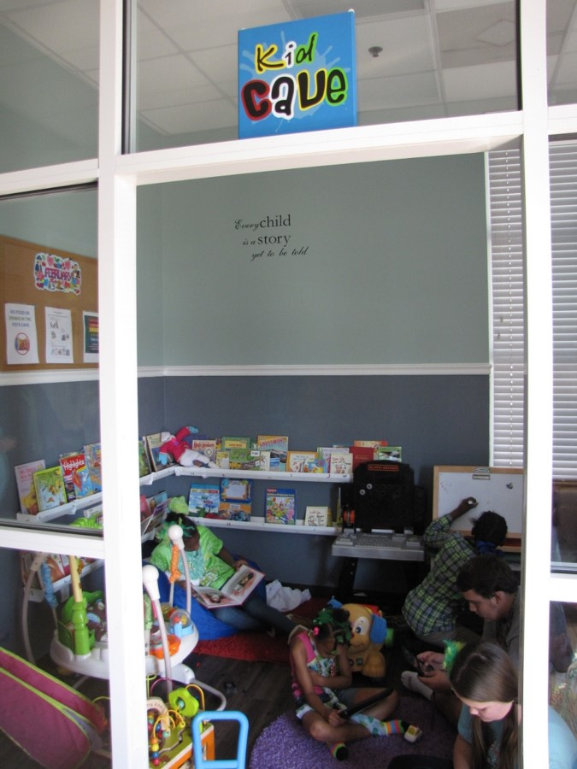
Buildings

Slide 31
Neighborhood Revitalization & Multi-Activity Applications

Slide 32
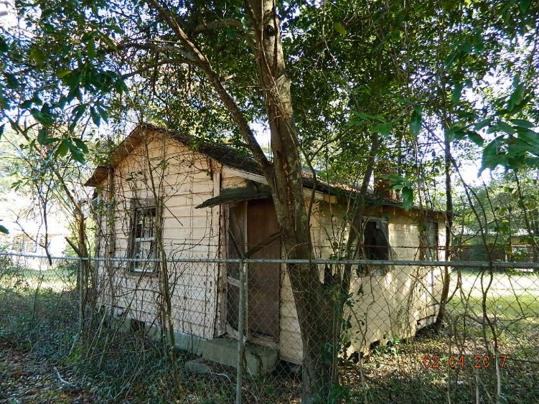
Neighborhood Revitalization & Multi-Activity

Slide 33
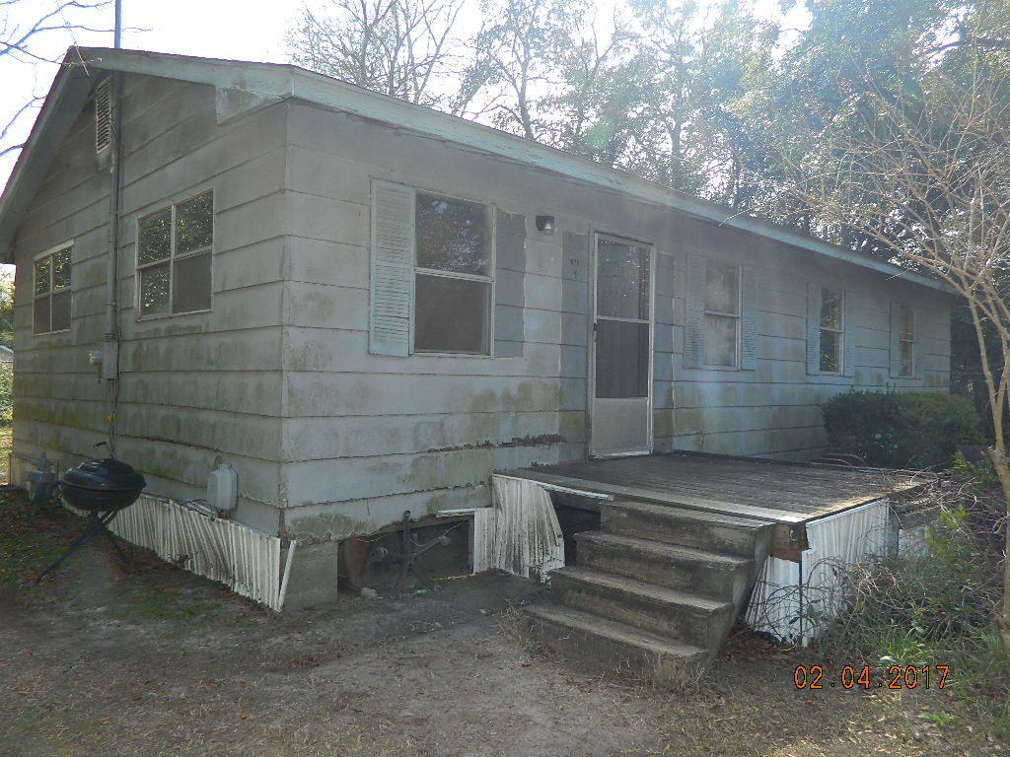
Neighborhood Revitalization & Multi-Activity

Slide 34
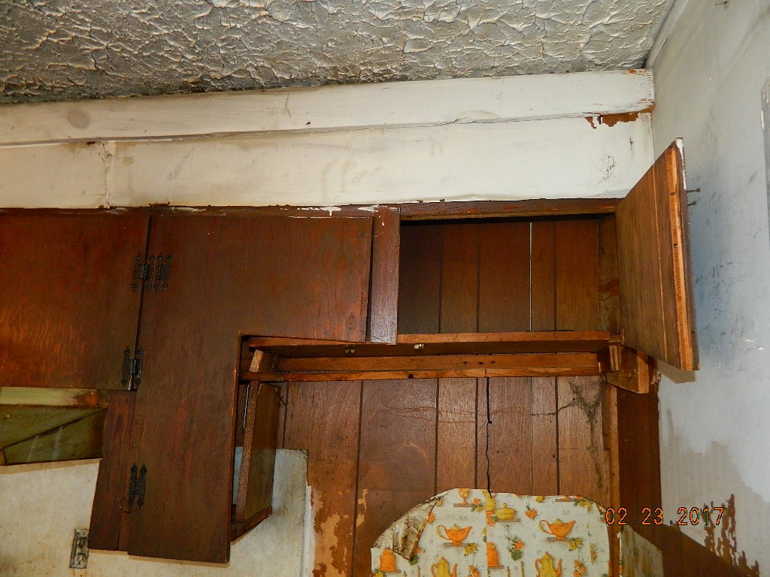
Neighborhood Revitalization & Multi-Activity

Slide 35
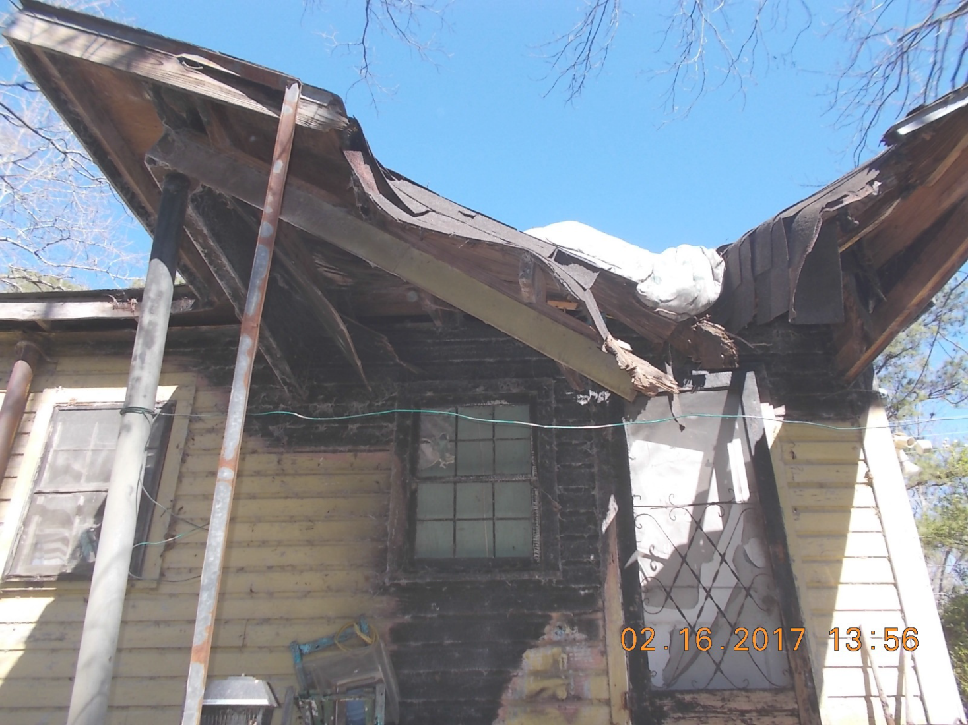
Neighborhood Revitalization & Multi-Activity

Slide 36
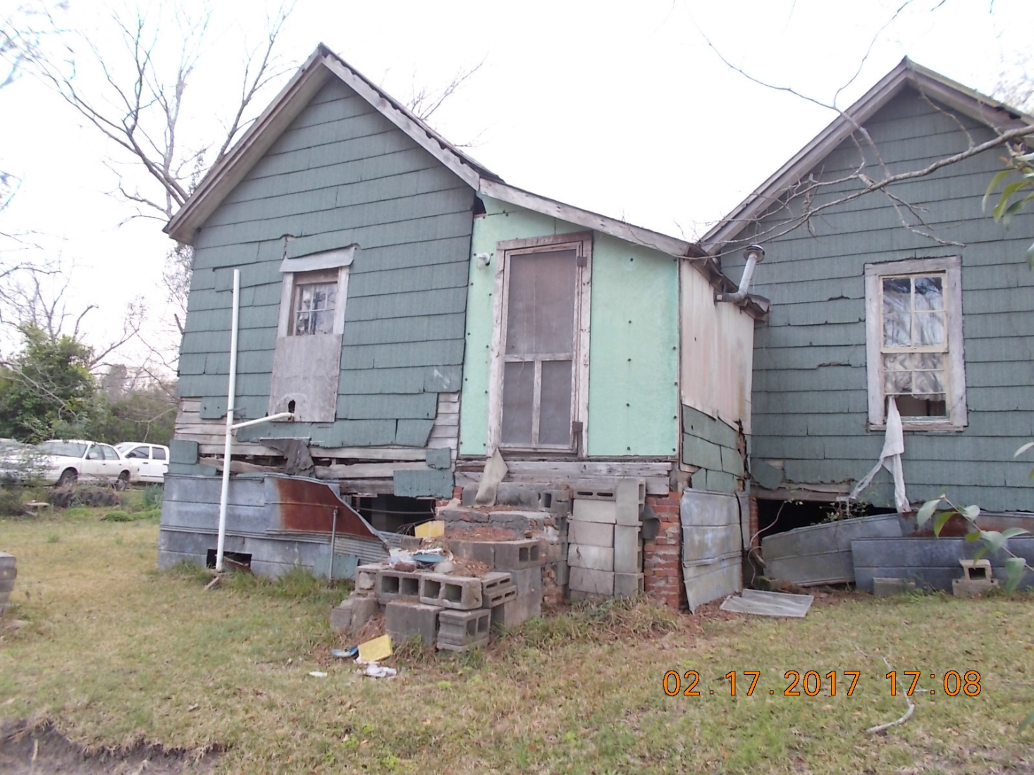
Neighborhood Revitalization & Multi-Activity

Slide 37
Neighborhood Revitalization & Multi-Activity

Slide 38
Neighborhood Revitalization & Multi-Activity

Slide 39
Neighborhood Revitalization & Multi-Activity

Slide 40
Neighborhood Revitalization & Multi-Activity

Slide 41
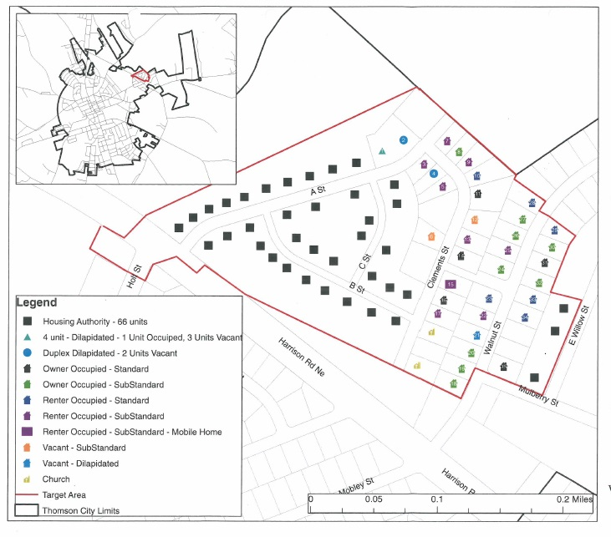
Neighborhood Revitalization & Multi-Activity

Slide 42
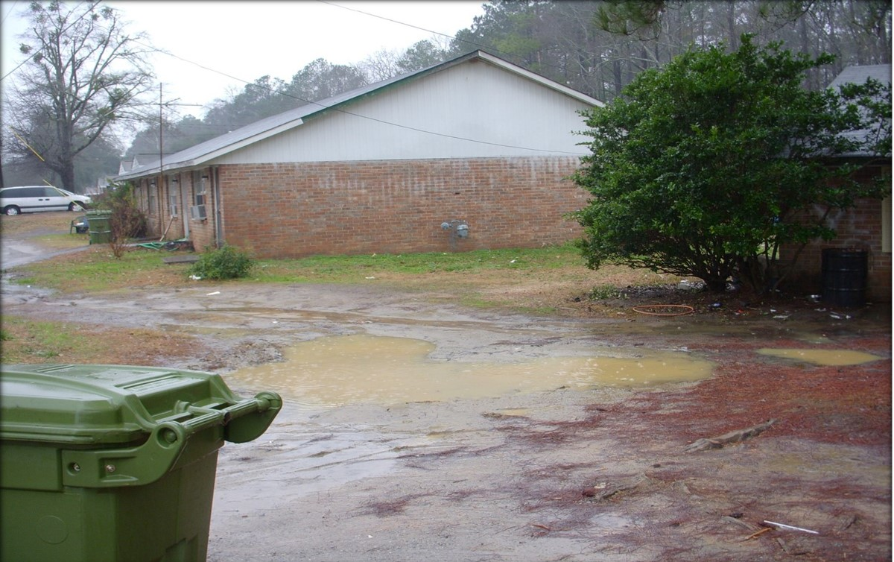
Neighborhood Revitalization & Multi-Activity

Slide 43
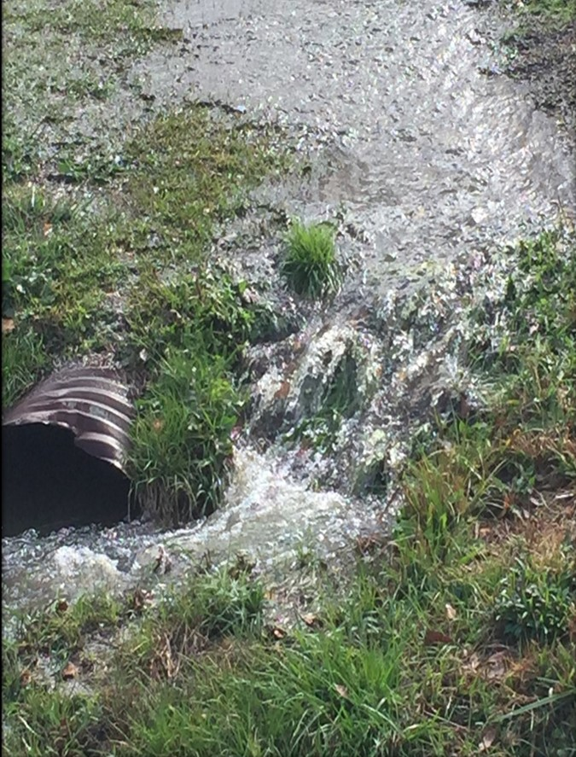
Neighborhood Revitalization & Multi-Activity

Slide 44
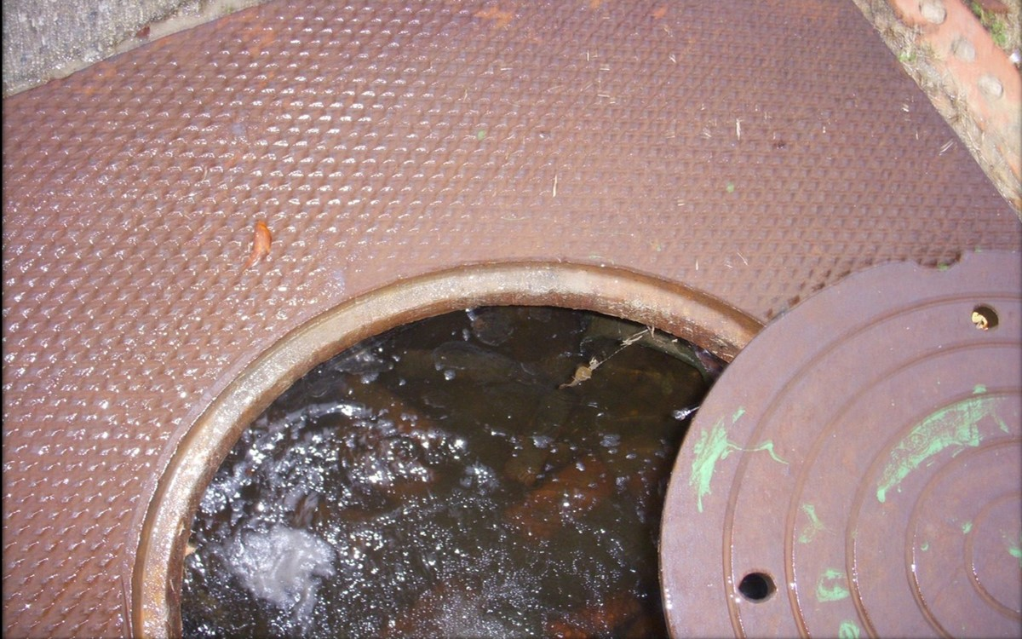
Neighborhood Revitalization & Multi-Activity

Slide 45
Neighborhood Revitalization & Multi-Activity

Slide 46
Neighborhood Revitalization & Multi-Activity

Slide 47
Questions?
Cindy Alligood
  cindy.Alligood@dca.ga.gov
  478-290-1074
Gabriel Morris
  gabriel.morris@dca.ga.gov
  404-679-3174
Dana Mykytyn
  dana.Mykytyn@dca.ga.gov
  404-679-0629

