Slide 1


Public Facilities Application Basics
12/6/2017
CDBG Field Services Representatives

Slide 2
Public Facilities Projects
Meeting the needs of low and moderate income people in the community, using bricks & mortar, concrete & paving and piping and plumbing.

Slide 3
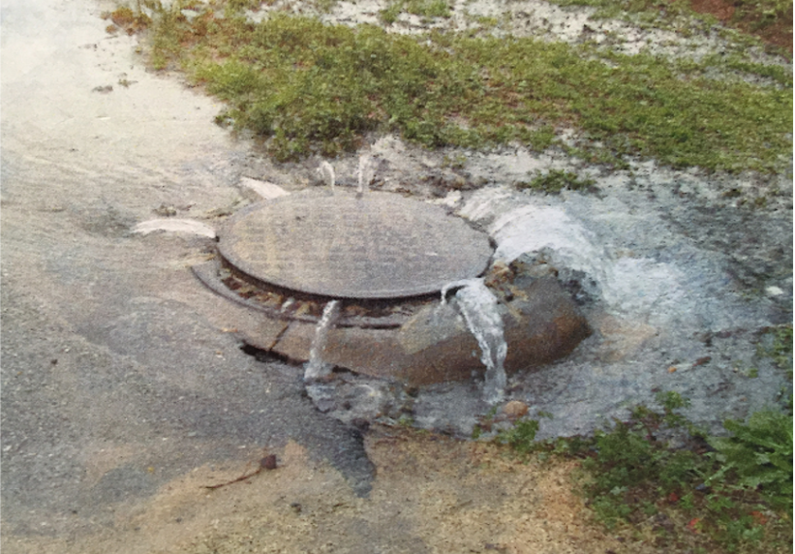
ELIGIBLE ACTIVITIES
Water & Sewer

Slide 4
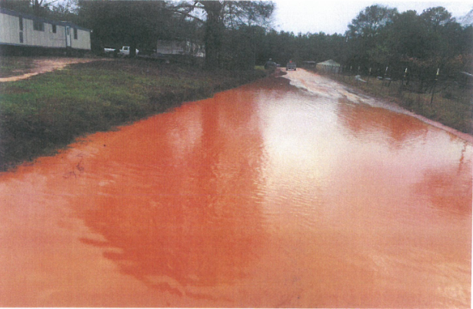
ELIGIBLE ACTIVITIES
Streets & Drainage

Slide 5
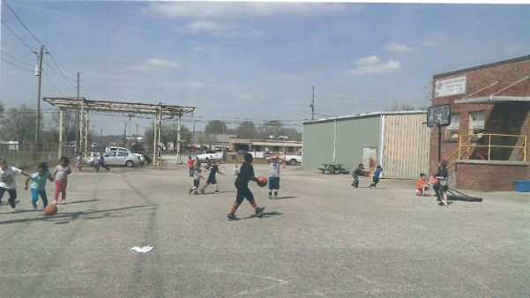
ELIGIBLE ACTIVITIES
Boys & Girls Club

Slide 6
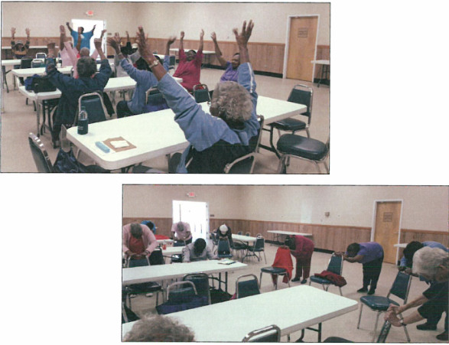
ELIGIBLE ACTIVITIES
Senior Centers

Slide 7
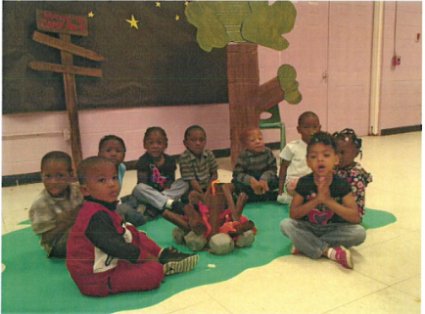
ELIGIBLE ACTIVITIES
Head Start Program Facilities

Slide 8
ELIGIBLE ACTIVITIES
Health Care Facilities
Battered Women’s Shelters
Mental/Physical Health Departments
Acquisition for Public Facilities

Slide 9

PROHIBITED!!
“...the renovation or construction of new space where the primary purpose is the provision of general purpose local government”

Slide 10

COMMUNITY NEED
The Community must decide what are the most severe needs for their particular community!
City Council or County Commission will decide which project to pursue.

Slide 11
Identify Key Players
Once a project has been identified, pull together the key players – quickly!
Grant writer
Administrator* (may also be your Grant Writer)
Architect / Engineer
* Funding for Administration must be included in the budget

Slide 12

FIRST, DECIDE…
How will Administration & Architect/Engineer fees be paid?
Local Funds?
CDBG Funds?

Slide 13
Procurement - CDBG Funds
Must use formal procurement procedure outlined in manual (Does not apply to RC’s for administration.)
Limits: 12% for Engineer; 10% for Architect (percent of CDBG construction, not grant amount). Break out CDBG amount from local funds on DCA-8.
Admin. Limit: 6% of grant amount for public facilities, 7% for multi-activity or housing.

Slide 14
PROCUREMENT REQUIREMENTS
CDBG Funds
Common rule (2 CFR Part 200)
Maximum Competition
Advertise in local paper. Allow 30 days response time
RFP: Send to 7 known providers for Administration; 10 for Architect/Engineers

Slide 15
PROCUREMENT REQUIREMENTS
CDBG Funds
Written method of selection (score sheet based on criteria listed in RFP)
Use Pre-selection to avoid headaches
Use Conditional Contract - if grant awarded, contract extended

Slide 16
Procurement - Local Funds
Engineer/Architect fees may be used as cash match or leverage.
Administration fees can be used as cash match, may also be used as leverage.

Slide 17
Sample Budget – CDBG Funds
Acquisition: $5,000
Administration (6%): $30,000
Engineering / Architect (12% / 10%): $42,000
Construction: $423,000
Total: $500,000 CDBG

Slide 18
Determine The Budget
Figure out what the project is going to cost.
Line items:
  Administration fee
  Architect/Engineering fee
  Construction estimate
  Acquisition

Slide 19
Budget - Revenue
Sources of income:
  CDBG Grant – Up to $750,000
  Matching funds – 5% of Grant amount above $300,000, up to $22,500
  Local Leverage funds - ?
  Other Funding Agencies (USDA, etc…)

Slide 20

Cash Match
Must be Cash!
Calculate at 5% of Grant Amount above $300,000.
A $500,000 Grant will have a $10,000 Cash Match requirement. A $750,000 Grant will have a $22,500 Cash Match.

Slide 21
Leverage = Bonus Points!
Additional funds, land and NEW materials above the required Cash Match are counted.
Operating budgets & salaries, already owned furnishings & equipment DO NOT count.
Leverage will be monitored – must be realistic and achievable, or penalties may apply.

Slide 22
Construction Costs
Your Architect or Engineer will give you the construction cost estimates.
The Preliminary Architectural/ Engineering Report is vital to the success of your application. More on this later.

Slide 23
Determine Size of Project
Will your budget cover the cost of the project?
Do you need to scale back, or can you increase the scope of the project (# of streets, size of building, etc…)
Finalize your project.

Slide 24
Determine the Beneficiaries
For Infrastructure – survey as Area Benefit.
Conduct door-to-door survey to count the number of people benefiting, and their low-mod status.
Surveys must be 100%, or a statistically valid random sample. See New Policies.
Vacant units are not households, cannot be surveyed.

Slide 25
Determine the Beneficiaries
For a Building – survey using Limited Clientele benefit.
Seniors at a Senior Center are categorically low-mod.
Nursing home residents are NOT categorically low-mod.
Who is going to use the building? Survey the user groups.

Slide 26
Determine the Beneficiaries
If your low-mod percentage of residents is not at least 70%, STOP! Going any further is a waste of time!
Can you reconfigure the project area to get above the 70% threshold?

Slide 27

Tell the Story – Sell the Story
DCA-4 Description of Need.
Describe the problem and how it affects the PEOPLE.
Keep the focus on the needs of the residents.

Slide 28
Tell the Story – Sell the Story
State how the identified need impacts LMI persons
If a community has cracked sewer lines, and the treatment plant is over capacity due to infiltration, how does this affect the residents? CDBG grants are to solve people problems, not municipal problems.

Slide 29
Tell the Story – Sell the Story
Quantify your need
to the greatest extent possible
“There are 46 households in the target area who are not served by City sewer and whose septic tanks are malfunctioning because of poor soil conditions and small lot sizes”

Slide 30
Tell the Story – Sell the Story
“According to the local Health Department the coliform counts in these wells has measured X which is a definite indication of contamination.”

Slide 31
Tell the Story – Sell the Story
“...the average income of these households is X and the high cost of drilling a deep well precludes these people from correcting the problem themselves. In addition, the lot sizes are so small that even if there were funds available to replace the septic tanks, they would not work anyway.”

Slide 32
Tell the Story – Sell the Story
ALWAYS DOCUMENT YOUR NEED
Letters from residents. Form letters or pre-typed letters not best practice.
Letter from the Fire Chief
Letter from the Health Dept.
Know the difference between letters of documentation and letters of support

Slide 33
Tell the Story – Sell the Story
Photos – quality photos are your best seller!
Identify location of photos (address, map)
News Reports
Mental Health Directors
AAA Directors
Building Inspectors
Reports and/or Consent orders from EPD
NOTE: Make sure the documentation is relevant to the project!

Slide 34

Tell the Story – Sell the Story
Keep the focus on people

Slide 35
Tell the Story – Sell the Story
Make sure that your project proposal addresses the need identified!

Slide 36
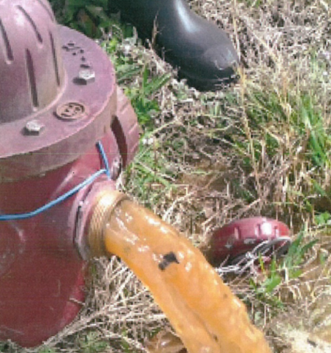
Tell the Story – Sell the Story
If the main problem is low water pressure, but resident letters also complain about quality, does the solution cover both problems?

Slide 37
Tell the Story – Sell the Story
Avoid political pitfalls!
If the project overlaps jurisdictions, all sides must agree in writing to the application.

Slide 38
Your Action Plan
DCA-5 Description of Activities
Project Overview
A detailed description of each activity
Evidence of conformance with Comprehensive Plan & Service Delivery Strategy
Copy of Service Delivery Strategy map with target area/facility in relation to service area

Slide 39
Action Plan – Be sure to cover:
ACQUISITION
PERMITS
TAP-ONS AND TAP-ON FEES
UTILITY RELOCATION
MAINTENANCE AND/OR OPERATION
CAPACITY
SITE
IMPLEMENTATION SCHEDULE
SECTION 3 and Other Applicable Laws

Slide 40
Action Plan – Be sure to cover:
Need for household plumbing
Abandonment of well and/or septic tanks
Design configuration must make sense
Drainage projects - downstream discharge area has sufficient capacity

Slide 41
Be sure to Address the following:
Section 3 documentation (SEE updated guidance)
Language Access Plan (LAP) certification and acknowledgement (SEE updated guidance)
Limited English Proficiency (LEP) requirements for jurisdiction. (SEE updated guidance)
Service Delivery Strategy map (See updated guidance)
SAM documentation
Affirmatively Furthering Fair Housing (AFFH)

Slide 42
Action Plan
Identify design standards and justify their usage. 25 YEARS IS THE NORM. YOU MUST THOROUGHLY JUSTIFY ANYTHING ELSE!
Try to avoid low density population target areas.
Problems created by developers will not be viewed as a high severity of need.

Slide 43
Action Plan
Average Cost per person for different activities from 2016 applications
  Water - $2,700
  Sewer - $2,800
  Water & Sewer - $4,600
  Streets & Drainage - $5,200
  Multi-Infrastructure - $6,300

Slide 44
Action Plan
Average Cost per person for different activities from 2016 applications
  Senior Centers - $5,300
  Health Departments – $700
  Boys & Girls Club/Rec. Facilities - $5,300

Slide 45
Action Plan – Project Impact
The impact the project will have on the problem.
Most importantly, the impact the project will have on the lives of the residents.

Slide 46
Financial Statements
Document your sources for cash match and leverage with signed, original commitment letters.
For a new program, document sources of operational funding (staff salaries, equipment, etc.) LIKE A BUSINESS PLAN

Slide 47
PRELIMINARY ENGINEERING REPORT
Amount of detail depends on complexity
Professional cost estimates required
Design Standard (25 year storm)
Unusual site conditions / higher costs
Preliminary Hydrologic/Hydraulic Calculations
  Scores will be reduced if calculations not provided.
Existing and Proposed Conditions maps

Slide 48
PRELIMINARY ENGINEERING REPORT
Engineer/Architect signature and stamp required.
Does Eng. Report agree with rest of application?
Viable alternatives - “No alternative” is not a good answer. Go into more detail.
Alternatives should have general cost estimates.

Slide 49
MAPS
Scale, north arrow, legend
All street names - correct and legible
Proposed and existing activity location
Identify all houses in project area - all applications, not just Housing Applications
Show and identify vacant housing units
Show and identify commercial buildings/churches

Slide 50
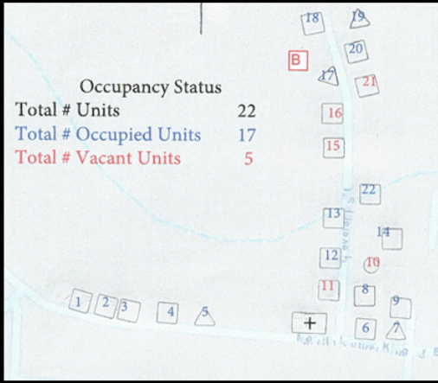
Maps – Identifying Housing Units

Slide 51
Maps
Include a street address in the target area that can be located on a GPS.
YOU MUST INCLUDE a copy of your Service Delivery Strategy map that shows the Target Area or facility in relation to the Jurisdiction’s Service Delivery Strategy, REGARDLESS of PROJECT TYPE.

Slide 52
MAPS – CONCENTRATIONS MAPS
Print three separate concentration maps (see below).
Maps of entire local government, not just the target area
Identify Target Area on the maps.
Three different maps for concentrations:
  Concentrations of minorities
  Concentrations of substandard housing
  Concentrations of low-mod persons

Slide 53
MAPS – CONCENTRATION MAPS
If there aren’t any concentrations for one or more of the three criteria, print the map and add the text “there are no concentrations, the minorities (or low-mod persons or substandard housing) are scattered.”

Slide 54
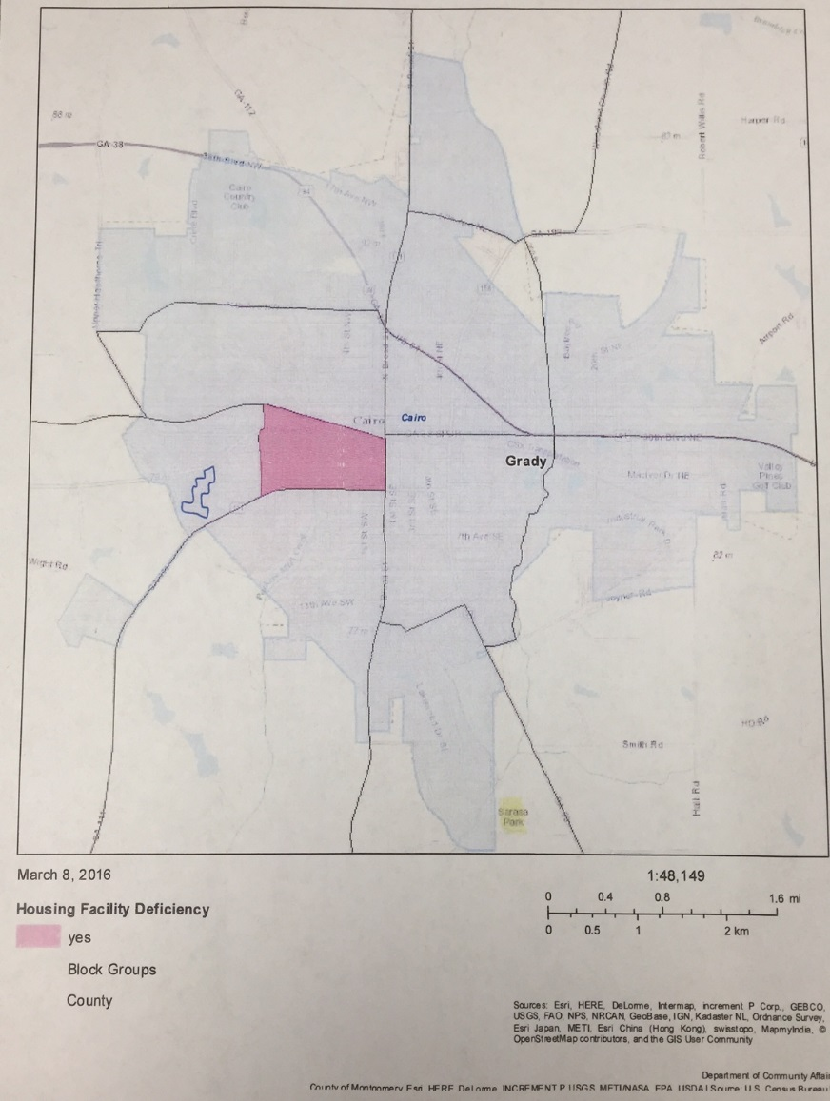
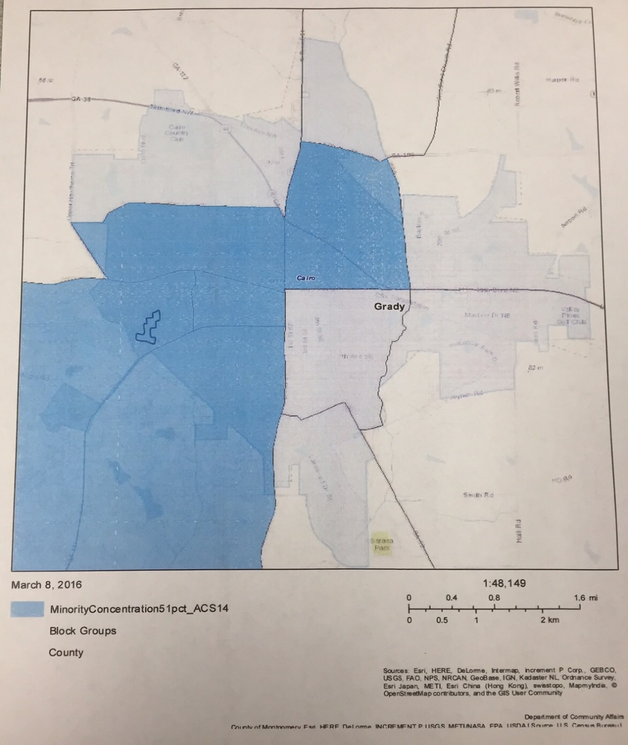
CONCENTRATION MAPS

Slide 55
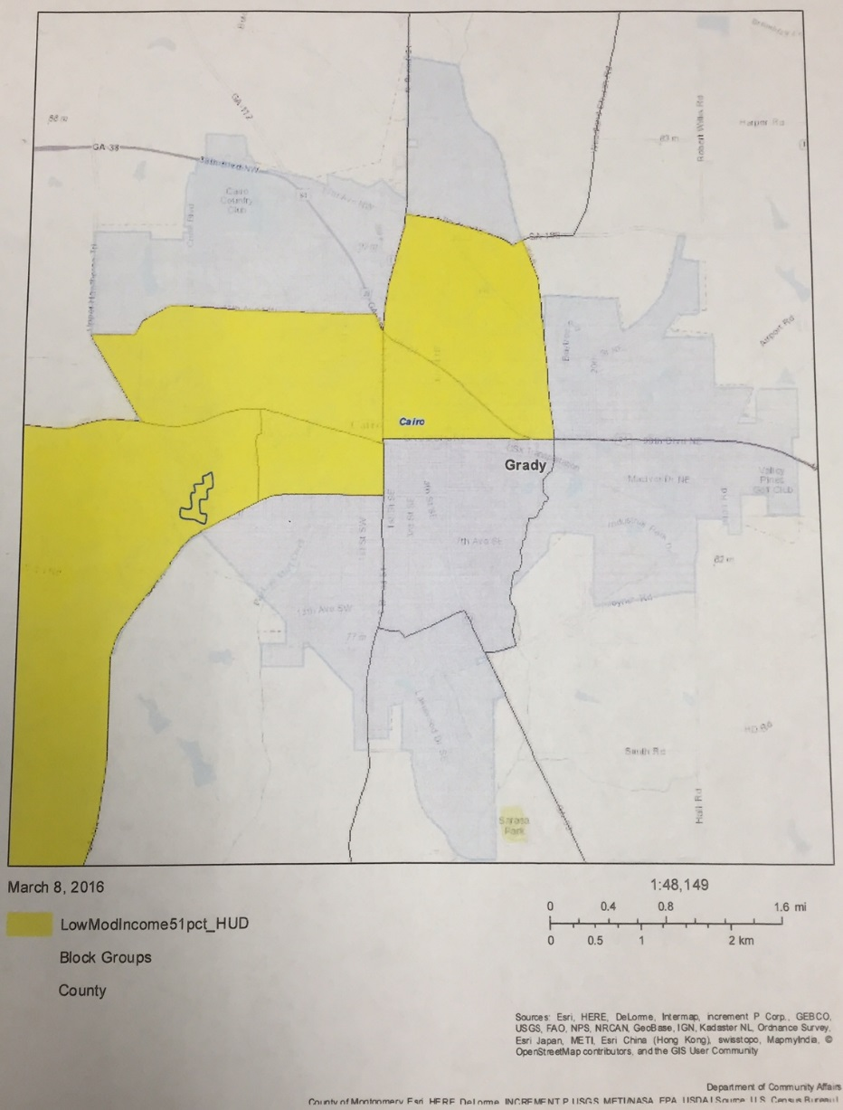
CONCENTRATION MAPS

Slide 56
CONCENTRATION MAPS
Use DCA Mapping Source, Map Atlas
http://georgia-dca.maps.arcgis.com/home/index.html (DCA Main page, Resources, Maps)
Most recent data should be available February 1, 2018
For help, contact Lisa Westin
  GIS@dca.ga.gov
  404-679-3135

Slide 57
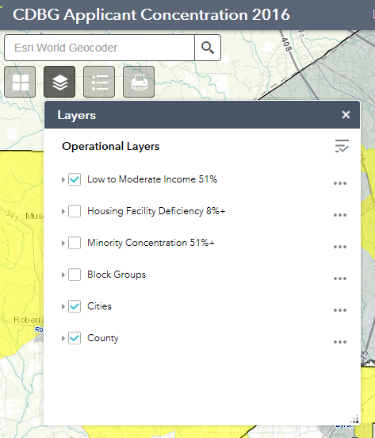
CONCENTRATION MAPS – MAP ATLAS
Use one of the top 3 Layers at a time, keep Cities & County checked.
Print all three different maps even if one doesn’t show any concentrations.

Slide 58
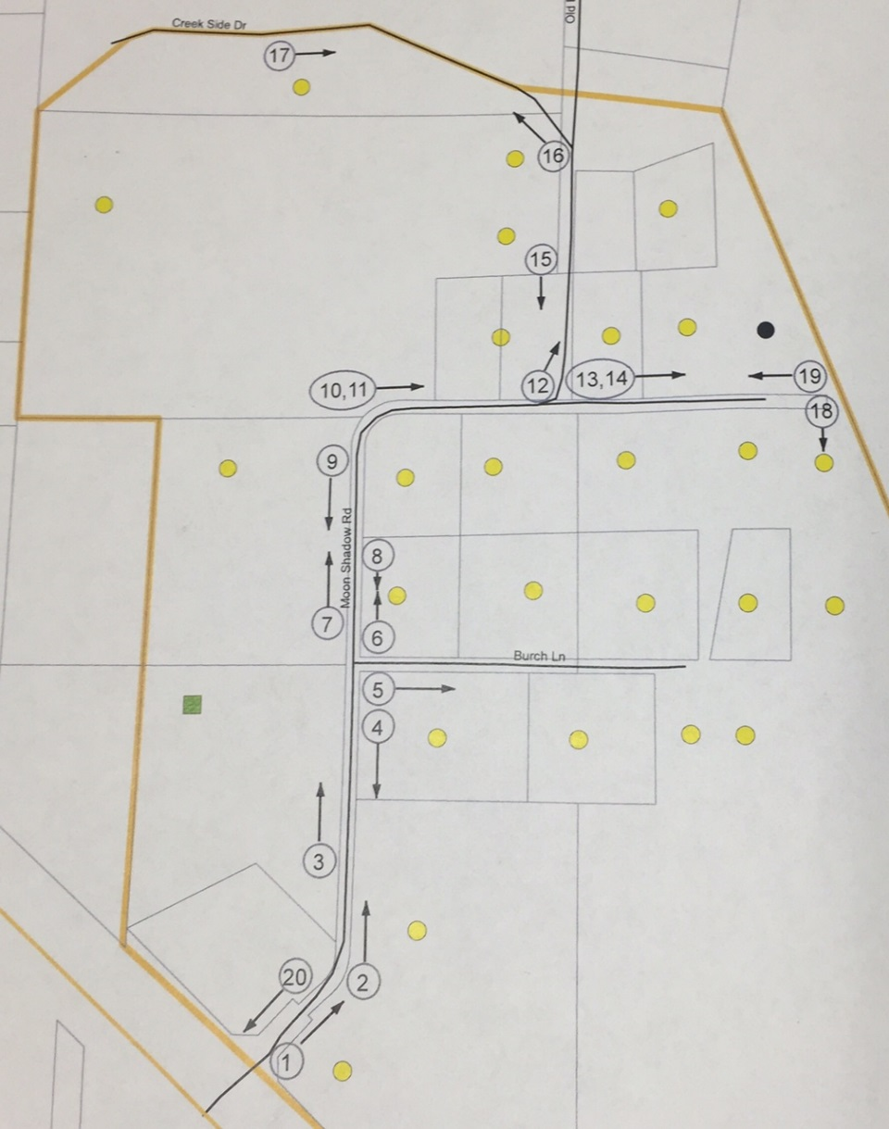
Maps – Photo Location
Location of photos
Numbered
Arrows showing direction
Cover all areas

Slide 59
Mistakes from last year - Buildings
The application states that 15,000 people use the gym annually. The city has a population of 2,347. It doesn't appear that 51% of the beneficiaries are from the city.
Application “estimates” that 80 – 90% of beneficiaries are low-mod. We Must have exact figures.
There are no beneficiary letters, from either parents or kids.

Slide 60
Mistakes from last year - Buildings
Overcrowding is claimed but not documented.
The changes that are being made appear to mainly benefitting the staff.
DCA-6 states "Income and racial data was provided by the ___ Mental Health facility for all 600 clients.“ No other supporting documentation, no letter from the Mental Health director, no survey form and no income limits are provided.

Slide 61
Mistakes from last year - Buildings
The PAR does not include an existing floor plan.
No operation and maintenance letter, just a continued use letter.
No third party letters included as documentation.
The application suffers from a severe lack of documentation.
The problems identified appear to be more of maintenance issues, especially with the exterior of the building.

Slide 62
Mistakes from last year - Buildings
None of the concentration maps are included.
Cost per person is $12,800 per person, which is extremely high. Average last year was $5,300.
The center is adding 2,000 sq. ft. but they are not adding any additional beneficiaries.
We can't determine if the survey was conducted properly.

Slide 63
Mistakes from last year - Buildings
The applicant did not conduct a survey, but instead included a letter we believe to be from the director breaking out the numbers of families in each LMI category. There is no further explanation about how these numbers were derived, or what income limits they were based on. The letter was not signed, nor attributed to an author.

Slide 64
Mistakes from last year - Buildings
While the project will improve the overall building, the panel has a hard time seeing how some of the improvements will really impact the kids.

Slide 65
MISTAKES FROM LAST YEAR – Water, Sewer
App. includes letters and narrative describing the problem, but no photos to document the claims - no photos of surging manholes, or surging clean-outs in yards, or in homes.
Water quality is reported to be poor, with odor & color, but no photos of water discoloration are included. No photos of stained clothes or fixtures are included.

Slide 66
MISTAKES FROM LAST YEAR – Water, Sewer
Health Department letter talks about abandoning 13 septic tanks, but residents are on sewer already.
Resident letters mainly talk about drainage problems, with yards flooding, but this isn't being addressed by the application.
No existing or proposed work map included in the PER.

Slide 67
MISTAKES FROM LAST YEAR – Water, Sewer
DCA-8 lists 88 service lines to be connected but the PER only lists 60 clean outs.
Dashboard rates appear to be low. It looks like the County could raise rates to help pay for needed improvements.
Photos didn't show any backup in homes. No contamination was documented.

Slide 68
MISTAKES FROM LAST YEAR – Water, Sewer
App. includes abandoning 5 septic tanks. The PER states the drainage fields are not working properly but there were no photos or letters to document this.
The application indicates 3 separate areas. Target area 3 - ______ Road does not meet LMI threshold. All TA’s must meet standard.

Slide 69
MISTAKES FROM LAST YEAR – Water, Sewer
Panel could not determine if there would be any utility relocation needed.
There was no photo key map included.
The LMI % is 74. They only surveyed 58% of the households and it was not a random survey.
No pressure tests were provided. No service calls documented.

Slide 70
MISTAKES FROM LAST YEAR – Water, Sewer
No photos showing back-up into homes. No evidence of damage to homes. No dates were included on photos of back-ups in yards. Panel could not determine how often back ups are occurring.
Panel could not determine if the residents on septic tanks are having problems. No comments were included from residents with septic tanks.

Slide 71
MISTAKES FROM LAST YEAR – Water, Sewer
PER Proposed Work map shows work being done outside the TA and shows many uncounted houses that appear to benefit from the proposed work.
Application did not indicate or provide funding for meters at non-LMI residences. The City match is being devoted to Engineering.
No pressure tests were provided. No service calls documented.

Slide 72
MISTAKES FROM LAST YEAR – Streets, Drainage
App. proposes to install curb & gutter throughout target area. Most photos show paved streets in very good condition with side ditches.
We don't see significant street flooding and erosion, or deep ruts.
No identified need for the sidewalks.

Slide 73
MISTAKES FROM LAST YEAR – Streets, Drainage
Several of the photos, some showing the worst conditions, are outside the target area.
The application claims yard, street and home flooding, but has very poor documentation of any real need.
The resident letters do not contain addresses, we can't determine where they are.

Slide 74
MISTAKES FROM LAST YEAR – Streets, Drainage
App. includes letters from a family stating they were flooded & had $3,000 worth of damage, but the address of the home is not included, no photos are included.
While the resident letters describe very bad roads with deep ruts, potholes and wash boarding, we just don't see this in the pictures.
Map does not identify where target area is in the county.
Most of the photos don't show any rain or water.

Slide 75
MISTAKES FROM LAST YEAR – Streets, Drainage
Cost per person is the highest, double the average cost per person, and does not document an extremely high need.
We don't see significant street flooding and no yard flooding. We don't see any damage to homes.

Slide 76
MISTAKES FROM LAST YEAR – Streets, Drainage
The are no photos showing the conditions on ___ Road, and for a large section of ___ Road - we have no idea what conditions are like on these sections, but the project calls for paving them all. This is probably over 50% of the project.
Application proposes $55,000 in sidewalks with no documented need.

Slide 77
QUESTIONS AT THE WORKSHOP
Should “do nothing” be listed as an alternative?
  Answer: No, do not list this as an alternative.
Is there a certain amount that may be claimed and counted for PER/PAR and app prep?
  Yes, DCA will allow up to $5,000 each for Grant prep and PER/PAR as Leverage, if adequate documentation is included in application.

Slide 78
QUESTIONS AT THE WORKSHOP
It may be wiser to request a smaller grant and add more local funds for a higher leverage score. For instance, if a project has a total cost of $800,000, instead of asking for $750,000 and putting in $50,000, you may receive more points for requesting $600,000 and putting in $150,000.

Slide 79
GOOD LUCK!

