Slide 1
Education Outreach
Forsyth County Department of Water and Sewer
September 14, 2016

Slide 2
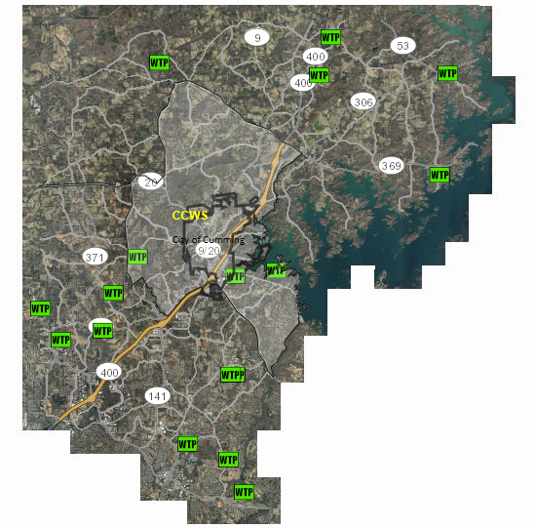
About Us…
• Population of 212,438 (7/1/15, US Census)
• 38 Departments and Offices
• Water and Sewer Created in 1987
• Obtained WaterFirst Certification in 2010 and Recertification in 2015
• 56,000 Customer Connections

Slide 3
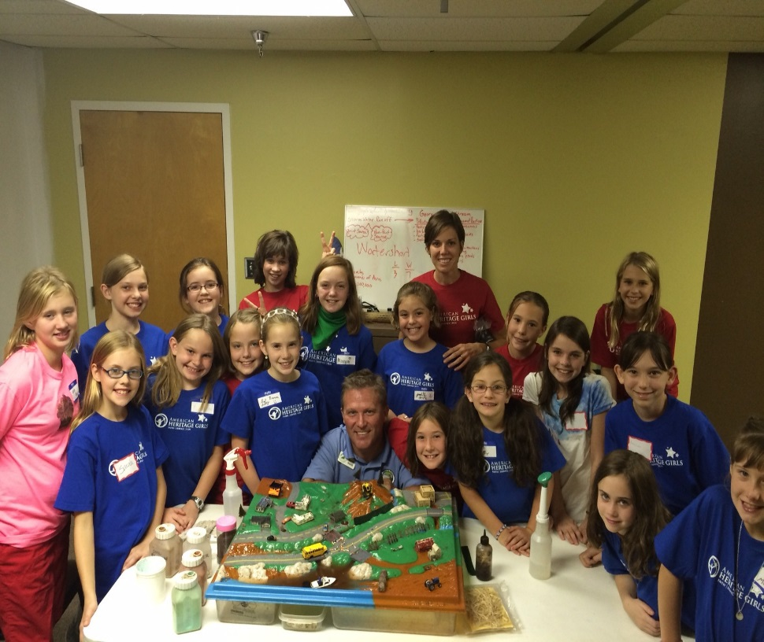
About Us…
• 37 Schools: 21 Elementary, 10 Middle, 5 High, and 1 Virtual
• 44,675 Students Enrolled in May 2016
• 366 Homeowners’ Associations (Service Area)
• Numerous Clubs, Organizations, Associations, Camps, Events, and Festivals

Slide 4
Outreach Budget
• 2010 through 2014 – No Specific Account, Other Departments and Accounts
• 2015 – Account Created, $2,000
• 2016 – Increased to $4,700
• 2017 – Proposed $5,200

Slide 5
2014 – Current Outreach Summary
• Approximately 6,600 Brochures Distributed
• $37,400 Toilet Rebates Issued
• 160 Water Quality and Conservation Classes / 3,938 Students (2014 - 2015)
• 40 Adopt-A-Stream Workshops / 814 Certifications Issued (2015)
• Attended Various Festivals, Events, and Workshops

Slide 6
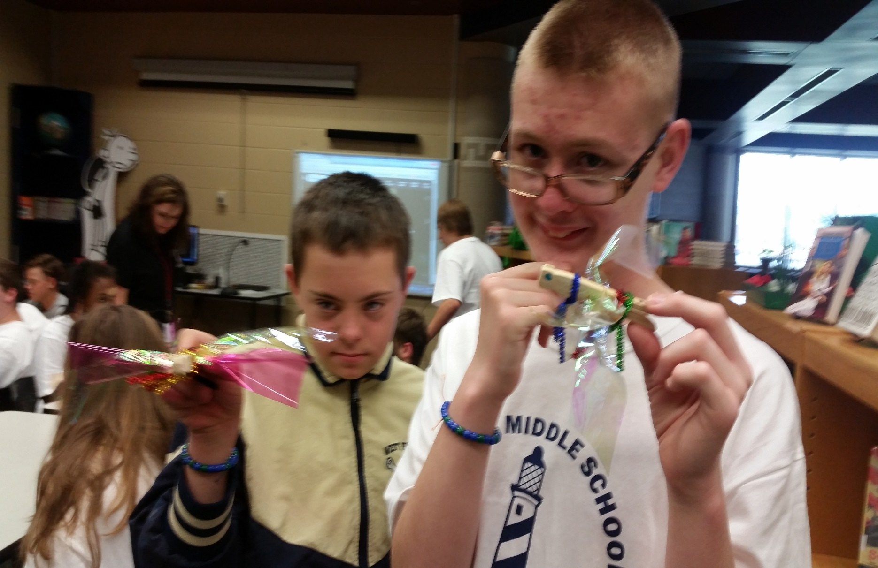
What Works…
• Motivated / Dedicated Employee(s)
• Establish Relationships
• Recognize Audience
• Promotional Item(s)
• Utilize Resources

Slide 7
Helpful Links
• Free Coloring Book - www3.epa.gov/safewater/kids/pdfs/activity_grades_k-3_activitybook.pdf
• Free Brochures, PowerPoints, and Activities -
extension.uga.edu/environment/water/
extension.uga.edu/publications/browse.cfm
• Free Activities -
www.discoverwater.org/blue-planet/

Slide 8
