Slide 1
Planning and Research Compliance

Slide 2
Table of Contents
Planning Compliance
QLG Program ties
Programs that impact all state funding/permitting
Locating Compliance results
Interpreting compliance results
Research compliance
Local government reporting requirements
Locating Compliance results
Interpreting GOMI/RLGF compliance
Interpreting AARF compliance

Slide 3
Programs that are tied to QLG Compliance
Items | Required for: | Due: | Other:
Comprehensive Plans | All Cities and Counties | Every 5 Years | N/A
Capital Improvement Element (CIE) | Any Gov’t or Authority that collects Impact Fees | Annually | N/A
Alternative Dispute Resolution | N/A | N/A | Parties must participate in process in “good faith”
Annexation Arbitration | N/A | N/A | Parties must participate in process in “good faith”
Development of Regional Impact (DRI) | Any Development that meets certain Threshold | N/A | Parties must participate in process in “good faith”
E-Verify (DOAA program) | All Cities and Counties | Annually | Please contact DOAA at immhelp@audits.ga.gov for assistance
*Items in bold are the most common programs associated with QLG
Notes:
Every community must adopt a DCA approved Comp Plan every 5 years to maintain Qualified Local Government status, or QLG status.
When a community wants to collect impact fees, they complete a CIE document, usually with the help of a consultant. Basically once a CIE is approved by DCA and adopted by the community – the community can begin collecting impact fees. Every year after this, the community must submit an annual CIE update to DCA for review. If a community does not adopt a DCA approved CIE annual update by their selected deadline, they lose QLG status.
Both ADR and annexation arbitration depend on both parties for the process to be successful. In both statutes it states that parties shall act in good faith throughout the process. If it is found that one party is not acting in good faith, then losing QLG status is a possibility.
The Regional Commission is responsible for administering the DRI process and determining whether a project meets the DRI thresholds. Failure of a community to properly file a project that exceeds the thresholds results first in a warning from the Regional Commission, and further failure to report projects will be reported to the DCA Board, and can result in the revocation of QLG status from DCA.
The General Assembly requires local government entities to participate in federal E-Verify programs when they’re hiring or contracting with folks. The law that was written about that ties it to the QLG status that DCA administers for comp plans. So—if local governments and authorities aren’t filing their E-Verify documents with DOAA, DCA is required to add them to the list of DIS-Qualified Governments.

Slide 4
Programs that Impact ALL state funding/permitting
Items | Required for: | Due: | Other:
Service Delivery Strategy (SDS) | All Cities and Counties | Every 10 years – or if anything changes | N/A
Sanctuary Cities (DOAA program) | All Cities and Counties | Annually | Please contact DOAA at immhelp@audits.ga.gov for assistance
Notes:
If a community fails to have an SDS verified by DCA, by the date of their 10 year selected deadline, they no longer qualify for any state administered financial assistance, or grant, loan, or permit will not be issued to any government or authority. Because, they are no longer compliant with the Service Delivery Act. This is SDA noncompliance – also called SDS noncompliance.
The next one has to do with “Sanctuary Cities”—you may remember a lot of discussion about that topic several years ago. Local Government entities are required to certify to DOAA that they are not a sanctuary city, every year. If they don’t, the DOAA has to tell DCA to put them on a list of noncompliant governments. The penalties are exactly the same as being SDS-noncompliant so, it’s a pretty big deal.

Slide 5
QLG vs. SDS/SDA Compliance
Very Bad
Bad
Compliance: | Qualified Local Government Status (QLG) | Service Delivery Act (SDA) Compliance/ SDS Compliance
Programs linked to this type of compliance: | Comp Plans & CIE’s & E-Verify & DRI/ADR/Anx. Arbtn. | SDS’s & Sanctuary Cities
When out of compliance, access is lost to these programs: | DCA Administered Programs + | All State Administered Programs/ Grants/ Permits
How to correct: | Corrected with Plan/ CIE approval and adoption. DRI/ADR/Arbitration is case by case E-Verify: please contact DOAA at immhelp@audits.ga.gov for assistance | Corrected with verified SDS* Sanctuary Cities: please contact DOAA at immhelp@audits.ga.gov for assistance
An abeyance granted by a judge could lift SDS sanctions: |  | Court ordered abeyance can remove sanctions while parties work through process
Programs linked to loss of QLG Status can be found here: | https://www.dca.ga.gov/node/2511/documents/2085
Notes:
So QLG vs. SDA or SDS Compliance – starting with QLG
QLG status is lost when a community fails to adopt their Comp Plan or CIE annual update by their deadline. It is also lost when E-Verify documents are not completed by the deadline. Lastly, it can be lost for not participating in good faith during the ADR and Annexation Arbitration process, as well as not following the DRI process appropriately.
QLG loss means a community is no longer eligible for DCA administered programs, and a few other state programs. This can include state programs funded with federal dollars.
SDA compliance is lost when a community does not have a verified SDS by their deadline – or they have not completed their Sanctuary City certification.
SDA noncompliance is much worse than QLG loss, as a community not only loses access to DCA programs, but ALL state administered programs, grants, loans, and permits.

Slide 6
Local Government Reporting to DCA
O.C.G.A. 36-81-8 requires local governments and authorities to submit various reports to DCA as a condition of receiving state appropriated funds from the Department.
These surveys create datasets to allow stakeholders and policy makers to understand and research how local governments in Georgia fund and provide services.
Survey | Description | Due Date | Users
Report of Local Government Finance | Standardized report on all funds, assets, revenues, expenditures and debts of the Local Government. | Within 6-months of the FYE | All Local Govs
Government Management Indicators | Covers all facets of local governments describing the scope and methods for service provision. | June 30th | All Local Govs
Authority Registration and Financial Reporting | Local authorities must annually register and report their finances to DCA. | Within 6-months of the Authority’s FYE | All Local Authorities

Slide 7
Accessing DCA’s compliance lists
Start at www.dca.ga.gov
Navigate to the “local government assistance” button and click the button
Scroll down to either the “Planning” or “Research and Survey’s section”
Click “Check your compliance status”
This will take you to a list of all the relevant links related to local government compliance https://www.dca.ga.gov/local-government-assistance/research-surveys/compliance -
The following slides will demonstrate this process with images

Slide 8
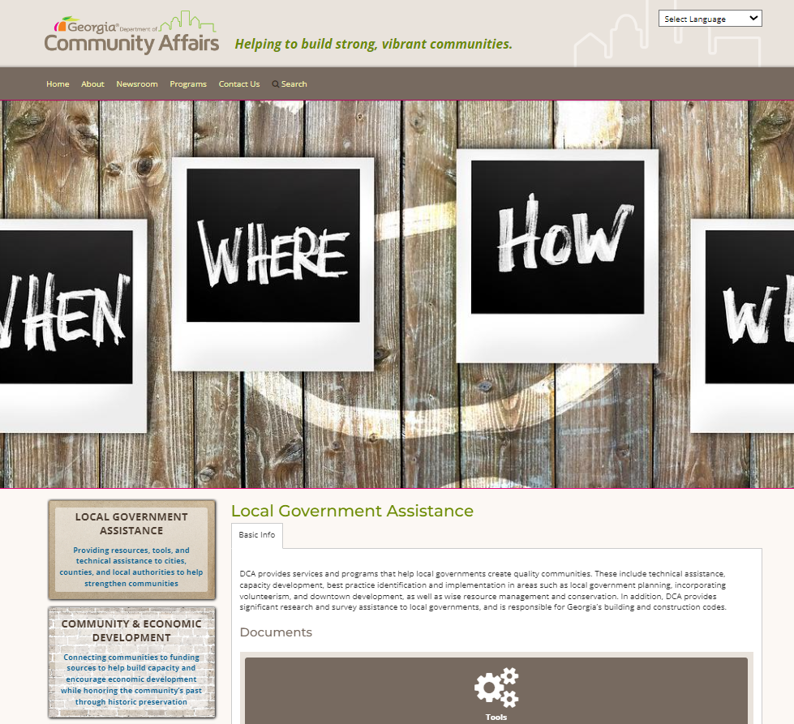
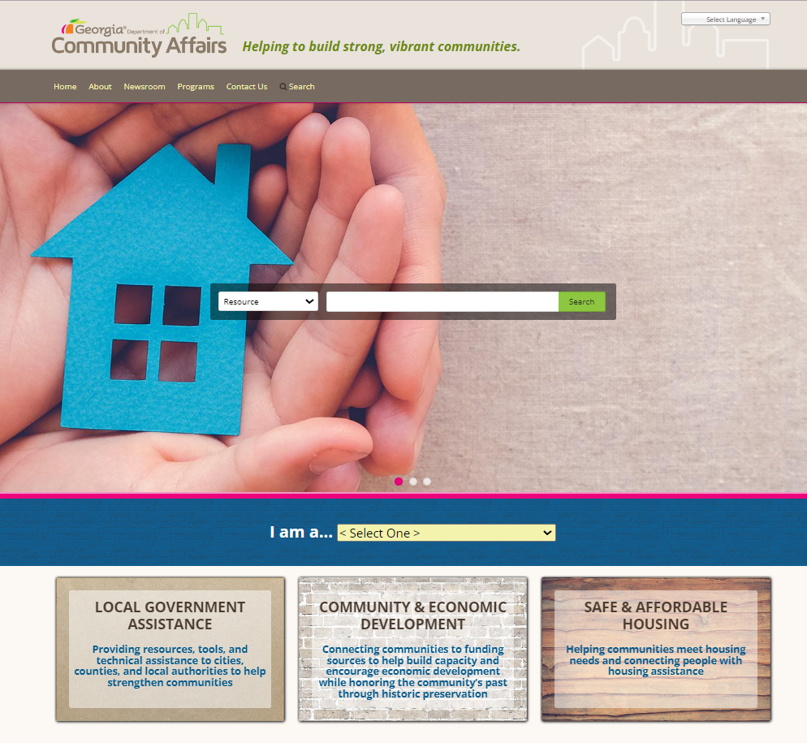
Accessing DCA’s Local Government compliance lists
Step 1: Start at www.dca.ga.gov
Step 2: Navigate to the “local government assistance” button and click the button
Step 3: Scroll down to either the “Planning” or “Research and Survey’s section”
1
3
2

Slide 9
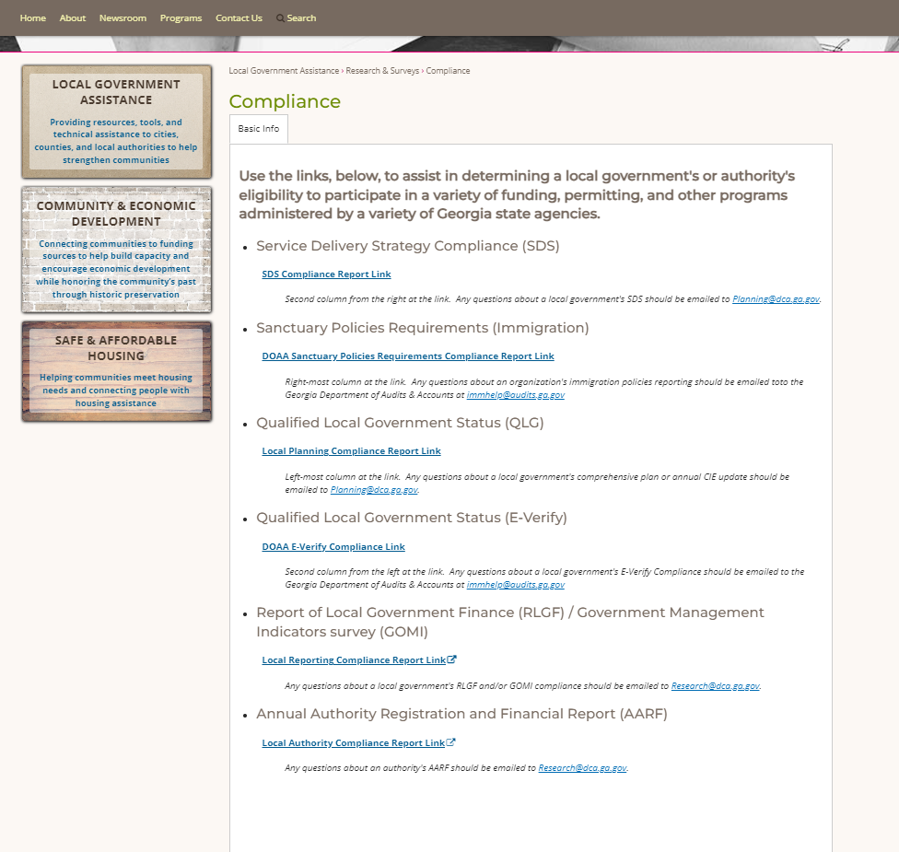
Accessing DCA’s Local Government compliance lists
Step 4: Click “Check your compliance status”
Step 5: This will take you to a list of all the relevant links related to local government compliance https://www.dca.ga.gov/local-government-assistance/research-surveys/compliance -
4
5

Slide 10
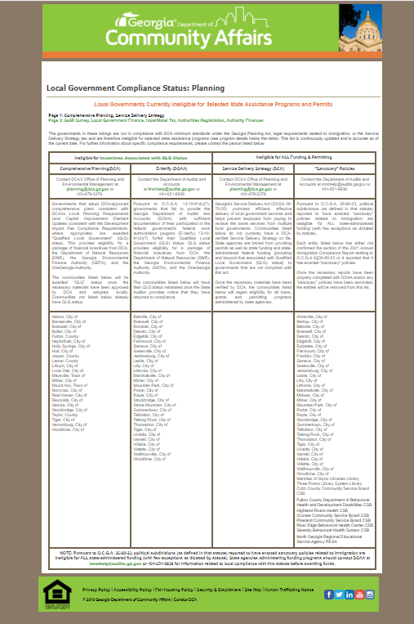
Interpreting QLG and SDS/SDA compliance results
If a local government is listed in one of the 4 columns at https://apps.dca.ga.gov/LocalGovStatus/planning.asp - then the entity is noncompliant
These links will redirect you here

Slide 11
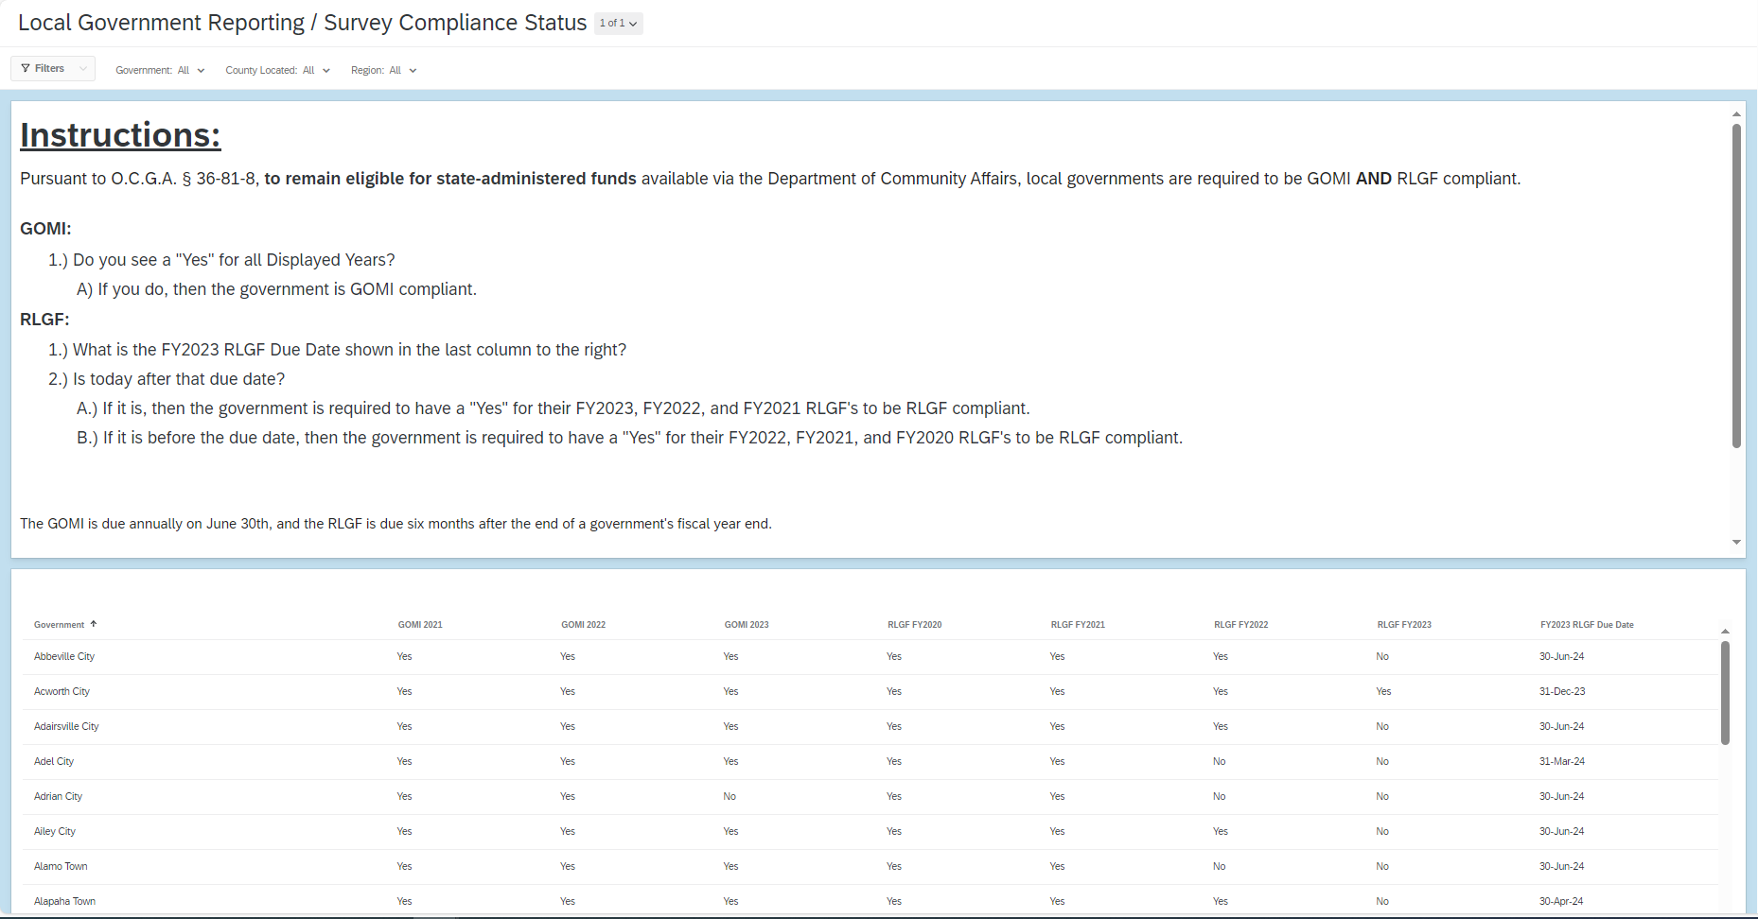
GOMI/ RLGF compliance
To be eligible for state-administered funds, local governments must have completed the last 3 years of GOMI AND the most recent 3 fiscal years for RLGF
Local governments that are noncompliant are barred from receiving state funding (O.C.G.A. § 36-81-8)
GOMI is an annual report due on June 30th of each year
RLGF is completed throughout the year with a local government’s due date being 6 months after the end of their fiscal year.

Slide 12
Interpreting GOMI/ RLGF compliance results
1
Read this section carefully.
Local governments must have last 3 years of GOMI AND most recent 3 fiscal years of RLGF to be compliant
Determine current RLGF fiscal year required here
GOMI = last 3 years complete
RLGF = last 3 fiscal years complete
Compliant
Not yet due
Noncompliant
Past due
Noncompliant
Not yet due
2
Determine compliance.
For the purposes of determining RLGF compliance in this example today is April 5, 2024

Slide 13
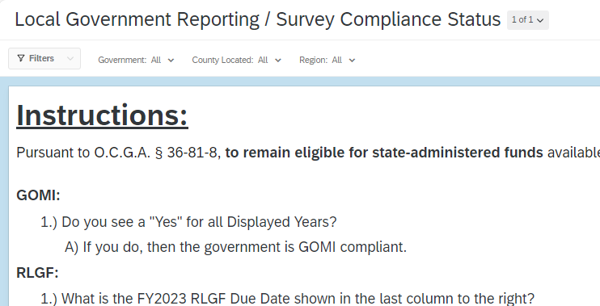
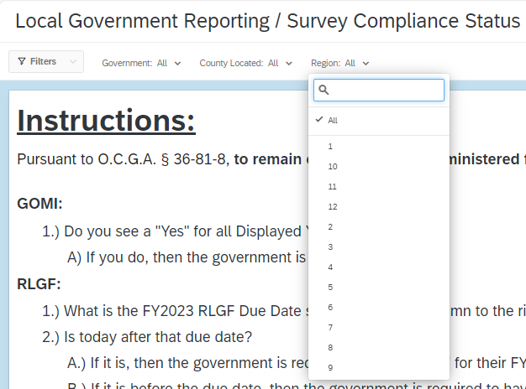
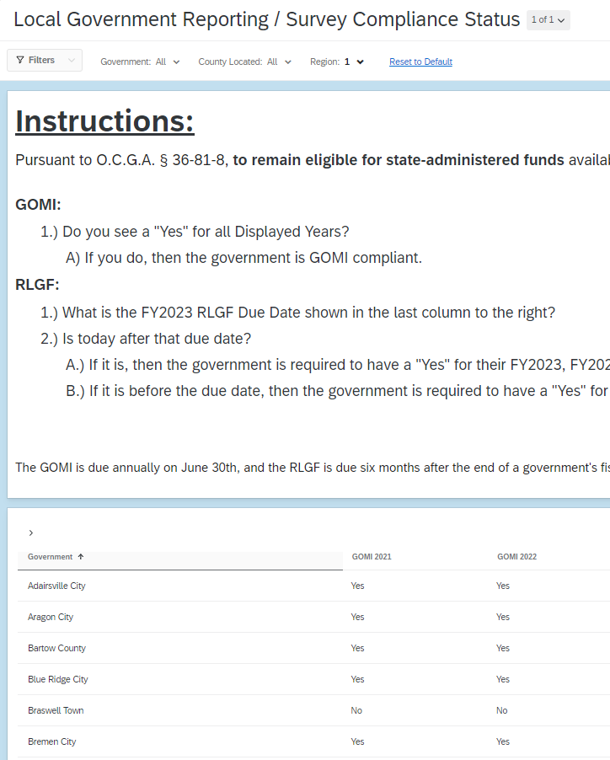
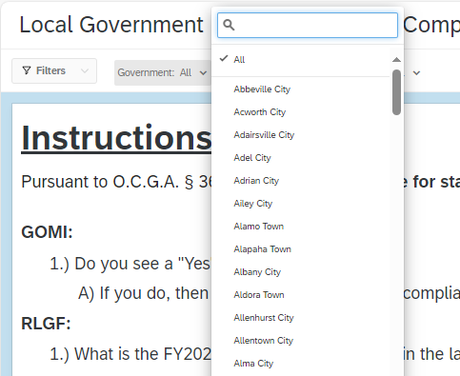
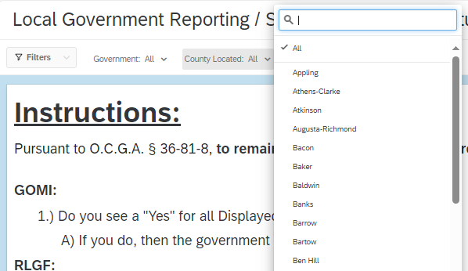
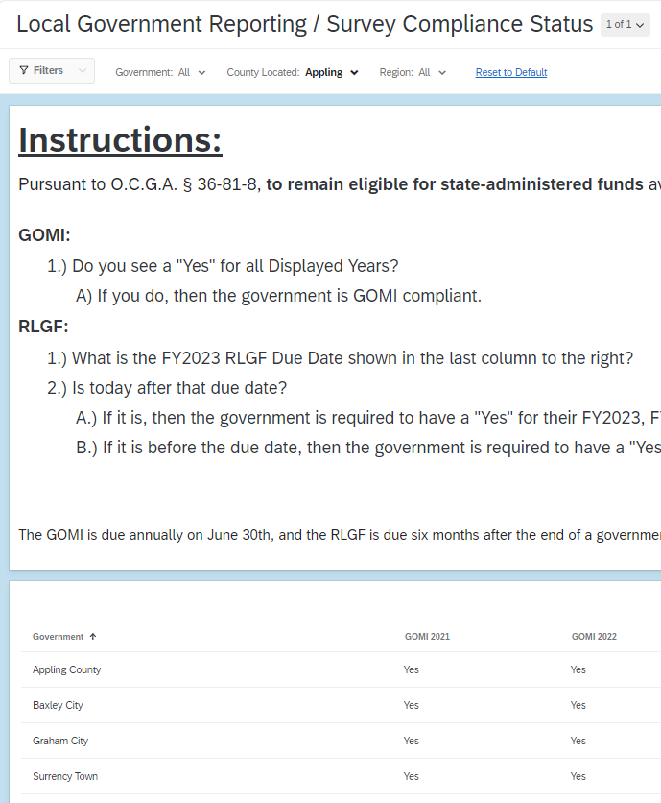
Search functionality in GOMI/ RLGF compliance dashboard
1
3
Clicking on “region” will allow you to search by a regional commission and will return the county information along with all the cities located in that regional commission.
Searching functionality
You can search using filters for the specific local government
2
Clicking on “government” will allow you to search by name for all municipalities and counties
Clicking on “county located” will allow you to search by a county and will return the county information along with all the cities located in that county. In the example below with Appling County, you see the search returns both the county and the municipalities contained within the county
4

Slide 14
Is your local government compliant with GOMI/RLGF and eligible to receive state funds?

Slide 15
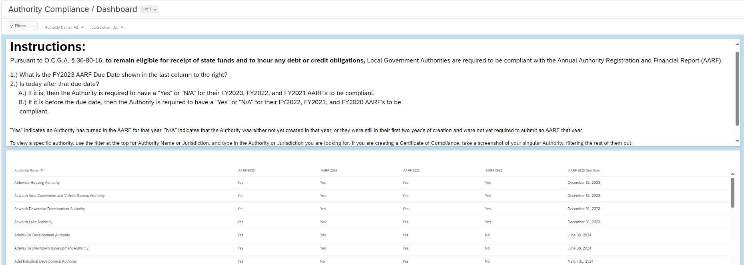
Interpreting Authority (AARF) compliance results
AARFs are completed throughout the year with a local government’s due date being 6 months after the end of their fiscal year.
To be compliant an authority needs to have completed their AARF for the 3 most recent fiscal years.
Authorities that are noncompliant are barred from incurring debt or receiving state funding (O.C.G.A. § 36-80-16).

Slide 16
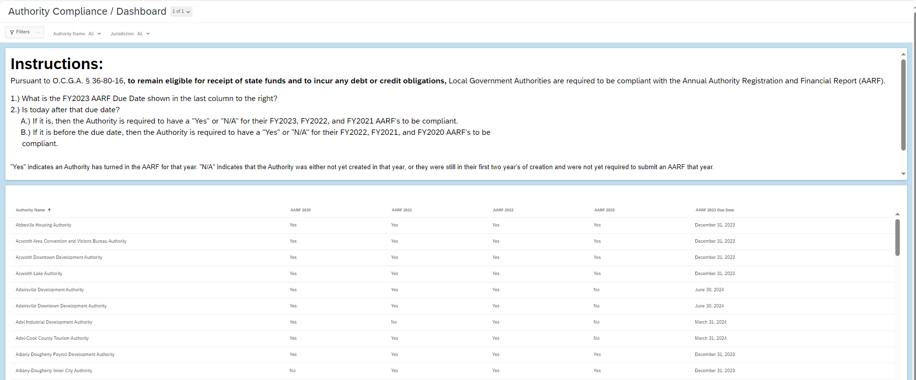
Interpreting Authority (AARF) compliance results
1
Read this section carefully.
Local governments must have last 3 fiscal years of AARFs to be compliant
Determine current AARF fiscal year required here
AARF = last 3 fiscal years complete
Compliant
Past due
Compliant
Not yet due
Noncompliant
Past due
Noncompliant
Past due
2
Determine compliance.
For the purposes of determining AARF compliance in this example today is April 5, 2024

Slide 17
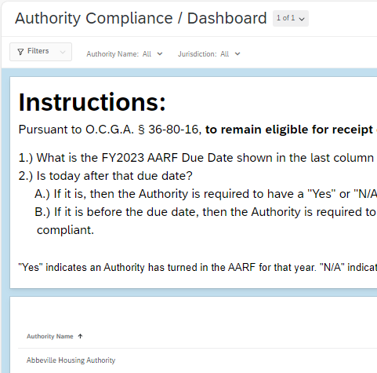
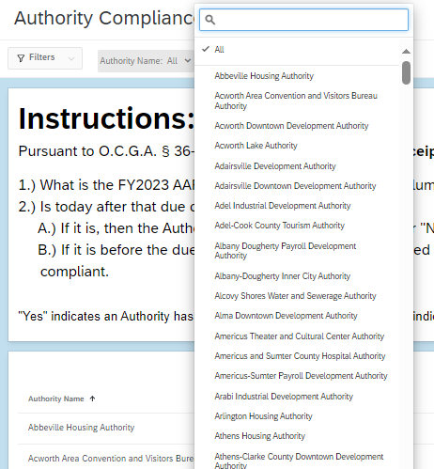
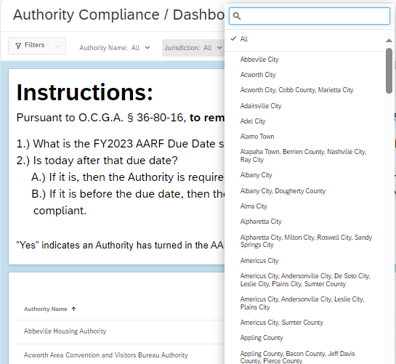
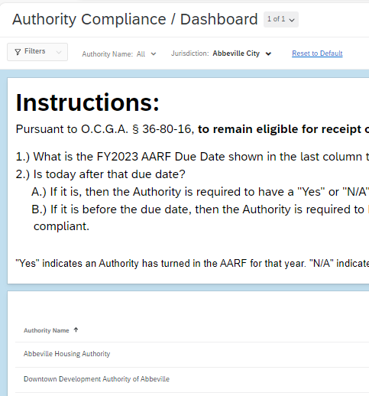
Search functionality in Authority (AARF) compliance dashboard
1
Searching functionality
You can search using filters for the specific local government
Clicking on “jurisdiction” will allow you to search by a jurisdiction (i.e. county, municipality, group of counties, etc.) and will return the information along with all the authorities located in that jurisdiction. In the example below with Abbeville City, you see the search returns both authorities contained within the city
3
2
Clicking on “authority” will allow you to search by name for each authority

Slide 18
Is your local authority compliant with their AARFs, eligible to incur debt, and receive state funds?

Slide 19
For any additional questions regarding QLG, SDS/SDA compliance please reach out to planning@dca.ga.gov
For any additional questions regarding Local Government compliance please reach out to research@dca.ga.gov

