Slide 1
Local Government Compliance CDBG Applicants’ Workshop
5 December 2017
Cam Yearty – Community Development Specialist

Slide 2
DCA Areas of Local Government Compliance
Qualified Local Government Status
Service Delivery Act Compliance
Local Government Annual Reporting Responsibilities

Slide 3
Qualified Local Government Status
Requirements to maintain QLG:
Adoption of a DCA-verified Comprehensive Plan
All local governments
Updated every 5 years
Adoption of a DCA-verified Capital Improvement Element
Local governments collecting Development Impact Fees
Annual reporting requirement

Slide 4
What if QLG Status is lost?
To regain QLG Status, all three actions below must have taken place:
DCA verifies a draft Comprehensive Plan/CIE,
Local government adopts the verified document, AND
DCA is notified of the local government adoption.
QLG Status is awarded immediately upon notification (Action 3).
http://www.dca.ga.gov/development/PlanningQualityGrowth/programs/planning.asp

Slide 5
Immigration Compliance Reporting and QLG
QLG status is now tied to Immigration Compliance Reporting (E-Verify)
Reports are due December 31st
DOAA manages the reporting process
DCA maintains the QLG listing

Slide 6
Service Delivery Act Compliance
Requires the development of a verified Service Delivery Strategy for each county
Formal adoption by all required local governments
Must address all required components (to be verified by DCA)
Updates required every 10 years, or upon other triggers

Slide 7
What else might trigger an SDS update?
Update to the county’s comprehensive plan,
Change in Service Delivery arrangements,
Change in revenue distribution (e.g., changes to LOST distribution between county and municipalities),
Creation, abolition, or consolidation of local governments, or
The county and affected municipalities otherwise agree to revise the strategy.

Slide 8
Project-specific SDS Compliance
The project must be consistent with the verified SDS:
Applicant is listed as a provider of the service
Project location must be within the applicant’s service area
The application should show this compliance
References to the SDS
Maps identifying the project location and relevant service delivery area

Slide 9
Out of compliance with the Service Delivery Act?
To re-enter compliance:
Local government must submit a Service Delivery Strategy to DCA for review, AND
DCA must verify that the submitted document adheres to Service Delivery Act.
Key difference from QLG Status:
Local government does not re-enter compliance until “the first day of the month following verification” by DCA (OCGA § 36-70-27)
http://www.dca.ga.gov/development/PlanningQualityGrowth/programs/servicedelivery.asp

Slide 10
Comprehensive Plan/SDS Deadlines
Keep in mind:
These are the dates by which the process must be completed, not just submitted to DCA for review!!!
DCA has review timeframes outlined in the rules for each document
Comprehensive Plans – 35 Days
Service Delivery Strategies – 30 Days
Three deadlines annually:
February 28th
June 30th
October 31st
View your community’s deadline: http://www.dca.ga.gov/dcacommunity/default.aspx

Slide 11
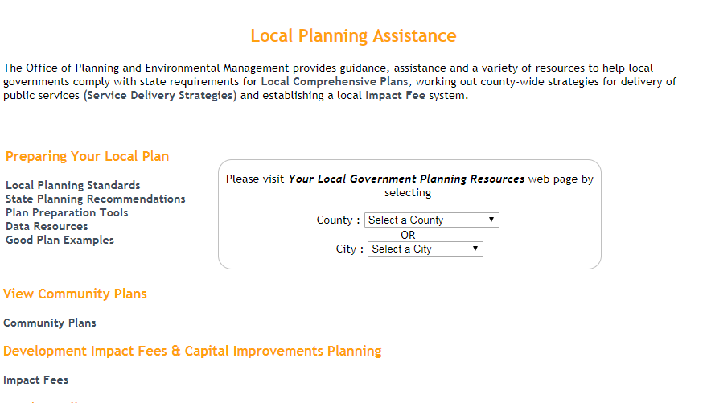
Comprehensive Plan/SDS Deadlines

Slide 12
Local Government Annual Reporting Responsibilities
Local Governments
Report of Local Government Finances (RLGF)
Government Management Indicators Survey (GoMI)

Slide 13
Government Management Indicators (GoMI) Survey
Background
Annual survey due by June 30th
ALL local governments required to have submissions for the most recent three (3) years
Without the three most recent GoMI submissions, a local government is ineligible for state or federal grant/loan funding administered by DCA
Responses
All 689 jurisdictions have a unique user name and password provided by Office of Research
Generally completed by Clerks, City/County Managers, or Chief Elected Official
Notes:
Usage
Commonly used by GMA, ACCG, CVIOG, others
University students, faculty, and other researchers
Local advocacy groups and citizen initiatives

Slide 14
Government Management Indicators (GoMI) Survey
Nine Sections
Management Functions
Services Provided
Public Facilities
Planning, Zoning, and Development
Financial Management
Economic Development
Public Safety
Form of Government
E-Government

Slide 15
Local Government Annual Reporting Responsibilities
Local Governments
Report of Local Government Finances (RLGF)
Government Management Indicators Survey (GoMI)

Slide 16
Report of Local Government Finances (RLGF)
Background
Annual report of all revenues, expenditures, assets, and debts of all funds and agencies of the local government
Mandated in 1985 for all local governments
To be submitted within six months of the local government’s Fiscal Year End (FYE)
Revised for FY2016 to better meet stakeholder needs and more closely conform with the Uniform Chart of Accounts (UCOA)
All 689 local governments are required to have submissions for the most recent three (3) fiscal years
Without the three most recent RLGF submissions, a local government is ineligible for state or federal grant/loan funding administered by DCA

Slide 17
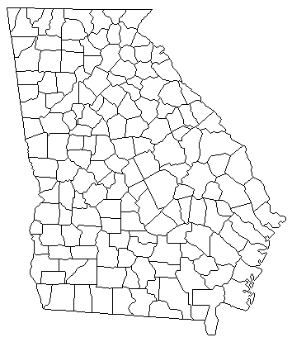
Local Government Fiscal Years
FY End Month | Total LGs (689) | RLGF Due Date (or preceding business day)
January | 2 | July 31
February | 2 | August 31
March | 2 | September 30
April | 5 | October 31
May | 3 | November 30
June | 270 | December 31
July | 6 | January 31 (following calendar year)
August | 10 | February 28/29 (following calendar year)
September | 58 | March 31(following calendar year)
October | 3 | April 30 (following calendar year)
November | 2 | May 31 (following calendar year)
December | 326 | June 30 (following calendar year)

Slide 18
RLGF Format and Preparation
Format
Microsoft Excel (.xls) form available on DCA Office of Research website
Includes revenue information on taxes, license & user fees, intergovernmental revenue, and enterprise funds
Includes expenditure information on general government, judicial, public safety, public works, health, culture and recreation, housing and development, and personnel wages and benefits
Includes outstanding, issued, and retired debt during the fiscal year, and cash, investments, and fund equity
Preparation
Generally prepared by jurisdiction’s Clerk, City/County Manager, CFO, or Chief Elected Officer (CEO)
Can also be prepared and submitted by auditor or CPA contracted by the jurisdiction
Name of CEO is required, but signature of CEO is not

Slide 19
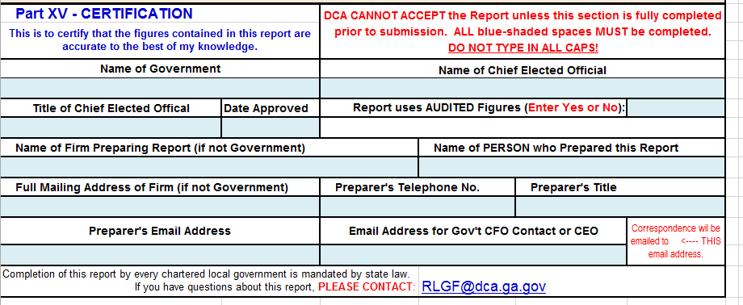
RLGF Audited Financial Statements
Audited figures not required for RLGF submission
Starting in FY2016, the RLGF captures audited/unaudited status
Many jurisdictions prefer to have an audit, but it does not change deadline – RLGF is due within six months of FYE, regardless of independent audit status
Georgia DOAA exempts certain local governments from audit requirements, so not all 689 jurisdictions will have audited figures
If a local government has less than $300K of expenditures, it is not required to submit an audit
In their most recent filings, 128 local governments (18.6%, all cities) are under $300K
If an audit is completed after the six month window, local governments may submit corrections to the RLGF if appropriate

Slide 20
Compliance status will be checked on August 3rd
By August 3rd, local governments must:
Have Qualified Local Government Status
Be in compliance with the Service Delivery Act
Have completed all Annual Reporting Responsibilities
GoMI – Most recent 3 years
RLGF – Most recent 3 fiscal years
Community should be working toward compliance well in advance of the deadline

