Slide 1
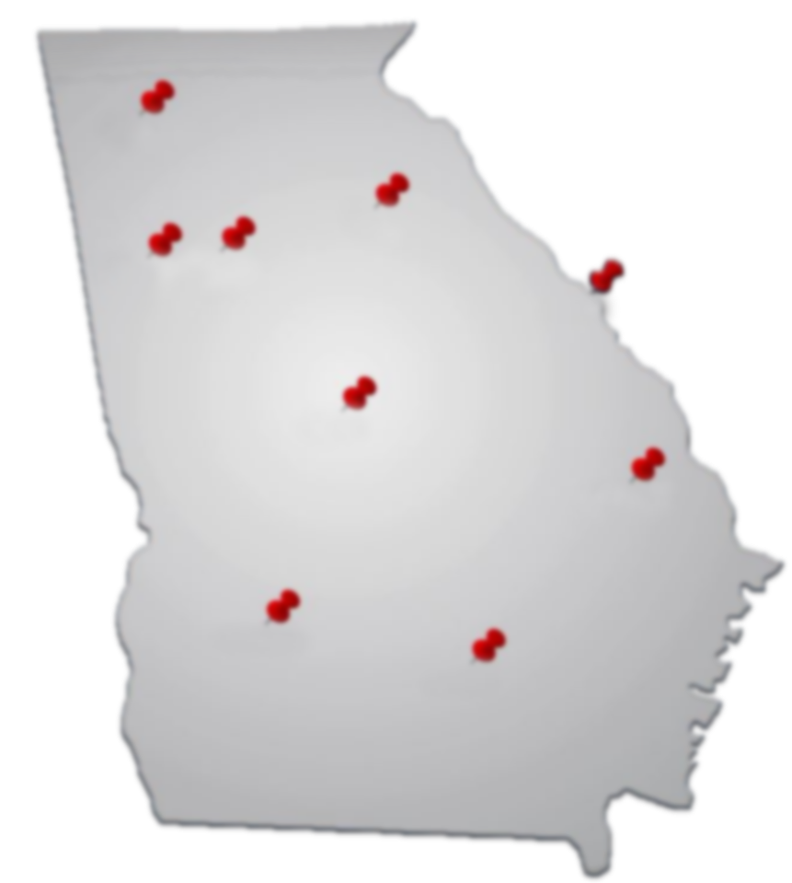
GEORGIA DEPARTMENT OF
AUDITS AND ACCOUNTS
Local Government Reporting and Audit Requirements

Slide 2
General Reporting Requirements
Focus on reporting requirements for annual audits and annual immigration compliance reporting
O.C.G.A § 36-81-7: Annual audits required
O.C.G.A § 50-36-4: Annual immigration compliance reporting

Slide 3
General Reporting Requirements
O.C.G.A. § 50-36-4: Annual reporting of immigration compliance
Specifically two of five reporting areas
O.C.G.A § 13-10-91 – Title 13 or contract reporting
O.C.G.A. § 36-80-23 – Sanctuary Policies

Slide 4
Submission of Annual Audits
O.C.G.A. § 36-81-7
Requires annual audits for each unit of local government
Unit of local government defined
As municipality, county, consolidated city-county government or other political subdivision (local government authorities) O.C.G.A. § 36-81-2

Slide 5
Submission of Annual Audits
Annual audit submitted to the State Auditor within 180 days after close of fiscal year (approximately 6 months)
Fiscal year end date:
March 31 due by September 30
June 30 due by December 31
September 30 due by March 31
December 31 due by June 30

Slide 6
Submission of Annual Audits
Agreed-Upon Procedures may be submitted
Total amount of expenditures and/or expenses of all funds does not exceed $300,000
Total amount must include all funds and activities
Include expenditures from the proceeds of SPLOST or grants

Slide 7
Submission of Annual Audits
Extensions of Time
State law allows DOAA to grant extension requests
Extended due date or new due date if granted will be for an additional 180 days
Extensions may be granted for 2 consecutive years (late submissions count as extensions)

Slide 8
Quarterly Non-Compliance Listings
Includes governments not in compliance with reporting requirements of O.C.G.A. § 36-81-7
Each quarterly non-compliance list includes:
5 years of information presented on each listing (currently 2012-2016)
Name of government
Type of government
Fiscal year end of government

Slide 9
Quarterly Non-Compliance Listings
Type of non-compliance
Type 1A: Report has not been received
Type 1B: Uncorrected report deficiencies
Type 2: Non-compliance with reporting requirements of O.C.G.A. § 36-81-8.1 (grant certifications)
Type 3: Reported to Office of the State Treasurer as non-compliant with O.C.G.A. § 47-1-5 or Article 2 of O.C.G.A. 47-20

Slide 10
Quarterly Non-Compliance Listings
Estimated time frames for release of listings:
January 31
April 30
July 31
October 31
Posted to the DOAA’s Local Government Audit and Accounting Resource Library at http://www.audits.ga.gov/NALGAD/resource.html

Slide 11
Immigration Compliance Reporting
O.C.G.A. § 50-36-4 requires governmental entities to report their annual immigration compliance
Report filed by December 31 each year
Current reporting period: December 1, 2016 through November 30, 2017
System opened on November 1, 2017

Slide 12
Immigration Compliance Reporting
Complete submission to the Immigration & Reform Collection System:
Confirmation of 5 areas of reporting
1) E-Verify Number (reporting government’s number)
2) Title 13 (contract reporting)
3) Title 36 (business licenses)
4) Sanctuary Policy (O.C.G.A. § 36-80-23)
5) Title 50 (public benefits)

Slide 13
Immigration Compliance Reporting
Focus on two areas that could affect state funding
Contract reporting
required by O.C.G.A. § 13-10-91 for contracts for the physical performance of service that are over $2,499.99
Sanctuary policy
Confirmation that organization has not enacted a sanctuary policy
O.C.G.A. § 36-80-23

Slide 14
Title 13: Contractor Reporting
Title 13: E-Verify contractor reporting
Reporting of contracts for the physical performance of service as defined in O.C.G.A. § 13-10-90
Failure to complete the Title 13 section or area may result in exclusion from the list of qualified local governments (QLG)

Slide 15
Title 13: Contractor Reporting
Report is due on December 31
DOAA is required to provide political subdivisions 30 days to demonstrate compliance
DOAA notifies any noncompliant governments on approximately February 1
30-day period will end around March 1
Commissioner of DCA notified

Slide 16
Title 13: Contractor Reporting
Notification of non-compliant municipalities, consolidated city-county governments and counties
DOAA required to notify the Commissioner of the DCA of non-compliance
DCA should exclude governments not in compliance from their list of qualified local governments

Slide 17
Title 13: Contractor Reporting
Failure to be recognized as a qualified local government may jeopardize funding of any grants or loans made through the DCA
Including any grants or loans provided under the State Community Development Program
Provisions of O.C.G.A. § 50-8-8

Slide 18
Sanctuary Policy Reporting
Provisions of O.C.G.A. § 36-80-23 require the confirmation that governments did not enact any sanctuary policies
No local governing body shall enact, adopt, implement or enforce any sanctuary policy
Report includes a question that asked whether or not sanctuary policies were enacted

Slide 19
Sanctuary Policy Reporting
Sanctuary policy – means any regulation, rule, policy, or practice adopted by a local governing body which
Prohibits or restricts local officials or employees from communicating or cooperating with federal officials or law enforcement officers with regard to reporting immigration status information while such local official or employee is acting within scope of his or her official duties

Slide 20
Sanctuary Policy Reporting
Confirm that no sanctuary policies were enacted
Reminder confirmation due by December 31
Governments will be reported if:
Noncompliance with provisions (policies enacted)
Failed to confirm

Slide 21
Sanctuary Policy Reporting
DOAA required to notify DCA, DOT and all other state agencies that provide funding
Separate notification will be sent for sanctuary policy non-compliance or non-respondent
Proof of compliance with the provisions of O.C.G.A. § 36-80-23 is a condition of funding

Slide 22
Immigration Compliance Reporting
Either non-compliance and/or non-respondent listings will be updated quarterly
Estimated date of first listings will be March 1
Subsequent dates will be June 1, Sept 1 and Oct 1
System remains open so governments may become compliant as soon as report is confirmed

Slide 23
Contact Information
Compliance status may be confirmed at any time
Please contact us at
locgov@audits.ga.gov
immhelp@audits.ga.gov
Or contact
Jackie Neubert at neubertj@audits.ga.gov
Telephone: 404-651-8938

