Slide 1

How to Conduct a Survey
December 5, 2017
Michael Casper, Compliance Manager

Slide 2
How to Conduct a Survey
Purpose of a survey is to document that the proposed Community Development Block Grant (CDBG) target area meets HUD’s Low and-Moderate Income (LMI) National CDBG Objective Requirement. Specifically, the proposed target area must have, at minimum, 70% LMI.

Slide 3
How to Conduct a Survey
For Detailed information regarding How to Conduct a Survey and Survey requirements, see the 2018 Applicants’ Manual Appendix C

Slide 4
Changes to Appendix C
See the Special NOTE for Revitalization Area Strategy (RAS) surveys.
---- Brief Summary ----
Typically, the American Community Survey (ACS) data has been used to determine the number of households in Poverty [census block group(s) of >20%]. However, the ACS may have a high error margin. An alternative is to survey the ENTIRE block group(s).

Slide 5
Changes to Appendix C
Random Sampling
When conducting less than a 100% target area survey (to determine LMI percentage), a random sampling technique must be used.
The purpose of the random sampling technique is to ensure everyone who is in the group (CDBG target area to be surveyed) has an equal chance of being included in the sample

Slide 6
Changes to Appendix C
Random Sampling (continued)
CDBG or RAS applicants, when conducting less than a 100% survey, MUST use a Random Number Generator in conducting a random survey

Slide 7
Changes to Appendix C
Random Sampling (continued)
[NOTE: Random Number Generators are available free on-line]
How to use a Random Number Generator
Assign sequential numbers to your Universe (addresses in the proposed CDBG target area) (Also, see “Defining Your Universe section in Appendix C)
For Example:
Assigned # Address___
  1 123 Happy Lane
  2 125 Happy Lane
  3 127 Happy Lane
  4 129 Happy Lane
  5 131 Happy Lane
  6 133 Smiley Place
  7 135 Smiley Place
  8 137 Smiley Place
  9 139 Smiley Place
  10 141 Smiley Place

Slide 8
Changes to Appendix C
Random Sampling (continued)
Enter Universe size into the Random Number Generator
Enter the desired number of random numbers to generate (as determined by the sample size and expected response rate calculations – See Appendix C)
The resulting listing is then assigned to the sequential numbering in (a), above.

Slide 9
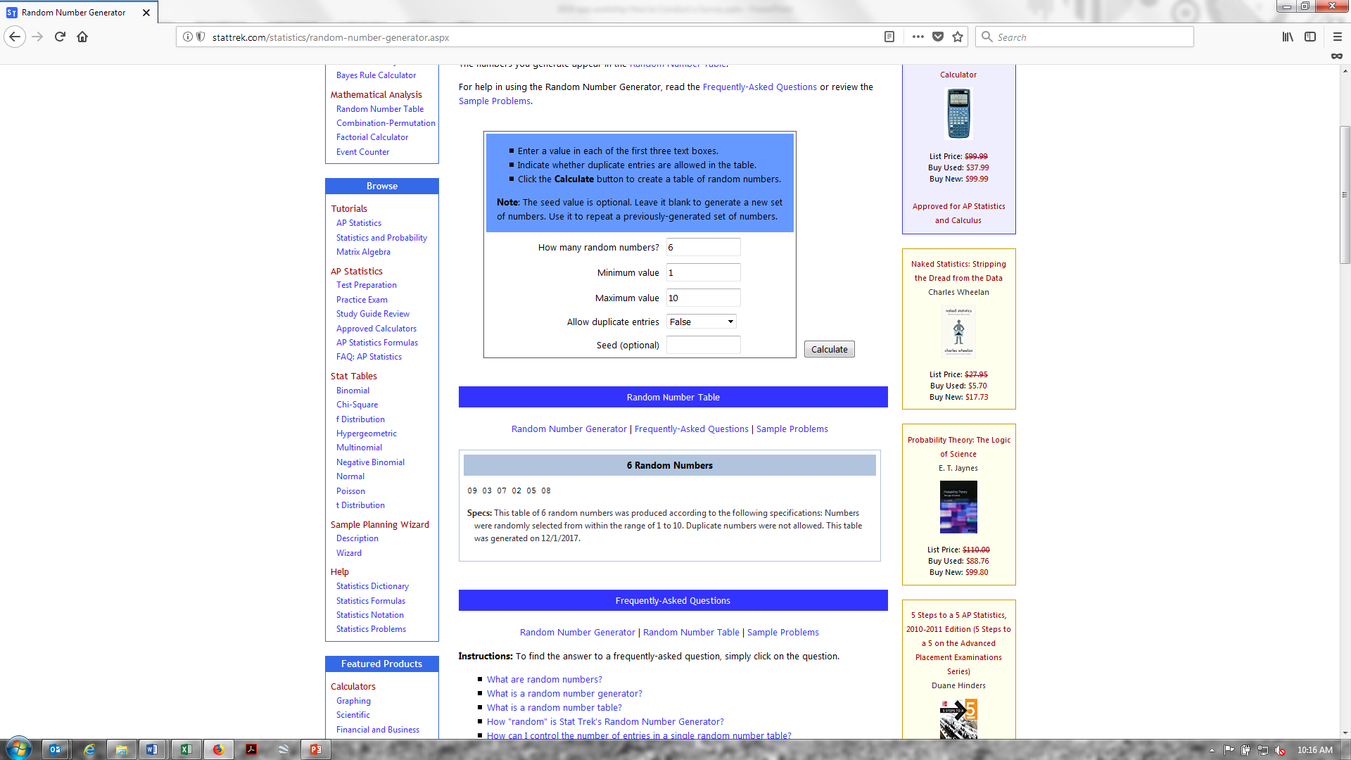
Changes to Appendix C
http://stattrek.com/statistics/random-number-generator.aspx

Slide 10
Changes to Appendix C
Random Sampling (continued)
Based on the Random Number Generator, and using the Universe example, we would select:
Assigned # Address___
  1 123 Happy Lane
  2 125 Happy Lane
  3 127 Happy Lane
  4 129 Happy Lane
  5 131 Happy Lane
  6 133 Smiley Place
  7 135 Smiley Place
  8 137 Smiley Place
  9 139 Smiley Place
  10 141 Smiley Place

Slide 11
How to Conduct a Survey
Important Considerations for Interviewers
Interviewers should attempt to contact respondents at a time when most likely to get high response rate
Interviewer should ensure each respondent is asked the exact questions as other respondents
Interviewers should ensure questions are not biased or “loaded” – questions should not imply that lower reported incomes equals higher probability of area receiving CDBG funding

Slide 12
How to Conduct a Survey
The following slides provide more survey methodology information and detail

Slide 13
Low and Moderate Income (LMI) Benefit
Documenting LMI Benefit (i.e., meeting a National CDBG Objective requirement) for the CDBG project:
Direct Count
Area Benefit
Area Benefit Surveys
DCA Form 6 Instructions

Slide 14
I. Documenting LMI Benefit
Two Methods
Direct count based on client records
  Housing
  Job Creation such as Employment Incentive Program (EIP), etc.
  Limited Clientele for Community Services Buildings
    Health Centers, Senior Centers, etc.
Area Benefit
  Public Infrastructure and other Area Benefit projects

Slide 15
I. Documenting LMI Benefit – Cont’d
I. A. Direct Count - Limited Clientele Benefit (LMC)
Some clientele can be assumed to be LMI
  Only need a count of the # of people
  Those Assumed LMI (Not for Area benefit):
    Elderly
    Severely Disabled
    Homeless
    Battered or Abused Men, Women or Children
    Migrant Workers
    Persons living with AIDS
    Illiterate

Slide 16
I. Documenting LMI Benefit – Continued
I. A. Direct Count - Limited Clientele Benefit (LMC) – Cont’d
If clients are not assumed to be LMI (e.g., Health facility clientele, etc.), the documentation of the number of persons to benefit must include family size and income data

Slide 17
I. Documenting LMI Benefit – Continued
1. B. Area Benefit Surveys
Area Benefit projects include:
  Water and sewer projects
  Streets and drainage projects, etc.
Count everyone in area to benefit
  All residents on a street
  Separate target areas…NOTE: One very low income area can not qualify a non-low and moderate income area - even if overall benefit exceeds 70% minimum

Slide 18
I. Documenting LMI Benefit – Continued
1. B. Area Benefit Surveys – continued
When properly conducted, Area Benefit Surveys Can be Accurate
Refer to the Applicants’ Manual – Appendix C, to determine when a 100% survey is required versus a Sample Survey
Prefer 100% survey for a small area
Large area may require a sample survey, such as a:
  Water Storage Facility
  Treatment Facility

Slide 19
I. Documenting LMI Benefit – Continued
1. B. Area Benefit Surveys – Continued
The goal of a sample survey is to make an accurate inference about a population based on a survey of a smaller or sample group
Sample surveys can be, generally, accurate if properly conducted

Slide 20
I. Documenting LMI Benefit – Continued
1. B. Area Benefit Surveys - Continued
Sample Standards
  Must be large enough - determination of sample size is based on population
  Table 2 (located in the Applicants’ Manual - Appendix C) gives required minimum sample size based on population or “universe”
  Example:
    100 to 115 households requires a sample of at least 90 households
    651 to 1,200 households requires a minimum sample of 300 households

Slide 21
I. Documenting LMI Benefit – Continued
1. B. Area Benefit Surveys - Continued
Must be a systematic and random selection (using a random number generator) of families to be surveyed so that each family has an equal chance of being selected
Going door-to-door (e.g., every other address) until you accumulate enough surveys to meet the minimum sample size is not random.
Guide provides more information regarding selection methods (See Applicants’ Manual, Appendix C)

Slide 22
II. DCA Form 6 – Instructions
See Applicant’s Manual, page 65
Must describe detail on how the information was determined (survey methodology).
If a survey (100% or random) is used, DCA-6 must include:
  Description of how the # of households was determined
  Description of how sample was selected
  Describe a random sample method (if applicable)
    See Appendix C for guidance
  Description of how the survey was conducted (Who and When)
  Provide a copy of the actual survey form
  A table of the results is helpful
Prior to funding decisions we may ask for copies of all surveys completed
Must keep all information for DCA review

Slide 23
II. DCA Form 6 Instructions - Continued
Basic data that must be included on DCA-6:
  # of households in area
  # of households interviewed (Note: a vacant house is not a household)
  # of LMI households interviewed
  # of people living in LMI households
  # of above LMI households interviewed
  # of people living in above LMI households
  Remember to use the LMI worksheet (Appendix C – page 10) for sample sizes of less than 100 percent.

Slide 24
II. DCA Form 6 Instructions - Continued
Example – Survey DCA-6

Slide 25
II. DCA Form 6 Instructions - Continued
Example – Survey Methodology Description

Slide 26
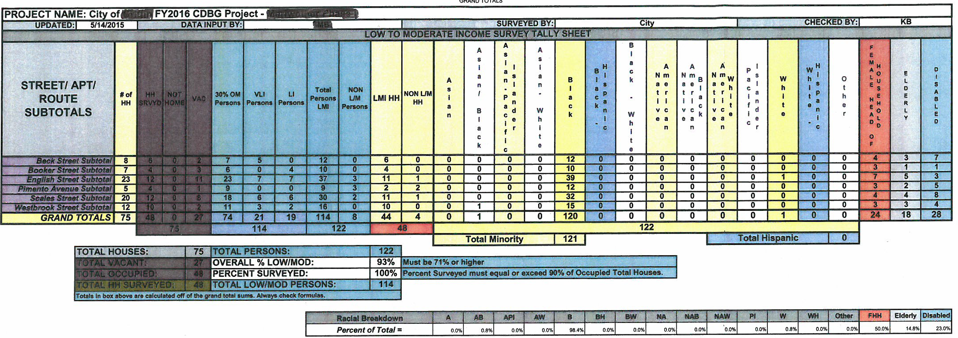
II. DCA Form 6 Instructions - Continued
Example - Survey Summary

Slide 27
For community-wide projects:
HUD Website for LMI estimates for all cities and counties.
https://www.hudexchange.info/programs/acs-low-mod-summary-data/acs-low-mod-summary-data-block-groups-places/

Slide 28
Questions?
Michael Casper, CDBG Compliance Manager
  (404)679-0594 or michael.casper@dca.ga.gov

