Slide 2
Topics covered
A) Who needs to fill out the HOME Rent Review Form and why?
B) How to locate the 2023 HOME Rent Review Form
C) How to complete the 2023 HOME Rent Review Form
D) Review of the Instructions
E) Review of the submission
F) List of links to resources

Slide 3
A) Who needs to fill out the HRR form?
Owners and/or Property Managers of HOME-assisted properties regardless of who carries out the property management function, type of ownership, property size, or location. Please submit all documents for the HOME Rent Review no later than September 30, 2023.
Why?
The HOME Participating Jurisdiction (PJ)/ DCA/GHFA is accountable to HUD for the compliance and performance of the properties and activities it finances with HOME funds during the HOME affordability period.

Slide 4
B) How to locate the HRR Form
DCA.GOV > PROGRAMS > SAFE AND AFFORDABLE HOUSING > RENTAL HOUSING DEVELOPMENT > COMPLIANCE MONITORING > FORMS (UNDER DOCUMENTS) > 2023 HOME RENT REVIEW FORM hrr_form_for_2023_0.pdf (ga.gov)

Slide 5
www.dca.ga.gov

Slide 6
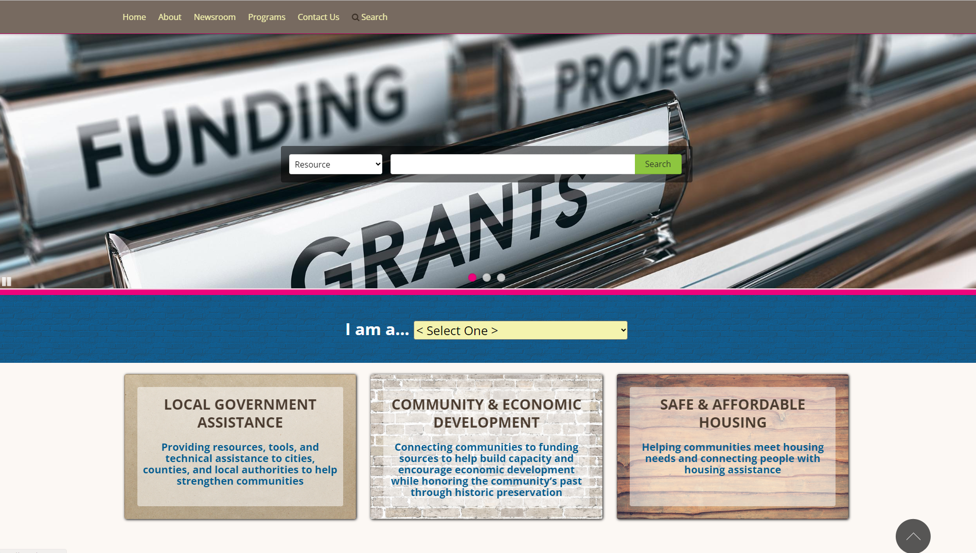
Click on SAFE & AFFORDABLE HOUSING

Slide 7
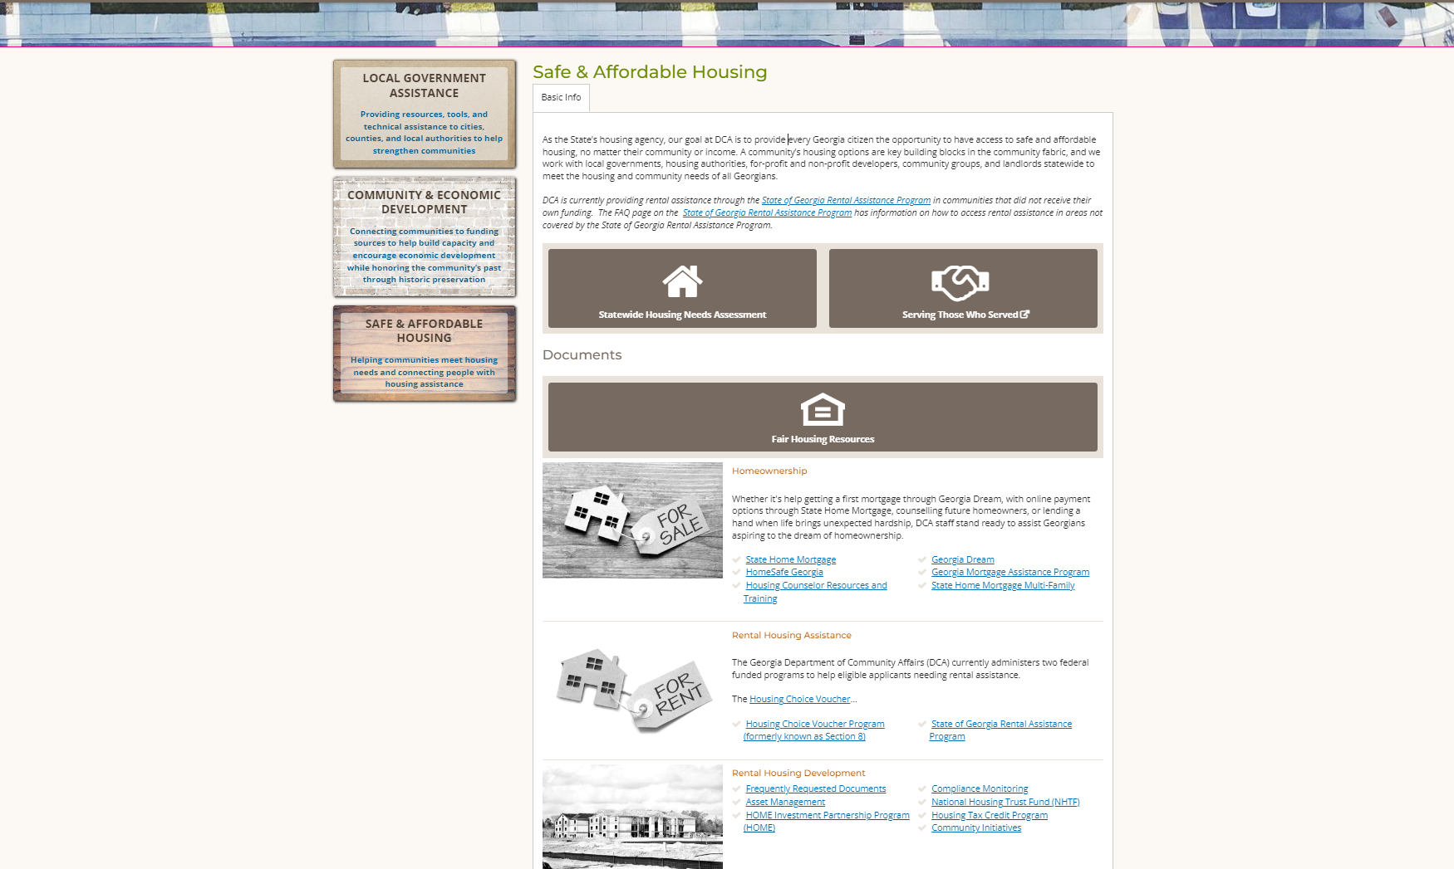
Scroll down to Rental Housing Development – Compliance Monitoring

Slide 8
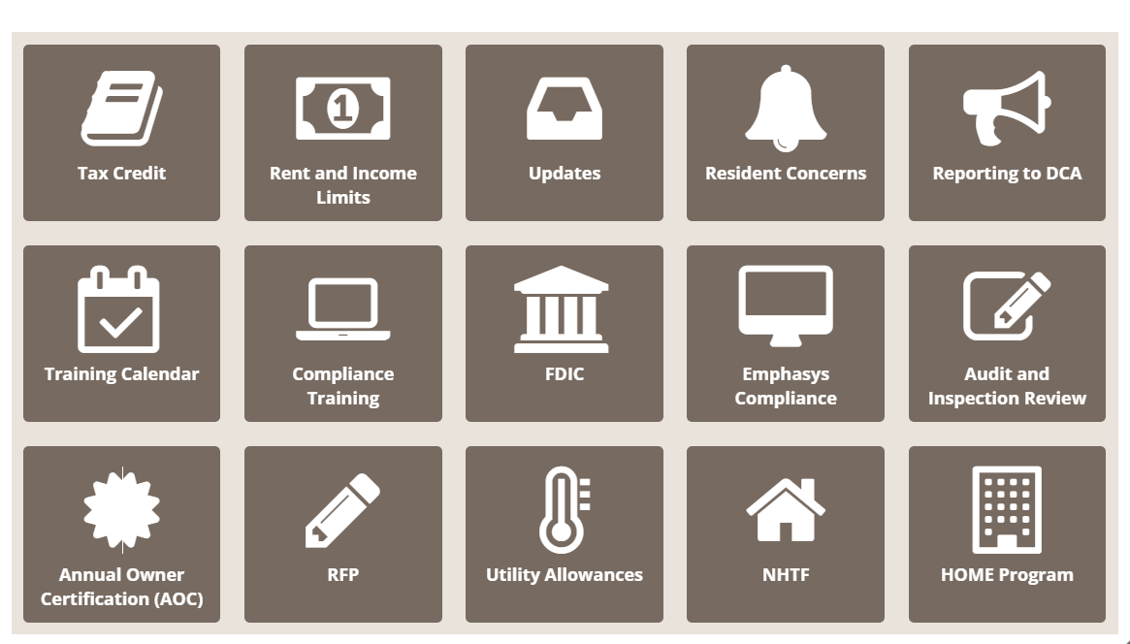
Click on the HOME Program tile.
You’re Almost There!!

Slide 9
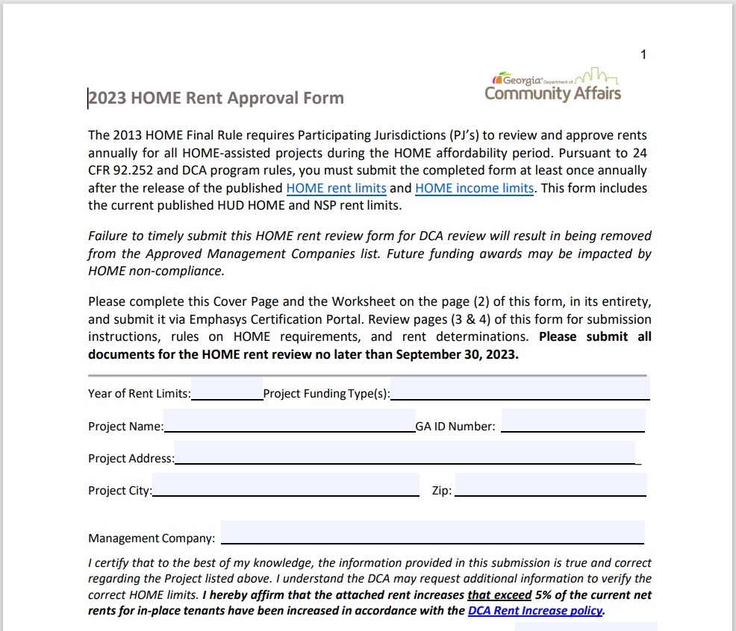
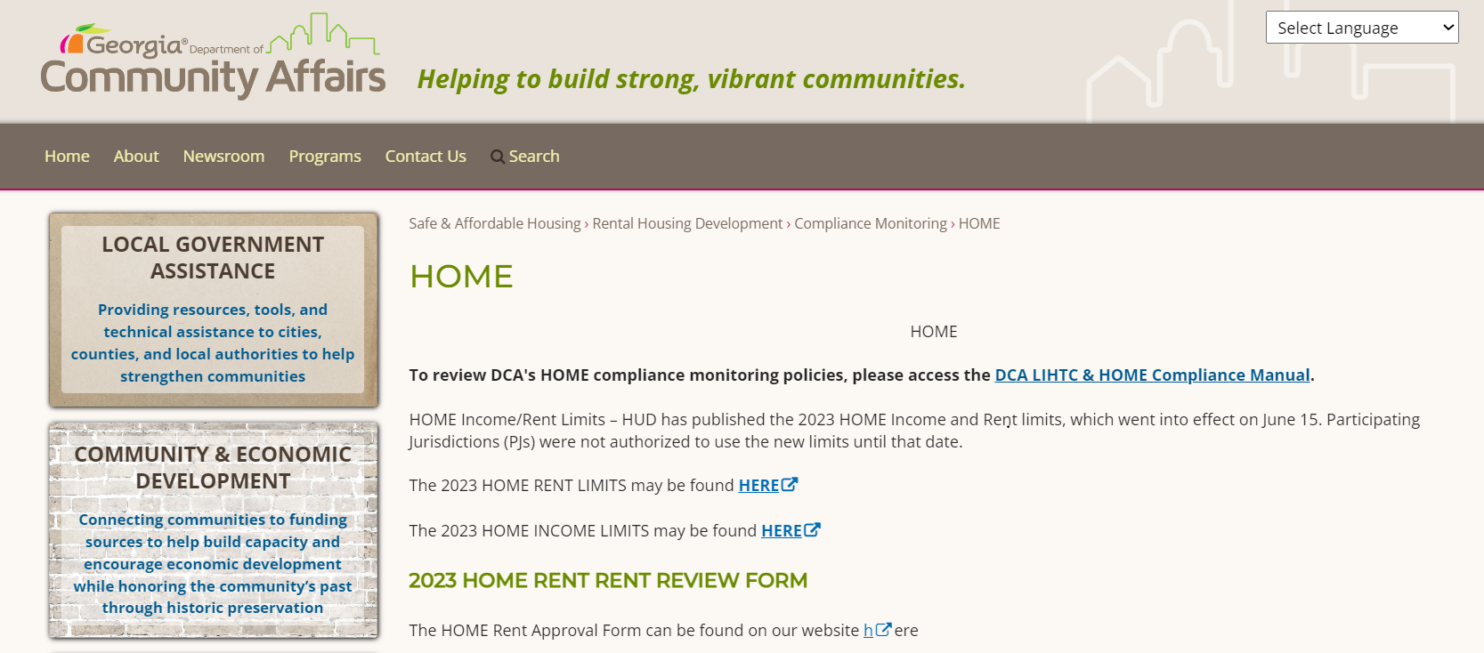
Click on the 2023 HOME RENT REVIEW FORM

Slide 10
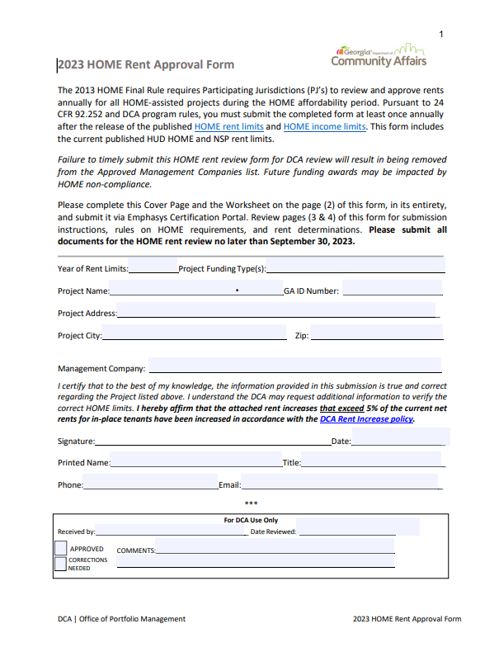
Sample
The HRR Approval Form
Each year a new form is released by DCA
The HOME limits are released July 15th
The HOME Rent Approval Period runs July 15th of the current year to July 14th of the next year

Slide 11
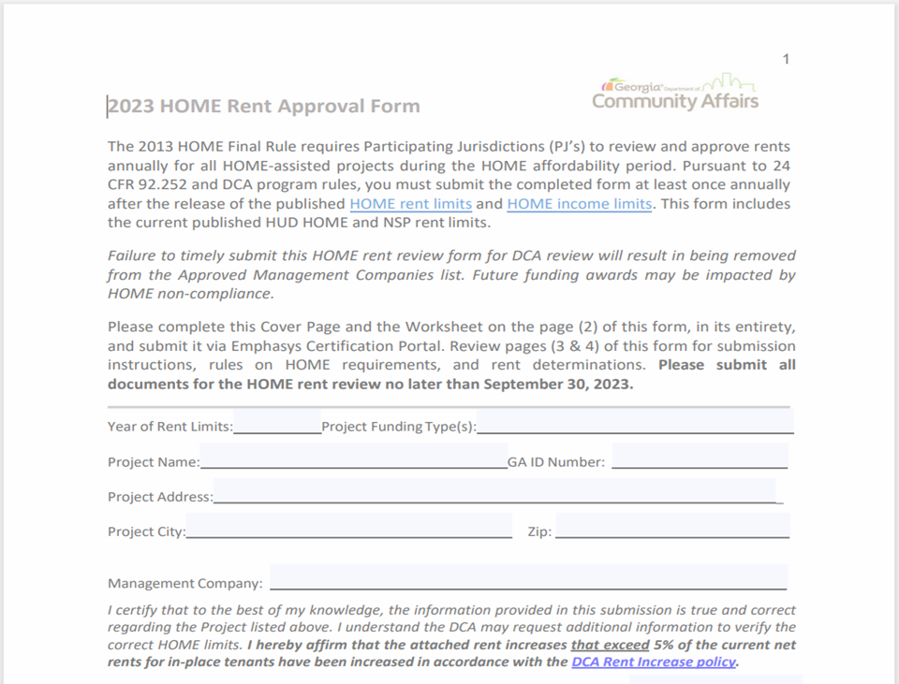
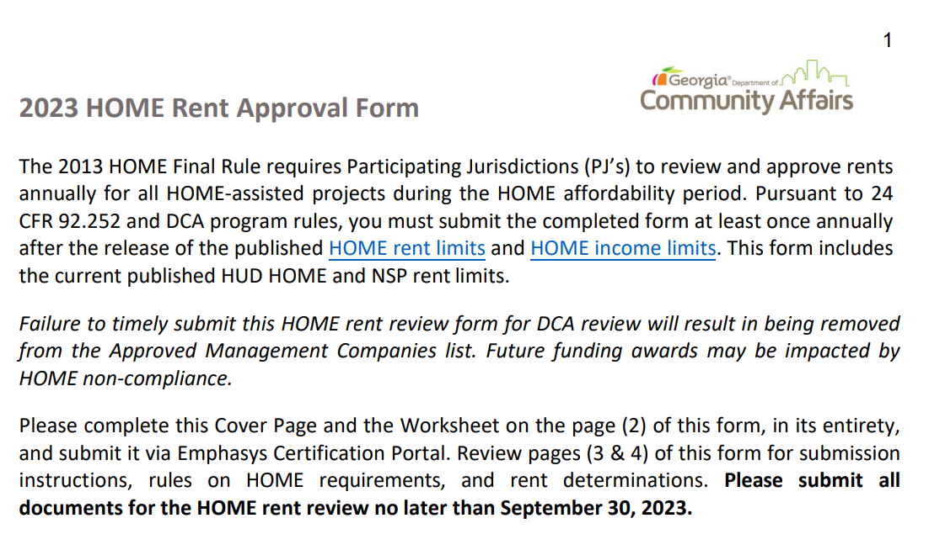
C) How to complete the 2023 Home Rent Review Form

Slide 12
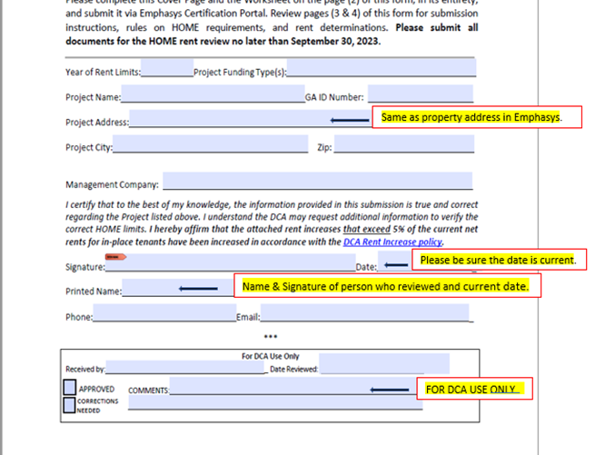

Slide 13
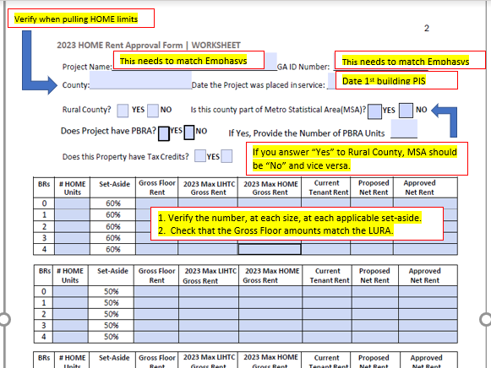

Slide 14
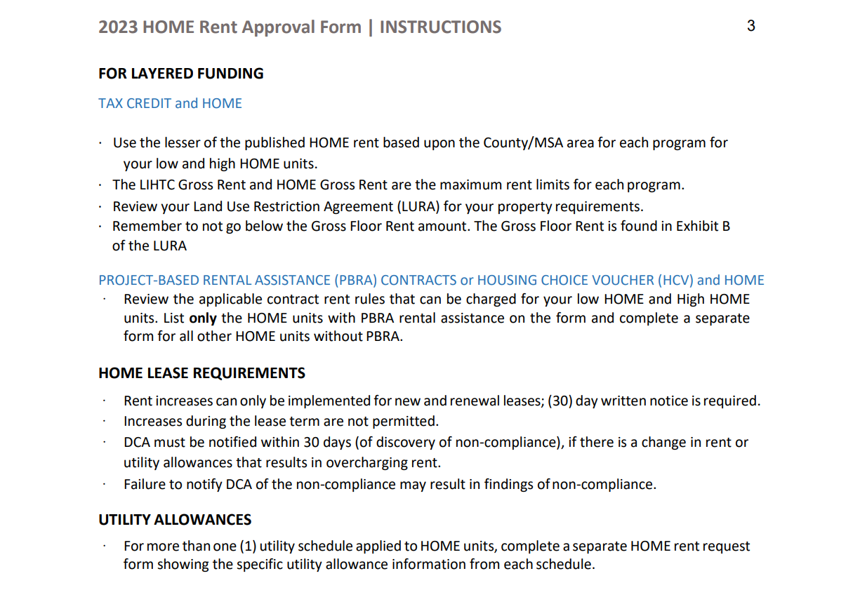
D) Review the Instructions

Slide 15
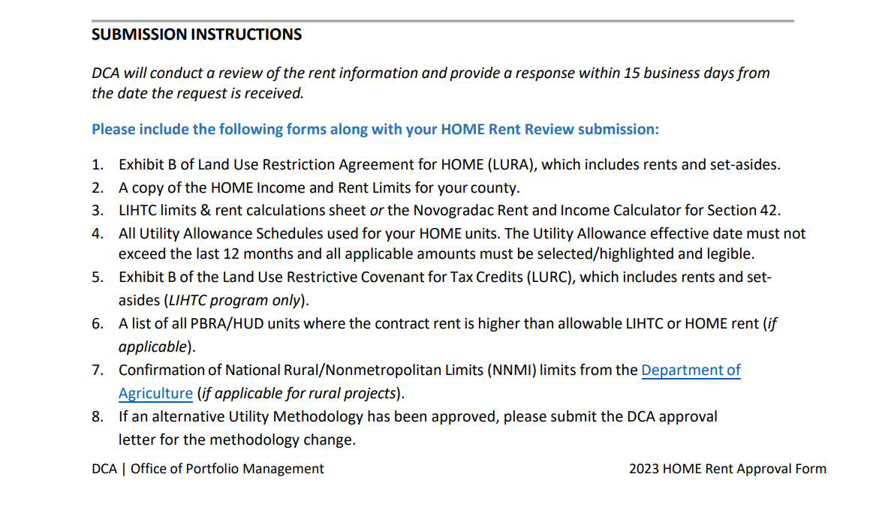
E) Review the Submission

Slide 16
Upload and Save
Using the Emphasys Certification portal

Slide 17
F) List of links to resources
DCA website: www.dca.ga.gov
HOME Rent Review Approval Form: hrr_form_for_2023_0.pdf (ga.gov)
HOME Rent Limits: HOME Rent Limits - HUD Exchange
HOME Income Limits: Version 9.4 SAS System Output (huduser.gov)
DCA Rent Increase Policy: Rent Limits | Georgia Department of Community Affairs (ga.gov)
Department of Agriculture: Rural Development (usda.gov)
Emphasys Certification Portal: Emphasys Certification Portal - System Login (emphasys-hft.com)
Additonal Resource: Novogradac | (novoco.com)
For additional support: Compliance@dca.ga.gov

Slide 18
Thanks!
Tarika Dorner
Tarika.Dorner@dca.ga.gov
Cell: 470.521.7301
Trainer
dca.ga.gov

