Slide 1
OneGeorgia Equity: Funding Community Strategies
November 14, 2019
Anna Hensley, OneGeorgia Program Manager

Slide 2
Topics of Discussion
1.) OneGeorgia Equity Program Overview
2.) Eligible Activities
3.) OneGeorgia Success Stories
4.) Utilizing OneGeorgia to Implement Comprehensive Plans
5.) Questions

Slide 3
Purpose
The OneGeorgia Authority exists to promote the health, welfare, safety and economic security of rural Georgians through the development and retention of employment opportunities in rural areas and the enhancement of infrastructures which accomplish that goal.

Slide 4
OneGeorgia History
Established in 2000
Program utilized one-third of Georgia’s share of the Tobacco Master Settlement Agreement to assist the state’s most economically challenged areas
Now funded by state funds, through an annual allocation from the General Assembly

Slide 5
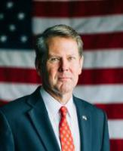
Governing Board
Governor Brian Kemp Chairman
Lieutenant Governor Geoff Duncan
Kelly Farr, Director Office of Planning and Budget
Commissioner Christopher Nunn, Department of Community Affairs
David Ralston, Speaker of the Georgia House of Representatives
Commissioner Pat Wilson, Department of Economic Development
Commissioner David Curry, Department of Revenue

Slide 6
OneGeorgia Equity
The OneGeorgia Equity Fund provides financial assistance to eligible rural communities to help build capacity and the necessary infrastructure for economic development.
The Program is designed to serve as a flexible community and economic development tool, providing grants and loans for eligible projects in rural Georgia.

Slide 7
Eligible Applicants
Who can apply for OneGeorgia Funds?
Cities
Counties
Local Government Authorities
Joint or Multi-County Development Authorities
All applicants must be located in a OneGeorgia eligible or conditionally eligible county

Slide 8
OneGeorgia Eligibility Map

Slide 9
Funding Availability
Up to $500,000 in grant or loan
Single County project - $200,000
Two Counties - $300,000
Three Counties with regional support - $500,000

Slide 10
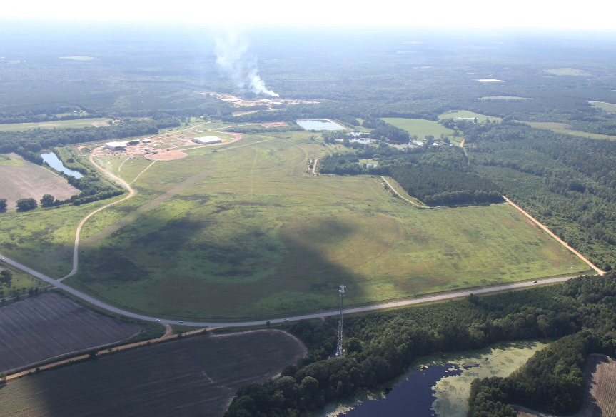
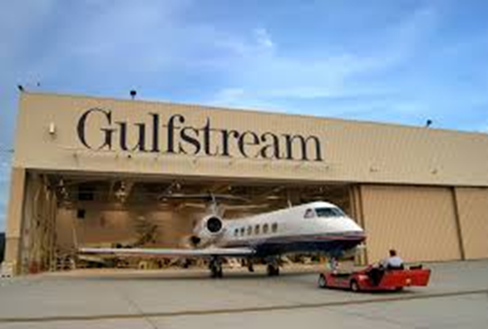
Program Goals
Enhancing Regional Competitiveness
Facilitating Business Growth

Slide 11
OneGeorgia Equity Grants
OneGeorgia Equity grants can be used toward publicly-owned infrastructure projects to build capacity and support economic development in rural Georgia.

Slide 12
Eligible Activities
Grants for Publicly-Owned Assets
Water
Sewer
Street & Drainage
Rail
Site Preparation
Land Acquisition

Slide 13
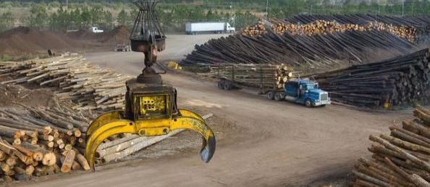
Water/Sewer Infrastructure
Development Authority of Peach County Southern Flavor Farms
City of Hazlehurst
Water Infrastructure for Fire Suppression at JA Yawn Road

Slide 14
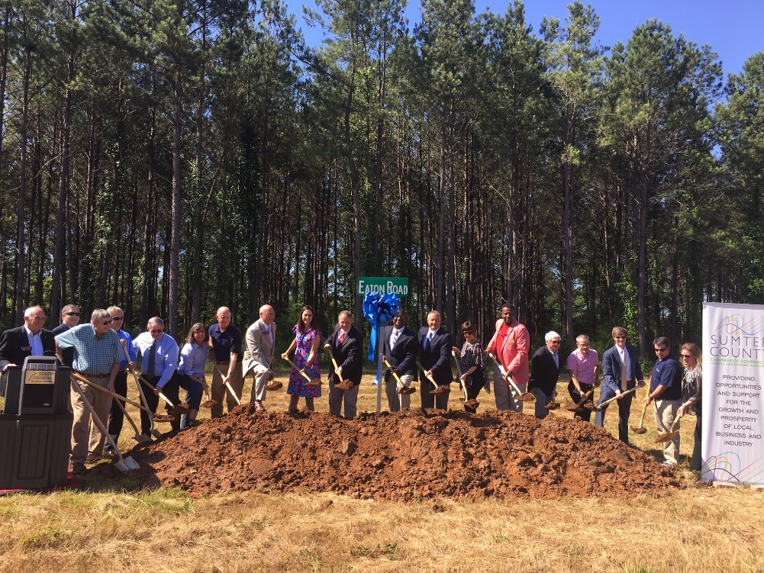
Street & Drainage Infrastructure
Fitzgerald & Ben Hill County Development Authority, Highway 319 Business Park
Americus-Sumter Payroll Development Authority, Eaton Road Groundbreaking

Slide 15
Land Acquisition/ Site Preparation
Development Authority of Jasper County
Land Acquisition for Minneta Crossing Industrial Park
Development Authority of Bulloch County
Site Preparation at Southern Gateway Industrial Park

Slide 16
OneGeorgia Equity Loans
Speculative Buildings:
Zero percent interest loan
20-year term with a 5-year deferment
Business Growth:
Machinery & Equipment 3% interest, 5-7 year term
Construction: 3% interest, 20 year term

Slide 17
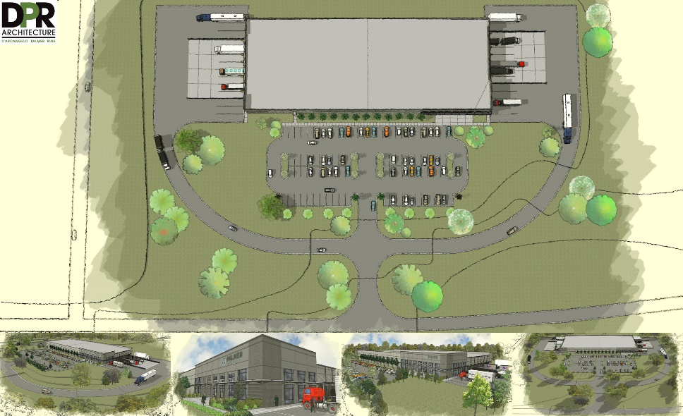
Speculative Buildings
Fannin County Development Authority
Ed’s Supply created 10 new jobs and $1 million investment
Screven County Industrial Park
$500,000 Loan
Currently Under Construction

Slide 18
What makes a great project?
Regional Impact
Community Strategy & Vision
Feasibility & Thorough Application
Demonstrated Need
Community Support & Collaboration
Regional Support

Slide 19
Funding Community Strategies
OneGeorgia can be a helpful tool in implementing your community’s plan
OneGeorgia Equity funds can be used to lay the groundwork for future development through Capacity Building
Review Short-Term Work Program to identify potential projects

Slide 20
City of Moultrie Philadelphia College of Osteopathic Medicine
$500,000 grant for water & sewer
$28,918,389 total project cost
27 Full-Time faculty and staff
Current Enrollment: 59 students

Slide 21
Stanton Springs JDA of Jasper, Morgan, Newton and Walton Counties
3 OneGeorgia Awards to develop 1,600-acre regional technology park
-2008 Equity
-2012 EDGE
-2018 Equity
$43.2 Billion Private Investment Leveraged
1,500 New Jobs

Slide 22
Coffee County Premium Peanut, LLC
$500,000 grant for street/drainage infrastructure
121 Jobs Created
$50 million Private Investment

Slide 23
OneGeorgia Equity Program Accomplishments
384 Direct Awards totaling $155,553,787
$2,379,884,060 Private Investment Leveraged
18,565 Jobs Created/Retained

Slide 24
How to Apply
Contact your DCA Regional Representative
Submit a Pre-Application, available at the DCA Website: https://www.dca.ga.gov/community-economic-development/funding-programs/onegeorgia-authority
Applications are accepted on quarterly basis with deadlines in January, April, July, and October

Slide 25
Questions?

Slide 26
Anna Hensley
OneGeorgia Program Manager
anna.Hensley@dca.ga.gov
404-679-4912

