Slide 1
Changes for 2018
December 5-6, 2017
2018 CDBG Applicants’ Workshop

Slide 2
Deadlines
If not met, applicant will not be eligible to receive funding

Slide 3
Deadlines – April 2, 2018
Annual Competition Application
Revitalization Area Strategy Application
Exceptions to the “Every Other Year” Rule
Applicants must have a current WaterFirst, PlanFirst, or GICH designation as of April 2, 2018

Slide 4
Deadlines – July 2, 2018
Timeliness Deadline
Sixty percent for those grant awarded in 2016
Deadline for Submission of Bonus Point Documentation*
Deadline for RLF Compliance
Submission of RLF Closeout for Bonus Points
*Annual Competition applications are required to be complete at the time of submission on April 2, 2018 except that additional documentation may be submitted for bonus points or leverage until July 2, 2018

Slide 5
Deadlines – August 3, 2018
Proposed CDBG Project must be included in Service Delivery Strategy
Service Delivery Act (HB 489)
QLG/Comprehensive Planning
DCA Local Government Finance Report requirements
Government Management Indicators Survey
Local Government Audit Act

Slide 6
Forms
DCA 1 - 13
Civil Rights Certification
Evidence of Compliance with SAM (through award date – October 31, 2018)
Acknowledgement of LAP Requirement
LAP Threshold Certification

Slide 13
Pre-Award Public Hearing in Spanish?
Yes, if
Applicant jurisdiction with more than 5% LEP, or
With 1,000 or more LEP persons
Where is the data?
Use the most recent data release of American Community Survey Table B16001 (Language Spoken at Home by Ability to Speak English for the Population 5 Years and Over) and Table S1601 (Language Spoken at Home) published in December of each year. Please source all data provided to DCA.
See Appendix R for Template and Guidance
See Appendix T for Pre-Award Public Hearing in Spanish

Slide 14
Service Delivery Strategy
Service Delivery Strategy (O.C.G.A. §36-70-20): State law requires that all projects funded be consistent with the community’s adopted Service Delivery Strategy (O.C.G.A. §36-70-20). The appropriate citation of the Strategy along with attachments and service area maps should be included in the application, along with a signed certification that the project is consistent with the Strategy. Maps should include the project area, or facility, in relation to the approved service area for that activity. If the project is not covered by the adopted Strategy by August 3, 2018, it will not be eligible for funding. Note that certain types of applications are not routinely included in Service Delivery Strategies. These may include Senior Centers, Boys and Girls Clubs and other types of services to limited clientele.

Slide 15
Appendix C
Guide to Acceptable Survey Methodology: The Guide to Acceptable Survey Methodology has been updated to prohibit the use of a “random” start for the initiation of a survey. A random number generator must be used when selecting the households to be surveyed. See Appendix C for further details.
See Michael Casper’s presentation on random sample surveys
RAS – now allows surveys to establish 20% poverty for relevant block groups

Slide 16
Building/Limited Clientele Applications
Wording change…
applicants for buildings must provide additional information regarding ownership, leasing and building maintenance arrangements.

Slide 17
Water and Sewer Rates
DCA currently uses the standard that water charges of .7% or greater of median household income and sewer charges of .7% or greater of median household income begin to demonstrate a significant local effort in meeting water/sewer infrastructure needs

Slide 18
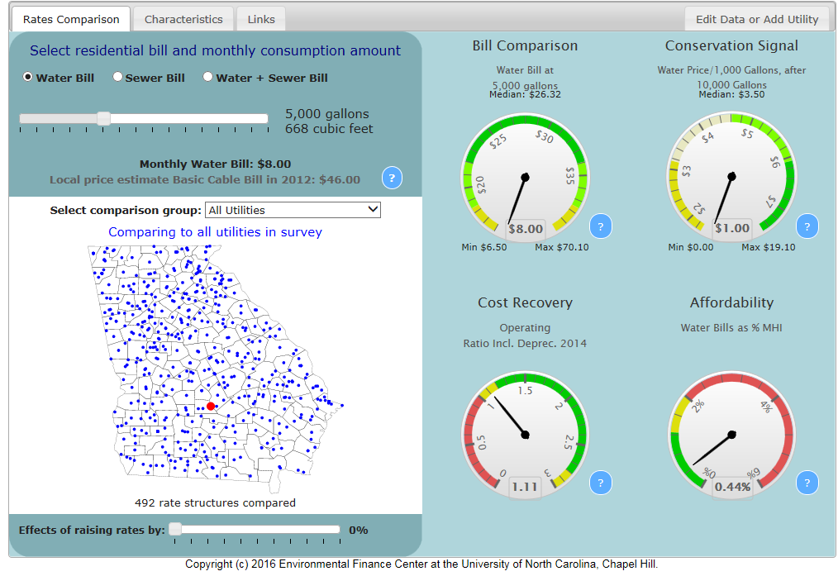

Slide 19
Other Reminders
Check water and sewer rates early at:
http://www.efc.sog.unc.edu/reslib/item/georgia-water-and-wastewater-rates-dashboard

Slide 20
PERs/PARs
Note that many street and drainage PERs are not including preliminary hydrologic and hydraulic calculations. These calculations are critical for DCA’s review of these projects. The calculations assist in determining the need for improvements and the appropriateness of the proposed solutions to those needs. Scores will be reduced if preliminary calculations are not provided.

Slide 21
Maps
Maps –
“All applicants, regardless of the type of application submitted, must submit a map where the target area, or facility, is located in relation to the jurisdiction’s Service Delivery Strategy for that activity.”

Slide 22
Leverage for PERs/PARs and Grant Writing
DCA will count up to $5,000 each toward the cost of grant writing services or the cost of preliminary engineering/architectural reports provided that adequate documentation is included in the application.

Slide 23
Other Reminders
Applicants should address applicable compliance areas
Section 3; AFFH; LEP; URA; LBP; Davis-Bacon, NEPA, etc.
Use the 504 meeting checklist
Ongoing Maintenance &Operations
Do more than sign letter stating that M&O will be followed
For example, policies or ordinances to prevent future problems
Should provide analysis of ongoing effort
E.g., capital improvement budget

Slide 24
Other Reminders
Resident letters:
Make sure that resident letters are good documentation
No type written letters that are illegibly signed
Survey comments are OK, but are not the best form of documentation of resident concerns
Establishes residents’ concerns but additional documentation required
Web site update

Slide 25
Bonus Points for Readiness to Proceed
A maximum of 25 bonus points may be earned through the demonstration of a project’s readiness to proceed.
Points may be earned through documentation in the application that:
Procurement documents/processes are ready to proceed
NEPA review and required notices for wetlands and floodplains are in process or have been completed
All engineering and architectural plans are finalized and have been submitted to the appropriate local, state or federal authorities
All real-estate (including easements and right of ways) needed for the project has been identified or acquired in accordance with applicable requirements and is available for the project;
Contract documents are finalized and approvals have been received from appropriate local authorities, bid packages ready to be distributed.

Slide 26
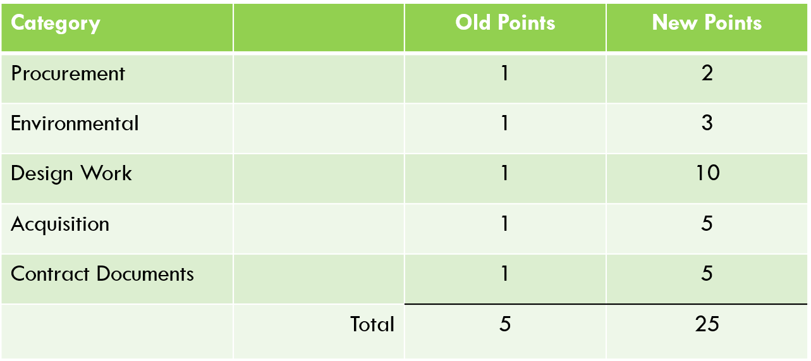
Bonus Points – New Values

Slide 27
Bonus Points (continued)
Procurement. These bonus points refer to procurement of professional services in accord with all DCA requirements.
If either the grant administrator or the architect/engineer is procured, 1 bonus point will be assigned.
If both are procured, 2 bonus points will be assigned.
Remember Section 3 for professional services procurement
Required Documentation
Applicant must provide a letter signed by the Chief Elected Official stating the CDBG procurement process has been followed and identifying the firm(s) that has been selected.

Slide 28
Bonus Points (continued)
Environmental Review. A maximum of 3 points may earned for completing different parts of the Environmental Review.
1 point for completing the tribal consultation process.
Documented by a copy of the tribal consultation letter(s) and the response letter(s) or a memo documenting no response(s) received.
1 point for the SHPO response letter
Documented by a copy of the response letter
1 point for full release of funds

Slide 29
Bonus Points (continued)
Architectural and Engineering Plans. A maximum of 10 points may be earned.
10 points may be earned for having the design completed and submitted to the appropriate agencies.
Documented by a letter from the Engineer/Architect that design is completed and must include a listing of the agencies to which plans have been submitted along with the dates of submission.
Neighborhood Revitalization. A maximum of 10 points may be earned.
1 point may be earned for having the rehab advisor under contract.
Documented by a letter signed by the CEO stating the procurement process has been followed and identifying the individual/firm that has been selected.
5 points may be earned for completing title searches on all proposed units.
Documented by a letter from the attorney stating that title searches on the proposed units have been completed and listing the property addresses and owners.
4 points may be earned for completing work write-ups on all units.
Documented by providing a copy of each work write-up with the application.
Plans should not be submitted to DCA.

Slide 30
Bonus Points (continued)
Acquisition Activities. A maximum of 5 points may be earned.
1 point will be given if the project does not require acquisition.
Documented by a letter from the CEO stating that no acquisition is needed.
3 points total may be earned if all acquisition has been identified and title searches are completed.
Documented by a letter from the attorney stating that the title searches on all the properties required for start of construction have been completed and listing the property addresses and owners.
5 points total may be earned for completed acquisition packages.
Documented by including easement plats for all required easements along with a valuation determination for each easement or parcel to be acquired.
Remember that all property acquired in anticipation of the proposed CDBG project regardless of the source of funding is subject to URA requirements. Non-compliance with URA requirements could lead to ineligible and non-reimbursable costs.

Slide 31
Bonus Points (continued)
Contract Documents – Public Facilities. A maximum of 5 points may be earned.
5 points may be earned for receiving all required plan approvals and/or permits from all applicable federal, state, and local agencies and having bid packages ready for distribution.
Documented by copies of approval letters and/or explanation of approval due to “no response”, and a certification from the CEO stating that the project is ready for bid.
Neighborhood Revitalization. A maximum of 5 points may be earned.
5 points may be earned for completing income verifications.
Documented by a letter from the CEO listing the names and addresses of the participants for whom income verifications have been completed.
Contract documents should not be submitted to DCA.

Slide 32
Bonus Points (continued)
Bonus points should be claimed on DCA-5.
A brief narrative should be included in DCA-5 stating the bonus points claimed and the rationale for claiming the points.
DCA-5 should clearly reference all documentation attached to the application that demonstrates accomplishment of the bonus point thresholds outlined above.

Slide 33
Questions

