Slide 1
Georgia Department of Community Affairs CDBG Economic Development
Annual Competition and Set-Aside Programs
CDBG, EIP, RDF and Capitalized RLF
December 6, 2017
Brock Smith, Gabriel Morris, Brent Allen

Slide 2
Brock Smith, Manager CDBG Set-Asides Gabe Morris, Program Manager (EIP/RDF/ITAD) Brent Allen, RLF Program Manager
December 6, 2017
Brock Smith

Slide 3
Employment Incentive Program (EIP) and Redevelopment Fund (RDF) Threshold Based “Competition” Grants
December 6, 2017
Brock Smith

Slide 4
Set-Asides Overview
Local governments can implement a broad range of activities as long as they further the National Objectives of the Act.
Three National Objectives are:
Majority benefit to low- and moderate-income persons through services and job creation;
Prevention or elimination of slum and blight;
Immediate Threat & Danger.

Slide 5
Available Funding: Georgia
CDBG Funds from U.S. Housing and Urban
Development (HUD)
HUD Authorization | $36,909,599
EIP | $8.0 million set-aside
RDF | $1.5 million set-aside
Immediate Threat | $350,000 set-aside
Notes:
These are the federal allotments for the current funding year.

Slide 6
Features of Economic Development Programs
Maximum Grant Amount | $750,000
Primary Purpose | EIP - Expand employment opportunities for L/M income people RDF – Eliminate Slum and Blight
Low/Moderate Income Benefit | At least 51% of jobs created and/or retained
Eligible Uses | Public facilities, infrastructure, business loans, elimination of Slum and Blight
Notes:
These are some basic features of the CDBG based Economic Development programs.

Slide 7
Four Routes to ED with CDBG
Annual Competition CDBG-ED application
Employment Incentive Program
Redevelopment Fund Program
Local Revolving Loan Fund (generated by CDBG-ED, EIP or RDF loans)
Notes:
(Could be eliminated)

Slide 8
Organizational Processes
Potential Project
Initial Project Assessments (EIP & RDF)
Market Successful Concepts
Local Community & Economic Development Needs
Application Development & Submission
Monitor & Audit
Manage Projects
Award / Denial
Final Structure of Assistance
Review & Underwrite Application
Notes:
(Could be eliminated)

Slide 9
What exactly is this IPA?
Initial Project Assessment (DCA)
The Who, What, Why, When and Where of a Project;
Determines and Preserves Eligibility of activities and costs;
Enables Pre-Agreement Cost Approval (PACA) which is
especially important for federal funds;
Ensures all available funding sources are considered; and
Provides an idea how competitive your project might be.

Slide 10
Process - What happens after I submit an IPA?
PACA
Provides guidance for application development
Initial Project Assessment EIP/RDF
Application Development
Completeness Letter
Completeness letters help identify shortcomings in the application
Since EIP and RDF funding is “threshold-based”, the completeness letter allows for Technical Assistance to get applications to funding range.
Application Submission and Completeness Check
Notes:
Community contacts DCA Field Representative about a potential project. In some cases, various funding sources may be considered for funding on a large-scale project.
Ideally, DCA conducts an Initial Project Assessment visit to assist a potential applicant in understanding process & programs.
DCA reviews IPA and issues/denies PACA.
If PACA granted, establishes the point from which costs are eligible and promotes efforts to address federal requirements.
Community prepares and submits application for DCA review. If the application is incomplete, the applicant is notified in writing of items needed to allow for a competitive application.
Application reviewed based on rating and selection criteria.
Award or denial of application.
Grant/loan management processes start – technical assistance provided through site visits.
Monitors project at intervals to ensure compliance with Award.
Everyone has expertise to bring to the table.
Not all partnerships are financial, but draw on expertise in areas such as scientific vetting from the University System or Georgia Technology Authority.

Slide 11
Rating and Selection Criteria:
EIP – 300 Point Threshold
Demographics
120 maximum points
Determined by County level Census Data
Feasibility
110 maximum points
27.5 points per level
Impact
110 maximum points
27.5 points per level
Strategy
110 maximum points
27.5 points per level
RDF – 375 Point Threshold
Demographics
120 maximum points
Determined by County level Census Data
Feasibility
210 maximum points
52.5 points per level
Strategy/Innovation
240 maximum points
60 points per level
Leverage of Additional Resources
30 maximum points
10 points per level
Notes:
Demographics is based on census information and cannot be impacted by the application materials.
All other scoring elements are determined by the information you present in the application.
The application materials and supporting documentation can be the difference between a 4 and 5.

Slide 12
EIP GRANT: PUBLIC INFRASTRUCTURE Gabriel Morris, Program Manager
December 6, 2017
Gabriel Morris, Program Manager

Slide 13
EIP Grant Program
Eligible Activities | Ineligible Activities
Public Facilities Public Infrastructure Acquisition, Construction, and/or Rehabilitation of: Water; Sewer; Roads; Storm water drainage; Rail Spurs; Other. | Working Capital Refinancing Speculative Projects Capacity Building General Conduct of Government Project Not Meeting Federal Guidelines Using Federal Funds to relocate businesses (Piracy - There are Restrictions)
Notes:
Water: lines, tanks, wells, treatment plants;
Sewer: gravity lines, force mains, pump stations, treatment plants, land application “spray fields;”
Roads: access, turn lanes, accel/decel lanes, paving;
Stormwater drainage: ditches, pipes, culverts, ponds;
Rail spurs: switches (excluding mainline switch), track, track base, derails, stops; and
Other: wastewater pretreatment plant.

Slide 14
EIP Infrastructure Grants
Financial Considerations Include an Assessment of:
Infrastructure Fund Capacity Analysis (IFCA)
Examine financial capacity of local government
Calculate operating and coverage ratios
Revolving Loan Fund Capacity
Notes:
When an application is reviewed, a primary component is the financial needs of the local government.
Grant award amounts may be adjusted if the local government appears to have other available funds.

Slide 15
EIP GRANT: LOAN TO PRIVATE FOR-PROFIT BUSINESS Gabriel Morris, Program Manager
December 6, 2017
Gabriel Morris, Program Manager

Slide 16
EIP Direct Loan Program
Eligible Activities | Ineligible Activities
Acquisition of land and buildings New construction Renovation to existing buildings Acquisition of M&E Limited soft costs* * Costs directly related to the fixed asset expenditure. Examples include: architectural/engineering costs; installation costs for machinery; and financing costs for bank loans. | Working capital Capacity building Refinancing Inventory/receivable financing Speculative real estate development Relocation costs Office equipment, small tools, supplies General conduct of government

Slide 17
EIP Direct Loan Program
Loan Terms
Up to 15 years for financed real property;
Up to 7.5 years for financed personal property;
The interest rate is fixed at or below market rates.
Security/Collateral
1st or shared 1st priority mortgage and/or lien position on project costs/uses financed;
Personal guaranties from owners (>20% ownership);
Corporate guaranties from related companies.
Repayment
EIP Loan repayments must capitalize or be placed into a local Revolving Loan Fund (RLF).
Notes:
Purpose-Provide low-interest rate loans to small and medium sized businesses that are purchasing or improving fixed-assets.
Basic Factors to Determine Eligibility:
# Jobs created and/or retained
Within 2-yr period, 1 job /$50k of EIP funds
Owner’s Equity and Private Financing
10% minimum equity contribution
At least 40% funded by 3rd party lender
Evidence of Need
Ability to repay debt
CDBG-Eligible Activity

Slide 18
EIP Loan Disbursement
Loan Disbursement
Disbursement agreement included in the EIP loan agreement.
The Borrower’s other public and/or private financing will be disbursed on a pro-rata basis with the EIP loan proceeds.
GRANT TO APPLICANT
LOAN TO
LOCAL DEVELOPMENT AUTHORITY
LOAN TO
SUB-RECIPIENT BUSINESS

Slide 19
REDEVELOPMENT FUND PROGRAM (RDF) Gabriel Morris, Program Manager
December 6, 2017
Gabriel Morris, Program Manager

Slide 20
Overview of the RDF Program
Encourage communities with blighted properties to focus on long-term community development.
Projects must demonstrate the following:
Resolution of Spot/Area Basis Blight;
Long-term planning and development efforts of the
community;
Significant impact on the overall project;
Strong community commitment;
Ready to Proceed; and
Completed within 24 months.

Slide 21
Elimination of Slum and Blight “Spot Basis” vs “Area Basis”
Spot Basis
Spot basis activities are limited to the extent
necessary to eliminate specific conditions
detrimental to the public health and safety.
Area Basis
Area basis activities are delineated by a unit of
local government, meets a definition of a blighted,
deteriorated, deteriorating, or slum area under
State of Local law.

Slide 22
Common Issues And Solutions
December 6, 2017
Brock Smith & Gabriel Morris
Notes:
Do not ignore this information. We see the issues we have mentioned here. Grant funds have been called back because of a lack of compliance or an inability to meet commitments.
Our goal is to try and ensure your applications are competitive and any awarded project is a successful project.

Slide 23
CDBG ED Applications
Timeline Awareness
Businesses don’t always consider the time for completing various federal requirements.
Typically, local governments contract with an administrator to ensure timelines are followed.
Typical timeline issues include:
Environmental – 90 days needed (Tribal, HPD, Notices)
Design review – can be several months (EPD, Railroad)
Acquisition – depends on the amount of acquisition needed
Submitting an application too late or too early is not advisable.
Notes:
Timeline
Government and business move at two different speeds, so coordinating the timing of a project can be tricky.
Get an administrator involved early to help ensure the required timelines are met.
Late applications may not be able to meet all required compliance guidelines.
On the other side, early (premature) applications may not develop. Keep in mind, PACA expires at one year.
Environmental Assessment (including SHPO, Tribal Consultation, Floodplain).
Acquisition – URA guidelines must be followed. Acquisition delays can derail a project.
Section 3 and Project Bid.
As an example: Railroad Timeline
Norfolk Southern will draft a Concept Plan (a rough design drawing showing the proposed spur layout). This Concept Plan is used by their Transportation Department to determine whether the proposed use can be accommodated by their regular service.
Once the local community has received notification from Norfolk Southern indicating the use can be accommodated, the Company/Local Government should engage their Professional Engineer (PE) to fully design the proposed rail spur and submit those official plans to Norfolk Southern for Design Approval. The Design Approval process can take 60-90 days to complete.
Once the design has been approved by Norfolk Southern, a notification package will be sent out which contains, at minimum, two items. 1) A Terms Letter (which outlines who owns the different areas of the rail spur and what the cost is for a Mainline Switch) and 2) a Siding Agreement (outlining operation and maintenance) will be issued to the owner of the rail spur. These two components are always included in the basic package Norfolk Southern issues. The Terms Letter must be signed, illustrating agreement with all of the terms, and a check for the amount of the Mainline Switch must be returned to Norfolk Southern.
If the user of the rail spur will be someone other than the owner (in our situation, public entity must own the rail spur and Company is the user), the package may also include a Supplemental Agreement outlining the terms of the owner user arrangement.
Once the items have been executed by all parties, the project is ready for bid and construction – no permit is necessary for work done in the railroad right-of-way because the terms for working in this area are outlined in the Siding Agreement.
The design and construction phase for a public rail spur as outlined above can take anywhere from 9 months to a full year.
Environmental Timeline
Project activities cannot commence until NEPA compliance is achieved;
HPD / Tribal – up to 30 day review;
State environmental agencies (DNR, EPD, DOT) – up to 30 day review; and
Notice publication – up to 30 day public comment period.
Environmental review process takes approximately 90 days;
Wetlands / Floodplain encroachment may requite additional time.

Slide 24
CDBG ED Applications
Engage Pertinent Partners
Local Government
Development Authority
Engineer/Architect
Business Contact
Grant Writer/Administrator
DCA Service Representative
Other federal/state programs
Owner
Railroad (if applicable)
Operator (if applicable)
Occupant (if applicable)
Notes:
Partners
Development Authority cannot be an applicant, so there needs to be a local government contact.
A direct contact with the business is necessary for gathering all of the relevant information for an application.
Third parties (railroads, other agencies, architect/engineer) should also be engaged early in the process.
For RDF, if a potential occupant is known at the time of application, they are a partner in the project.

Slide 25
CDBG ED Applications
“Paint the Whole Picture”
Provide ALL pertinent information regarding a potential
project.
All financing components must be identified and listed in the
budget forms and application narrative (DCA-5).
Include a current PER or PAR (within the last 6 to 8 months).
For RDF, indicate occupants for redeveloped facilities (if
known).
Source and Use/Budget Forms.
Notes:
Whole Picture
Outline the company structure, including affiliates, subordinates, etc.
If owner will hire a management company, the application should include detailed information on the management company and executed management contracts (if available).
There is a difference between equity and private financing. Equity is literal company cash on hand, while private financing is a loan to the company from a bank or other lending institution.
Preliminary designs and cost estimates must be available for project budget and activity description.
For RDF, if a potential occupant is known at the time of application, provide company background information with the application (business plan, # of employees, pro forma).
A Source and Use statement identifies all sources and uses.
The Budget form is for the entire project, not just the EIP/RDF.

Slide 26
CDBG ED Applications
Required Agreements
Cooperating agreement for joint applications;
Submit Draft or Executed Agreements with application:
MOU;
Intergovernmental Agreement(s);
Lease Agreements; and
Deeds.
RLF Policies and Procedures, if requesting comments on draft; and
Loan Documents – DCA can provide draft documents if loan project will require funds available at closing (not a “dry closing’).
Letter of Credit/Surety Instrument.
Notes:
Agreements
Correctly identify and note the responsible jurisdiction on the application. If it is a joint application, please provide the cooperating agreement as well as any additional documents outlined in the most current CDBG Applicants Manual.
If an agreement or partnership is mentioned in the narrative of your application, or if one appears to be necessary, provide any existing documentation whether it is draft or executed. If you don’t provide it, we will probably ask for it in the completeness letter.
The boiler plate RLF policies and procedures may are able to be adjusted based on local needs, financing strategies, etc. Please provide a draft copy of the RLF policies and procedures so DCA staff can review it as soon as possible, as there may need to be further adjustments.
Loan documents often go through many revisions between the requests of the Company and DCA requirements. Provide the DCA templates to the Company during application development so their legal team can begin the process as early as possible.
The business should be made aware of the surety requirements at the beginning of the application process. DCA Staff is available to discuss the Surety requirements with businesses, as needed. Recommend last condition to be cleared.

Slide 27
CDBG ED Applications
Local Government Compliance
Local government audits for previous 3 years;
https://ted.cviog.uga.edu/financial-documents/
Comprehensive Plan/SDS/Finance
Survey/Authority Registration; and
Department of Audits and Accounts Compliance:
Out of Compliance = Ineligible for State Funds!
Notes:
Compliance
If the local government audits are not available on TED (UGA), please provide the previous 3 years of audits so our Credit Team can conduct a proper review.
SDS is a showstopper. If the local SDS has not been approved, no funds (state or federal) can be awarded to a local government covered under the SDS.

Slide 28
CDBG ED Applications/Awards
Communicate with DCA Staff
When questions or issues arise: Guidance from Office Staff
or Field Staff;
Change Orders or Increase/Decrease in Scope: Keep DCA
informed;
10% Change in size or cost requires a Grant Amendment.
Questions or Comments on Forms.
Talk to DCA more than you talk to your Mom …
Notes:
Communicate
Do not wait for a problem to work itself out. Any issue, large or small, should be made known to DCA staff.
The earlier guidance can be provided and problem areas corrected, the less likelihood of a finding or a repayment of funds.
Gabe creates and edits the forms for the EIP/RDF. If there are questions on how to properly fill out the forms, please contact Gabe and he will provide the necessary guidance.
You should not go more than a month without any communication with DCA Staff. A lack of communication can lead to problems which cannot be corrected.
If you don’t hear from your Field Staff, you should call them. It is what they get paid for.

Slide 29
CDBG ED Awards
Contracts/Agreements
Economic Development & Construction Agreement (ED&C) –
Do Not Date!
Ensure contractor clearance is granted by DCA before work
is initiated.
Review Certified Payrolls and check Davis-Bacon Wage
Rates for any additional classifications.
The state public procurement process must be followed for
any contract exceeding $100,000.
Keep DCA staff aware of any changes to the construction
timeline, especially if it may lead to a need for requesting an
extension.
Notes:
Contracts
Agreements are dated by the final party signing the document. This is when the document is executed.
Contact DCA for Wage Rates, Contractor Clearance, Notice of Contract Action, Additional Classifications. Contact Cindi Bernhardt with any questions.
If you are not receiving payrolls, please notify DCA. We will not process drawdowns if the contractor is not submitting weekly payrolls for the grant administrator to review.
Even if a contract was originally believed to qualify for following small purchase procurement, if the contract ends up exceeding $100,000 – the project must follow state public procurement policies.
Extension requests are usually granted, when there is a reasonable need. When requesting an extension, consult with all parties on the project to ensure you are requesting enough time.

Slide 30
CDBG ED Awards
Drawdowns
Drawdowns for ED projects are conducted on a Pro-Rata
basis;
All invoicing and any voided checks must be included with
draw requests;
Update the signature card if there has been a change in
local government officials;
Drawdowns are generally processed on Tuesdays and
Thursdays;
Drawdowns will be deposited in the local account within 7-
10 business days after being processed.
Notes:
Drawdowns
Review the grant award documentation for guidance on the Pro-Rata requirements for a project. It will be indicated in the final General Condition of the Grant Award documents.
If there is a large amount of invoicing, which is common on RDF projects, provide a spreadsheet summary of the documentation. Vendor, amount, date, check #, etc.
If the authorized official changes because of an election, you must provide an updated signature card to prevent delays in the drawdown process.
Any uncommon scenarios regarding drawdown must be discussed with and approved by DCA central office.
When reviewing drawdown requests, invoicing must match or exceed the draw request.

Slide 31
CDBG ED Awards
Closeout
For EIP, provide a letter from the local government and the
Company indicating all commitments were met.
The final Quarterly Report should display the cumulative
number of jobs created and the Accomplishments tab should
reflect all of the information presented on the Employer
Summary form.
DO NOT LET THE GRANT PERIOD LAPSE.
Notes:
Closeout
Do not wait for the final Quarterly Report (QR) to start listing jobs. As the jobs are created, they should be included on the QR.
The Employer Summary form must match the information in the system. This ensures the accuracy of the information presented to HUD.
Expired grants cannot be closed out. The grant should be extended until the closeout process is complete.

Slide 32
LOCAL REVOLVING LOAN FUND (RLF) Brent Allen, Program Manager
December 6, 2017
Brent Allen, RLF Program Manager

Slide 33
Local Revolving Loan Funds
EIP/RDF loan repayments capitalize local RLF loan. The repayments (including interest), and bank account interest retain federal identity. This is considered program income.
RLFs may be used for local CDBG eligible economic development needs.
Opportunities available to partner with local banks to finance eligible activities (same as EIP) that create employment for LMI persons.
50/40/10 Rule: Project funded with 50% RLF, 40% local bank, and 10% private funding.

Slide 34
Local Revolving Loan Funds
67 active RLF’s throughout Georgia, with:
$36.7 million in RLF assets
$15.6 million in cash
$21.1 million in loan receivables
$1.3 million cash returned to DCA over the past year for
non-compliance or closure (7) of RLFs.
Encourage Local RLF’s to use RLF funds as a funding gap
for large projects – may request one-time waiver to DCA, if
necessary.

Slide 35
CONTACTS
December 6, 2017
Brock Smith

Slide 36
Community Services Representatives
Region 1 Patrick Vickers | Region 2 Kathy Papa | Region 3 John VanBrunt | Region 4 Corinne Thornton
(404) 695-2093 | (770) 362-7078 | (706) 825-1356 | (706) 340-6461
Region 5 Beth Eavenson | Region 6 Tonya Mole | Region 7 Tina Hutcheson | Region 8 Casey Beane
(404) 387-6977 | (404) 852-6876 | (478) 278-9434 | (404) 227-2860
Region 9 Lynn Ashcraft | Region 10 Gina Webb | Region 11 Kelly Lane | Region 12 Jennifer Fordham
(478) 484-0321 | (404) 387-1429 | (404) 227-3619 | (912) 531-1746
Corinne Thornton
Office Director
(706) 340-6461
corinne.thornton@dca.ga.gov
Saralyn Stafford
Division Director
(404) 679-3166
saralyn.stafford@dca.ga.gov

Slide 37
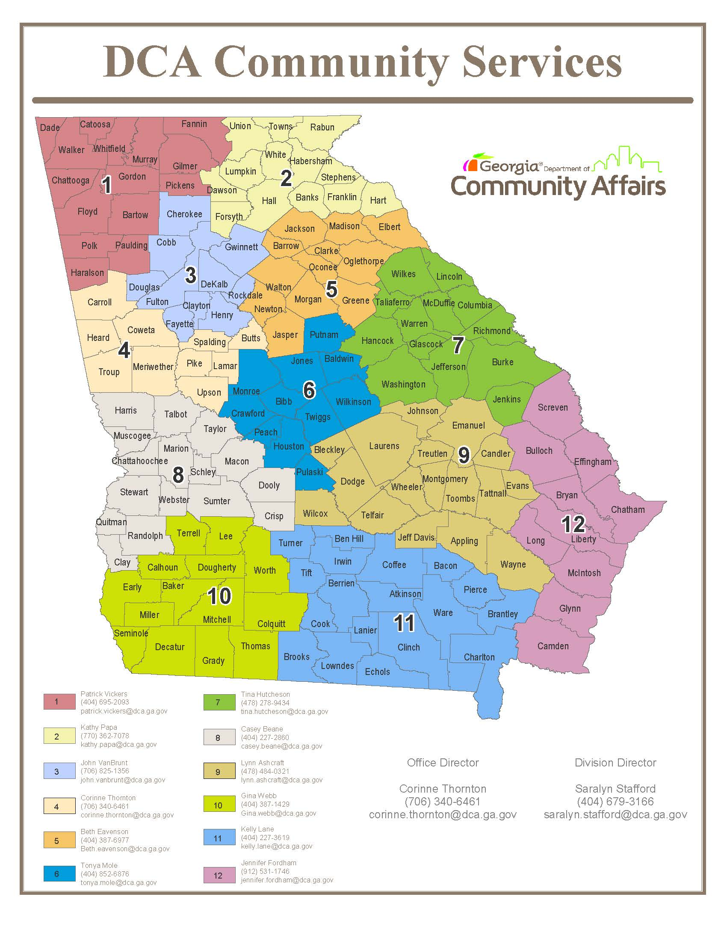

Slide 38
Program Manager Contacts:
Brock Smith – Manager, CDBG Set-Asides
(404) 679-1744 brock.smith@dca.ga.gov
Gabe Morris – EIP/RDF/ITAD
(404) 679-3174 gabriel.morris@dca.ga.gov
Brent Allen – RLF Program Manager
(404) 217-0733 brent.allen@dca.ga.gov

