Slide 1
EFFECTIVE COMP PLANNING
Community Planning Institute
SPRING 2019
Madison, GA
Aspiration > TO > Implementation
MONICA H. CALLAHAN
CITY OF MADISON PLANNING & DEVELOPMENT 132 N. Main Street | Madison, GA 30650
mhcallahan@madisonga.com

Slide 2
PLANNING FRamework
What is a Comprehensive Plan?
Forms the policy basis for local regulatory tools
Promotes the community vision – its goals, objectives, and policies
Establishes a process for orderly growth and development
Provides for a balance between the natural and built environment

Slide 3
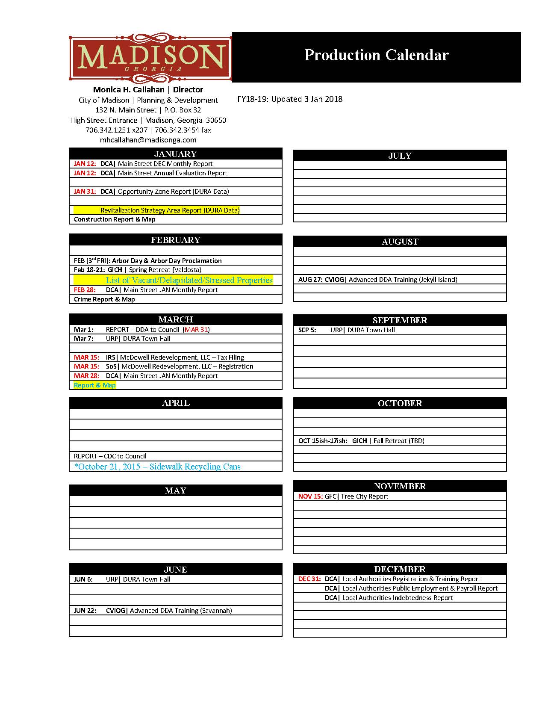
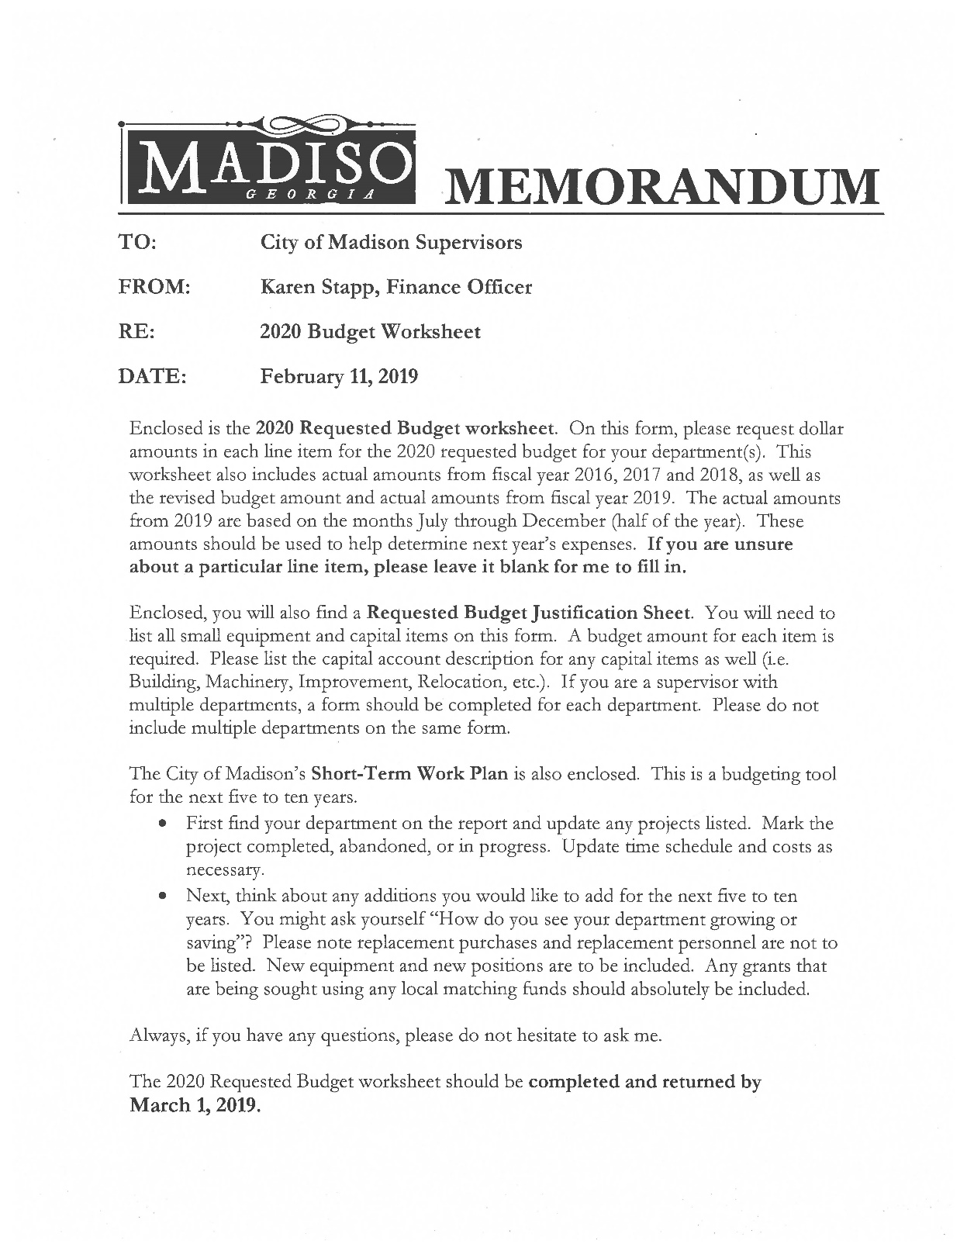
PLAN implementation
What is the Comprehensive Plan good for now?
Task Reminders
Work Plan Tools
Report Cards

Slide 4
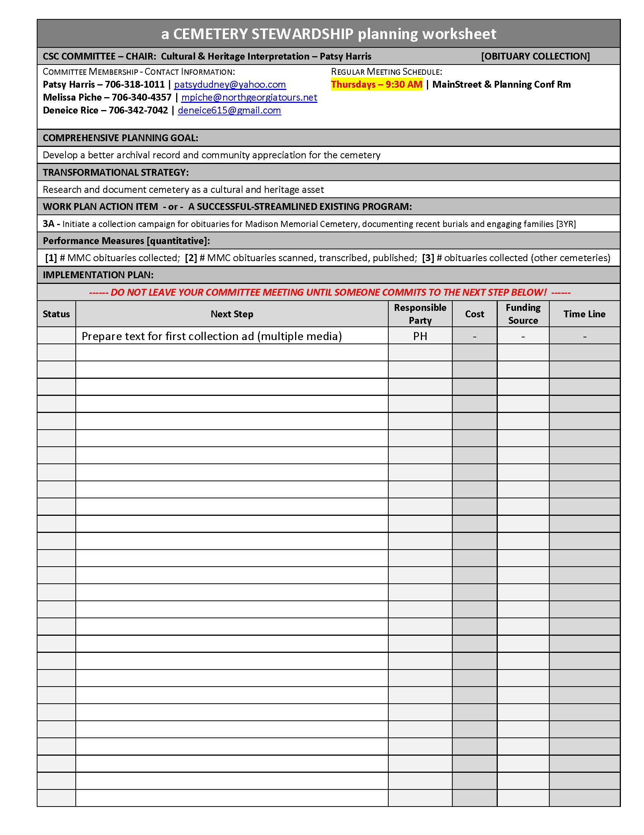
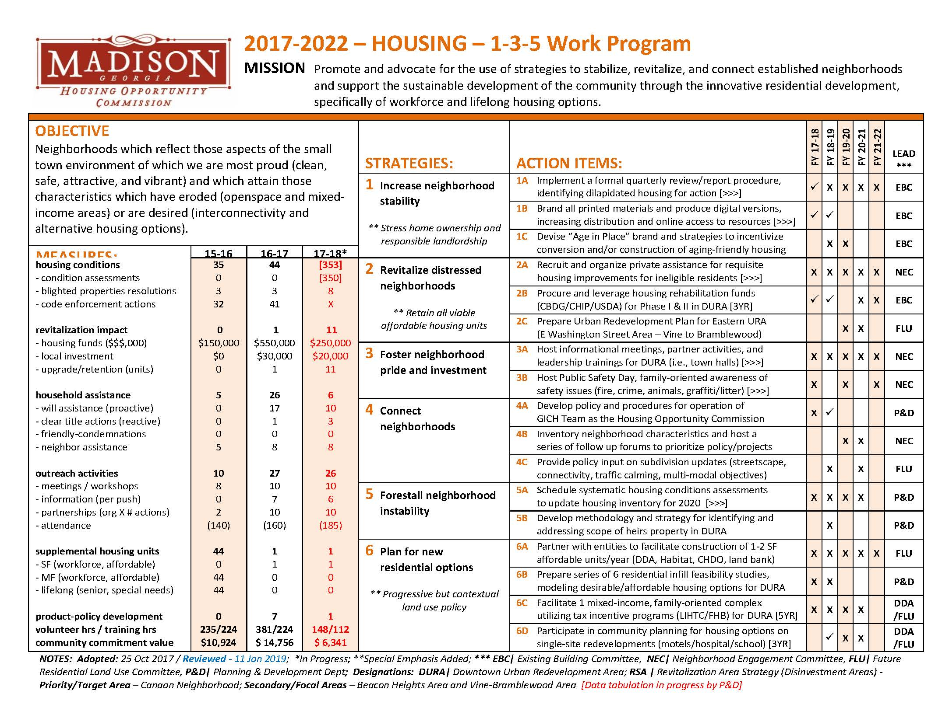
PLAN implementation
How do we use this Comprehensive Plan?
Task Reminders
Work Plan Tools
Report Cards

Slide 5
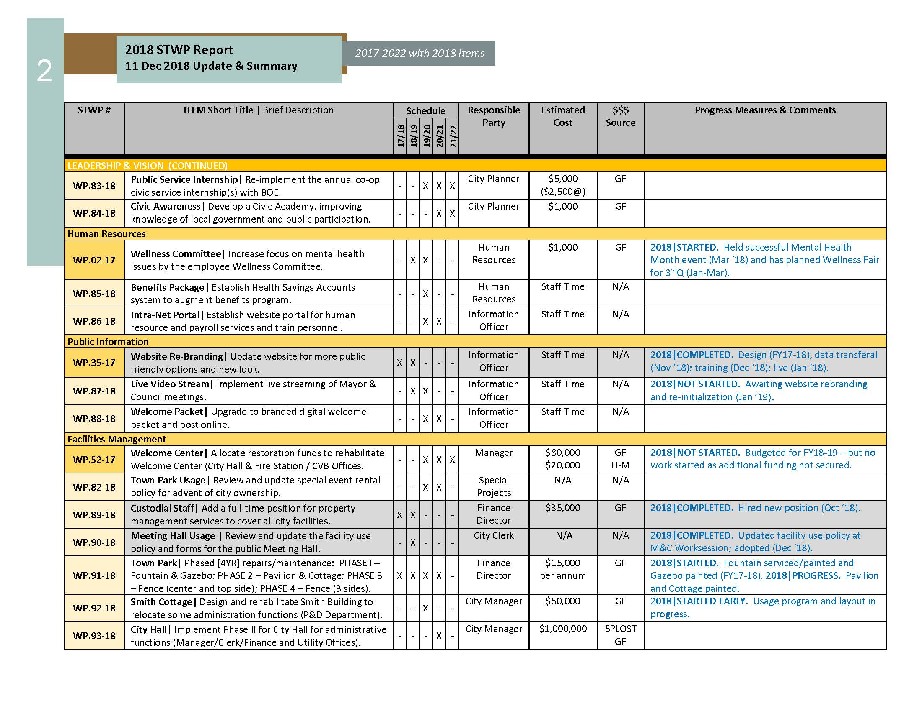
PLAN implementation
When do we finish this Comprehensive Plan?
Task Reminders
Work Plan Tools
Report Cards

Slide 6
PLAN implementation
How do we make the Comprehensive Plan into reality?
Projects
Focuses upon a specific site or outcome; usually a placed into service timeframe
Plans
Breaks planning area into smaller service areas or a system into segments; typically
incremental completion and moving horizon
Programs
Not area, site, or infrastructure-oriented; generally statistical and mid-term length

Slide 7
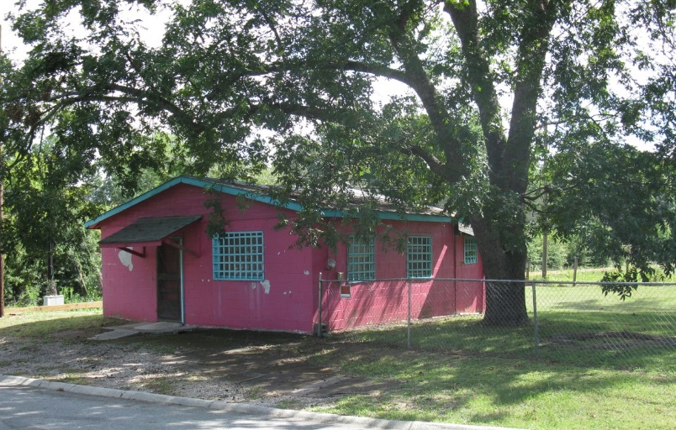
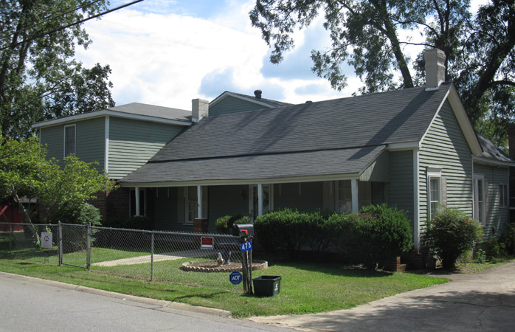
GILMORE PROPERTY - HOUSE & STORE
TIP: Think of planning as resource management
Site
Neighborhood decline
Vacant large house
Substandard accessory building
Lost institutional node
Objective: a neighborhood hub – an incubator with affordable housing
Plan Implementation – Project

Slide 8
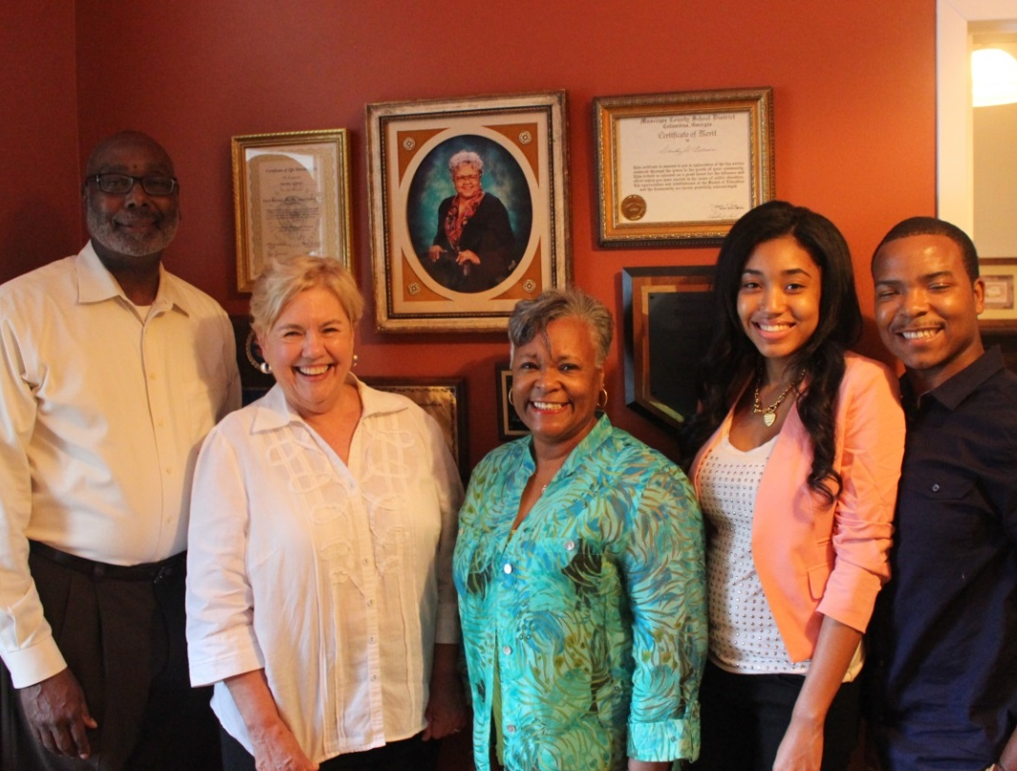
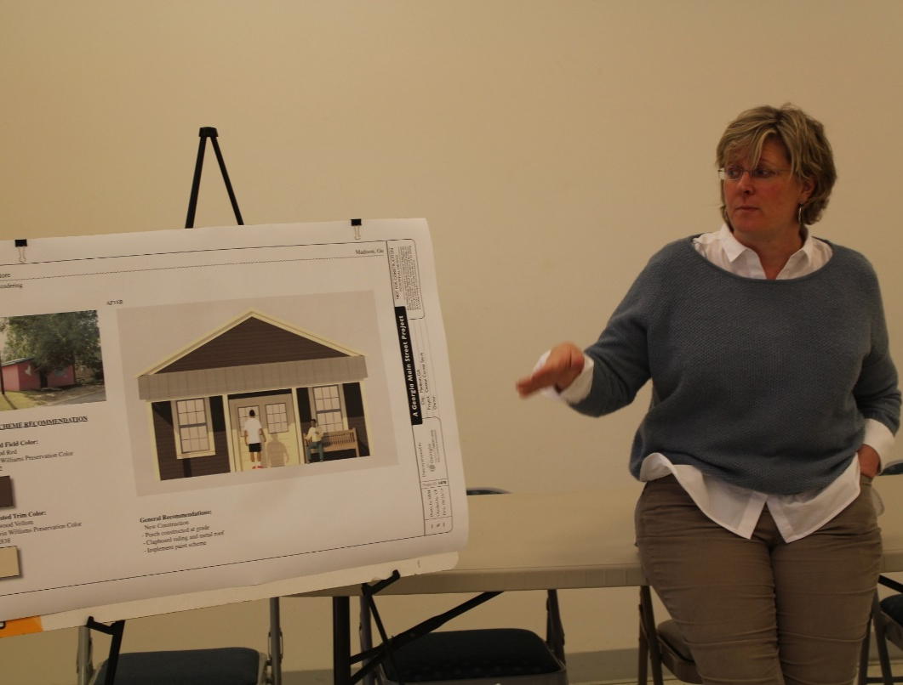
GILMORE PROPERTY - HOUSE & STORE
TIP: Let the history and context inform your objective implementation
Plan Implementation – Project

Slide 9
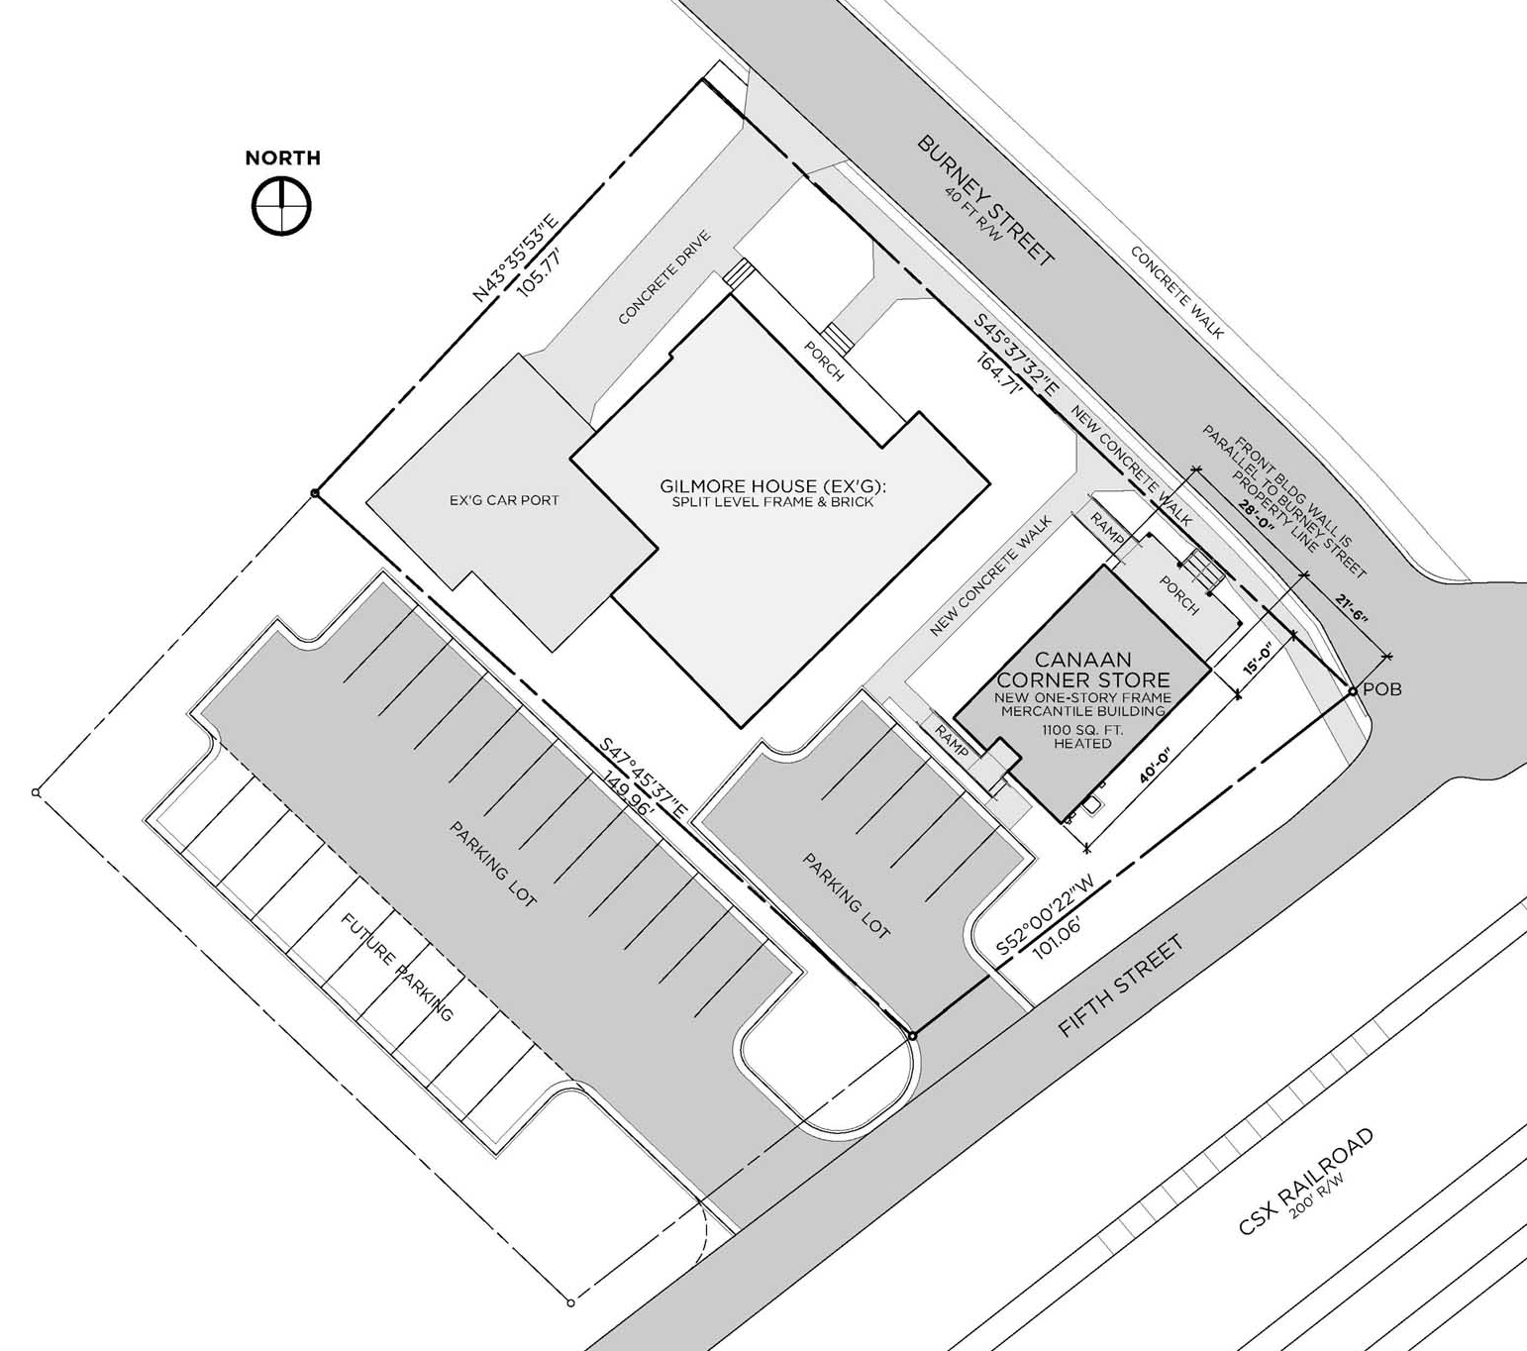
GILMORE PROPERTY - HOUSE & STORE
GILMORE PROPERTY - HOUSE & STORE
Plan Implementation – Project
Plan Implementation – Scope: Site

Slide 10
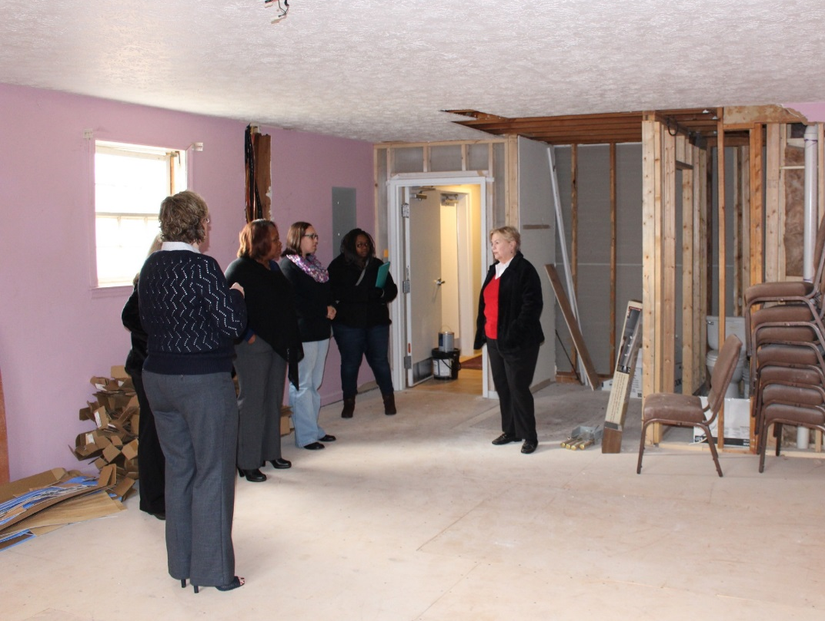
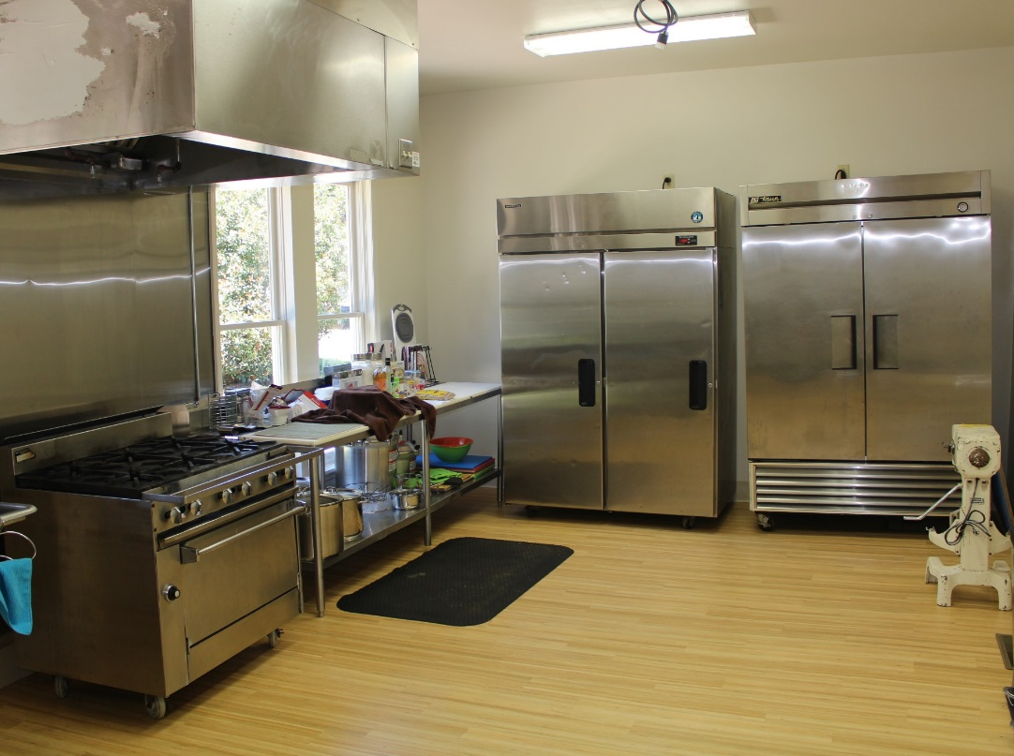
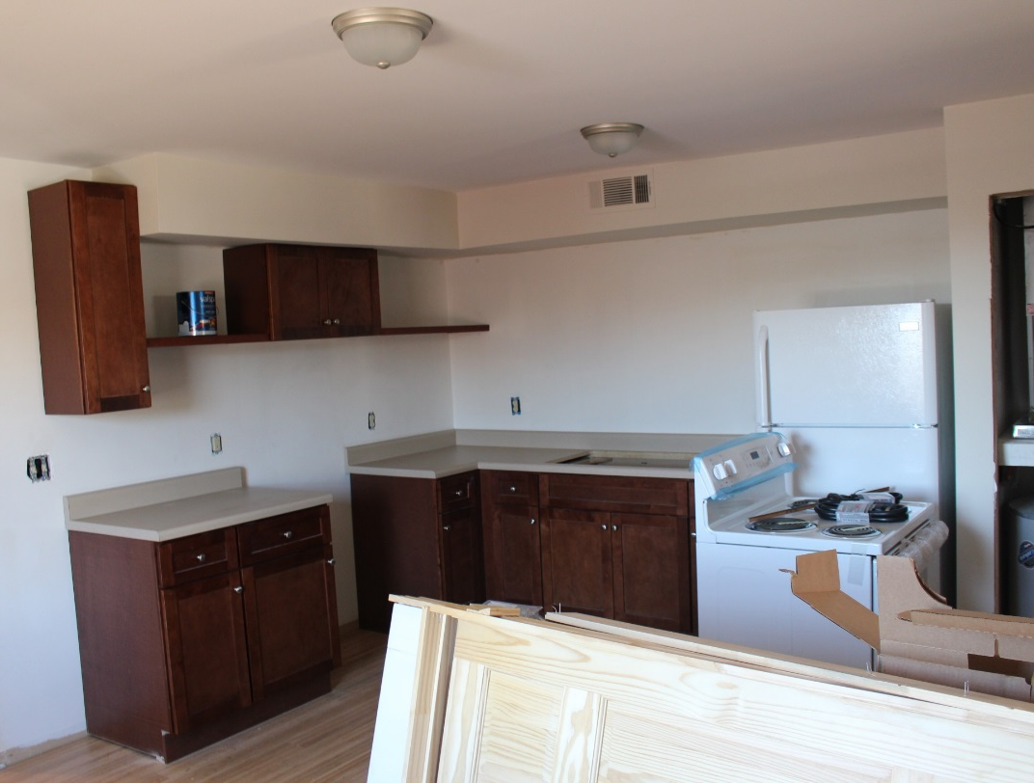
GILMORE PROPERTY - HOUSE & STORE

Slide 11
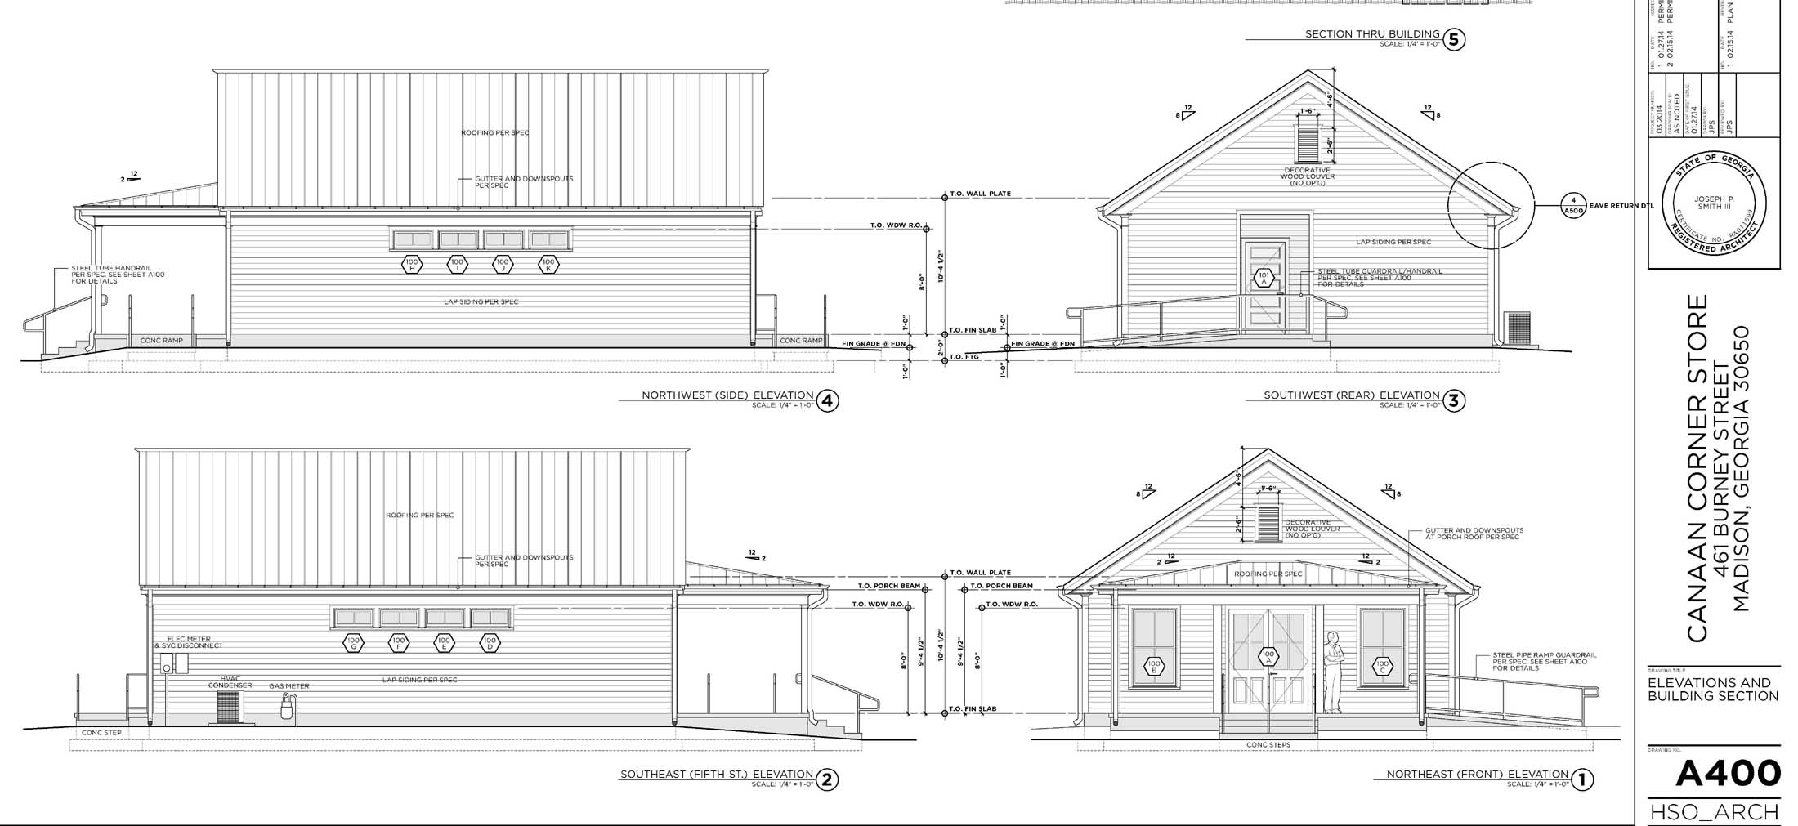
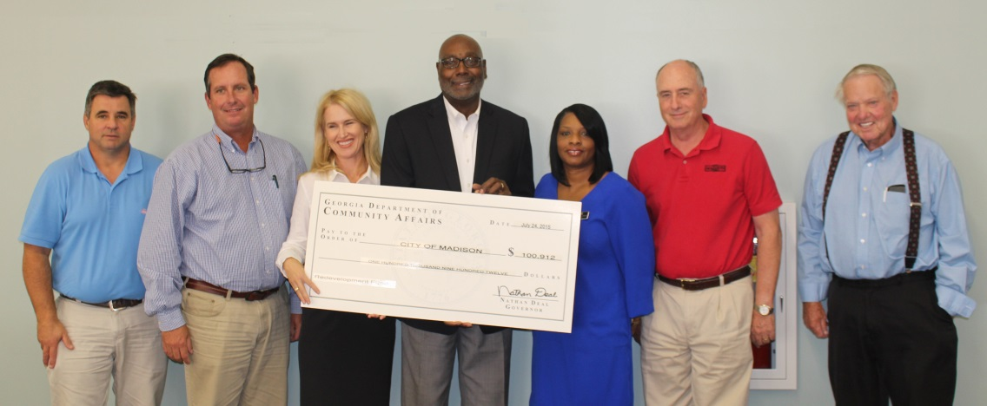
GILMORE PROPERTY - HOUSE & STORE
Plan Implementation – Scope: Site

Slide 12
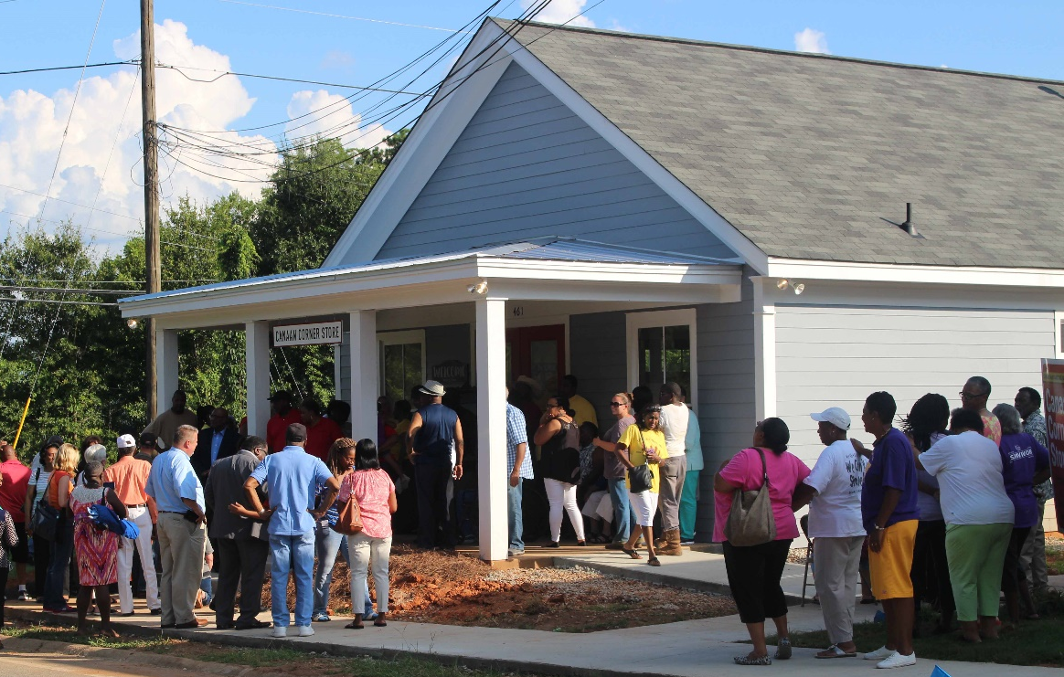
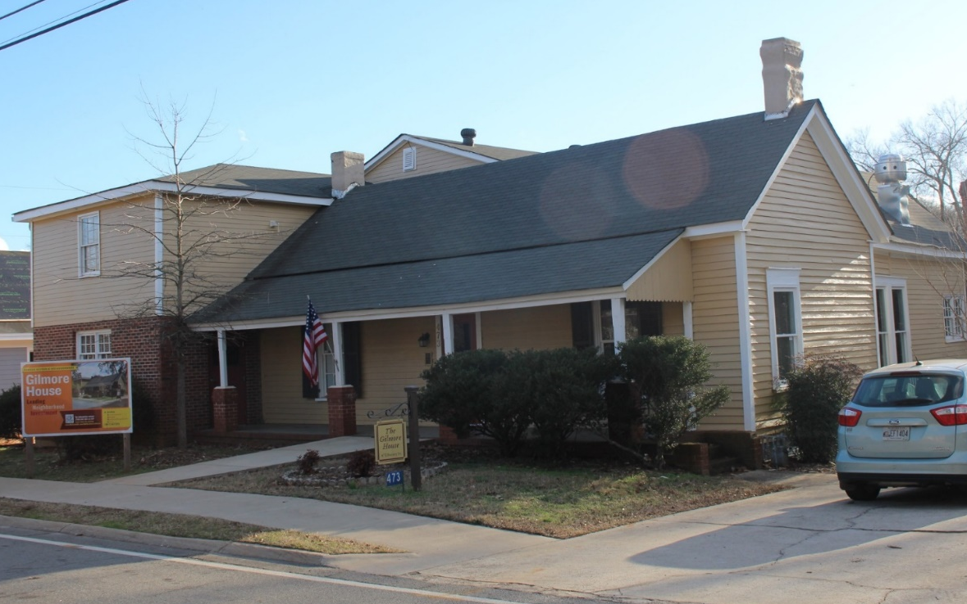
GILMORE PROPERTY - HOUSE & STORE
TIP: Remember to include the idea makers in the outcome celebration
Site
Neighborhood decline
Vacant large house
Substandard accessory building
Lost institutional node
Objective: a neighborhood hub – an incubator with affordable housing
Plan Implementation – Project

Slide 13
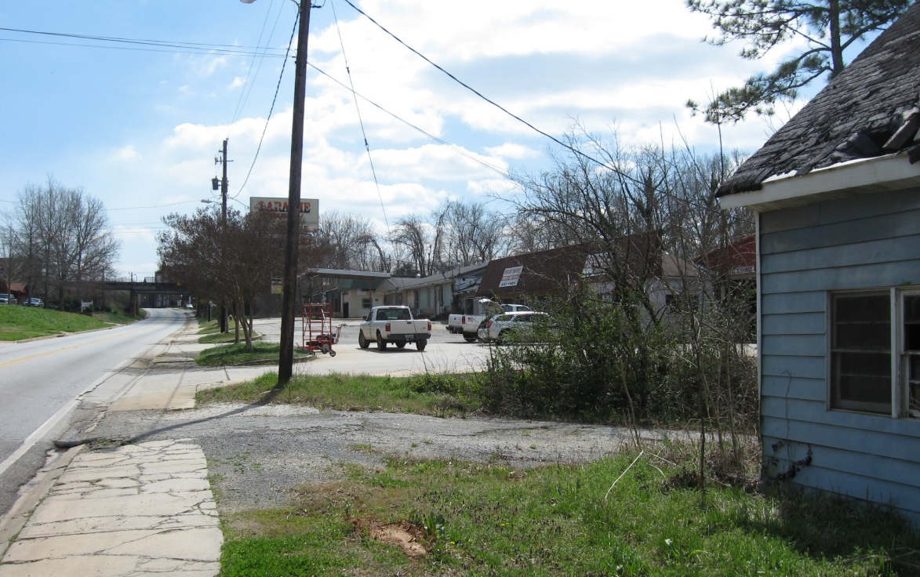
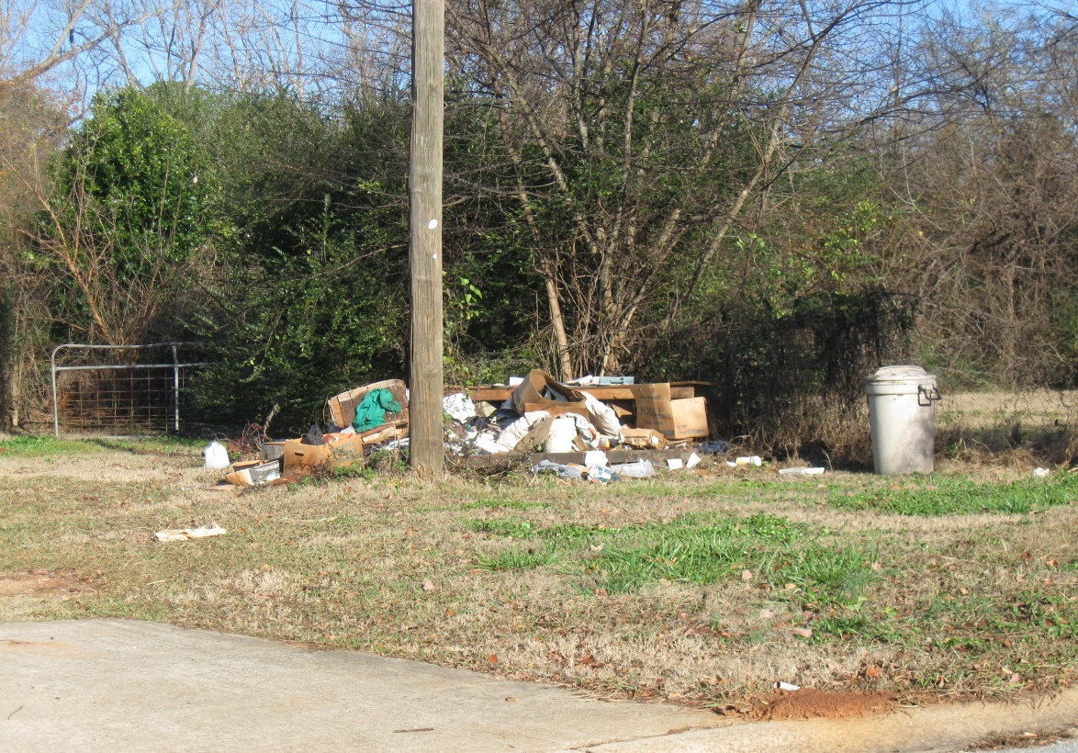
W. Washington St GATEWAY
TIP: Think of area planning as setting the table
Area
Dead commercial strip
Slum and blight conditions
Negative tax base
Objective: full redevelopment and new opportunities
Plan Implementation – Plan

Slide 14
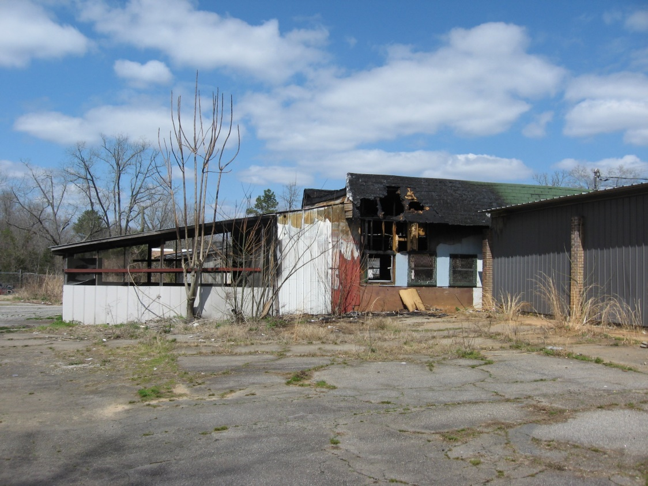
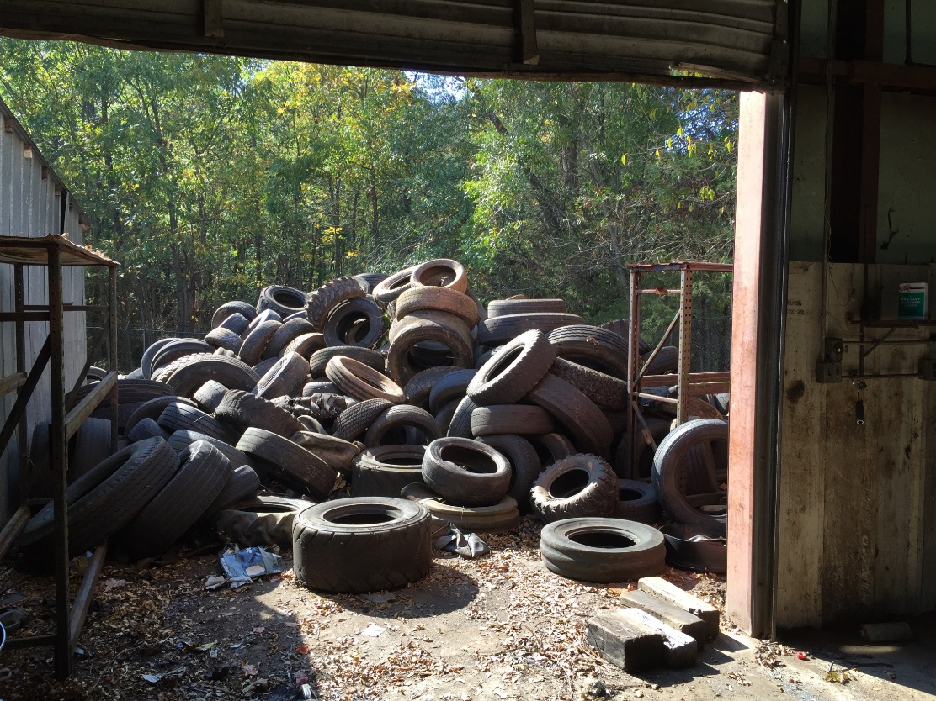
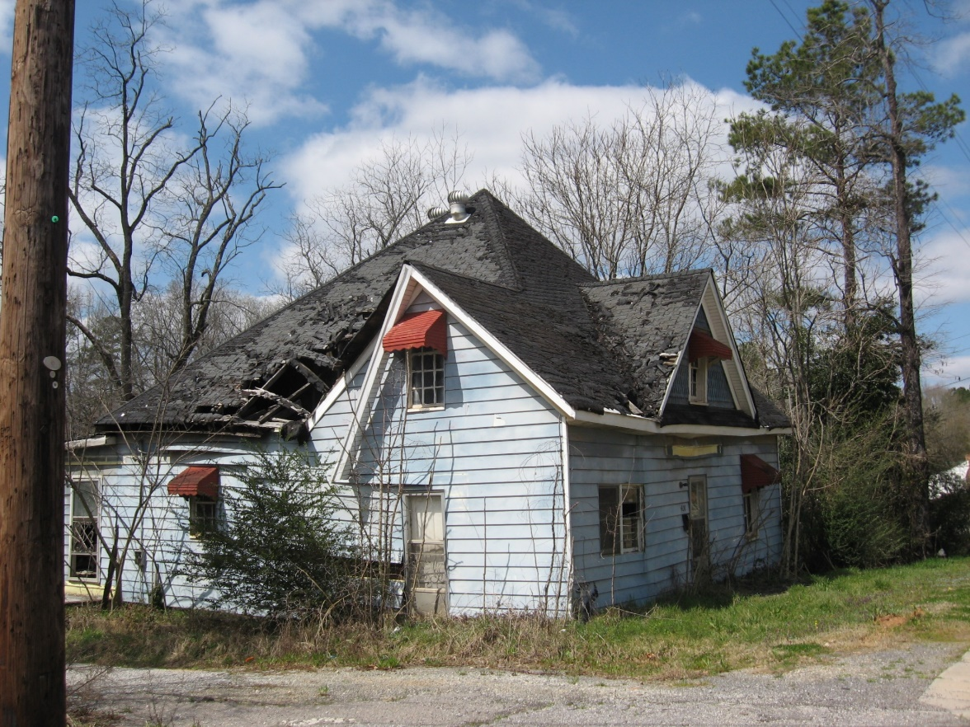
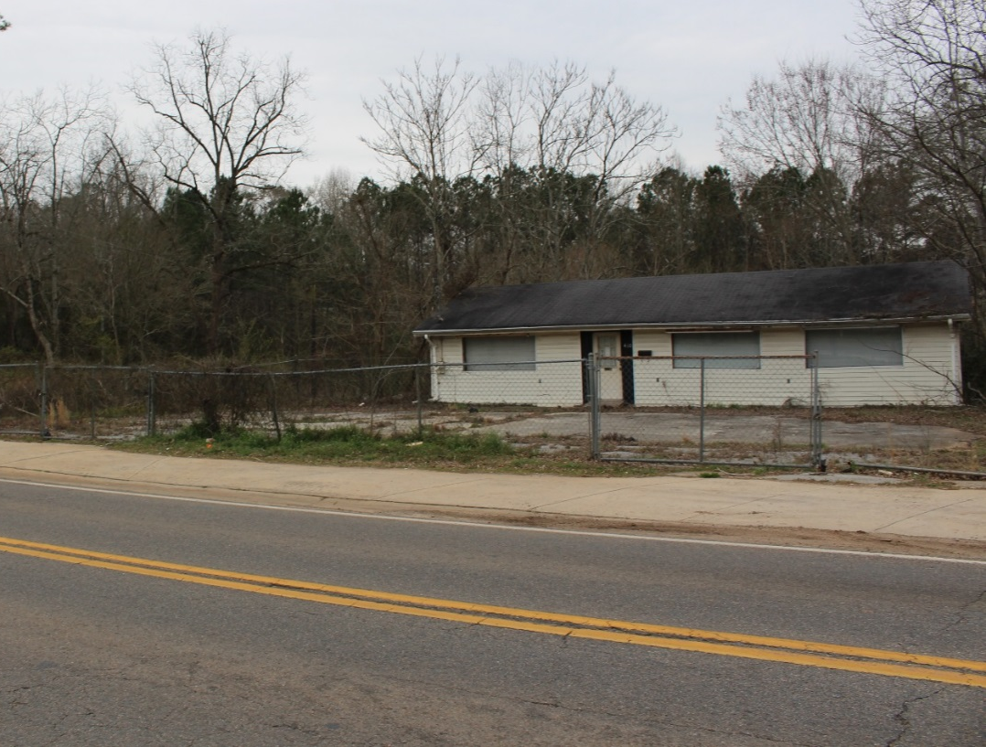
GILMORE PROPERTY - HOUSE & STORE

Slide 15
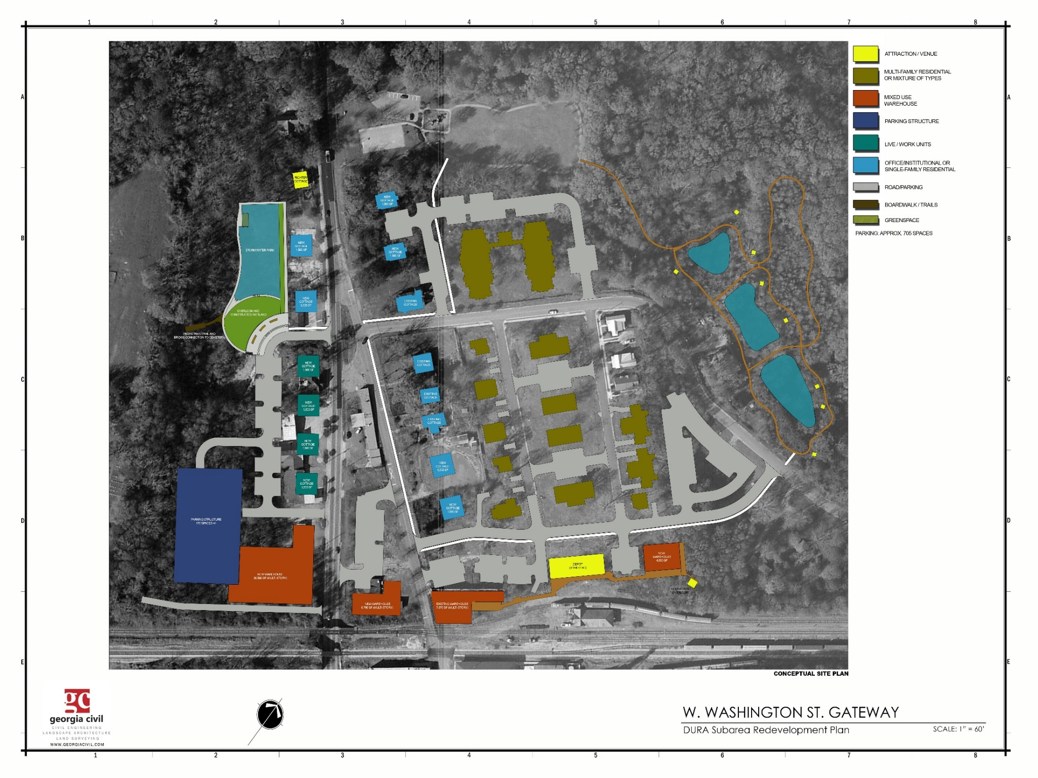

Slide 16
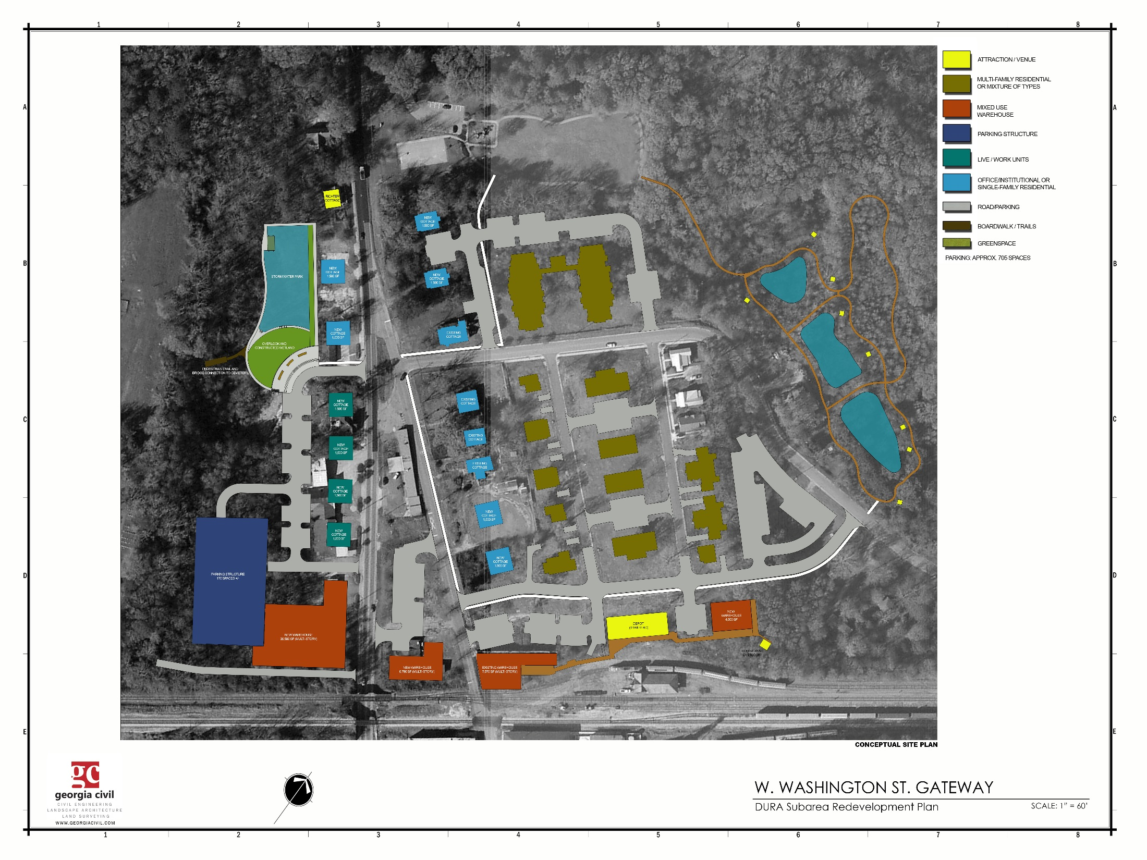
W. Washington St GATEWAY
DOWNTOWN RESIDENCY
SURPLUS PROPERTY
CONTEXT-BASED DESIGN
DOWNTOWN LIVING > INCREASE & DIVERSIFY
7 parking public to go with adj public asset (Richter Cottage)
Subtitle page with text and photo
2,000 sqft @ / 2 O/I or RES
4-6 private parking spaces @
1,600 sqft @ / 1 O/I or RES
2-4 private parking spaces
31,376 sqft-RES / 44apts / 1&2 bed
3,000 sqft-COM / common&O-I / 67 parking
W. Washington St GATEWAY
OBJECTIVE:
Long-Term, Sustainable Mixed-Use Area
867% change in tax base (w/o Anchorage)
80,000 Non-Residential Income-Producing Sq.Ft.
Housing Options (104+)
44 apts (senior)
30 apts
20 condos
20 garden flats
10 patio homes
10 single-family
5 apts (affordable)
4 live-work units
8 acres of protected riparian greenspace
Parking required – 369
Parking shown – 373 (w/o Anchorage and
w/o Silver Lakes Court)
*proposed public – 131
Plan Implementation – Plan
Plan Implementation – Scope: Site
36 total RES units / mixture
62 private parking spaces
3,200 sqft @ / 4 live-work units
49 parking / 10 to RES-39 public
32,400 sqft-RES / 18 con / 2 bed
150 parking / 75 private-75 public
1,600 sqft @ / 1 O/I or RES
2-4 private parking spaces
31,500 sqft-RES / 30apts / 1&2 bed
3,000-5,000 sqft-COM / 1 restaurant
17,500 sqft-COM / brewery/restaurant
2,000 RES / 1 con / 2 bed
6,790 sqft-COM / O-I/rest/liquor / 29 parking
4,078 sqft-RES / 5 apts / 1 bed / 5 parking

Slide 17
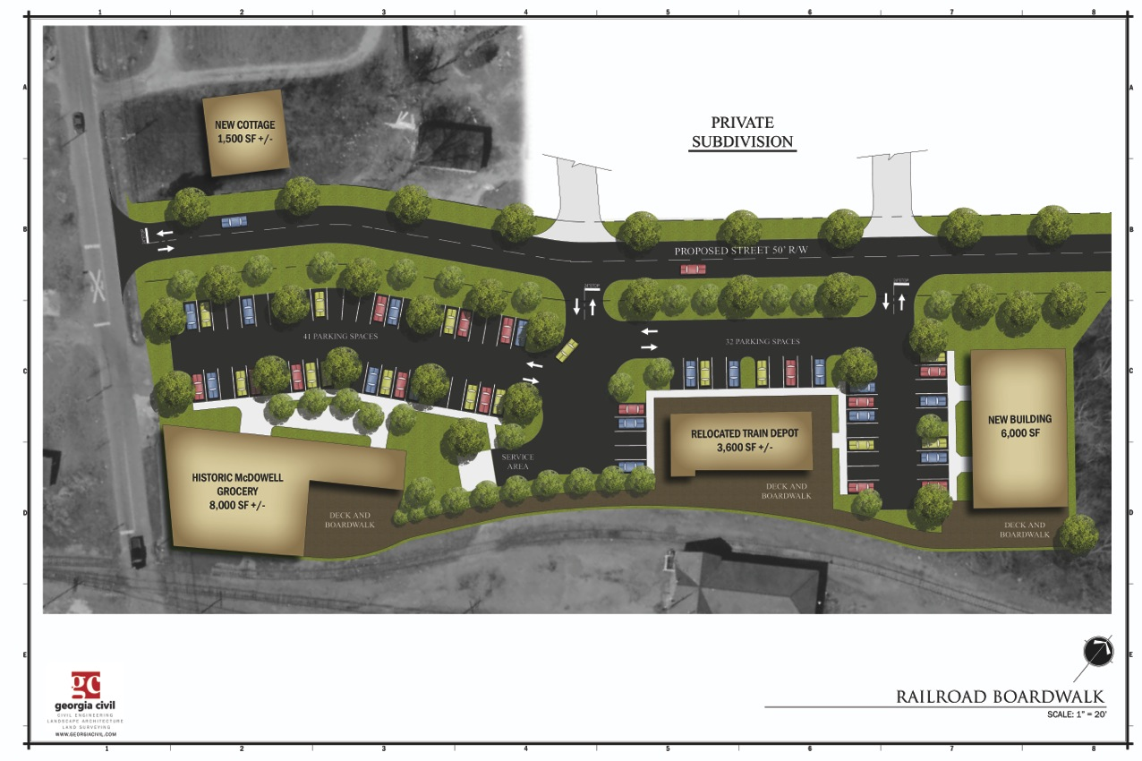
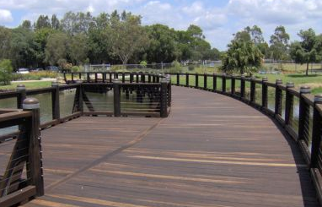
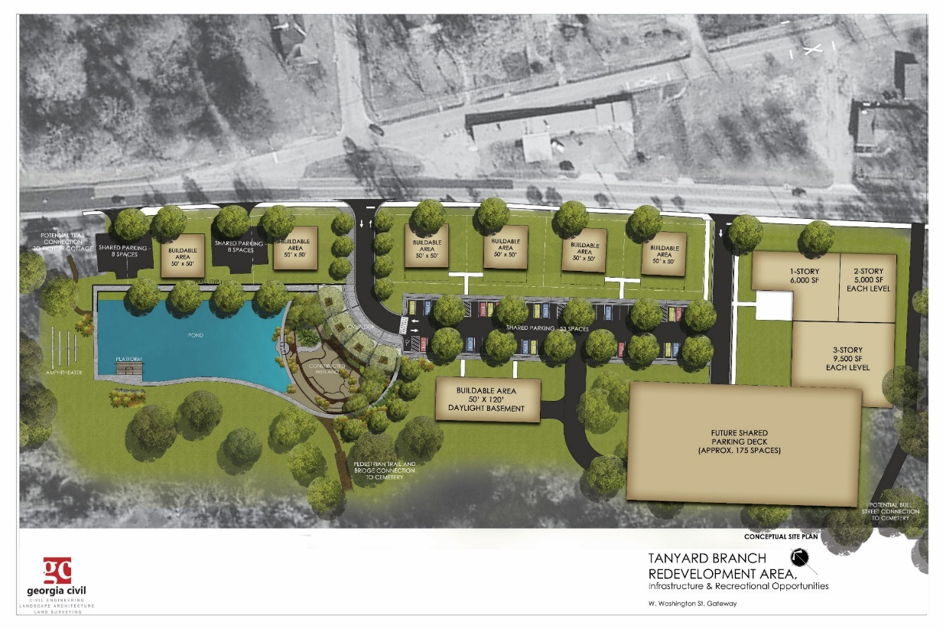
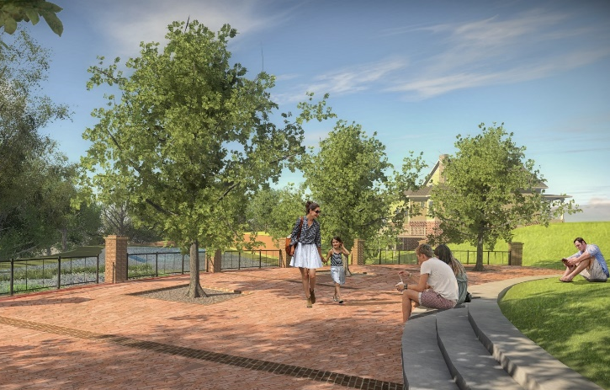
TIP: Help others visualize to invest in plan fulfillment

Slide 18
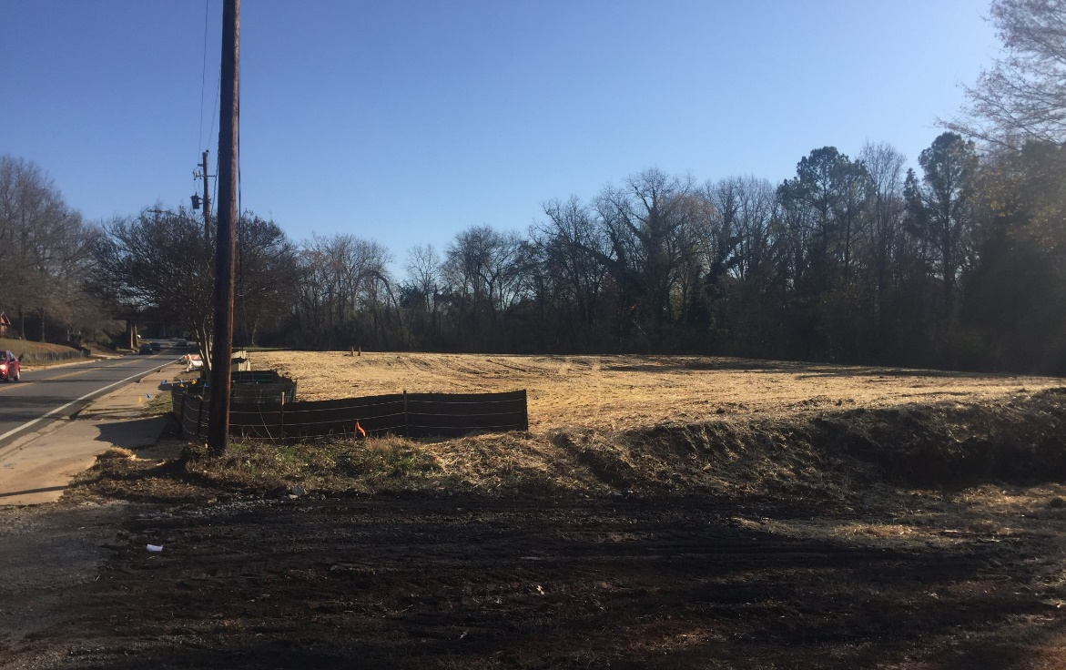
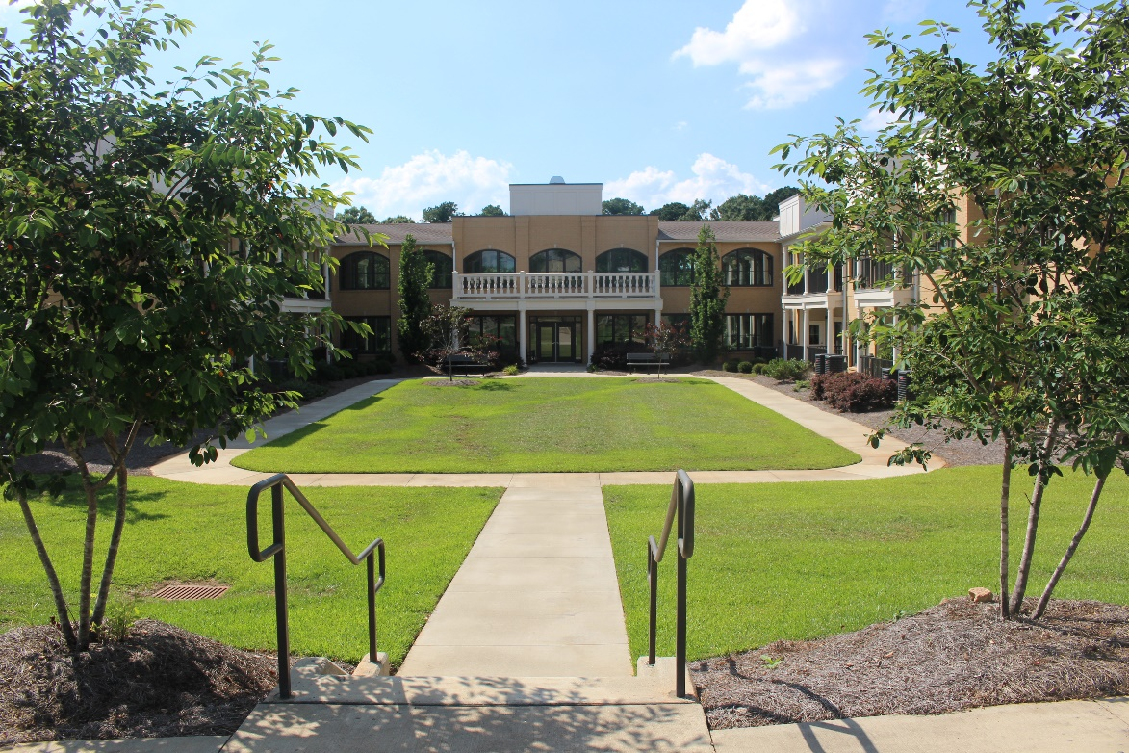
W. Washington St GATEWAY
TIP: Area planning is a long-game – patience matters
Area
Dead commercial strip
Slum and blight conditions
Negative tax base
Objective: full redevelopment and new opportunities
Plan Implementation – Plan

Slide 19
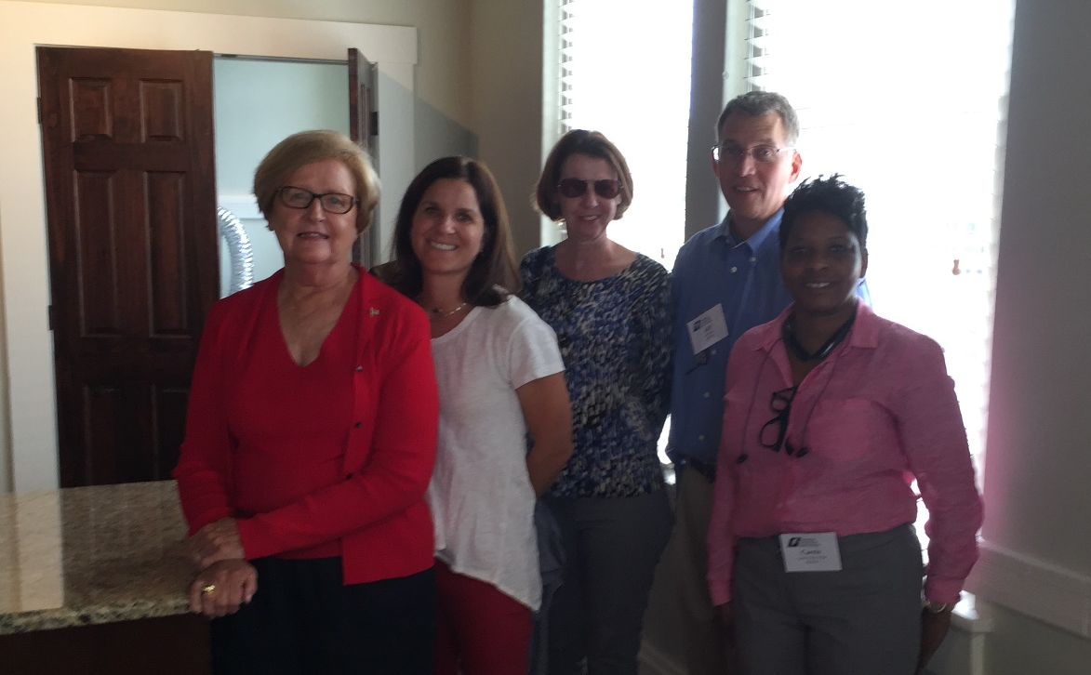
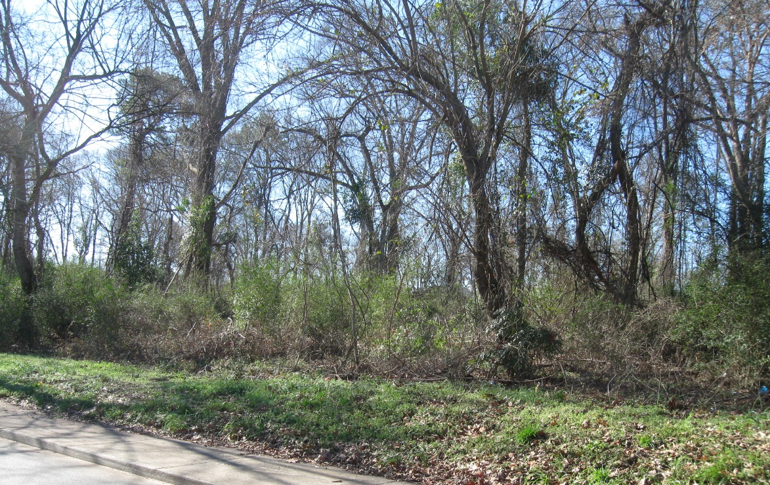
HOC NEIGBORHOOD ENGAGEMENT
TIP: Keep in mind that planning is first and foremost about people
Service
Neighborhood decline
Geographical isolation
Disaffection
High poverty
Objective: develop initiatives to arrest and reverse destabilization
Plan Implementation – Program

Slide 20
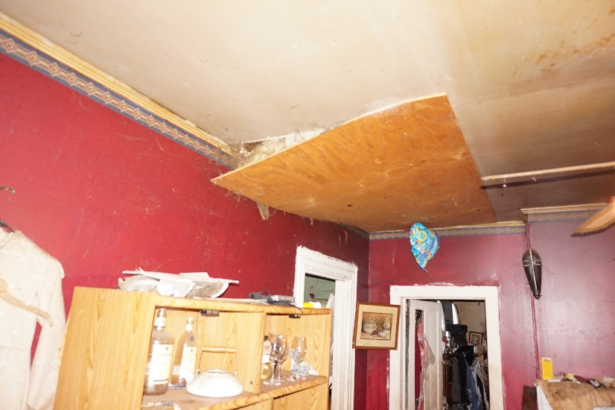
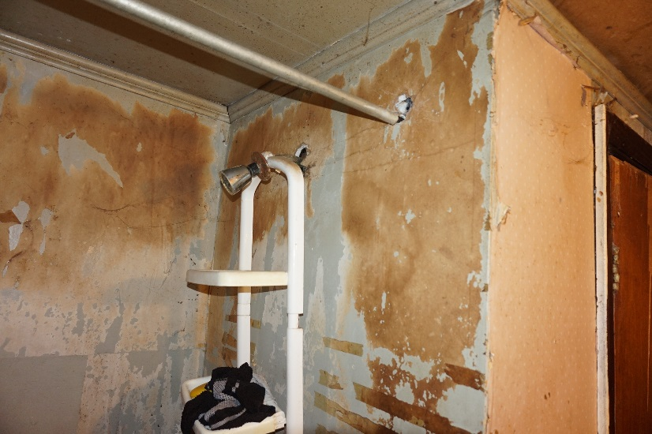
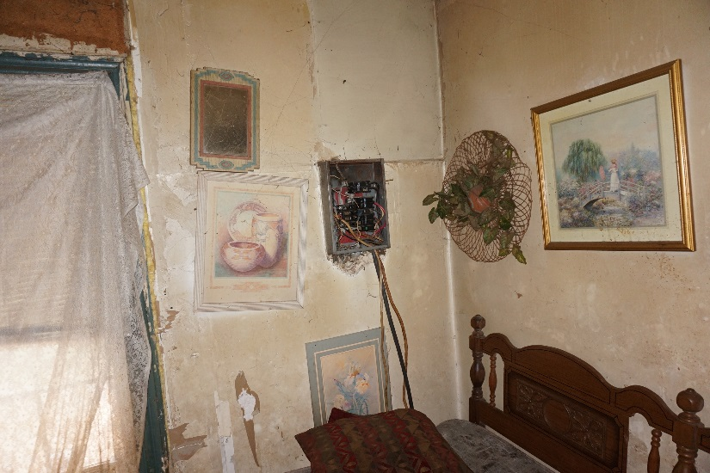
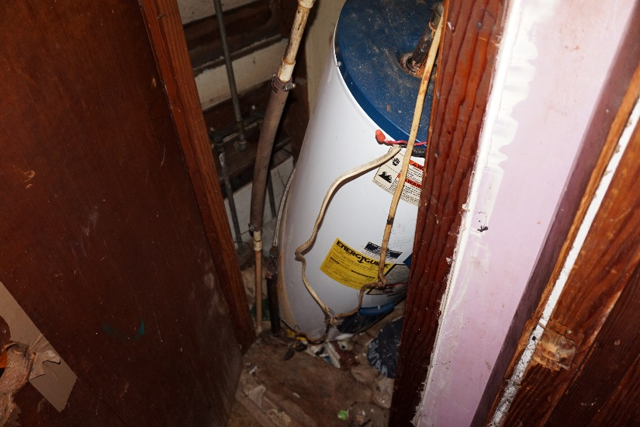
GILMORE PROPERTY - HOUSE & STORE

Slide 21
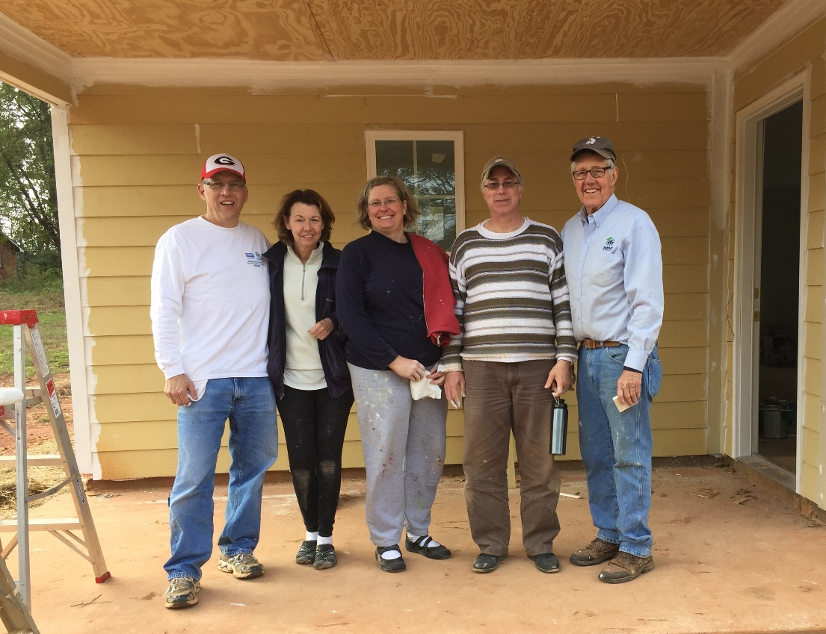
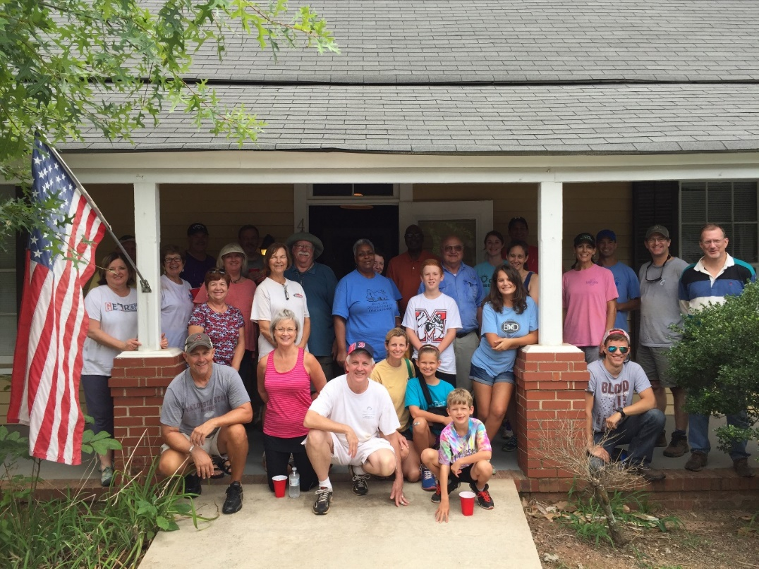
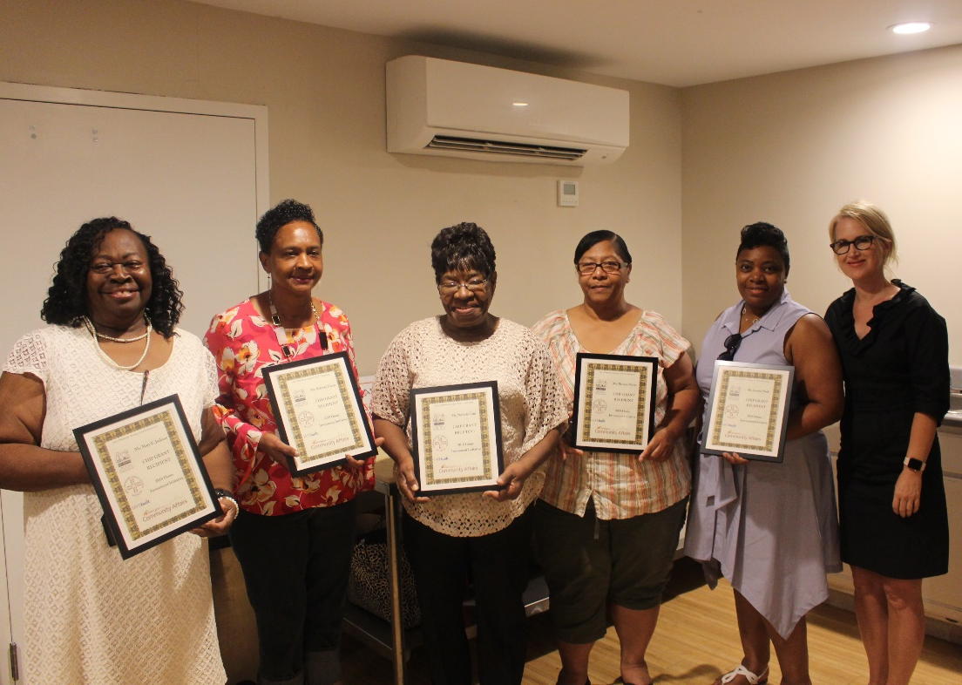
GILMORE PROPERTY - HOUSE & STORE
TIP: Let the history and context inform your objective implementation
Plan Implementation – Program

Slide 22
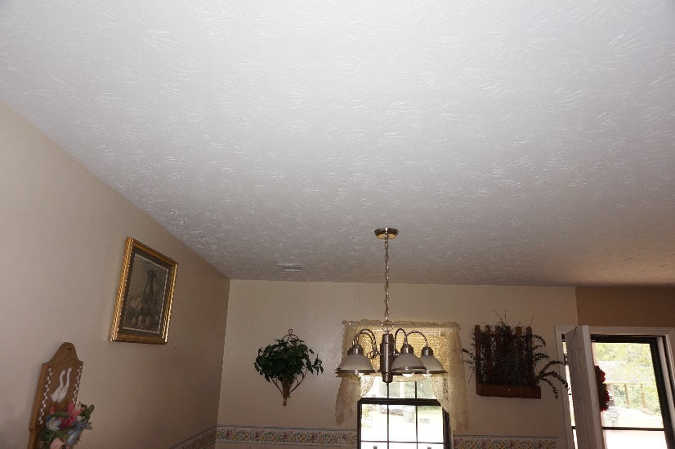
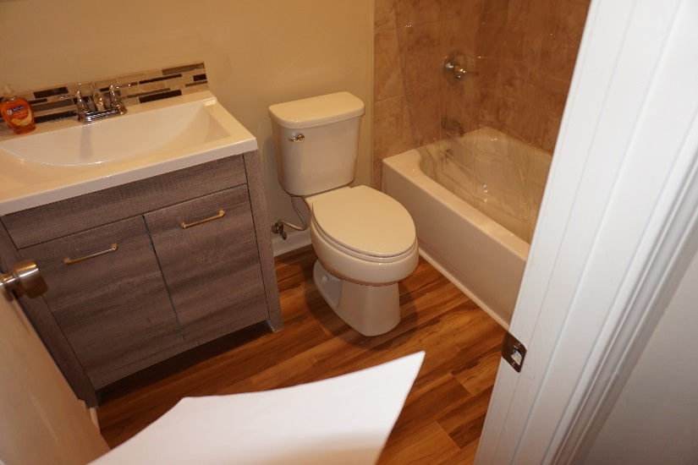
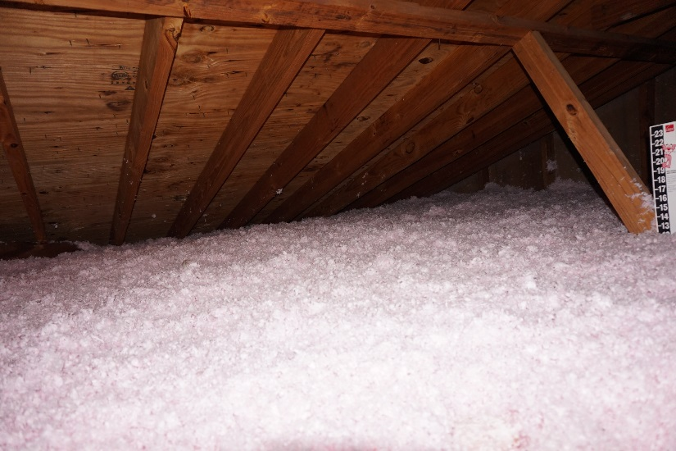
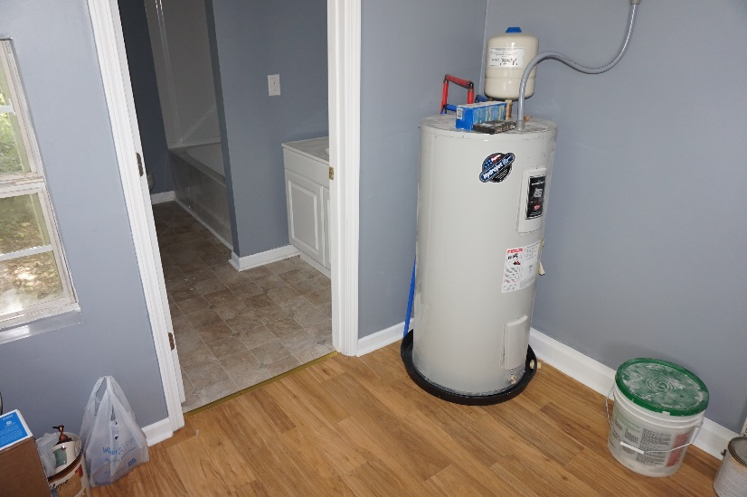
GILMORE PROPERTY - HOUSE & STORE

Slide 23
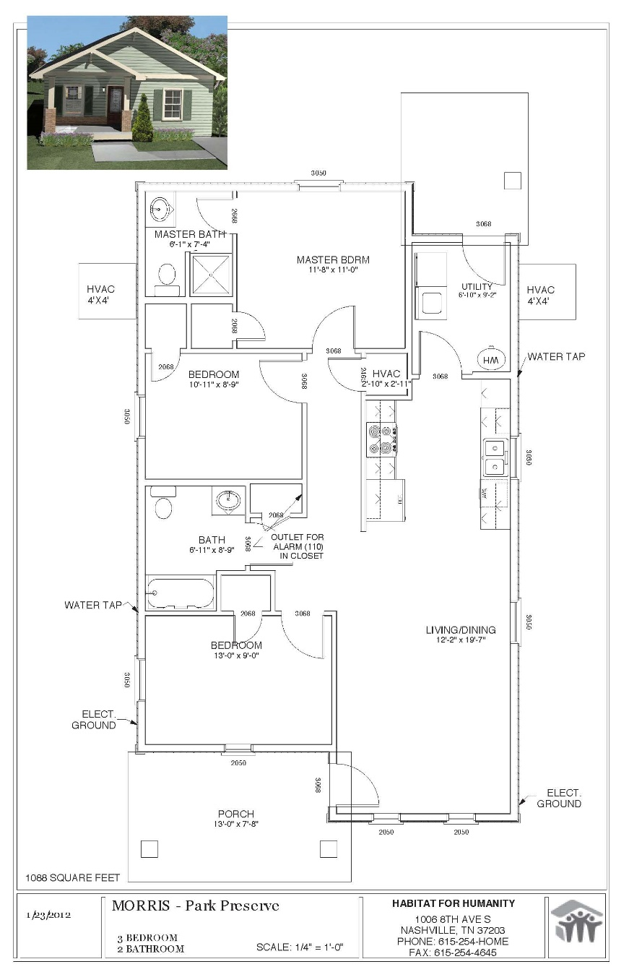
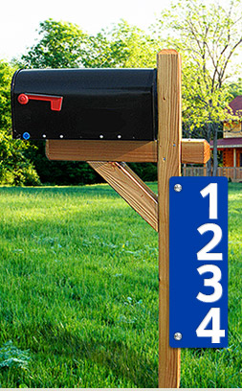
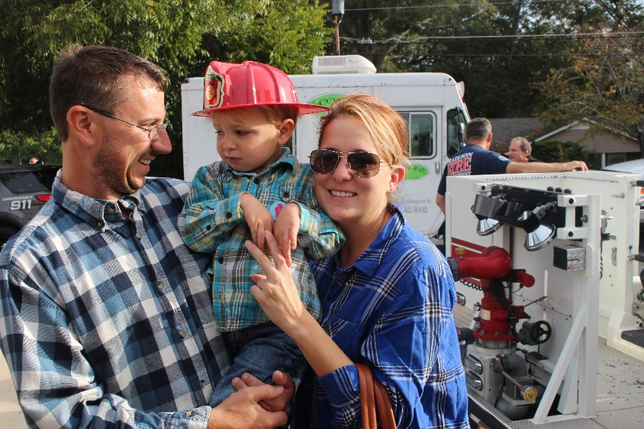
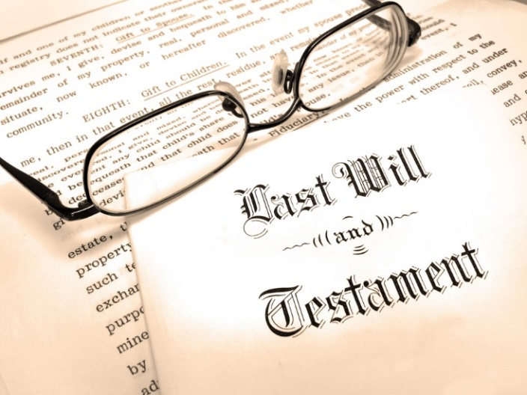
GILMORE PROPERTY - HOUSE & STORE
Plan Implementation – Program

Slide 24
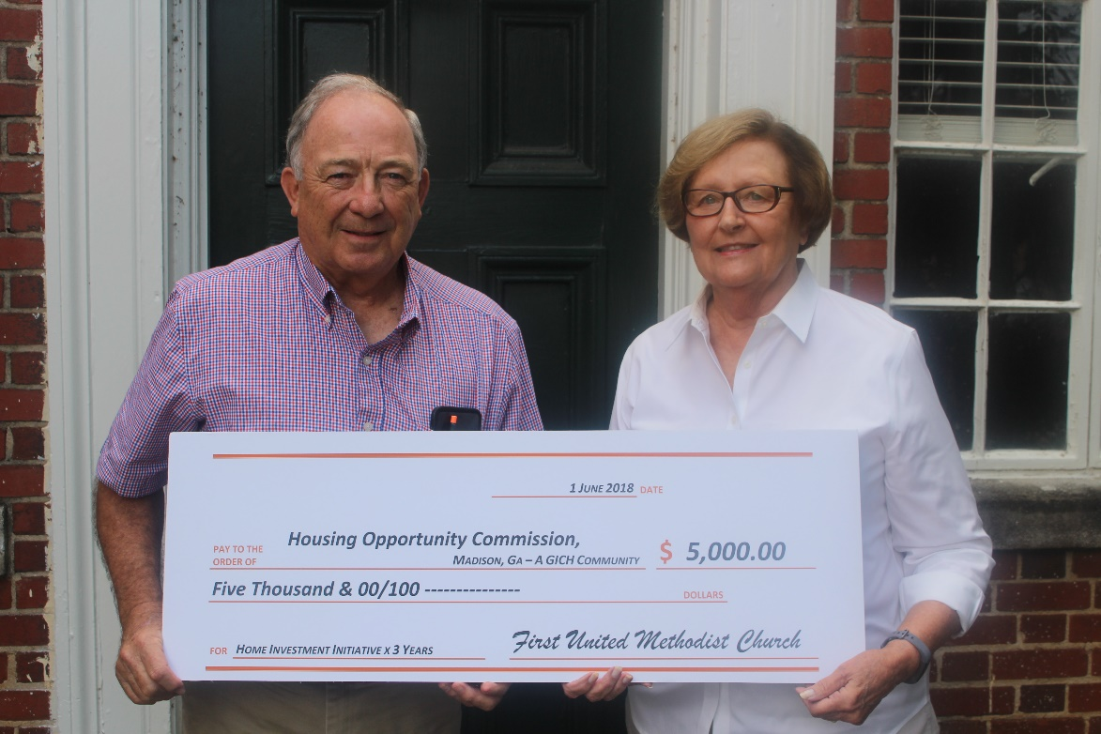
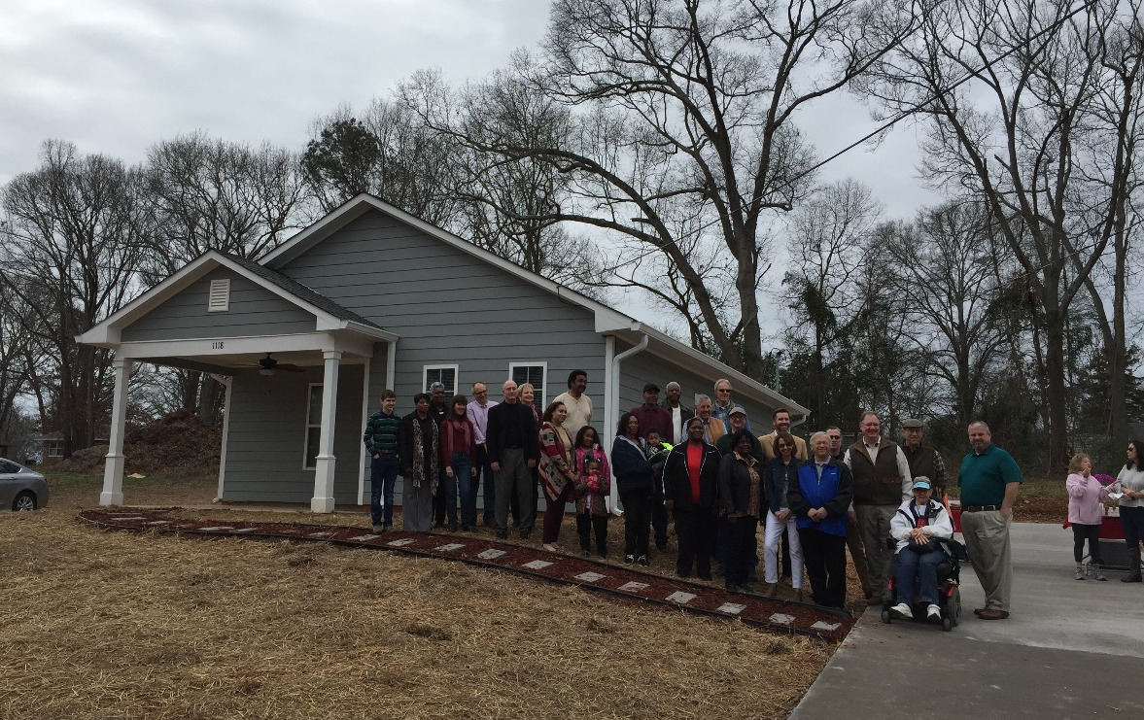
HOC NEIGBORHOOD ENGAGEMENT
TIP: Invest in a citizen planning corp
Service
Neighborhood decline
Geographical isolation
Disaffection
High poverty
Objective: develop initiatives to arrest and reverse destabilization
Plan Implementation – Program

Slide 25
REAL PLANNING
When do we get to do the next Comprehensive Plan?
Resource Assessment
Address the baseline – a frank perusal of the resources at hand and the stark reality of impediments
Focused Aspirations
Establish not funding-based goals and objectives but outcome-oriented strategies
Incremental Achievements
Outline measured steps – known tasks as well as a few blanks and a mote of flexibility to be pragmatic

Slide 26
EFFECTIVE COMP PLANNING
Community Planning Institute
SPRING 2019
Madison, GA
Aspiration > TO > Implementation
MONICA H. CALLAHAN
CITY OF MADISON PLANNING & DEVELOPMENT 132 N. Main Street | Madison, GA 30650
mhcallahan@madisonga.com

