Slide 1
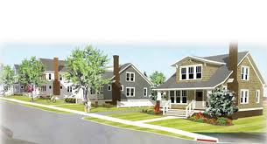
2018 CDBG Applicants’ Workshop Neighborhood Revitalization Session
December 6, 2017
Glenn Misner

Slide 2
Do these look familiar???

Slide 4
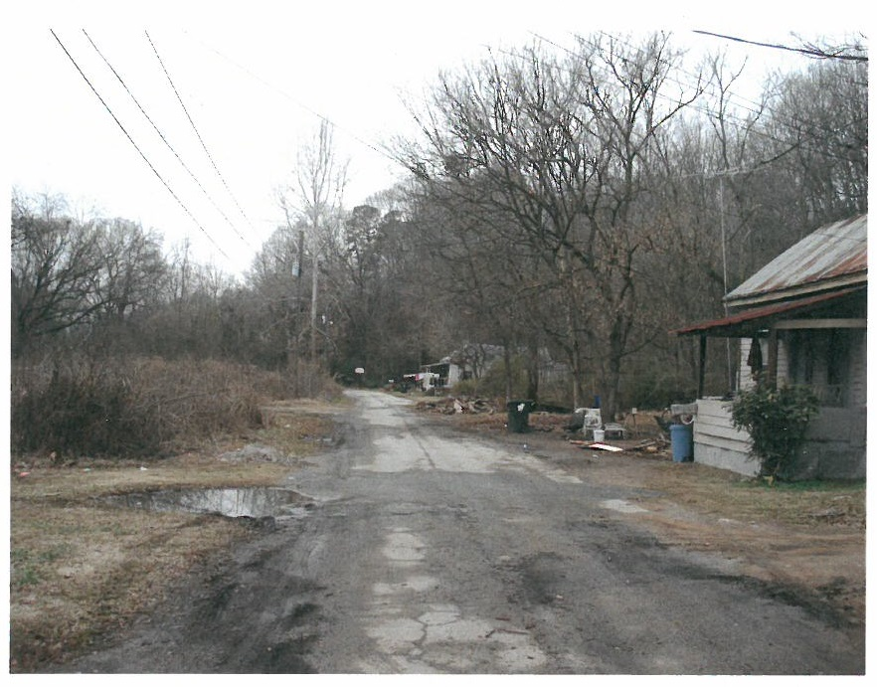

Slide 14
One tool that can help…….CDBG
Community Development Block Grant (CDBG) enacted by Congress as Title I of Housing and Community Development Act of 1974
The primary objective of CDBG is “the development of viable communities through improvement of living conditions, housing and the expansion of economic opportunities in cities and counties, principally for persons of low-and moderate income.”

Slide 15
CDBG
Local governments can implement a broad range of activities as long as they further the National Objectives of the Act
National Objectives are:
Majority benefit to low and moderate income persons through services and job creation
Prevention or elimination of slums and blight
Meeting urgent needs that pose a threat to the health and welfare of the community

Slide 16
CDBG Annual Competition
Funding Limits
Single Activity CDBG (Annual Competition)
Employment Incentive Program $750,000
Redevelopment Fund Program
Multi-Activity ------------------------------------ $1,000,000

Slide 17
CDBG Annual Competition
Due Date:
April 2, 2018

Slide 18
CDBG Neighborhood Revitalization
Types of Grants
Single Activity:
Housing Activities Only
Infrastructure Activities Only
Multi-Activity:
Housing PLUS Infrastructure Activities

Slide 19
CDBG Neighborhood Revitalization
Assessing Needs
What are the needs community wide?
Are there concentrations of substandard housing? Are there Infrastructure needs?
Determine the project area (TARGET AREA)

Slide 20
Single Activity Neighborhood Revitalization
Addresses Housing Activities
May Include Several Activities
Rehabilitation
Reconstruction
Acquisition
Relocation
Demolition/Clearance

Slide 21
Single Activity Neighborhood Revitalization
Who May Receive Assistance?
Individual or Family Home-Owners (Owner Occupants).
Investor Owners (Rental Units).
Occupants must meet Low-Moderate Income definition.
Must possess clear Deed to property.
Properties must be within Applicant Jurisdiction.

Slide 22
Single Activity Neighborhood Revitalization
Limit of $750,000.
May be City/County Wide, Target Area, or Targeted to a Specific Group
Elderly
Handicapped
Working Families with Children

Slide 23
Eligible Activities Single Activity Neighborhood Revitalization Maximum $750,000.
Rehabilitation – To repair and/or bring to Code existing substandard housing unit.
Reconstruction – Where unfeasible to Rehab, Demolish and construct new unit on same site – Owner Occupied ONLY.

Slide 24
Eligible Activities Single Activity Neighborhood Revitalization Maximum $750,000.
Acquisition - of Real Property
Disposition – Costs Incidental to Disposing of Property Acquired with CDBG Funds
Code Enforcement – but…

Slide 25
Eligible Activities Single Activity Neighborhood Revitalization Maximum $750,000.
Clearance – Of Dilapidated Structures, out-buildings, etc.
Interim Assistance
Relocation – Temporary or Permanent
Temp Relocation is NOT mandatory for Owner occupied units
Removal of Architectural Barriers

Slide 26
Eligible Activities Single Activity Neighborhood Revitalization Maximum $750,000.
Home Buyer Assistance
Down Payment
Closing costs
Principle Reduction Payment
Interest buy-down
NOTE: DCA policy mandates use of fixed rate mortgages on all CDBG funded projects

Slide 27
Multi-Activity Maximum $1,000,000.
Multi-Activity
“Comprehensive Neighborhood Revitalization”
Includes Housing AND Public Facilities Activities
Limit of $1,000,000
Inter-related Activities
Same Target Area
Comprehensive (Meets all/most of the Needs in the Target Area)
Reasonable Distribution of Funds Between Activities

Slide 28
Revitalization Area Strategy (RAS)
Officially adopt a local Redevelopment Plan in accordance with the Urban Redevelopment Act O.C.G.A. 36-61
Eligible area of Census Block Group(s) of 20% or greater poverty level.
Develop strong local partnerships focusing local resources within the Revitalization Area.
Submit application for designation to DCA.
Must be designated by DCA through application
Due no later than April 2, 2018

Slide 29
CDBG Neighborhood Revitalization Application Review Process
Each application is read and reviewed by the Housing Panel
Rank and Score based on:
Feasibility of Project
Strategy Proposed
Impact of Project

Slide 30
Feasibility Considerations
How and why the project was chosen
Property Standards to be used
Lead Based Paint (LBP) fully addressed
Outside Funding Sources and Commitments
Operation Oversight / Experience
Maps and Overview
Selling Your Project
Costs

Slide 31
Feasibility Considerations
How and why the project was chosen
Provide a compelling narrative that describes the process used to choose the project – Including the required Citizen Participation process

Slide 32
Feasibility Considerations Minimum Property Standards
Realistic Local Minimum Property Standards – you determine what standards you want in your community.
Code Violations and Incipient Violations.
First priority should be given to Health, Safety, and ADA accommodation.

Slide 33
Feasibility Considerations Lead Based Paint (LBP)
Lead hazard evaluation is required on any structure built before 1978.
Evaluation services must be performed by an inspector/risk assessor licensed and certified by the State of Georgia.
Lead hazard control work must be performed by certified contractors who have passed the EPA Renovation, Repair and Painting (RRP) rule safe work practice training.

Slide 34
Feasibility Considerations Lead Based Paint (LBP)
Be prepared to seek services outside your local area.
Demonstrate understanding of LBP regulation requirements.
Lead hazard control can be costly, budget 25% of estimated rehab hard cost on ALL budget forms.

Slide 35
Feasibility Considerations Funding, Partnerships, Other Resources.
Provide reasonable justification for all costs, and the basis of those costs.
Obtain FIRM, SPECIFIC commitment letters from all partners.
Ensure that the commitment letters are issued and signed by authorized individuals.
Pledges of support without firm commitment letters will not be considered.

Slide 36
Feasibility Considerations Funding, Partnerships, Other Resources.
Indicate how each will be applied, at what point will these funds be released.
General Property Improvements (GPI) are not funded by CDBG.
Secure firm, convincing documentation of participation from investor-owners.

Slide 37
Feasibility Considerations Schedules and Time tables
Who will provide Project oversight?
What are their credentials?
Demonstrate capacity to undertake the project.
Develop and show a schedule of start and completion dates. Indicate milestones and inspection points.

Slide 38
Feasibility Considerations Contracting and Construction
The Application must demonstrate understanding of the Rehab process
Beneficiary eligibility
“Work Write-Up” and “Scope of Work”.
Maximum value rehabilitation!!!!
MHU Rehab Limit of $7,000 – including owner match
Qualifying contractors: establish guidelines and criteria.
Bidding process and bid acceptance protocol.
Contract negotiations.
Change Orders protocol.
Draw Request and approval process.

Slide 39
Feasibility Considerations Maps and Photos
DCA Form 12 instructions spells out what is required for Concentration Maps of the ENTIRE COMMUNITY – not just the TA
You MUST include the required concentration maps from DCA’s website
SDS map requirement must be met for infrastructure projects (MA apps) – Housing is exempt.
More on Maps under Strategy

Slide 40
Feasibility Considerations Maps and Photos
DCA Form 12 instructions spells out what is required on TA maps.
Map should be in common scale.
Show details in the Target Area(s): ALL existing structures (unit map #’s), street names, schools, etc.
Photographs must indicate Unit numbers.
Indicate occupancy status of structure (e.g. occupied, vacant, investor owner/rental, non-targeted structure, non-residential, etc.).
Indicate type of construction (Stickbuilt/modular or MHU)
Indicate proposed Activity.

Slide 41
Feasibility Considerations Maps and Photos
Indicate condition of all residential structures –THREE CLASSIFICATIONS
Standard
Substandard
Dilapidated

Slide 42
Feasibility Considerations Maps and Photos
Indicate Occupancy
Owner occupied
Renter occupied (Investor owned)
Vacant
Indicate construction type
Stick/Site built or Modular
Manufactured Housing Unit (MHU)

Slide 43
Feasibility Considerations Maps and Photos
Indicate Proposed Activity
No activity – standard or otherwise explained
Rehab
Reconstruction
Clearance
INCLUDE FINANCIAL PLAN FORM (EXHIBIT H)

Slide 44
Unit Map Numbers
Street Names
Substandard
Substandard
Substandard
Stickbuilt
30
MHU
31
Type of Construction

Slide 45
Feasibility Considerations Maps and Photos (cont.)
Photographs.
Show all 4 elevations.
Interior and exterior photos should clearly represent condition of structure and problems described in narrative.
Photos should illustrate problems that will be addressed in the scope of work/cost estimate.

Slide 46
Photo Examples
Unit #1#

Slide 47
Photo Examples
Unit #1#

Slide 48
Photo Examples
Unit # 10 - Left Front View

Slide 49
Photo Examples
Unit #10 Interior Roof Leak Damage – Living Room

Slide 50
Feasibility Considerations Selling it to DCA
Exactly WHERE the target area(s) are located (map).
Exactly HOW this project was chosen.
Describe process for choosing this TA (See mapping Req.)
Exactly WHAT will this project achieve.
Exactly WHO will the project impact.
Exactly HOW you will accomplish the project.
BE SPECIFIC!

Slide 51
Feasibility Considerations
Financing Technique(s) AGAIN - BE SPECIFIC
Deferred Payment Loans – discuss terms
Leveraged Loans/Interest Buy Downs
Who are your partners
Include participation formula
Know your community! Be realistic with participation formula

Slide 52
Feasibility Considerations
Confirmation of proposed resources and partners
Compliance with Applicable Laws
Be Sure to address:
Sec 3
FHEO – AFFH Efforts
LEP
URA- Acquisition/Relocation/Displacement
NEPA- Historic Preservation (SHPO)

Slide 53
Feasibility Considerations
Investor Owner Eligibility
Financing: 50%, DPL at full term (no forgiveness)
Rent Regulatory Agreement
Timetable for proposed accomplishments

Slide 54
Feasibility Considerations
Unit by unit analysis of proposed activity
Include per unit cost estimate.
Include description of proposed work needed with pictures illustrating problems (exterior and interior).
Feasibility Test Forms – if applicable
Complete “Financial Plan” Form (Appendix H)

Slide 55
Strategy Considerations
Describe and Document Severity of problems
Demonstrate needs in Narrative AND with Pictures
Alternatives to Strategy
Especially true for Multi-Activity infrastructure activities
Discuss other possible strategies and why the proposed strategy is best for problems described. Inclusion of cost of alternative strategies can demonstrate why the chosen strategy is the best.

Slide 56
Strategy Considerations
Describe what steps the community has, or will take, to prevent reoccurrence of the described situation. Be specific.
Include copies of current ordinances and enforcement policies that govern community blight.
Include examples of actions taken and results
Discuss other detrimental conditions to which the community is exposed and efforts being taken to resolve these issues.

Slide 57
Strategy Considerations
Discuss the financial commitments that the applicant has, or will take, to support and maintain continued area improvements.
Describe how CDBG funds will augment and support other efforts within the community to improve the “livability” of both the target area, as well as, the community at large.

Slide 58
Strategy Considerations
Marketing of Program
Who has expressed interest in Program?
How will community interest be generated?
Are residents supportive of the program?
Document Commitment from Owner Occupants and Investor Owners!
Resident letters

Slide 59
Strategy Considerations Maps
DCA Form 12 instructions spells out what is required on TA maps:
In addition to the TA/Housing maps discussed earlier
You MUST include the required concentration maps from DCA’s website

Slide 60
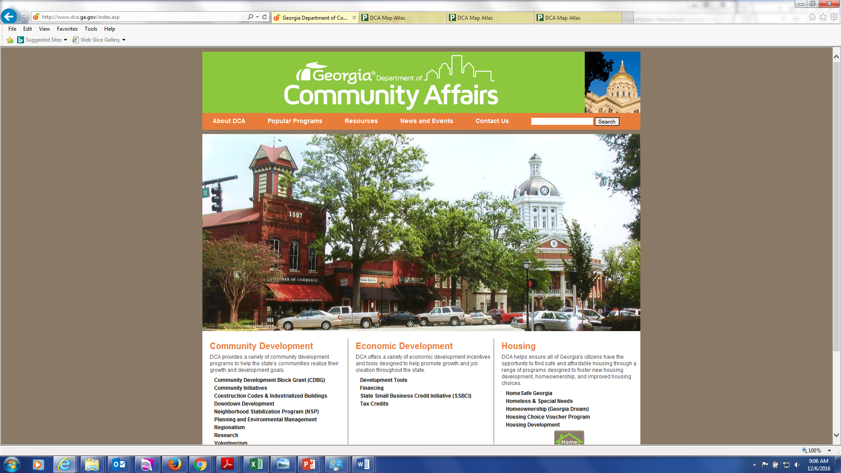

Slide 62
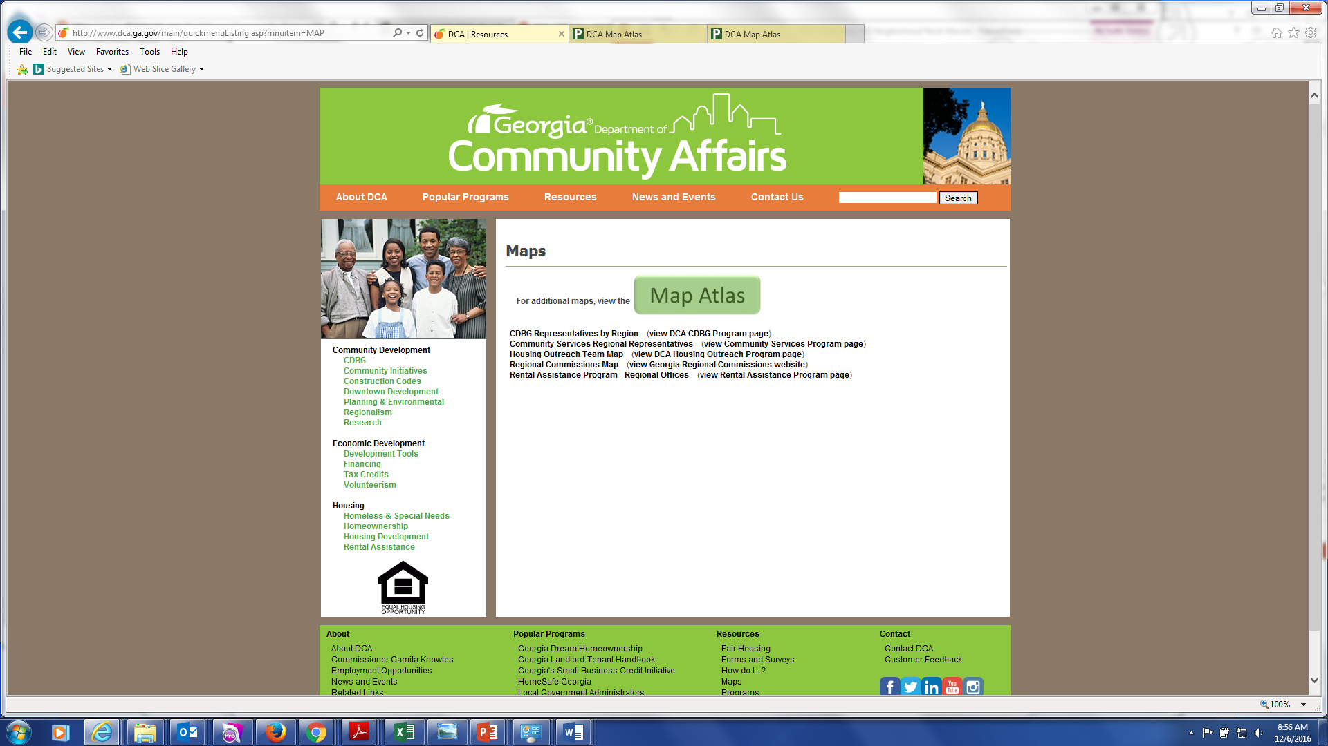

Slide 63
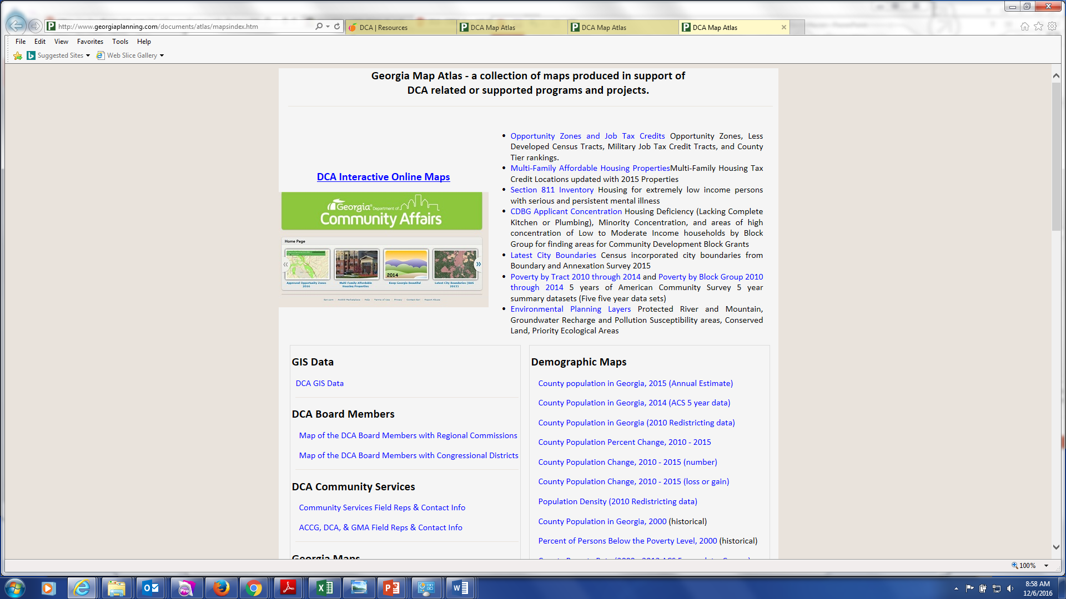

Slide 64
Impact Considerations
Impact Of Project
Documented severity of need.
Photos of all problems described
Must support the budget for the proposed activity
Describe the effect the proposed project will have on the identified needs as well as the community as a whole.
DCA 4 should describe the needs of the entire community as well as the needs the project will address

Slide 65
Impact Considerations
Impact Of Project
DCA 5 should propose a plan to address all needs described in DCA 4
If a Phased approach is needed to address all needs, the plan should be discussed in as much detail as possible.
Indicate Number of persons who will benefit.
Overall CDBG Cost per person.

Slide 66
Successful Strategies Financial Participation
Owner Participation as Fixed Percentage of Annual Income based on Income Level.
Example: for Participants at or below 30% AMI…
“Participants whose income is below 30% of AMI are required to pay 3% of their annual income”……

Slide 67
Successful Strategies Financial Participation
Owner Participation as Fixed Percentage of Annual Income based on Income Level.
Example: for Participants between 30% to 50% AMI…
“Participants whose income is between 30% and 50% of AMI are required to pay 6% of their annual income”…..

Slide 68
Successful Strategies Financial Participation
Owner Participation as Fixed Percentage of Annual Income based on Income Level.
Example: for Participants between 50% to 80% AMI…
“Participants whose income is between 50% and 80% of AMI are required to pay 9% of their income”

Slide 69
Successful Strategies
Mandatory Homebuyer Counseling
Credit Counseling (must be documented)
Employment training
Holistic approach to neighborhood revitalization
Address issues and concerns along with housing/infrastructure problems
Discuss how identified problems not addressed with CDBG funds will be addressed

Slide 70
Compliance with Regulations
Acquisition must be in compliance with Uniform Relocation Act (URA)
Easements for Public Facility Improvements
Dilapidated Units

Slide 71
Compliance with Regulations
Relocation – Permanent
Uniform Relocation Act (42 months)
Owner OR Tenant
104(d) “Barney Frank” (60 Months)
Tenant Only (Rent to Rent)
One for One Replacement

Slide 72
Compliance with Regulations
Identify Available Resources
Comparable Units
Provide Basis for Relocation
Current vs. available rents rates

Slide 73
Compliance with Regulations
New Construction Eligibility
Last Resort
No Available Resources Exist
Cost exceeds allowable limits:
Application must provide credible evidence.
Cheaper to build (including land) than purchase.
Not-for-profit or for-profit developer
Approved Community-Based Development Organization.

Slide 74
For Target Areas, Make sure you . . .
Provide a Unit by Unit Analysis
Keyed to Map
Picture(s) of Units (Exterior and Interior)
List of Deficiencies for Targeted Units

Slide 75
For Target Areas, Make sure you . . .
Provide Cost Estimates:
Keep in Mind that Actual work may be 1 or 2 years away….Budget Appropriately.
Provide Reasonable estimates for each unit based on complete walk through.
Budget for Lead Hazard Control.
(Program will pay all LBP Costs)

Slide 76
For Target Areas, Make sure you . . .
Provide Target Area Data:
Total Number of Units.
Total Number of Substandard units.
Total Number of Dilapidated units.
Total Number of Owner Occupied.
Total Number of Renter Occupied.
Total Number of Vacant.

Slide 77
For City or County Wide Programs, Make sure you . . .
Describe how units were chosen in a fair and equitable manner.
Provide description of overall housing conditions jurisdiction wide - IMPORTANT
Overall assessment of need for Housing improvements and justification for the chosen units.
Scores for Applications lacking overall assessment are reduced.

Slide 78
Other Important things to Do
Provide Financial Plan!!!
In Narrative and on Financial Plan Form provided in Appendix H of Applicant Manual
OR
Exhibit H in Guidelines for Residential Rehabilitation Programs
Explain formula for Owner Participation Amounts.

Slide 79
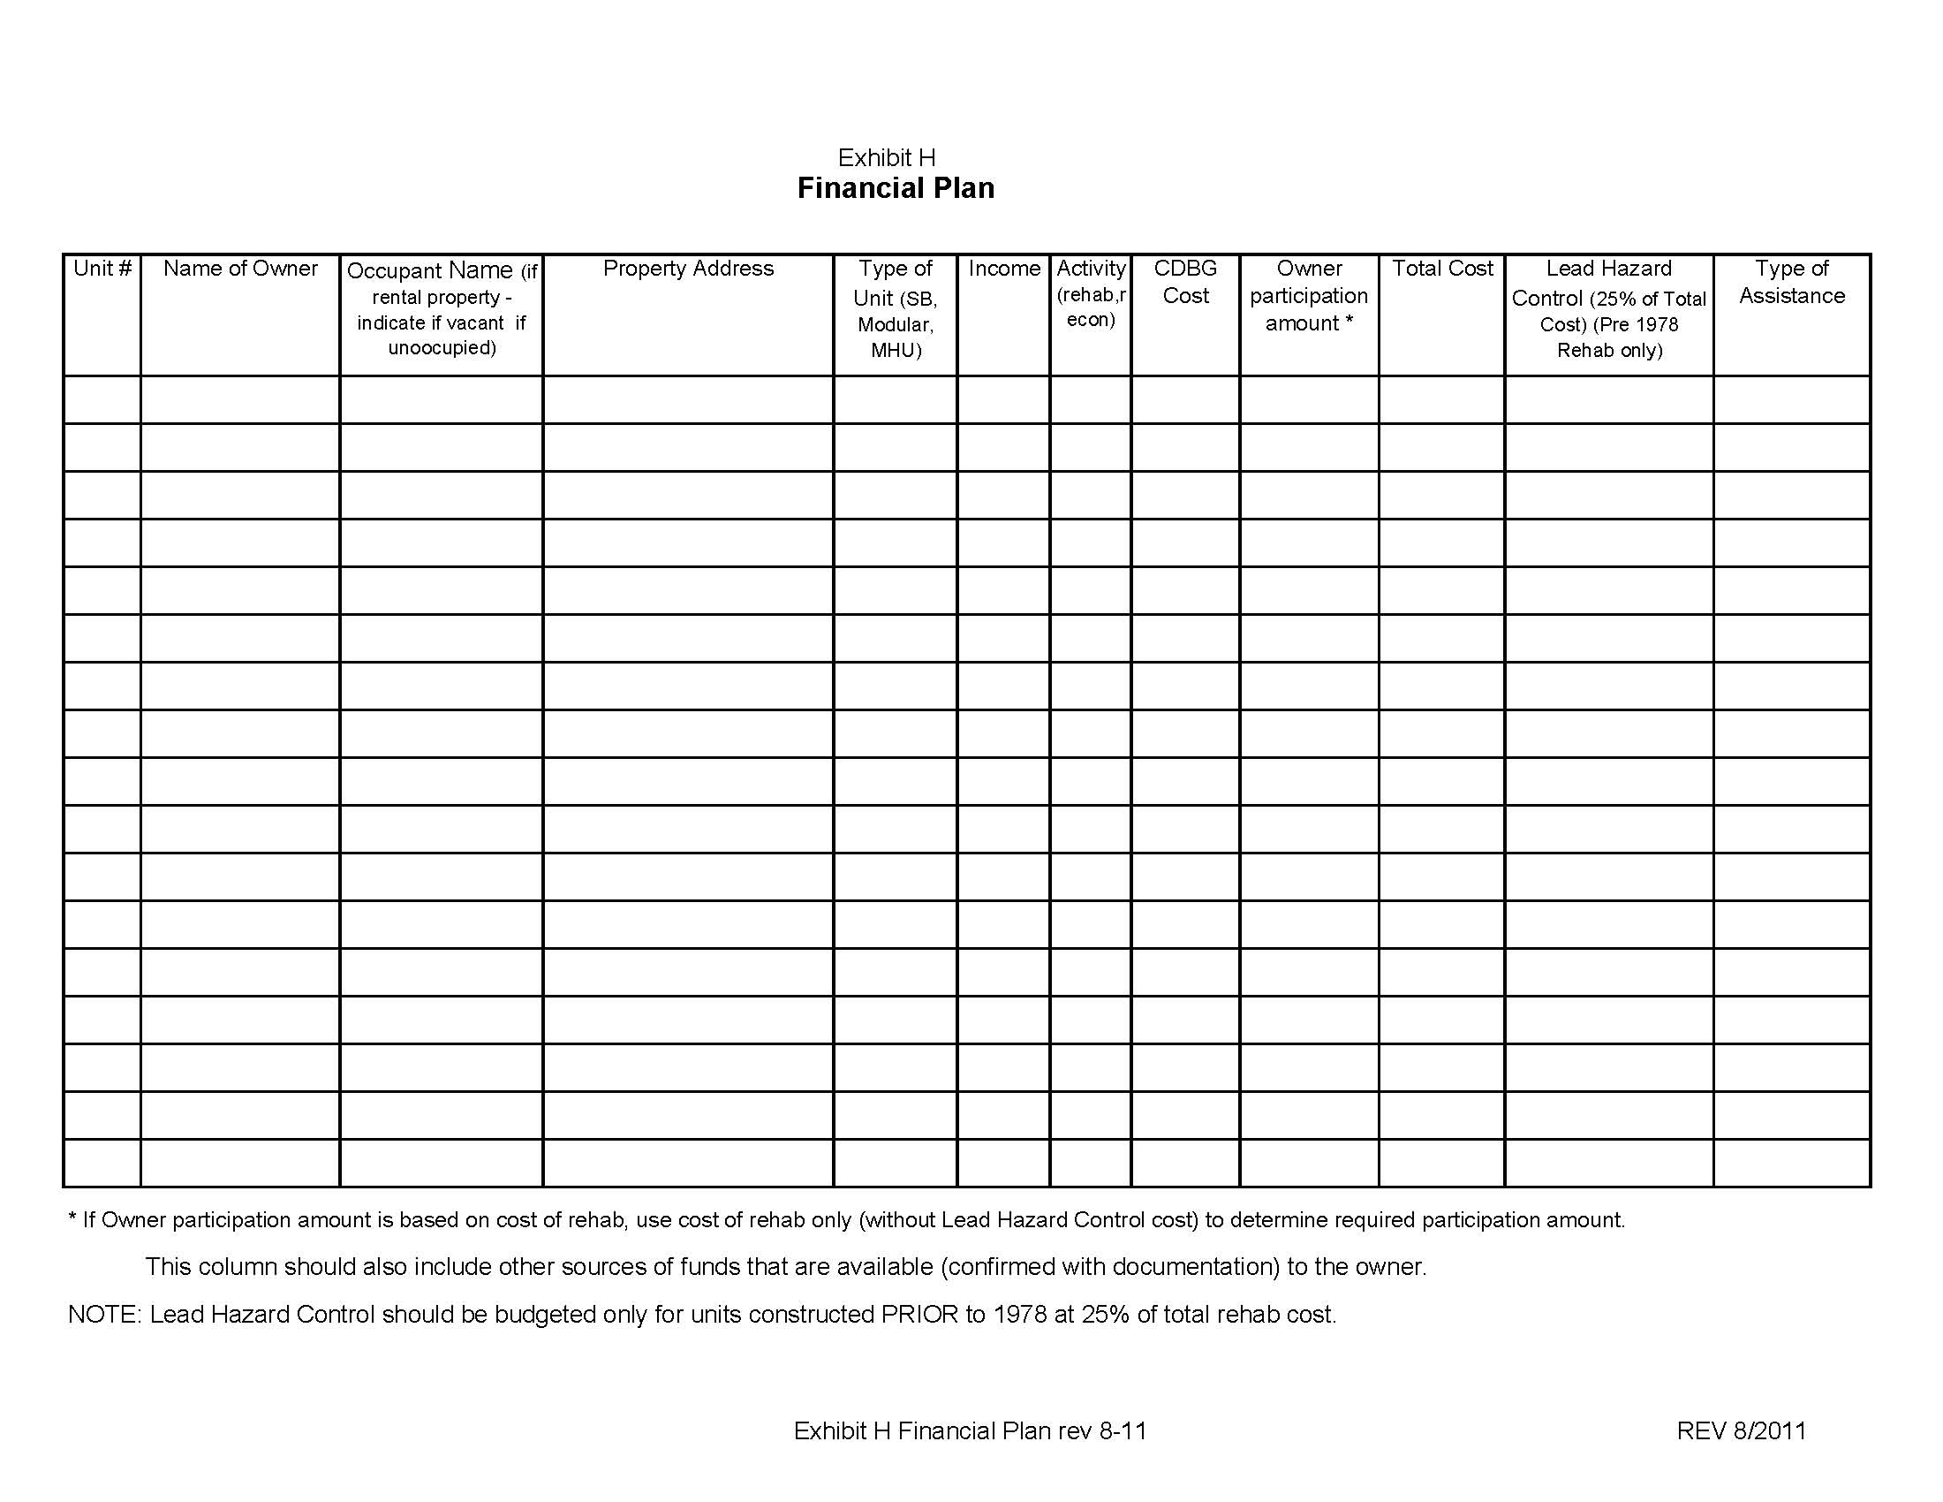
This form should not include PDC’s or relocation – those are itemized on DCA 8

Slide 80
Things NOT TO DO
Work in Previous CDBG Target Areas or Units.
Propose 100% Grants or 100% DPL’s.
Propose Assistance to Landlords that exceeds 50% of Rehab Cost (Not including Lead Hazard Control).
Include Elected Officials or their family members without full disclosure in the application (Conflict of Interest).

Slide 81
Things NOT TO DO
Exceed $7,000 TOTAL COST to Rehab a Manufactured Housing Unit (MHU) without VERY strong justification. (Advance approval from DCA Required.)
Prepare grant request based on Maximum funds available rather than needs identified.

Slide 82
Problems with Previous Applications
100% grants/DPL’s.
Proposed Unit Deficiencies not adequately described.
Per Unit cost estimates not included or too high.
Flat Participation amounts for all Participants regardless of income level.
Failure to present clear financial plan and Owner Participation formula.

Slide 83
Problems with Previous Applications
Rental Properties proposed without convincing commitment to participate by Landlord.
Lack of consistency throughout application.
Numbers do not add up or differ from one section to another.
Numbers on DCA 8 does not reconcile with numbers projected in DCA 5.
Failure to describe who will play key roles in program administration.
Failure to address Lead Hazard Control.

Slide 84
Problems with Previous Applications
Failure to adequately describe or document need for project (Including alternatives to strategy).
Failure to budget for all needed activities:
Temporary relocation.
Easements/Acquisition.
Lead Hazard Control.
Failure to Disclose Conflict of Interest.

Slide 85
Don’t Forget:
If rehab of vacant units is proposed, provide plausible explanation.
Provide clear and understandable Owner participation formula – that cover ALL circumstances (even if there are no TA families currently in a particular L/M Income Range)

Slide 86
Don’t Forget:
Include House by House Analysis:
Units keyed to map
Provide pictures (Exterior & Interior)
Cost Estimate by Unit
List of Deficiencies
Feasibility Test Forms (for Reconstruction)

Slide 87
REMEMBER:
If Rental Rehab is Proposed, Include Convincing Commitment Documentation from Owners.
50/50 $ Contribution Required
Include Map Identifying all Units, Construction Type, Condition and Proposed Activity.

Slide 88
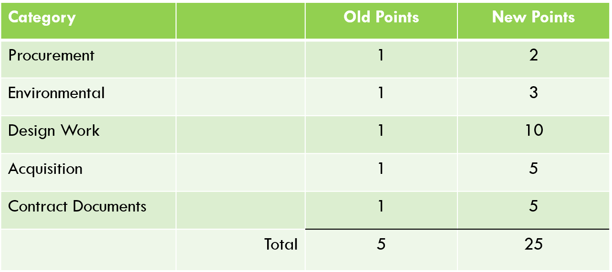
Bonus Points – New Values

Slide 89
Bonus Points – New Values
Contract Documents – as related to Housing:
Neighborhood Revitalization. A maximum of 10 points may be earned.
1 point may be earned for having the rehab advisor under contract.
Documented by a letter signed by the CEO stating the procurement process has been followed and identifying the individual/firm that has been selected.
5 points may be earned for completing title searches on all proposed units.
Documented by a letter from the attorney stating that title searches on the proposed units have been completed and listing the property addresses and owners.
4 points may be earned for completing work write-ups on all units.
Documented by providing a copy of each work write-up with the application.
For Multi-Activity (Infrastructure)
10 points may be earned for having the design completed and submitted to the appropriate agencies.
Documented by a letter from the Engineer/Architect that design is completed and must include a listing of the agencies to which plans have been submitted along with the dates of submission.
No, You cannot get 20 points if you do both

Slide 90
Bonus Points (continued)
Acquisition Activities. A maximum of 5 points may be earned.
1 point will be given if the project does not require acquisition.
Documented by a letter from the CEO stating that no acquisition is needed.
3 points total may be earned if all acquisition has been identified and title searches are completed.
Documented by a letter from the attorney stating that the title searches on all the properties required for start of construction have been completed and listing the property addresses and owners.
Five points total may be earned for completed acquisition packages.
Documented by including easement plats for all required easements along with a valuation determination for each easement or parcel to be acquired.
Remember that all property acquired in anticipation of the proposed CDBG project regardless of the source of funding is subject to URA requirements. Non-compliance with URA requirements could lead to ineligible and non-reimbursable costs.
Notes:
A bonus point will not be given if the chief elected official submits a letter stating acquisition is not required but DCA-8 or the engineering report has budgeted for acquisition.

Slide 91
Bonus Points (continued)
Contract Documents – Public Facilities. A maximum of 5 points may be earned.
5 points may be earned for receiving all required plan approvals and/or permits from all applicable federal, state, and local agencies and having bid packages ready for distribution.
Documented by copies of approval letters and/or explanation of approval due to “no response”, and a certification from the CEO stating that the project is ready for bid.
Neighborhood Revitalization. A maximum of 5 points may be earned.
5 points may be earned for completing income verifications.
Documented by a letter from the CEO listing the names and addresses of the participants for whom income verifications have been completed.
Contract documents should not be submitted to DCA.

Slide 92
Bonus Points (continued)
Bonus points should be claimed on DCA-5.
A brief narrative should be included in DCA-5 stating the bonus points claimed and the rationale for claiming the points.
DCA-5 should clearly reference all documentation attached to the application that demonstrates accomplishment of the bonus point thresholds outlined above.

Slide 93
Statutory References
Regulations: 24CFR,570,xxx
Uniform Act: 49 CFR, Part 24
Section 104(d) “Barney Frank”: 24 CFR, Part 42
Lead-Based Paint: 24 CFR, Part 35
Last Resort: 49 CFR, Part 24.404
e-CFR Website
http://ecfr.gpoaccess.gov/

Slide 94
LASTLY. . .
DISCUSS PROPOSED PROJECT
WITH DCA STAFF
Glenn Misner
404-679-3138
glenn.misner@dca.ga.gov

Slide 95
Questions?

Slide 96
GOOD
LUCK!

