Slide 1
Community Revitalization through Housing Tax Credit Program
10/5/2017
Grace Baranowski, Housing Policy Analyst

Slide 2
Overview
What is the Housing Tax Credit Program (LIHTC)?
Why would we want it in our community?
How does it work?
How can it work for us?

Slide 3
What is the Housing Tax Credit Program?

Slide 4
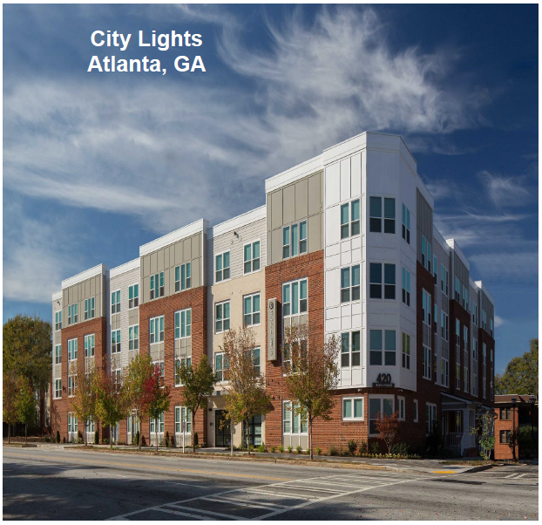
What is the Housing Tax Credit?
Largest producer of affordable housing
Highly accountable: private sector participation and state administration
Enacted by Tax Reform Act of 1986 under Pres. Reagan
Georgia authorized matching state housing credit in 2001

Slide 5
Why would our community want this?

Slide 6
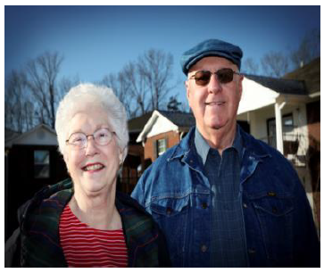
Our neighbors need affordable housing solutions
Seniors seeking independent living
Georgia working families with low and moderate incomes
Individuals with disabilities
Residents at Lone Mountain Village (Ringgold, GA)

Slide 7
Affordable housing helps students and teachers
Affordable housing minimizes disruptive, frequent moves, which increase the likelihood of low test scores and dropping out of schools.
School districts across the country have developed innovative affordable housing programs that recognize it is important for teachers to put down roots in the communities
  Federal government’s “Teacher Next Door” program helps teachers live in the school districts where they teach at an affordable price.
Notes:
http://www.affirmedhousing.com/resources/myths.html

Slide 8
Housing credit properties revitalize corridors
After
Before
Photo credit: Walton Communities
Photo credit: Augusta Chronicle
Spotlight: Walton Oaks (Augusta, GA)

Slide 9
Walton Oaks
(Augusta, GA)
Platform for centralizing programs and services
Culmination of the Underwood Homes Redevelopment (multi-phase effort); DCA awarded over $3.3 million between 2009-13.
Mixed-use community developed and built by Walton Communities in association with the Augusta Housing Authority
Provides residents with a number of special programs and services:
  Kid’s Club Program
  Family Life Library
  Individual & family counseling
  Partners with local organizations to bring additional services and support to residents

Slide 10
2016 Georgia Housing Credit Economic Impact
In 2016, the State funded a total of 2,438 units.
A funded tax credit property had, on average, 90 units.
In the first year after 90 units have been placed in service, the surrounding community benefits:
In the first year after 2,438 units have been placed in service, the state as a whole benefits:
Local Government (average, 90 units)
Local Income | $10.5 million
Tax and Local Government Revenue | $2.0 million
Local Jobs | 149 jobs
Statewide (total, 2,438 units)
Local Income | $302.3 million
Tax and Local Government Revenue | $80.5 million
Local Jobs | 4,145 jobs

Slide 11
What about property values?
Several studies have shown that affordable housing generally has no adverse effects and may even have positive effects.
One study found:
  Every 100 additional tax credit units led to a 14.9% increase in the surrounding neighborhood’s median home value.
  Overall, each new tax credit unit increased the number of recently built rental units by 0.8 units within one kilometer of the project site.
Notes:
(“One study”): https://www.ncbi.nlm.nih.gov/pmc/articles/PMC3824966/
Affordable housing is even more likely to neutrally or positively affect the surrounding neighborhood when it is thoroughly integrated into the neighborhood.
Design, management, location, and dispersion
http://www.affirmedhousing.com/resources/myths.html
MYTH: Affordable housing will look like “cheap housing.”
REALITY: Affordable housing must comply with the same building restrictions and design standards as market-rate housing. Builders know that it makes sense to use the same construction techniques and materials for all units in a development. Furthermore, because affordable housing is often funded in part with public money, sometimes it needs to comply with additional restrictions and higher standards than market-rate housing. Groups like the Franciscan Ministries, the Community Housing Association of DuPage, the Lake County Residential Development Corporation (LCRDC) and a number of for-profit housing developers provide strong examples of high-quality affordable housing that blends in with market-rate housing here in the Chicago region. Many developments incorporating affordable units are built as low-rise garden apartments at a scale similar to large houses. Affordable housing is not affordable because it’s built with “sub-quality” materials; it is affordable in the sense that it is less costly to live in because it is supported by additional public and private funds.

Slide 12
Impact on local tax base and property tax system
Nationwide, the effective tax rate (property tax paid relative to the market value) for multi-family complexes is significantly higher than single-family homes.
Multi-family housing offers greater efficiency in use of public services and infrastructures.
Lower housing costs help retain volunteer fire and ambulance crews.
Notes:
A Massachusetts study of 41 towns found that multi-family complexes often generated a profit for local governments.
http://www.affirmedhousing.com/resources/myths.html

Slide 13
What about traffic?
DCA awards more points to Applications proposing a site in an area with access to local jobs, particularly where employees working in that area have significant commute distances to their jobs.
Affordable housing helps reduce the number of cars on the road by allowing working people to live near their jobs
Studies show that affordable housing residents own fewer cars and drive less than residents of market-rate homes.
Notes:
http://www.affirmedhousing.com/resources/myths.html

Slide 14
How does the Housing Tax Credit program work?

Slide 15
How does this competitive program work?
The IRS allocates ~$2.35/resident to each state
The State Housing Finance Agency sets the rules (QAP)
Developers compete to win award of credits
Private investors contribute equity to build housing and receive benefits of the tax credits
Housing is built and rents must be affordable (typically 60% AMI) for at least 30 years
Once housing is inhabited, then tax benefits begin

Slide 16
QAP development occurs annually
Listening sessions, consultation: Aug.-Sept.
QAP draft out for public comment: early Oct.
QAP finalized: mid-Nov.
Gov. Deal signs QAP: early Spring (Jan.-Feb.)
2017 Application submission deadline was May 25

Slide 17
Snapshot: 2016 Funding Round
29 (of 79) applications funded
11 (of 29) properties in rural
25 (of 29) properties new construction
12 new and rehabilitated senior properties funded

Slide 18
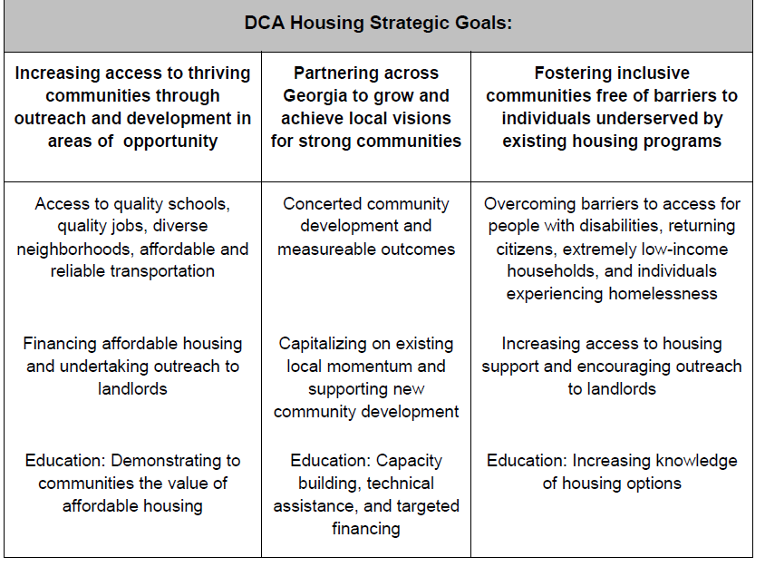
DCA State Priorities
Notes:
wes

Slide 19
The QAP’s two tracks for development
Revitalizing Communities
Communities of Opportunity

Slide 20
How can it work for us?

Slide 21
Community-Driven Opportunities to Score
Leveraging with local HOME, CDBG, or other funds
GICH communities are able to choose one property to receive 1 pt
Rewarding community investments:
  Proximity to regular or on-call bus route
  Brownfield remediation and development
Building on community-driven revitalization strategies

Slide 22
Spotlight: Rome, GA
Notes:
What does it look like to successfully integrate DCA funding streams to revitalize a community?

Slide 23
Spotlight: Transforming Rome, GA
South Rome Boys and Girls Club built with a combination of CDBG funds and a SPLOST
  Close to nearby elementary school
South Rome Redevelopment Corp & Laurel Street Residential awarded 2015 credits, starting construction of scattered-site development in June 2016
  A mix of apartment units and units designed to look like single-family homes
  Budget was $13.8 million – construction costs mostly financed by sale of federal and state tax credits.
Notes:
Rome recognized with Community Transformation Award in October 2015 GICH celebration; this award “highlights innovative neighborhood revitalization that improves educational opportunities within the community, provides transportation options, increases retail development, and incorporates walkability.”
http://www.northwestgeorgianews.com/rome/news/local/ground-broken-for-south-rome-housing-housing-to-be-scattered/article_559c69e2-52eb-11e6-aa77-6bff53ed385a.html

Slide 24
Spotlight: 2015 DCA Program Grants (Rome, GA)
Tax Credits
  $771,929 in State Tax Credits
  $77,929 in Federal Tax Credits
Downtown Development Revolving Loan Fund
  July 2015 - $222,400
  Oct 2015 - $75,000
  Nov 2015 - $176,000
  Nov 2015 - $250,000
Notes:
Through the DDRLF, the state loans up to $250,000 for a downtown redevelopment project, at below-market interest rates. This funding covers 40% of a project’s total cost, traditional bank loans finance 50%, and the owner or developer fronts 10%. Rome has received over $2.7 million in DDRLF loans.
By 2012, the community had leveraged nearly $6 million in low-interest loans into over $22 million in total private investment.
https://www.nado.org/vibrant-rural-communities-rome-georgia/

Slide 25
Spotlight: Transformational Communities
Notes:
What does leveraging a revitalization plan look like?

Slide 26
Defining “Community” for Revitalization
Community Revitalization Plan
  “Clearly delineate a targeted area that includes the proposed site but does not encompass the entire surrounding city, municipality, or county” (p. 17 of 44).
Community Transformation Plan
  “Clearly delineate a targeted area (Defined Neighborhood) that includes the proposed site but does not encompass the entire surrounding city, municipality, or county” (p. 18 of 44).
“The Community Transformation Plan’s Defined Neighborhood may be smaller than that of the Community Revitalization Plan. This Defined Neighborhood is not to be smaller than one census tract but may not encompass the entire city or county in which the proposed site is to be located. Exceptions may apply where the city or county falls within one tract” (p. 19 of 44).

Slide 27
Community Revitalization Plan
Sub-Section A

Slide 28
Community Revitalization Plans
2017 (Maximum points: 2)
“Contributes to a written Community Revitalization Plan for the specific community in which the property will be located.” | 1 pt
“Is in a QCT and that contributes to a written Community Revitalization Plan for the specific community in which the property will be located.” | (+1 pt)

Slide 29
2017 Changes to “Community Revitalization Plan” Requirements
Must meet:
Ineligible if:
a) Clearly delineate a targeted area that includes the proposed site but does not encompass the entire surrounding city, municipality, or county;
b) Include public input and engagement during the planning stages;
c) Call for the rehabilitation or production of affordable rental housing as a policy goal for the community;
d) Designate implementation measures along with specific timeframes for the achievement of such policies and housing activities. The timeframes and implementation measures must be current and ongoing, as evidenced by a list included in the DCA Neighborhood Redevelopment Certification of specific actions taken in furtherance of the plan within one (1) year of Applicant submission and associated documentation;
e) Include a discussion of resources that will be utilized to implement the plan; and
f) Be officially adopted by a Local Government.
a) The plan was formulated by a Project Team member and submitted to a local government for approval.
b) The plan is a short-term work plan, comprehensive plan, consolidated plan, municipal zoning plan or land use plan.
c) The plan is outdated and does not reflect the current neighborhood conditions. Plans that are more than three (3) years old will be presumed outdated unless documentation regarding the continued viability of the plan from the Local Government is submitted with the Application as required below.
d) Plans that are less than six months old at the time of Application Submission will not be considered.
Notes:
Additions to definition of Community Revitalization Plan:
In 2017, we state that the plan must “not encompass the entire surrounding city, municipality, or county”
In 2016, the plan must c) “be current, ongoing, and directly affect the proposed site” and f) “designate implementation measures along with specific time frames for the achievement of such policies and housing activities. The timeframes and implementation measures must be current and ongoing.”
In 2017,” item d) combines these two requirements.
In 2017, we removed the need to “include an assessment of the existing physical structures and infrastructure of the community” in a recognized community revitalization plan, as many different types of plans were submitted, and the standards for assessment varied depending on the uses of the plan outside of the QAP.
Ineligible:
Four years became three years

Slide 30
Ensuring the CRP is active and ongoing
Documentation of specific actions taken in furtherance of the goals of the plan within one (1) year of Applicant submission
If the plan is older than three (3) years at the time of submission, the Applicant must also include a letter from an official community representative certifying that the plan is current and ongoing. This letter must include an updated list of funding sources, implementation measures, and timeframes.
Notes:
Additions to Minimum Documentation for Community Revitalization Plan

Slide 31
Community Transformation Plan
Sub-Section B

Slide 32
Transformation: Coordinated service delivery
Contains strategies for the coordination and provision of local services and resources to those most in need in a Defined Neighborhood around the development.
A holistic, placed-based strategy to transform the Defined Neighborhood by addressing critical problems and challenges identified by the citizens as well as public and private community partners.
  The solutions proposed may be existing or newly planned but each must represent an intentional community strategy targeting both the future residents and surrounding community within the Defined Neighborhood as a whole.
  The Community Transformation Plan may include initiatives highlighted elsewhere in the Application, such as Scoring Sections XVI. Innovative Project Concept and XIX. Healthy Housing Initiatives and Threshold Section IV. Required Services, if the initiatives were collaboratively reached as outlined below.
Notes:
“A Community Transformation Plan…represents a community’s deepened commitment to investing in its most valuable asset: its residents.”

Slide 33
Transformation Team (2 points)
Who is driving this change? Who is ensuring its sustainability?
Transformation Team (2 pts)
Team contains Community-Based Developer (1 pt)
AND/OR
Team partners with Community Quarterback (1 pt)

Slide 34
Who is a Community-Based Developer? (1 pt)
A Project Team member…that demonstrates an ongoing commitment to developing collaborative, holistic solutions in the Defined Neighborhood the proposed development is located. A CBD will be identified by meeting:
At least two of these requirements:
i) Proof of successful partnership with at least 2 established community organizations that serve the area in which the proposed property will be located in.
ii) In the last three years, CBD has participated or led philanthropic activities benefitting either: a) Defined Neighborhood b) Targeted area surrounding their development in another Georgia community
iii) CBD has been selected through local government’s community-driven initiative in response to an RFP or other public bid process
OR
Meeting this requirement
iv) Project Team received a HOME consent for proposed property and was designated as a CHDO.
Notes:
Minimum documentation:
In the Community Transformation Plan Certificate, the Applicant identifies at least one Georgia community in which the Applicant has created long-term partnerships with local organizations to improve community outcomes (e.g., improved educational achievement, increased access to health services) surrounding an Applicant’s development. The Applicant should identify the community in which the proposed development will be located if the Applicant is able to do so (item i).
Each established community partner named by the Applicant in the Community Transformation Plan Certificate provides one (1) letter that 1) recognizes the length of their partnership with the Applicant and confirms that this relationship is ongoing; and 2) discusses how the partnership has measurably improved community development outcomes (item i).
Grant statements, press releases, letters, or other documentation substantiating the local philanthropic activities (item ii).
The RFP used by the local government to select the Community Based Developer, or one (1) letter from the local government describing the process used to select the Community Based Developer (item iii).
One (1) letter from DCA certifying that the Project Team received a HOME consent and was designated as a CHDO (item iv).

Slide 35
Who is a Community Quarterback? (1 pt)
An external partner not part of the Project Team
The Community Quarterback is a local community-based organization or a public entity that performs the following:
  Drives the revitalization initiative to make sure the housing, education, and community wellness components are successful and sustainable;
  Ensures the people in the Defined Neighborhood are engaged, included, and served; and
  Serves as a single point of accountability for partners and funders.
The Community Quarterback must also have a demonstrated record of serving the Defined Neighborhood, as delineated by the Community Transformation Plan, to increase residents’ access to local resources such as employment, education, transportation, and health.
Notes:
Minimum documentation:
One (1) letter from the local community-based organization or public entity confirming their partnership with the Project Team to serve as Community Quarterback.
• In the Community Transformation Plan Certificate, the Applicant provides a summary of the mission and activities of the Community Quarterback.

Slide 36
Quality Transformation Plan (4 Points)
Applicants that receive at least one point under “Community-Based Team” are eligible to receive up to total 4 points here.

Slide 37
Any Transformation Plan must include:
Assessment of the existing Community Revitalization Plan and any other past strategies directly affecting the Defined Neighborhood.
Data from Community Engagement and Outreach that demonstrates the level to which the local population to be served (low-income families or seniors) currently accesses community resources (e.g., education, health services, employment, and transportation).
Input from Community Engagement and Outreach that identifies the challenges the local population to be served face in accessing those community resources.
For each prioritized challenge, the Transformation Team and Partners identify at least one measurable goal for 1) increasing future residents’ access to these resources and 2) catalyzing improved access to such resources for the Defined Neighborhood as a whole. For each goal, the Community Transformation Plan names at least one solution to be implemented by one or more Transformation Partners and/or Team members.
Notes:
Minimum Documentation:
• A copy of the full Community Revitalization Plan that meets DCA requirements.
• A copy of the full Community Transformation Plan that meets DCA requirements.
• A completed Community Transformation Plan Certificate
• A map of the Defined Neighborhood surrounding the proposed site targeted by the Community Transformation Plan.
• Details regarding meeting(s) between Transformation Partners
• Evidence of outreach efforts to engage the local population to be served.
The Community Transformation Plan must include a full description of all goals, solutions, metrics of success, milestones, resources committed, and entities responsible.

Slide 38
Community Engagement and Outreach
Public and Private Engagement
Family Applicants must engage at least two of the following Transformation Partners, while Senior Applicants must engage at least one:
  a local K-12 school district representative,
  a local health provider,
  an employment services provider,
  and/or a transportation services provider.
The Transformation Team may engage additional community partners beyond this list after meeting the stated minimum requirement. The Transformation Team must show documentation that at least one (1) meeting between Transformation Partners open to the public were held to identify challenges to transformation.
Citizen Outreach
The Transformation Team must make substantial efforts to record feedback from the low-income population to be served on what challenges prevent this community from accessing local resources such as education, health services, employment, and transportation.
This requirement for Community Outreach may be met through one (1) survey or two (2) public meetings. The requirement for one of the public meetings may be satisfied by the one required public meeting between Transformation Partners.

Slide 39
Community Investment (4 points)
Introduces “Community Improvement Fund”
2017’s “Transformational Communities” adopts the two sub-sections from 2016’s “Leveraging”:
  “Long-Term Ground Lease”
  “Off-Site Improvement, Amenity, and Facility Investment” (now “Third-Party Capital Investment.”)

Slide 40
Community Improvement Fund (1 pt)
Receive a commitment of funds amounting to no less than $50,000 for services to support the provision of community services and resources to the proposed development’s future residents and neighbors.
The commitment may be from the Applicant itself or another entity, related or unrelated to the Applicant.
The funds must be directed to a designated financial account that is capable of documenting specific deposits and expenditures. The funds must be spent out over a period of five (5) years following the date that the development is placed in service.
Notes:
Minimum Documentation:
• Commitment of funds.
• Detailed source of funds.
• Detailed use of funds.
• Narrative of how the secured funds support the Community Revitalization Plan or the Community Transformation Plan.

Slide 41
Approved Uses of Community Improvement Fund
Is the proposed development a Family Property?
No
Utilized Community Transformation Plan
(sub-section B)
Utilized only Community Revitalization Plan
(sub-section A)
Yes
Funds must support the goal of increasing educational achievement of children age 18 and under living in the property.
Funds must support one or more collaborative solutions to provide services and resources as outlined in the Community Transformation Plan*
*The provision of services and resources may be an Applicant-operated fund to support educational achievement in the community surrounding the development.
Funds must support the provision of services and resources to the proposed development’s future residents and neighbors*
Notes:
If a) the Application is not a Family property and a Community Transformation Plan, the dedicated funds must support one or more collaborative solutions to provide services and resources as outlined in the Community Transformation Plan.
If b) the Application is not a Family property and includes a Community Revitalization Plan, the dedicated funds must support the provision of services and resources to the proposed development’s future residents and neighbors; these services and resources may be highlighted elsewhere in the Application, such as Scoring Section XIX. Healthy Housing Initiatives and/or Threshold Section IV. Required Services.
Additionally, for either a) or b), the provision of services and resources may be an Applicant-operated fund to support educational achievement in the community surrounding the development.

Slide 42
Long-Term Ground Lease (1 pt)
“One (1) point will be awarded for Applications receiving a long-term ground lease (no less than 45-year) from a local public housing authority or government entity for nominal consideration and no other land costs.”
“Leases can only be considered for points under this sub-section and not under any other scoring sub-section. No funds other than what is disclosed in the Application may be paid for the lease either directly or indirectly.”
Notes:
Minimum Documentation:
• A copy of the ground-lease agreement.

Slide 43
Third-Party Capital Investment (2 pts)
Widened mechanisms for receiving third-party support:
  Unrelated third-party may now include businesses
  Local government dedicating a local funding mechanism (e.g., tax-allocation district)
Allows Applicant to tie in investment to completion of a targeted (impacting no more than three census tracts), place-based component of a current and ongoing Community Revitalization Plan/Community Transformation Plan.
Geographic scope has widened: investment must still serve the proposed tenant base but may now exist no more than 0.5 miles (used to be adjacent) from proposed project site
Allows Applicants to receive credit for slightly older completed investments: “improvements that were completed more than 3 years (used to be 1) prior to Application Submission are not eligible for points.”
Flexible Pool | Investment amount at least 10% of TDC | 2 pts
 | Investment amount at least 5% but less than 10% of TDC | 1 pt
Rural Pool | Investment amount at least 5% of TDC | 2 pts
 | Investment amounts at least 2% but less than 5% of TDC* (NEW) | 1 pt

Slide 44
Community Designations (10 Points)

Slide 45
Community Designations (10 points)
HUD Choice Neighborhood Implementation (CNI) Grant
Proposed development in area that has received a CNI grant
CNI awardee must select only one Application to receive these points. This development must be identified in the CNI Grant application.
Purpose Built Communities (PBC)
One (1) Application that is designated by PBC as furthering one (1) PBC’s transformation.
PBC must select only one (1) Application to receive these points.

Slide 46
Wrap Up
To receive information on trainings, workshops, and general program updates, sign up to our email list at: http://www.dca.ga.gov/housing/HousingDevelopment/programs/OAH.asp
Contact Grace Baranowski (grace.baranowski@dca.ga.gov) with any questions

