Slide 1
CDBG Helpful Resources
October 3, 2017
Michael Casper, Compliance Manager

Slide 2
Resources
Government in the Sunshine:
A Guide to Georgia's Open Meetings and Open Records
Laws for Municipal Officials
https://www.gmanet.com/Advice-Knowledge/GMA-Publications/Government-in-the-Sunshine-A-Guide-to-Georgia-s-Op.aspx

Slide 3
Resources
Davis Bacon Guide
https://www.hud.gov/sites/documents/4812-LRGUIDE.PDF
or
https://www.hud.gov/program_offices/davis_bacon_and_labor_standards

Slide 4
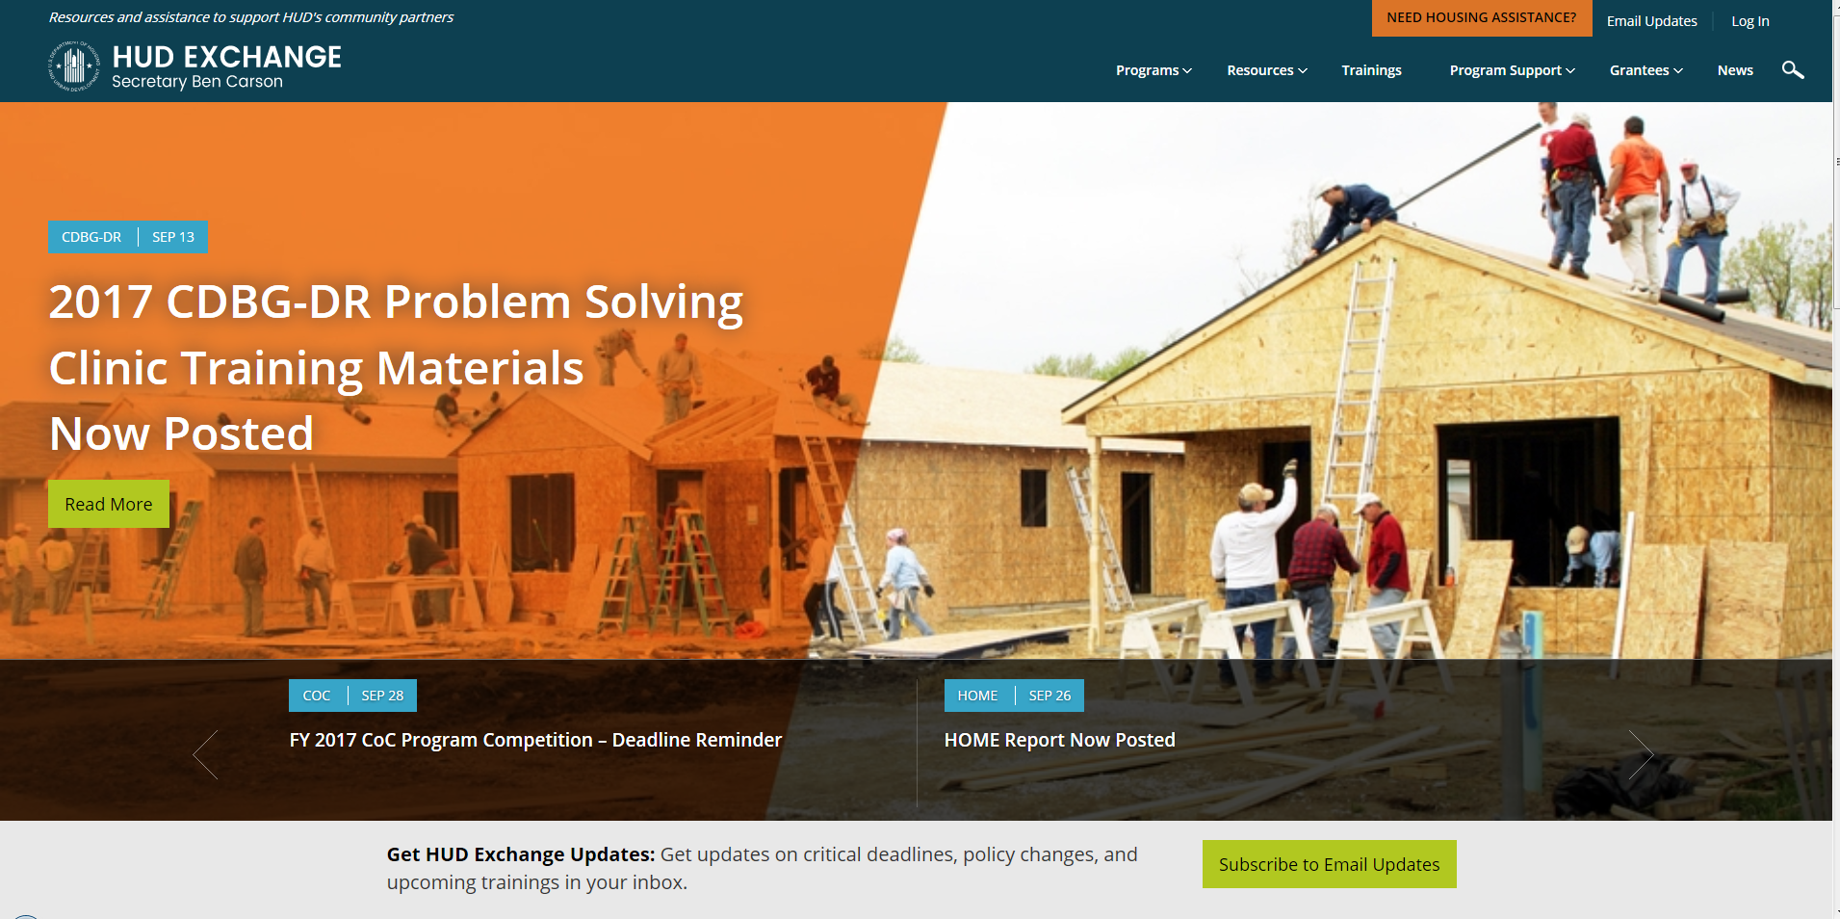
Resources
HUD Exchange
https://www.hudexchange.info/
https://www.hudexchange.info/

Slide 5
Resources
Conflict of Interest Regulations
24 CFR 570.489 (h)
https://www.gpo.gov/fdsys/pkg/CFR-2012-title24-vol3/pdf/CFR-2012-title24-vol3-sec570-489.pdf
Begins on page 126

Slide 6
Resources
Sole Source Requests
https://www.gpo.gov/fdsys/pkg/CFR-2012-title24-vol1/pdf/CFR-2012-title24-vol1-part85.pdf
24 CFR Part 85

Slide 7
Resources
2 CFR 200
The “Super Circular”
https://www.ecfr.gov/cgi-bin/text-idx?tpl=/ecfrbrowse/Title02/2cfr200_main_02.tpl

Slide 8
Resources
Environmental Regulations
24 CFR Part 58
DCA 2017 Recipients’ Manual, Chapter 1, Section 2

Slide 9
Resources
CHIP
CHIP website:
https://www.dca.ga.gov/housing/housingdevelopment/programs/homeinvestment.asp
HUD HOME Regulations:
https://www.hudexchange.info/programs/home/

Slide 10
Resources
LEP (Limited English Proficiency)
https://www.lep.gov/

Slide 11
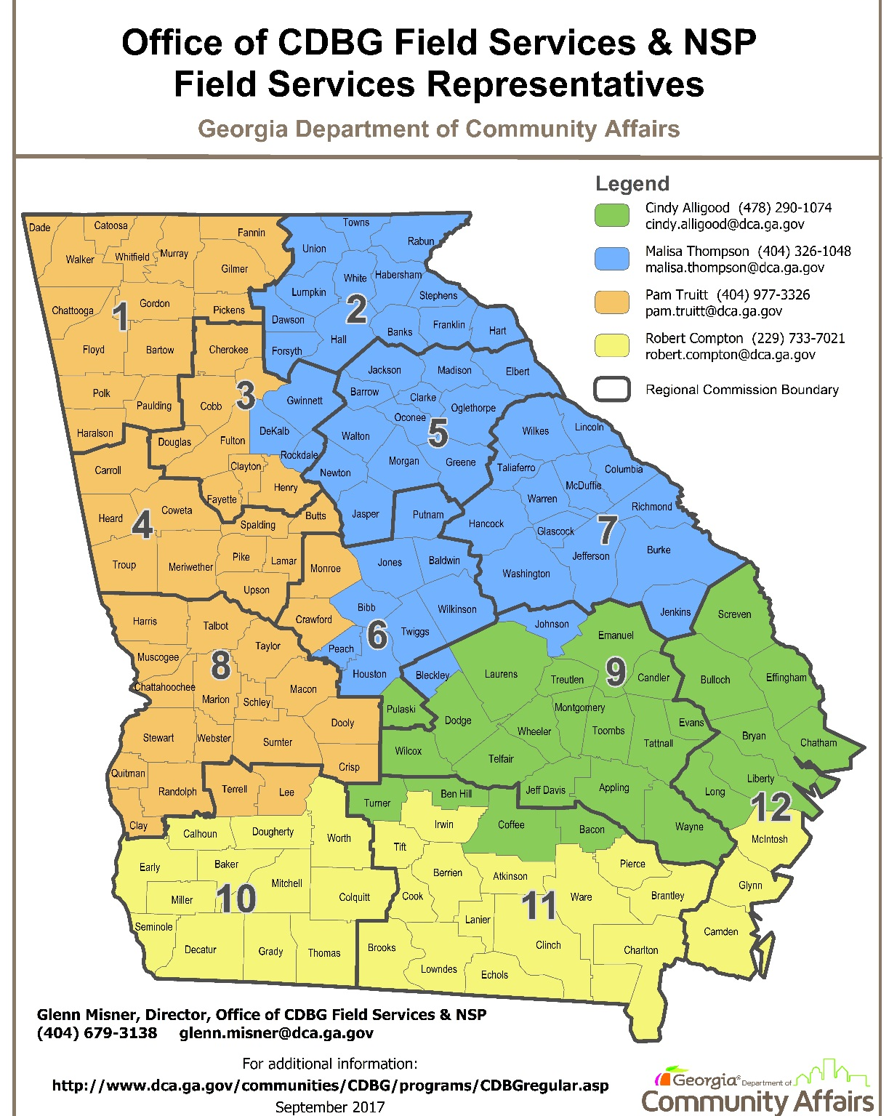
Resources

Slide 12
Questions:
Michael Casper
Email: michael.casper@dca.ga.gov
Voice: (404) 679-0594

