Slide 1
Georgia Department of Community Affairs Funding to End Homelessness In Your Community 2017
October 5, 2017
David Whisnant, Director, Office of Homeless and Special Needs Housing

Slide 2
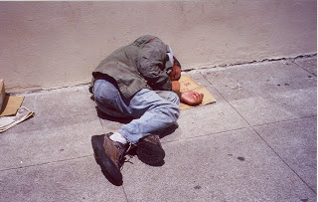
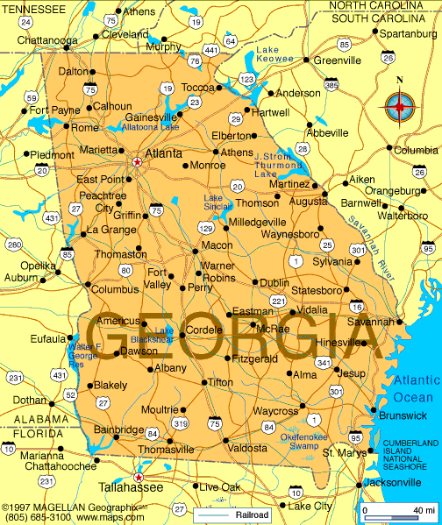
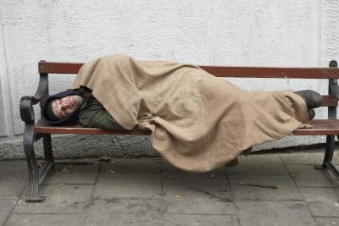
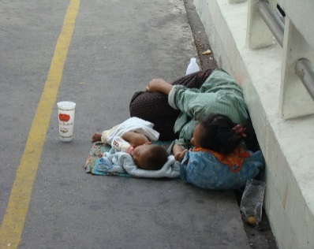
IN OUR STATE OF….
10,373 People are Homeless
Individuals and families who lack a fixed, regular, and adequate nighttime residence and includes a subset for an individual who resided in an emergency shelter or a place not meant for human habitation and who is exiting an institution where he or she temporarily resided.

Slide 3
From HUD to Your Community
CoC Funds
ESG Funds

Slide 4
Emergency Solutions Grants Program
ESG Eligible Programs:
Outreach
Emergency Shelter
Hotel/Motel Voucher
Rapid Re-housing
Homeless Prevention
Supportive Services

Slide 5
ESG Entitlements
There are nine ESG Entitlement areas/communities in Georgia. They are: Atlanta, Augusta-Richmond, Macon-Bibb, Savannah-Chatham, Clayton County, Cobb County, DeKalb County, Fulton County, and Gwinnett County, and the DCA Entitlement, which covers all areas of the State not covered by one of the other ESG Entitlements.
Each entitlement conducts their own competition. The DCA Entitlement funds state-wide, with most monies being reserved for the entitlement.

Slide 6
Application Process
Each year, typically in mid to late February, the State of Georgia opens a competitive application process for the Emergency Solutions Grants (ESG), Housing Opportunities for Persons with AIDS (HOPWA), Shelter Plus Care Matching, and Shelter Plus Care Harm Reduction programs.
For this fiscal year, we received 224 requests totaling $13.8 million across all four programs.
Of the requests, $8.7 million was awarded to 155 programs.
Match: Leverage Those Dollars! 25% required.

Slide 7
Some Familiar Faces….
Rapid Rehousing- $30,000
Hotel/Motel Vouchers- $50,000
Prevention- $30,000
How are they making it happen?
Rapid Rehousing- $40,000

Slide 8
DCA is Wanting to Add More Familiar Faces
Calling All City and County Governments!
Match is affordable -- $25 for every $100 in Federal Dollars.
Provide services directly, or grant to non-profits in your area. (They can make match).
We would love to talk to you about your needs and what programs could help solve the problems in your community.
Bonus points for applicants within our state entitlement area.

Slide 9
Coordinated Entry: We Need You!
Provides the opportunity for the re-organization of a community’s entire homeless system to effectively meet the needs of the community.
Because our system looked like this- multiple programs, ad-hoc processes, dozens of intake and assessment protocols, different eligibility rules resulting in duplication of services, lack of access to programs, and inefficient use of resources.
It is supporting the switch to a “Housing First” system.
HUD requires it.

Slide 10
Contacts
David Whisnant
Director, Office of Homeless and Special Needs Housing
(404)679-0660
David.Whisnant@dca.ga.gov

