Slide 1
CDBG Online Quarterly Reporting & Electronic Business
10/06/2016
Robert Shaw

Slide 2
HUD Accounting Changes
HUD previously used FIFO (First In First Out)
This allowed DCA to effectively move money forward for award purposes
HUD has been forced by auditors to change to Grant year based accounting
CDBG Funds are now always tied to the year DCA received them and must be given out as such
There are some workarounds for small $ amounts

Slide 3
HUD Accounting Change Impact
Impact of the change at this point? Minimal to none
2014 and earlier funds stay FIFO, effectively all funds before 2015 are now 2014 funds.
Unless a grant runs significantly longer than anticipated no change at all
Possible future adjustments to our system might make this a non-issue.

Slide 4
2016 Awards with Earlier Funding
Jacksonville, City of
Jeffersonville, City of
Adairsville, City of
Atkinson County
Banks County
Ben Hill County
Bronwood, City of
Cook County
East Dublin, City of
Eatonton, City of
Ellenton, City of
Lakeland, City of
Pelham, City of
Sylvania, City of
Warren County

Slide 5
The Purpose of Reporting
Tracking grant progress and monitoring
Demonstrating the value of the program
Compliance with laws

Slide 6
From Paper to Online Entry
CFD has 250-450 Open Federal Grants at any given time, As of 9/21/2016: 331 CDBG grants, 244 with a balance
Requirements for Faster Data Reporting to HUD & other Federal Partners and Auditors
Continuously Increasing Data Requirements
Creation of our Online Reporting System in 2005/2006

Slide 7
Reporting Basics
Web Reporting Required
Quarterly for:
Financial/Contracts
Narrative
Accomplish/Signature
For Activity Accomplishments, Quarterly or More Often

Slide 8
Common Issues
Make Sure Accomplishments Balance
Low Mod Only Reporting Not Acceptable (Some Exceptions)
Lack of a Chief Elected Official Signature
Hispanic is an Ethnicity, Not a Race
Accomplishment Detail timing

Slide 9
More Issues
Activities Should Not Have Negative Beneficiaries
Full Accomplishment details needed for us to report to HUD
Leverage: Include Match Enter as you go, don’t wait for people Include all Match, In Kind, and other If you are not going to make your Leverage #s get with DCA ASAP

Slide 10
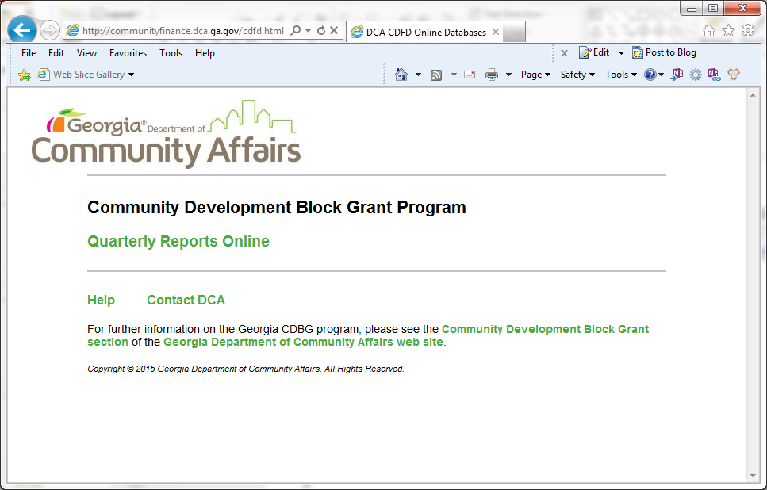
http://Communityfinance.dca.ga.gov/cdfd.html

Slide 11
Log In and Sign Up Forms

Slide 12
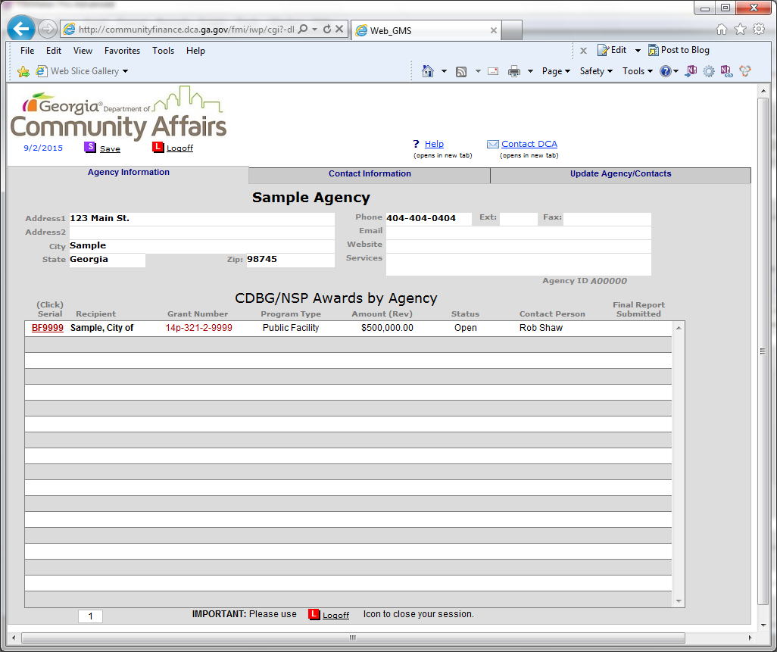

Slide 13
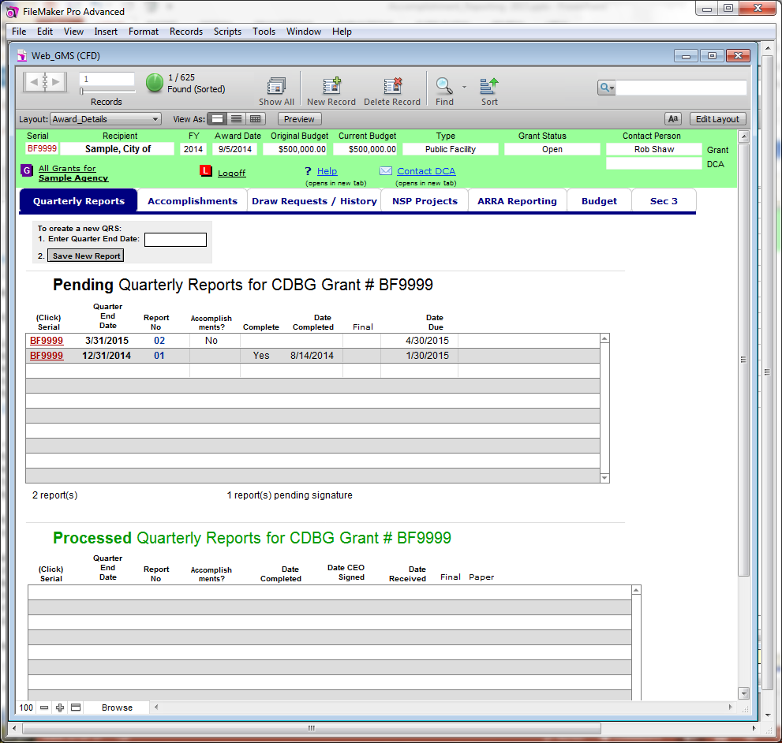

Slide 14
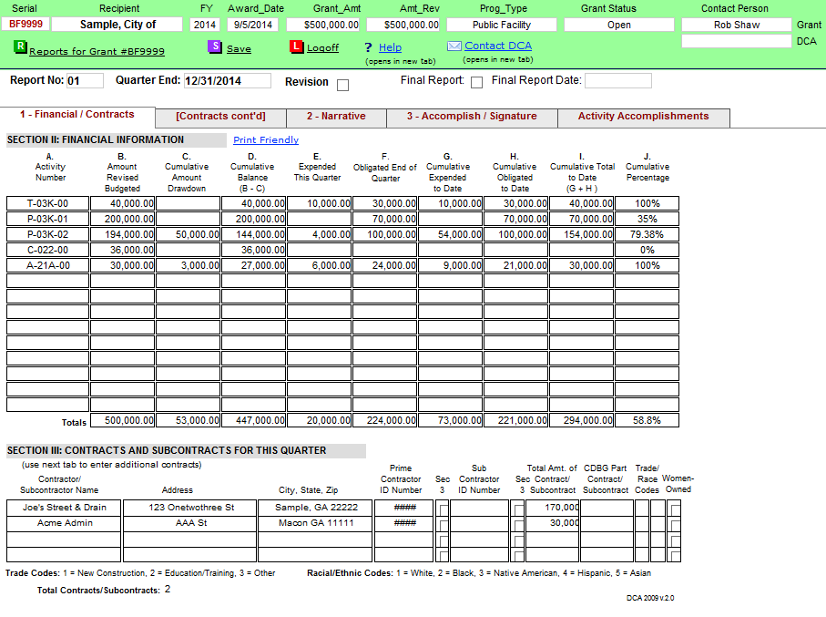

Slide 15
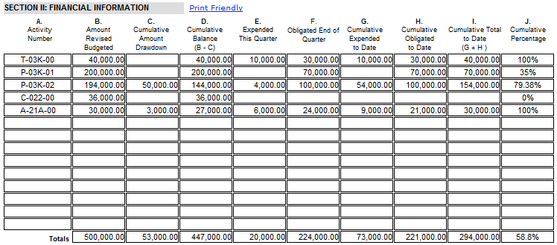
Closer View of Quarterly Financials

Slide 17
Accomplishments Base Screen

Slide 18
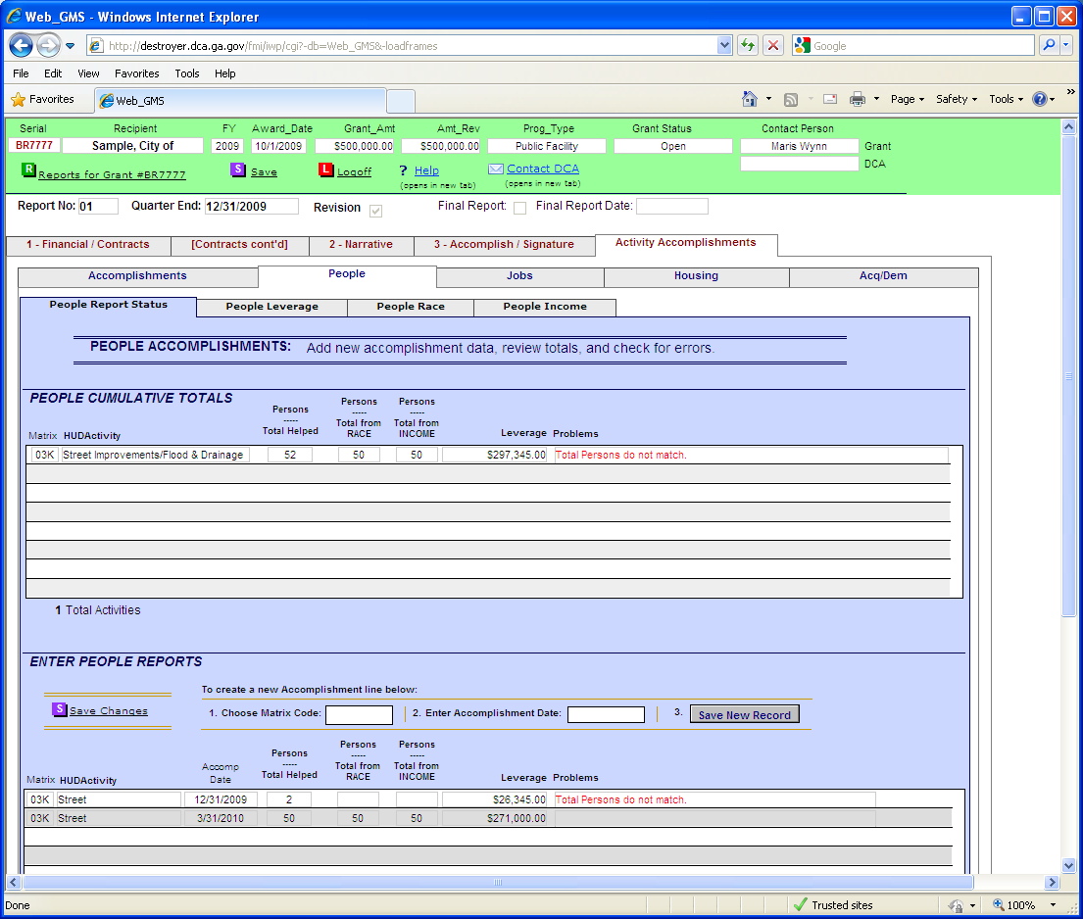
Accomplishments by Type

Slide 19
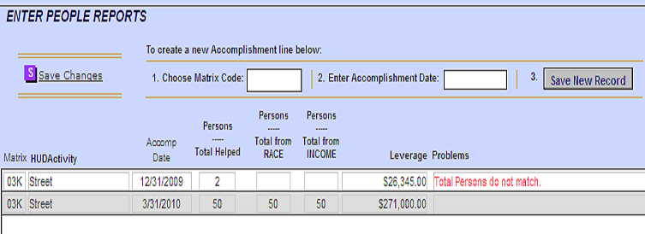
A closer look at a Data Mismatch

Slide 20
Leverage

Slide 21
Racial and Ethnic Data

Slide 22
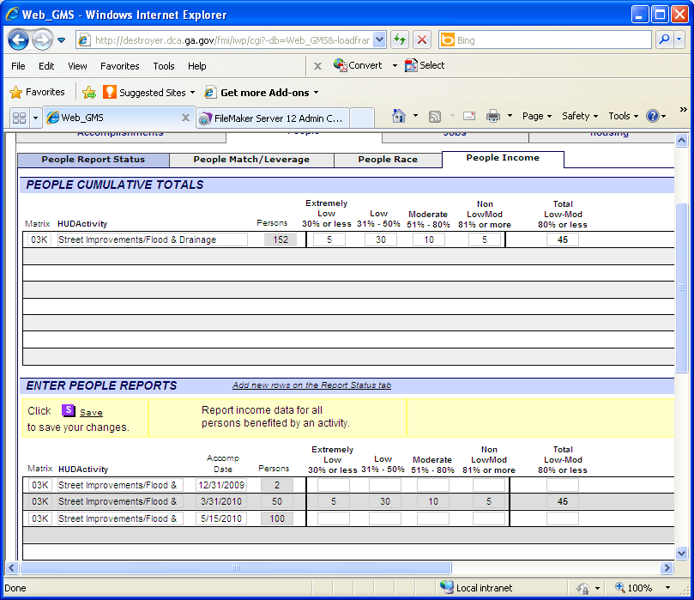
Tracking Income

Slide 23
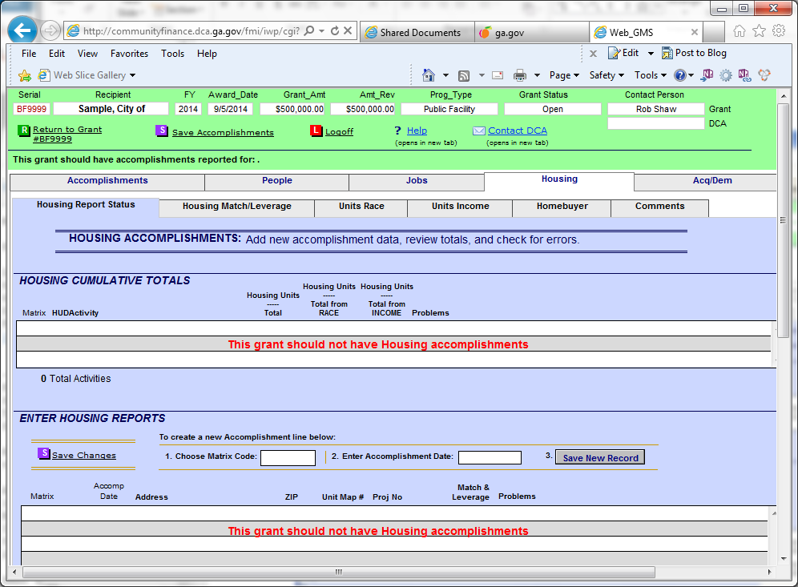
Wrong Activity Type

Slide 24
Housing Differences
Address and Map number
CDBG Funds per house
Map & Project numbers for DCA use
Most Data is Based on Head of Household
Elderly (62+)/Female Head of Household
Energy Star and other categories
Homebuyer Data Tab

Slide 25
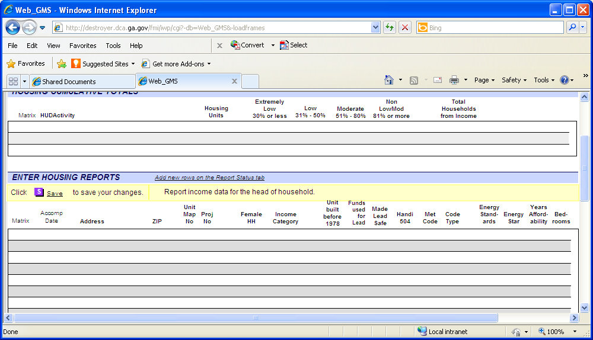

Slide 27
Job Differences – Quarterly Report
2 Categories: Created or Retained
Full Time Equivalent (FTE)
Made up of Full-Time and Part-Time
HUD FTE = 40 hours
With Part-Time jobs: FTE will NOT match Racial or Income numbers

Slide 28
Job Differences Continued
Health Benefits & Prior Job Status
Report Job Type

Slide 29
Job Issues – Quarterly Report
Retained Jobs are only jobs that would have been lost, not all jobs with the company or location
Retained Jobs Only Entered Once
Typically the first quarter of the grant period
Position Turnover: You are reporting the job position not the person
Data for first person to hold the position

Slide 30
Job Subtraction?
Under Detail Accomplishments Tab
Do not Subtract Jobs out once reported
On signature page should Show / Discuss loss of jobs - page 2 and 3 (slide 16)

Slide 31
Other Tabs
Draw Request / History
NSP Projects Use their own Tab, NOT the Housing Tab, CDBG ignore the NSP Tab
ARRA Legacy tab, Not used for current CDBG awards
Budget
Section 3 – Now only shows the current FY to stop editing earlier data and destroying our records

Slide 32
General Advice
Save Often! The System Will Time You out
2 Ways Into Accomplishment Tabs
Best Information Known When Submitted
For Large Errors Use the Revision Option

Slide 33
Common Problems
Make Sure Accomplishments Balance
Full Accomplishment Details
Lack of a Chief Elected Official Signature
Hispanic NOT A RACE
Retained Jobs are only Jobs that would have been lost
Retained Jobs Only Entered Once (First Q)
Should Not Have Negative Beneficiaries
Match & Leverage, enter as you go, include in Kind, Should Not Decrease without DCA Approval

Slide 34
Common Problems Continued
If the contact person for the grant changes, LET US KNOW!
Please help us keep our Web GMS user list up to date
I do disable accounts if I discover the email address is no longer valid
Don’t change the printed copy: un-submitting and Final Report check box
Cumulative Leverage on the Signature page should match total leverage on the detail tab
Break Leverage out by activity code

Slide 35
Web Sites
Web Reporting URL: http://Communityfinance.dca.ga.gov/cdfd.html
Local Government Contact Updates URL: http://www.dca.ga.gov/LGContactsOnline/Index.aspx

Slide 36
Current Issues
DUNS #
SAM (CCR) System for Awards Mgmt & New Certification https://www.sam.gov/index.html
Federal Funding Accountability and Transparency Act : FFATA
Temporary Job Tracking
Remediation:
Open 1 year with no draws
Open 3 years no Accomplishments
80% drawn no Accomplishments

Slide 37
Electronic Business
Send CDBG Draws to: cdbg.draws@dca.ga.gov
Other CDBG Business: cdbg.biz@dca.ga.gov
State/OneGa Draws/Business: oed@dca.ga.gov
Naming format: Recipient Name, Full Grant Number, Type of Business and Draw # if it is a draw
Send one email per type of business, attach backup documents in the same email unless file size causes problems
Applications, Award Package, Contracts with multiple signatures must be paper

Slide 38
Electronic Business Continued
Signature Cards: Original paper with the award package, later updated Signature Cards can be emailed in
Quarterly Reports can be emailed in, but we need all 3 pages & the Chief Elected Official signature
Please make sure scanned documents are readable, especially $
The Original documents must be kept by the grant recipient so that they can be produced on request for HUD or other auditors
Keep email size below 25 MB
Files should be PDF or Microsoft Office

Slide 39
Contact Information
Rob Shaw
rob.shaw@dca.ga.gov
404-679-4806
Lisa Smith
lisa.smith@dca.ga.gov
404-679-5276

